Slide 1
CSE 473: Pattern Recognition

Slide 2
Linear Classifier: Introduction
Classifies linearly separable patterns
Assume proper forms for the discriminant functions
may not be optimal
very simple to use
2

Slide 3
Linear discriminant functions and decisions surfaces
3
Definition
Let a pattern vector x = {x₁, x₂, x₃, …,}
a weight vector w = {w₁, w₂, w₃, …,}
A discriminant function :
g(x)=x₁w₁+x₂w₂+x₃w₃+…
OR
g(x) = w^{t}x + w₀ (1)
where w is the weight vector and w₀ the bias

Slide 4
Linear discriminant functions and decisions surfaces
Classify a new pattern x as follows
Decide class ω₁ if g(x) > 0
and class ω₂ if g(x) < 0
If g(x) = 0 ⇒ x is assigned to either class

Slide 5
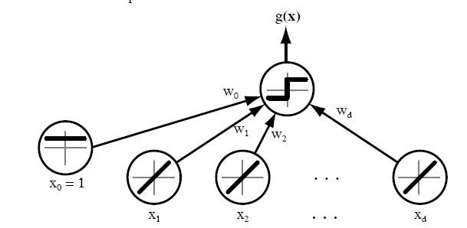
Linear discriminant functions and decisions surfaces

Slide 6
The equation g(x) = 0 is the decision surface that separates patterns
When g(x) is linear, the decision surface is a hyperplane

Slide 7
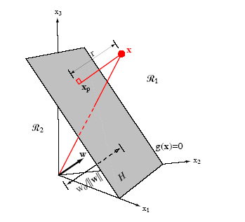

Slide 8
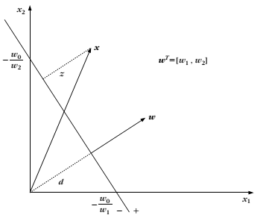

Slide 9
A little bit mathematics
The Problem: Consider a two class task with ω₁, ω₂

Slide 10
Hence:

Slide 11
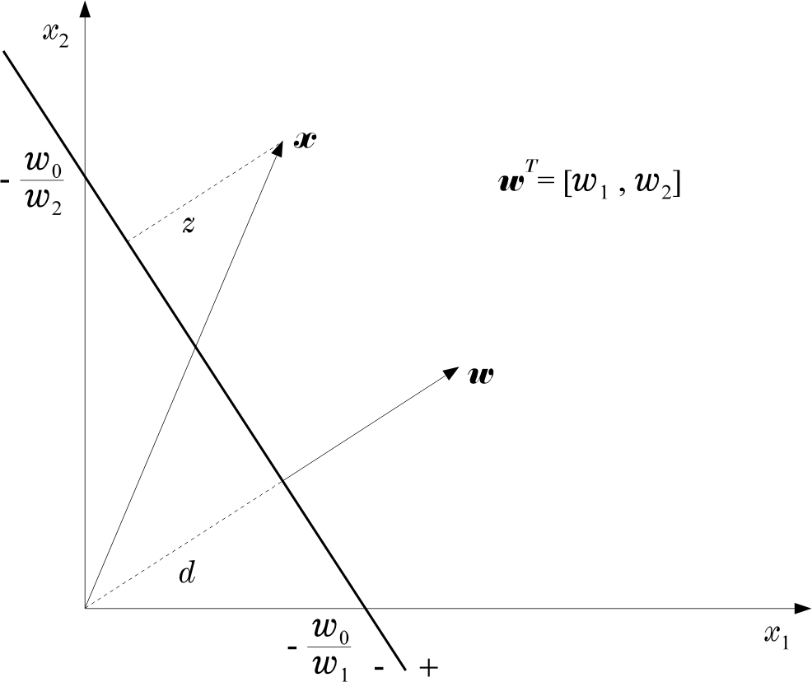
Hence:

Slide 12
The Perceptron Algorithm
Assume linearly separable classes, i.e.,
12

Slide 13
The Perceptron Algorithm
Assume linearly separable classes, i.e.,
The case falls under the above formulation, since

Slide 14
Our goal: Compute a solution, i.e., a hyperplane w, so that
The steps
Define a cost function to be minimized
Choose an algorithm to minimize the cost function
The minimum corresponds to a solution

Slide 15
The Cost Function
Where Y is the subset of the vectors wrongly classified by w.
15

Slide 16
The Cost Function
Where Y is the subset of the vectors wrongly classified by w.
when Y=(empty set) a solution is achieved and
otherwise

Slide 17

J(w) is piecewise linear (WHY?)
The Algorithm
The philosophy of the gradient descent is adopted.

Slide 18
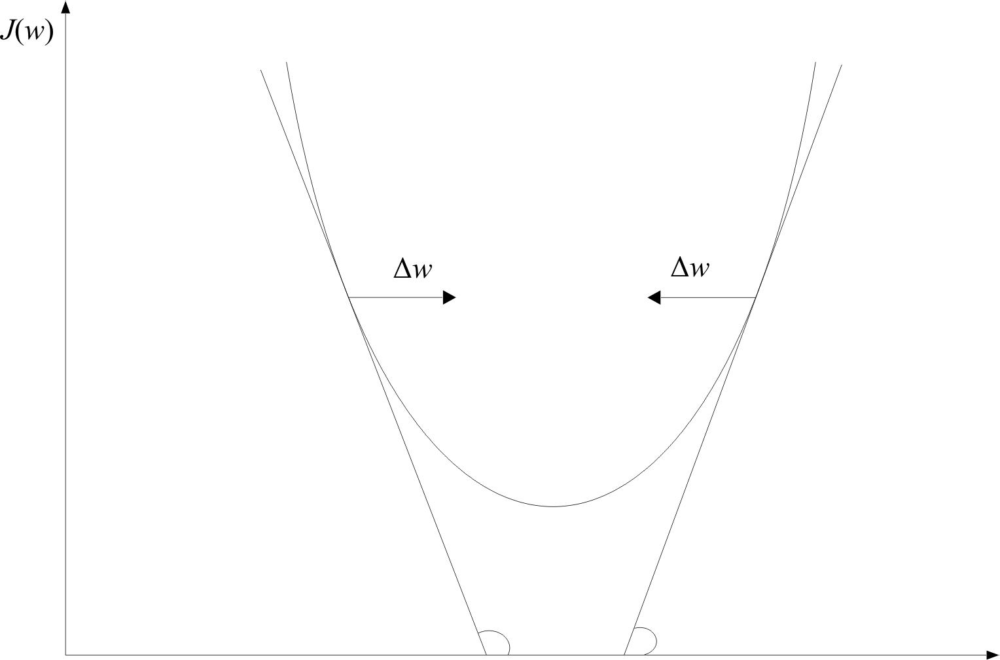
w

Slide 19
Wherever valid
This is the celebrated Perceptron Algorithm
w

Slide 20
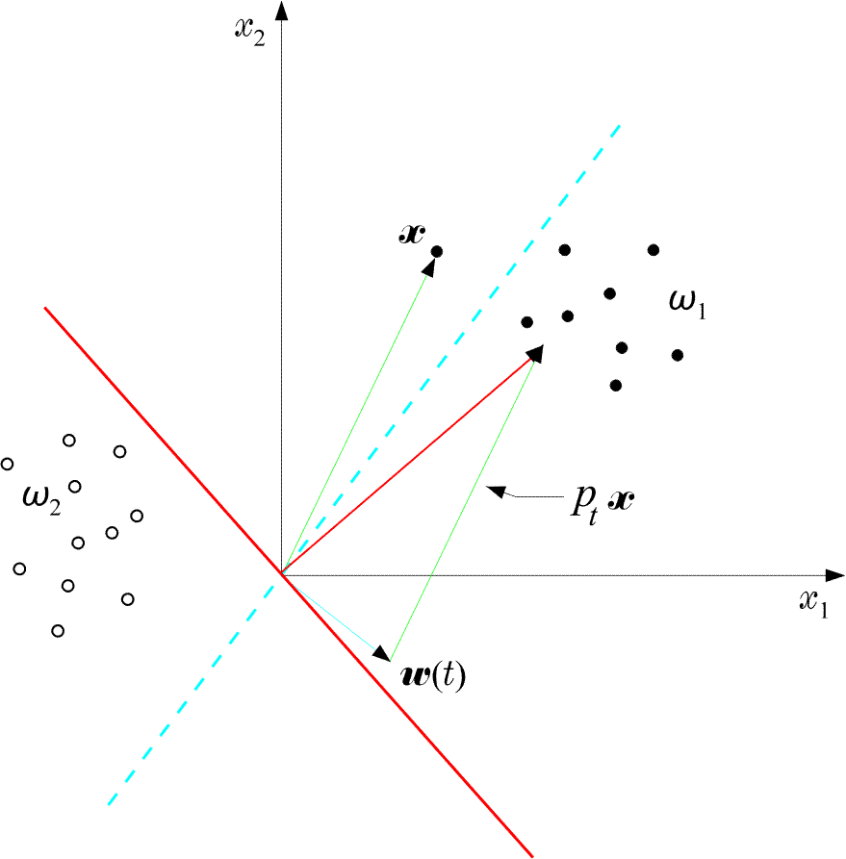
An example:
20

Slide 21
An example:
The perceptron algorithm converges in a finite number of iteration steps to a solution if patterns are linearly separable

Slide 22
Example: At some stage t the perceptron algorithm results in

Slide 23
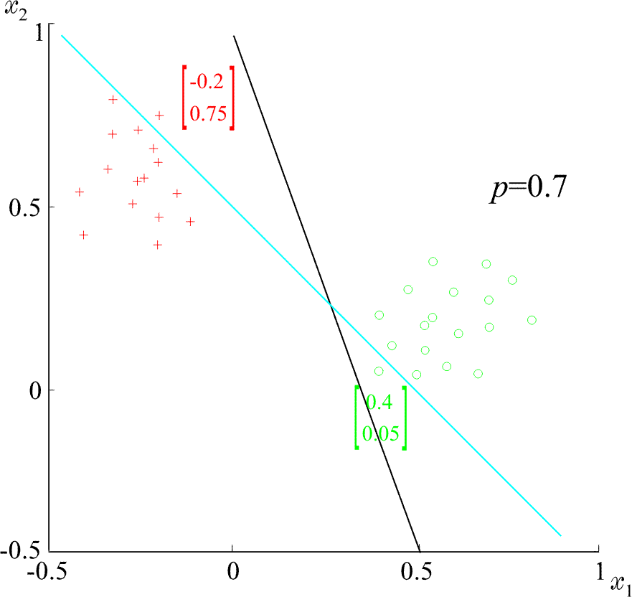
Example: At some stage t the perceptron algorithm results in
The corresponding hyperplane is
+
+
+
+
ρ=0.7
+
+
+

Slide 24
Example: At some stage t the perceptron algorithm results in
The corresponding hyperplane is
+
+
+
+
ρ=0.7
+
+
+

Slide 25
Example: At some stage t the perceptron algorithm results in
The corresponding hyperplane is
+
+
+
+
ρ=0.7
+
+
+

Slide 26
Convergence Proof of Perceptron Algorithm
Let , w* be the optimal weight vector
w(t) be the weight vector at the tth iteration
w(t+1) be the weight vector at the (t+1)th iteration
We will prove that ||w(t+1) - w* || < ||w(t) - w* ||

Slide 27

Convergence Proof of Perceptron Algorithm
We know that
Let , α be a positive real number
Then,

Slide 28


Convergence Proof of Perceptron Algorithm
Squaring both sides,

Slide 29

Convergence Proof of Perceptron Algorithm
However,

Slide 30


Convergence Proof of Perceptron Algorithm
However,
Hence,

Slide 31


Convergence Proof of Perceptron Algorithm
Now, define
and

Slide 32

Convergence Proof of Perceptron Algorithm
Now, define
and
Here, is always negative, so is γ

Slide 33

Convergence Proof of Perceptron Algorithm
Now, define
and
Here, is always negative, so is γ
We can write,

Slide 34

Convergence Proof of Perceptron Algorithm
If we choose,
We can write,

Slide 35
Convergence Proof of Perceptron Algorithm
Here,
How?

Slide 36



Convergence Proof of Perceptron Algorithm
Applying the above equation successively for steps t, t-1, . . ., 0, we get
However,
and

Slide 37
Convergence Proof of Perceptron Algorithm
However,
and
This means,
After some constant tine t₀ the R. H. S. will be non-positive
But, the L. H. S. cannot be negative
Therefore,

Slide 38

Convergence Proof of Perceptron Algorithm
is equivalent to

Slide 39
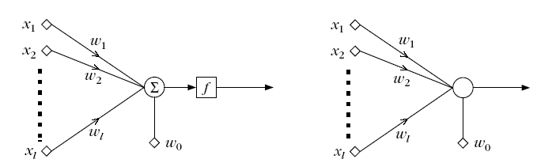
The Perceptron
This structure is called perceptron or neuron
a learning machine that learns from the training vectors

Slide 40
Variants of Perceptron Algorithm (1)

Slide 41
Variants of Perceptron Algorithm (1)
update
No Update

Slide 42
Variants of Perceptron Algorithm (1)
It is a reward and punishment type of algorithm
update
No Update

Slide 43
Variants of Perceptron Algorithm (2)
initialize weight vector w(0)
define pocket w_{s}.and history h_{s}
generate next w(t+1). If it is better than w(t), store w(t+1) in w_{s} and change the h_{s}

Slide 44
Variants of Perceptron Algorithm (2)
initialize weight vector w(0)
define pocket w_{s}.and history h_{s}
generate next w(t+1). If it is better than w(t), store w(t+1) in w_{s} and change the h_{s}
It is pocket algorithm

Slide 45
Generalization of Perceptron Algorithm for M- Class case

Slide 46
Generalization of Perceptron Algorithm for M- Class case
Let M classes ω_{1,} ω_{2,} ω_{3,} . . ., ω_{M,}
Let M linear discriminant functions, w_{i}
46

Slide 47

Generalization of Perceptron Algorithm for M- Class case
Let M classes ω_{1,} ω_{2,} ω_{3,} . . ., ω_{M,}
Let M linear discriminant functions, w_{i}
The object x is classified to ω_{i}, if
47

Slide 48
Generalization of Perceptron Algorithm for M- Class case
The object x is classified to ω_{i}, if
48

Slide 49
Generalization of Perceptron Algorithm for M- Class case
The object x is classified to ω_{i}, if
can be written as
49

Slide 50
Generalization of Perceptron Algorithm for M- Class case
50

Slide 51
Generalization of Perceptron Algorithm for M- Class case
51

Slide 52
Generalization of Perceptron Algorithm for M- Class case
52

Slide 53
Generalization of Perceptron Algorithm for M- Class case
53

Slide 54
Generalization of Perceptron Algorithm for M- Class case
Let,
and
ith pos
jth pos
54

Slide 55
Generalization of Perceptron Algorithm for M- Class case
Let,
and
ith pos
jth pos
Then, the condition is
55

Slide 56
Generalization of Perceptron Algorithm for M- Class case
For each training vector of class ω_{i}, construct
ith location
jth location
(l+1)M dimension
Concatenate the weight vectors:
56

Slide 57
Generalization of Perceptron Algorithm for M- Class case
Use a single Perceptron to solve
Parameters:
(l+1)M feature dimension
All N(M-1) training vectors to be on positive side
The reorganization is known as Kesler’s construction
57

Slide 58
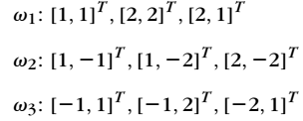
Example

Slide 59
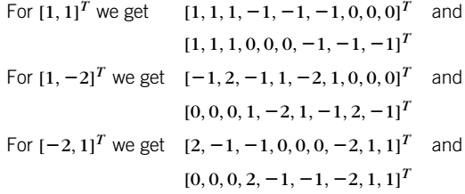
Example

Slide 60
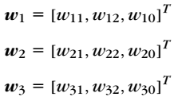
Example

Slide 61
Example
Composite weight vector:

Slide 62
Example
Composite weight vector:
Condition:

