Slide 1
Healthcare Analytics Dashboard
Insights from Patient Health Data
Presented by: [SAQIB ALI]
Date: [27/06/2025]

Slide 2
Agenda
- Introduction & Objectives
- Dashboard Overview
- Detailed Analytics (1–10)
- Key Insights & Recommendations
- Technical Approach
- Q&A

Slide 3
Project Introduction & Objectives
- Analyze patient data to extract meaningful insights
- Identify health risk patterns
- Support hospital decision-making using data analytics

Slide 4
Dashboard Overview
- Dashboard includes metrics on health risk, lifestyle, demographics, and medical history
- Visual insights for decision-makers

Slide 5
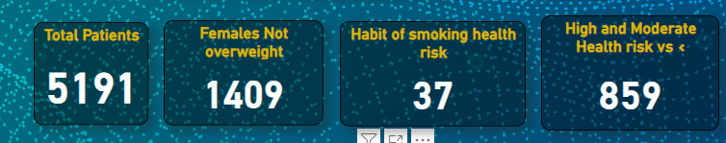
Total Number of Diagnoses
Displays total diagnoses from the dataset using KPI cards.

Slide 6
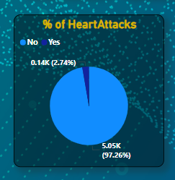
Percentage with Heart Attack History
Shows % of patients with heart attack history using pie/donut charts.

Slide 7
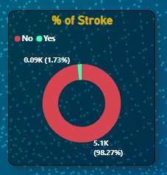
Percentage with Stroke History
Shows % of patients with stroke history using pie/donut charts.

Slide 8
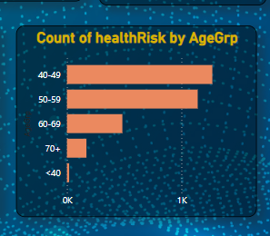
COUNT OF HEALTHRISK AGEGROUP
Bar chart to count non-overweight female patients.

Slide 9
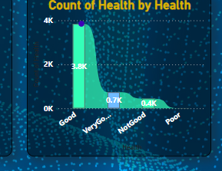
Health Risk Distribution BY HEALTH
CLUSTERED chart to show health risk categories.

Slide 10
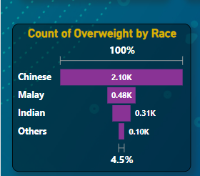
Average Weight by Race
FUNNEL chart showing average weight grouped by occupation.

Slide 11
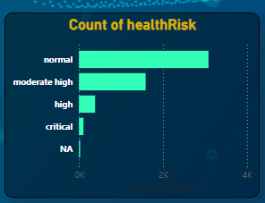
COUNT OF HEALTH RISK
Stacked bar chart for overweight patients based on race.

Slide 12
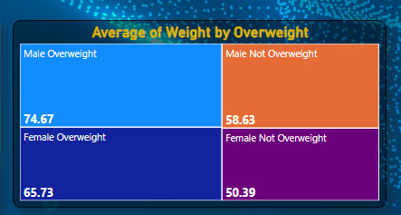
Normal Health WEIGHT
TREEMAP

Slide 13
Summary of Key Insights
- Overview of each metric and its operational implication
- Example: High smoking risk → Targeted cessation programs

Slide 14
Technical Approach
- Tools Used: Power BI, DAX, Excel
- ETL Steps: Data cleaning, transformations, normalization
- Visual Design: Filters, KPI cards, slicers

Slide 15
Recommendations
- Encourage exercise in at-risk groups
- Promote targeted smoking cessation
- Monitor race/occupation-linked risks

Slide 16
Q&A
Open floor for questions and feedback.

