Slide 1

c₂ filters
…
H
c₁
ReLU
c₁
h₁
H2
c₂
W
w₁
H
W2
W

Slide 2
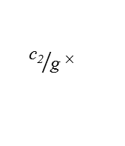
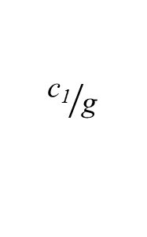
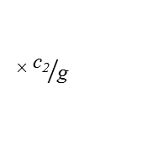
c₂ filters
×${ \text{c}\text{2}}/{\text{g} }$
H
${ \text{c}\text{2}}/{\text{g} }$×
ReLU
c₁
h₁
$${\text{c}\text{1}}/{\text{g} }$$
H2
c₂
W
w₁
H
W2
W

Slide 3
d filters
H
H
…
W
W
c
d
c
1
1

Slide 4
c₂ filters
c₃ filters
…
H
c₁
…
H
c₁
ReLU
H2
c₂
c₂
ReLU
W
c₃
W
h₁
w₁
H
W2
W
1
1

Slide 5
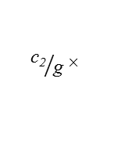
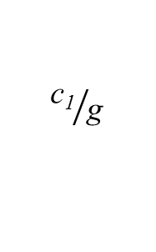
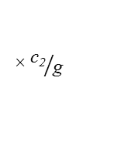
c₂ filters
×${ \text{c}\text{2}}/{\text{g} }$
c₃ filters
H
${ \text{c}\text{2}}/{\text{g} }$×
…
H
c₁
ReLU
H2
c₂
c₂
ReLU
W
c₃
W
h₁
w₁
$${\text{c}\text{1}}/{\text{g} }$$
H
W2
W
1
1

Slide 6
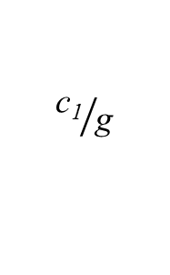
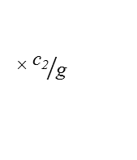
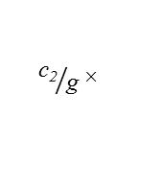
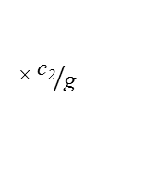
c₂ filters
×${ \text{c}\text{2}}/{\text{g} }$
c₃ filters
×${ \text{c}\text{2}}/{\text{g} }$
H
${ \text{c}\text{2}}/{\text{g} }$×
…
H
c₁
ReLU
H2
c₂
c₂
ReLU
W
c₃
W
H
W2
${ \text{c}\text{2}}/{\text{g} }$×
W
h₁
1
w₁
$${\text{c}\text{1}}/{\text{g} }$$
1

Slide 7
…
H
ReLU
W
H2
3
W2
Input Image

Slide 8
…
…
ReLU
H2
ReLU
W2
1
1

Slide 9
…
ReLU
H2
W2

Slide 10
…
…
ReLU
H2
ReLU
W2
1
1

Slide 11
…
ReLU
H2
ReLU
W2
1
1
Root-2 Unit

Slide 12
…
ReLU
H2
ReLU
W2
1
1
Root-4 Unit

Slide 13
…
…
ReLU
H2
ReLU
Convolutional Layer
W2
1
1

Slide 14
…
ReLU

Slide 15
…
H
ReLU
W
3

Slide 16
…
ReLU

Slide 17
…
ReLU
1
1

Slide 18
ReLU

Slide 19
ReLU

Slide 20
…
ReLU

Slide 21
…
ReLU
1
1

Slide 22
…
ReLU
1
1

