Slide 1

d filters
…
H
H
W
c
c
W
d
h
w

Slide 2
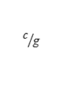
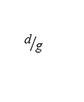
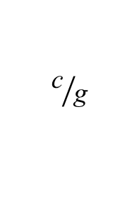
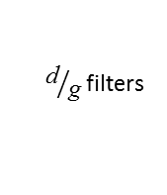
${\text{d}}/{\text{g} }$filters
…
H
H
W
c
h
W
d
$${\text{c}}/{\text{g} }$$
w
$${\text{c}}/{\text{g} }$$
$${\text{d}}/{\text{g} }$$

Slide 3
d filters
H
H
…
W
W
c
d
c
1
1

Slide 4


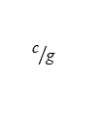
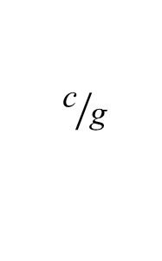

${\text{d}}/{\text{g} }$filters
…
…
$$\text{group} \text{g}$$
H
…
H
…
$$\text{group} \text{2}$$
W
c
h
$$\text{group}\text{ 1}$$
W
d
$${\text{c}}/{\text{g} }$$
w
$${\text{c}}/{\text{g} }$$
$${\text{d}}/{\text{g} }$$

Slide 5
${\text{d}}/{\text{g} }$filters
…
$$\text{group} \text{g}$$
H
H
$$\text{group} \text{2}$$
W
c
h
$$\text{group}\text{ 1}$$
W
d
$${\text{c}}/{\text{g} }$$
w
$${\text{c}}/{\text{g} }$$
$${\text{d}}/{\text{g} }$$

Slide 6
d filters
H
…
H
W
c
c
W
d
h
w

Slide 7
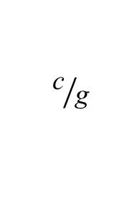


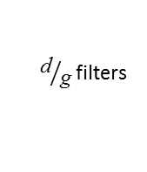
…
…
H
H
W
c
W
d
$${\text{c}}/{\text{g} }$$
$${\text{d}}/{\text{g} }$$
$$\text{group} \text{g}$$
${\text{d}}/{\text{g} }$filters
…
$$\text{group}\text{ 1}$$
${\text{d}}/{\text{g} }$filters
h
$${\text{c}}/{\text{g} }$$
w

