Slide 1
Operating Systems
Mansoor Nasir

Slide 2
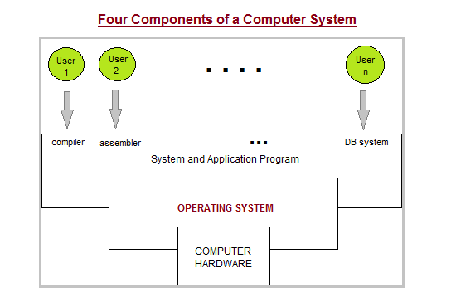
Introduction
A computer system can be roughly divided into the hardware, the operating system, the application programs, and the users.
The hardware (i.e., CPU, memory, I/O devices) provides the basic computing resources.
The application programs (e.g., web browsers, word processors, and compilers) are used to solve user problems.
The operating system controls and coordinates the use of hardware among various application programs
Notes:
A computer system has many resources (hardware and software), which may be require to complete a task. The commonly required resources are input/output devices, memory, file storage space, CPU etc. The operating system acts as a manager of the above resources and allocates them to specific programs and users, whenever necessary to perform a particular task. Therefore operating system is the resource manager i.e. it can manage the resource of a computer system internally. The resources are processor, memory, files, and I/O devices. In simple terms, an operating system is the interface between the user and the machine.

Slide 3
User View
PC Users: an operating system is a program that provides an easy-to-use interface for using the hardware. Mainframe/Minicomputer Users: an operating system is a program that helps maximize the system resource utilization.
Workstation Users: an operating system is a program designed to compromise between individual usability and resource utilization.
Mainframe/Minicomputer Users: an operating system is a program that helps maximize the system resource utilization.

Slide 4
System View
A Resource Manager: the operating system allocates and reclaims the system hardware resources to and from user programs.
A Control Program: the operating system controls the execution of user programs to prevent errors and improper use of the computer
There is no universal definition of what is an operating system. A common definition is that the operating system is the one program running at all times on the computer (i.e., the kernel). All other programs are application programs

Slide 5
Slide Title
Make Effective Presentations
Using Awesome Backgrounds
Engage your Audience
Capture Audience Attention

Slide 6
Slide Title
Product A
Product B
Feature 1
Feature 2
Feature 3
Feature 1
Feature 2
Feature 3

Slide 7


