Slide 1
HOSPITAL MANAGEMENT SYESTEM
PRESENTATION
Saqlain Haider 193319
Mohsin Amir Butt 211304
Muhammad Hamid Jamil 173327

Slide 2
Introduction
The Database is for the automation of a tiny Hospital Management.
To change the whole system from paper work to proper database based automated system.
The database will gives us the details of doctors , patients and Tests history.
It will also provide us our desirable information as we need.

Slide 3
Problem
Information retrieval is difficult because if you have to find patient history so you have to search in various registers.
Difficult to store bulky information.
Difficultly in change incorrect information.
To provide correct report from various registers.
Manual calculation cause errors like age from date of birth.

Slide 4
Solution
To develop database based software that overcome all the problems.
Database provide fast information retrieval at finger tap.
Storage issues resolve by tiny hard disk.
Database provide easy modification as database designed effectively.
Database able to generate multiple views for report.
Calculations on data is done by computer accurately.

Slide 5
SDLC
Planning
Analysis
Design
Implementation
Maintenance

Slide 6
Planning
What do we need this system for?
Ans: simple to change paper work to software work.
What will the system do for the organization?
Ans: To overcome maximum problems that they facing with conventional system.
How are we going to make this system?
Ans: To understand business process model by discussion with stack holders, by observe old system, to go through documents.

Slide 7
Analysis
Can this system be created with the resources (and budget) we have available?
Yes, How?
Will this system significantly improve the organization?
Yes, How?
Does the old system even need to be replaced?
No,Why?

Slide 8
Designing
Logical designing : like Modelling etc.
Physical designing: like in sqlserver etc.

Slide 9
“Logical Designing” Entities and Attributes
Patient :
Patient_ID,Name, Father_Name, Husband_Name, Age, Gender, Insurance, Phone _NO, Date_Admitted, Date_Checked_Out, Date_Of_Birth, Address.
Doctor:
Doctor_ID ,Name, Gender, Address, Specialization, Phone _NO .
Test:
Test_ID ,Test_Name, Date, Time, Result.

Slide 10
“Logical Designing” Tables
Test
Test_ID | Test_Name | Date | Time | Result
1 | Maleria | 12/10/2002 | 12:45:35 | Positive
2 | Urine | 12/10/2002 | 12:45:35 | Negative
3 | Dengue | 12/10/2002 | 12:45:35 | Positive
4 | Cancer | 12/10/2002 | 12:45:35 | Negative

Slide 11
Doctor
Doctor_ID | Name | Gender | Address | Specialization | Phone _NO
1 | Farhan Ali | M | Lahore,johar town | Physicain | 3429357478
2 | Atif Rehman | M | Lahore,johar town | surgeon | 3429357478
3 | Mohsin Amir | M | Lahore,johar town | Dr | 3429357478
4 | Haider Ali | M | Lahore,johar town | Dr | 3429357478
5 | Amir Butt | M | Lahore,johar town | Dr | 3429357478

Slide 12
Patient
Patient_ID | Name | Father_Name | Husband_Name | Age | Gender | Insurance | Phone _NO | Date_Admitted | Date_Checked_Out | Date_Of_Birth | Address
1 | Muhammad Ali | Ali hussain | Null | 26 | M | Yes | 3429357478 | 12/9/2020 | 12/10/2020 | 12/10/2002 | lahore
2 | Ali Hassan | hassan mehmood | Null | 24 | M | No | 3429357478 | 12/9/2020 | 12/10/2020 | 12/10/2002 | kohat
3 | Hassan Raza | Raza ali | Null | 20 | M | No | 3429357478 | Null | Null | 12/10/2002 | sailkot
4 | Muhammad hussain | hussain majeed | Null | 18 | M | Yes | 3429357478 | 12/9/2020 | 12/10/2020 | 12/10/2002 | Islamabad
5 | Zahra Ali | null | Ali zulfiqar | 22 | F | No | 3429357478 | 12/9/2020 | 12/10/2020 | 12/9/1999 | Quetta

Slide 13
Primary keys
Patient_ID
Doctor_ID
Test_ID

Slide 14
Multivalued attributes
Phone_NO
Address
Specialization

Slide 15
Derived attribute
Age : Derived from Date_Of_Birth.

Slide 16
Relationships
Patient-Doctor: many to many.
Patient-Test: one to many.
Doctor-Test: one to many.

Slide 17
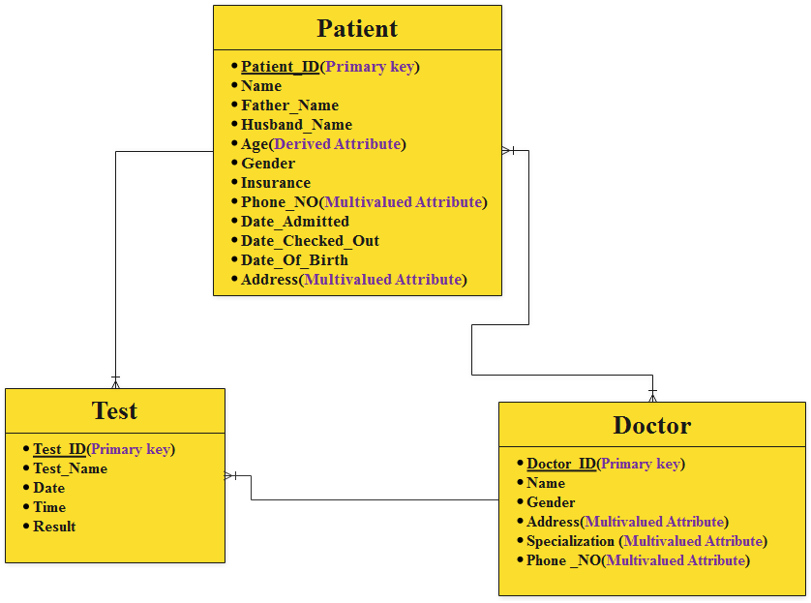
ER-Diagram

Slide 19
“Physical designing”
To put our logical modelling to proper database system by using accurate platform for your requirement.
Changing imagination to reality.
Select platform like oracle and start from scratch to complete system.

Slide 20
Implementation
Physical installation of the server hosting the database.
Installation of the database onto the system.
Installation of the dbms.
Initialization and continuous operation of DB.

Slide 21
Maintenance
Backup and recovery.
Enhancement performance
Adding entities and attribute.
Improving efficiency of system.
And So on…….

Slide 22
THANK YOU!!!!!
ANY QUESTION????
PLEASE FEEL FREE TO ASK

