Slide 1
SENTIMENT ANALYSIS IN BENGALI
By
Sk Saqlain Ali and Priyanka Bhadury

Slide 2
Introduction
Sentiment Analysis deals with identifying and classifying opinions or sentiments expressed in source text.
An opinion may be positive, negative or neutral depending on an individuals judgment.
We have performed sentiment analysis on a Bengali dataset.
Our work mainly focuses on resource based sentiment analysis and our resource here is SentiwordNet.

Slide 3
Motivation
Such works on sentiment analysis are relatively less observed for low-resourced language like Bengali.
Research on Sentiment Analysis in Bengali is flourishing as a challenging area and is getting researcher's attention at a rapid pace.
Since Bengali is our native language and Bengali literature is quite well-known worldwide, we think that with the help of sentiment analysis it would help us to understand the importance of this language in many literary texts.
To the best of our knowledge, there are few research on the sentence-level sentiment analysis of Bangla text
This can be described as being due to the lack of available Bengali datasets.

Slide 4
Methodology
Collecting Dataset and Data Pre-processing.
Firstly we collected a dataset from Kaggle.
It was a Bengali dataset of newspaper articles comprising of around 7000 sentences.
We have cleaned our dataset of various punctuations such as ‘,’ ‘|’,’!’
Such punctuations do not add any meaning to our dataset.
The removal of these unwanted punctuations would not hamper the result or accuracy of our project.

Slide 5
Removing numbers and Stopwords
Numbers do not contribute to the accuracy and has no meaning in sentiment analysis.
So they are removed during our data pre-processing.
In our Bengali dataset there were several stop words as such ‘যা’ , ‘যার’ , ‘এই’ , ‘তাও’
They do not generally carry any important meaning to our dataset
So they are removed so that the more emphasis can be made on the important word which in our case are the positive words and the negative words.

Slide 6
Resource Based Sentiment Analysis
In resource based sentiment analysis we take the help of a prior resource.
With the help of the resource we predict the sentiment of our dataset.
Our resource here is the Bengali SentiWordNet which we have used for classification.
From Kaggle we have collected a Hindi SentiWordNet and using google trans we have converted it to Bengali.

Slide 7
Flowchart Of Our Resource Based Approach
Collecting dataset
Our resource here is the Bengali SentiWordNet which we have used for classification.
The list was POS tagged and each word had its corresponding positive and negative score assigned to it.
Data Preprocessing
This dataset also had synonyms of the words in the list. These synonyms were removed.
Determining The Sentiment
Based on this dataset in our code if the positive score in a sentence of the testing dataset is greater than the negative score then we have returned 1 and the sentiment of the sentence is positive.
. The words which had underscore(_) in it were replaced with a space.
These were taken in a new .csv file. These Hindi words were converted to their corresponding Bengali words using the Googletrans package available in python.
Similarly if the negative score is greater than the positive score then we have returned 0 and the sentiment of the sentence is to be negative.

Slide 8
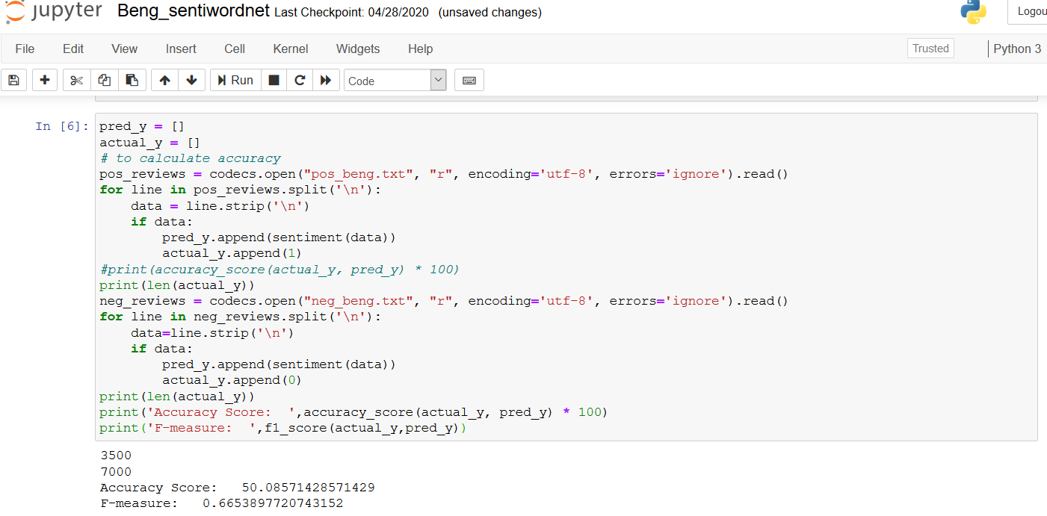
Result
The Accuracy score of our model is 50.08
The F-measure is 0.66

Slide 9
References
[1] Shaika Chowdhury and Wasifa Chowdhury, Performing sentiment analysis in Bangla microblog posts, 2014 International Conference on Informatics, Electronics and Vision, ICIEV 2014.
[2] Arora P., Sentiment analysis for hindi language. MS by Research in Computer Science(2013).
[3] Mohammad Samman Hossain, Israt Jahan Jui and Afia Zahin Suzana, Sentiment analysis for Bengali newspaper headlines, BRAC University,2017.
[4] Das A. and Bandyopadhyay S.,(2009a). “Subjectivity Detection in English and Bengali: A CRF-based Approach.”, In Proceeding of ICON 2009, December 14th-17th, 2009, Hyderabad.

Slide 10
Thank You

