Slide 1

Political Literacy Project (PLP)
Empowering Informed Citizenship

Slide 2
Agenda
1
2
Website & Platform Vision
Monetisation Strategy
Exploring the core structure and key features for an engaging user experience.
Unveiling diverse income streams and a sustainable financial model.
3
4
Branding & Community
LMS & Membership Structure
Building a movement and fostering identity around political literacy.
Detailing the learning platform and tiered access for users.
This presentation outlines PLP's strategic roadmap for expanding its reach, impact, and sustainability. We will cover the foundational elements of our digital presence, diverse revenue generation, community-building efforts, and the technical infrastructure supporting our educational mission.

Slide 3
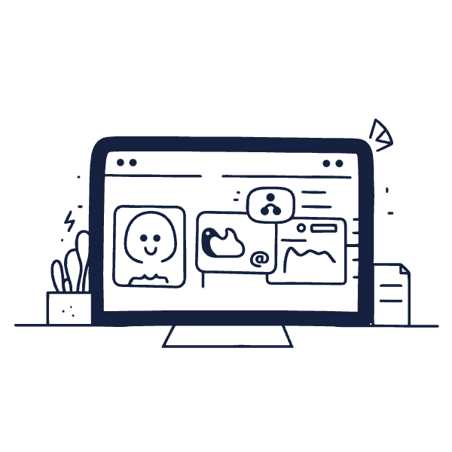
Website & Platform Structure
The PLP website will be a central hub, establishing a strong organisational brand over a personal one. This builds long-term credibility, facilitates partnerships, and simplifies team expansion.
A prominent hero section will articulate PLP's value proposition.
Testimonials and quotes will highlight the importance of political literacy.
Key features include a main landing page with clear navigation, integrated social media links via a banner, and an "About Us" section featuring the founder to add a personal touch.
An "Impact Page" will showcase the organisation's educational contributions and where donations are directed, such as supporting humanitarian causes.

Slide 4
Diverse Income Streams
Direct Monetisation
Social Media Monetisation
Indirect Social Media Income
Paid courses (one-off or bundles)
Patreon memberships (tiered content)
YouTube ad revenue
Membership/subscription programs (donations with benefits)
YouTube Premium subscriptions
TikTok Creator Fund earnings
Donations via live streams (Instagram, TikTok, Twitch)
Twitch monetisation (ads, donations)
Direct sales of educational kits (e-guides, PDFs)
Brand partnerships and sponsorships aligned with political values
Podcast ads and affiliate marketing (Spotify, Apple/Google)
Flexible donation options (one-time, monthly)
Podcast sponsorships (mid-roll ads)
PLP aims for financial sustainability through a diversified approach, blending direct sales, subscription models, and social media advertising. This multi-pronged strategy ensures resilience and consistent funding for our mission.

Slide 5




Reusable Content Model
Our content strategy focuses on maximising reach and value through a layered free/premium model.
Core Video Content
Multi-Platform Distribution
Record a guest conversation at a university.
Upload full version to YouTube; share clips on TikTok & Instagram Reels.
Audio & Live Extensions
Written & Premium Content
Publish audio on Spotify/Apple Podcasts; stream Q&A on Twitch.
Transcribe highlights into newsletters; offer full notes to premium members.
This systematic approach ensures content longevity and appeals to various audience segments, from casual viewers to dedicated members.

Slide 6
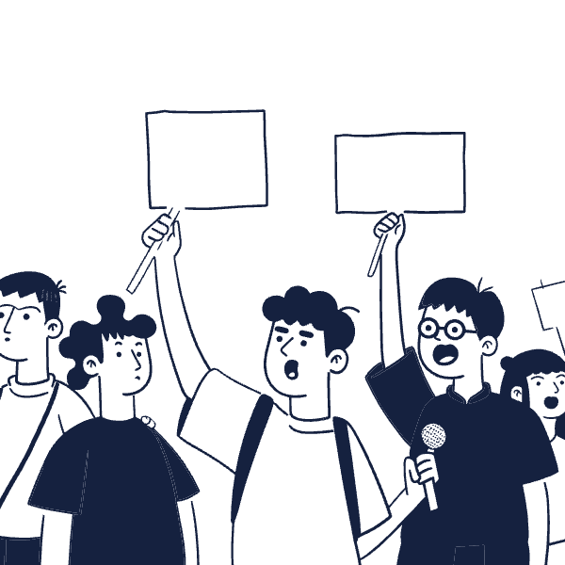
Building Our Brand: A Social Movement
PLP seeks to establish itself as a social movement, inspiring youth engagement in political literacy. Our branding will be rebellious and youth-focused, using slogans like "We Have a Voice" and "Umma needs to participate in politics to empower the community."
Key elements include:
Clearly defined mission and vision statements.
Compelling video/course covers explaining implications and takeaways.
This approach fosters community identity, encourages student-led initiatives, and sets the stage for future monetisation through merchandise, live events, and direct donations.
Detailed course information and previews.

Slide 7

LMS & Membership Structure
Learning Platform: LearnWorlds
Market Research: Udemy
We recommend LearnWorlds over Thinkific for its robust features tailored to building an educational movement.
Pros
Built-in community feed + learner profiles
Interactive content (quizzes, videos, eBooks)
Strong marketing tools (popups, funnels)
Research on Udemy shows that niche topics like "Islam and Politics" attract a smaller student base (5-20 per course). This underscores the need for PLP to cultivate its own dedicated platform and community to thrive.
Option for branded mobile app
Cons
Examples of courses offered:
Slightly steeper learning curve
Some features on higher plans only
Explaining How Government Works (Local to National)
How to Write to Your MP – step-by-step guidance
Understanding the Party System or Media Bias & Propaganda

Slide 8
Tiered Membership System
Tier 1: Casual Viewer
Discovers PLP via social media. Goal: Hook interest with engaging content on YouTube, TikTok, Instagram.
Tier 2: Engaged Follower
Consistently follows, attends events, completes free series. Goal: Turn interest into consistent engagement on Discord, Email list, Website.
Tier 3: One-Time Supporter
Believes in the project, donates occasionally. Goal: Offer frictionless donation via Buy Me A Coffee, PayPal, Patreon.
Tier 4: Active Member
Monthly supporter with exclusive access to content and workshops. Goal: Build trust and retention through Patreon, private playlists, Discord roles.
Tier 5: Course/Workshop Buyer
Active members interested in purchasing one-off courses directly from PLP's LMS.
Tier 6: Community Advocate (Future)
Promotes the movement, wears merch, leads chapters. Goal: Empower with tools, recognition, and leadership roles.

