Slide 1
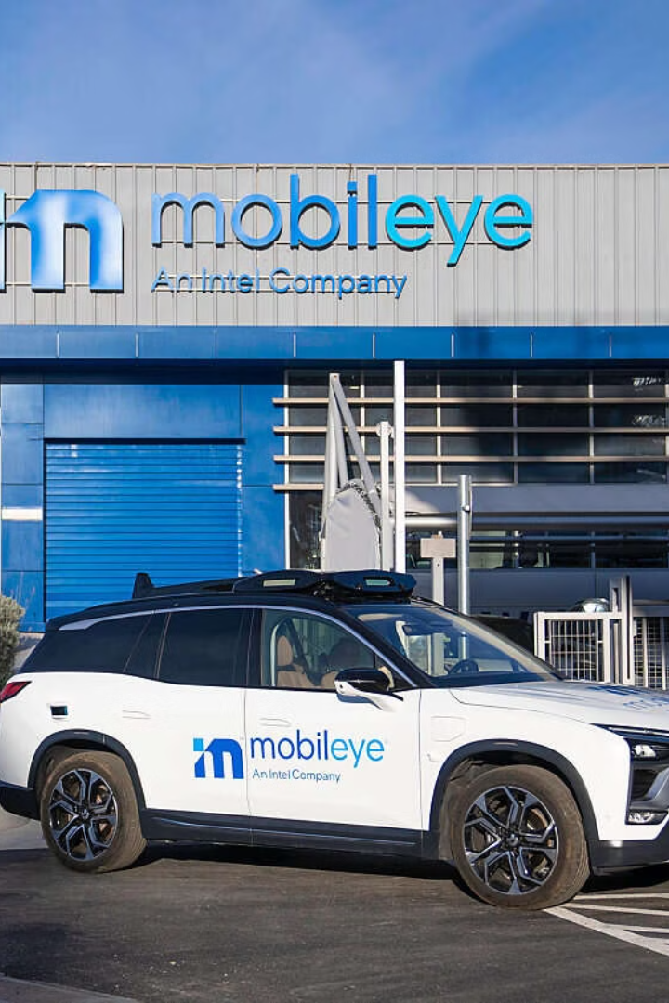

Mobileye's Return to Public Markets
In 2022, Mobileye, a leader in autonomous driving technology, launched its IPO. This marked a significant moment for the automotive and tech sectors. The IPO followed Intel's acquisition of Mobileye in 2017.
by Saquib Alhoque

Slide 2
IPO Details and Market Reaction
Sector
Auto Parts and Equipment/Automotive Industry Software
Ticker
NasdaqGS:MBLY
Exchange
NasdaqGS
Amount Raised
$861 million
Offered Price
$21/share
Shares Offered
41 million
Market Cap (IPO)
$16.7 billion
Market Cap (Dec 8th)
$25.3 billion

Slide 3
Mobileye's Technology and Strategy
Advanced Driver-Assistance Systems (ADAS)
Autonomous Driving Solutions
Responsibility-Sensitive Safety (RSS)
Mobileye develops cutting-edge ADAS, enhancing road safety. These systems include features like lane keeping assist and adaptive cruise control.
Mobileye is at the forefront of autonomous vehicle technology. Their solutions range from assisted driving to fully autonomous systems.
Mobileye's RSS model ensures safe operation of autonomous vehicles. This model uses mathematical principles to define safe driving behavior.

Slide 4
Intel's Strategic Rationale
1
Investment in Chip Manufacturing
2
Advancement of EUV Lithography
3
Long-Term Growth in Autonomous Vehicles
Proceeds will support Intel's investments in chip production. This is crucial for competition with TSMC.
Funding will accelerate research and development of EUV lithography. This cutting-edge technology creates smaller, denser chips.
Intel sees high growth potential in the autonomous vehicle sector. This IPO positions Mobileye to capitalize on this growth.

Slide 5



Potential Risks and Downsides
Market Scrutiny
Growth-stage companies, especially in tech, face intense scrutiny. Current market conditions demand profitability.
Interest Rate Environment
Rising interest rates pose challenges for businesses. This can impact Mobileye's growth trajectory.
Government Regulation
Autonomous vehicle regulations could affect Mobileye's prospects. Favorable policies are crucial for successful commercialization.

Slide 6



Mobileye's Future
Autonomous Driving Adoption
Technological Advancements
Financial Performance
Continued innovation in autonomous driving technology will be crucial for staying competitive.
Demonstrating profitability and managing costs will be essential for attracting investors.
Mainstream consumer adoption of self-driving cars is key for Mobileye's long-term success.

