Slide 1

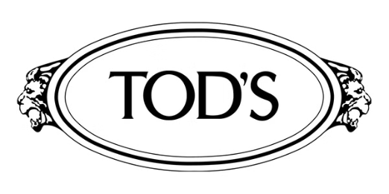
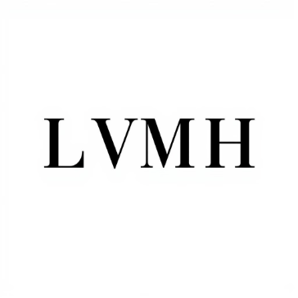

Tod's acquisition by L Catterton
Tod's, the Italian luxury footwear and leather goods company, has received a €1.4 billion takeover offer from L Catterton, the private equity firm owned by LVMH. This move aims to delist Tod's and take the company private.
by Saquib Alhoque

Slide 2


Tod's and L Catterton
Tod's, the luxury Italian fashion brand, has a long-standing partnership with the private equity firm L Catterton. This strategic alliance has enabled Tod's to leverage L Catterton's expertise in the global luxury goods market and drive growth through acquisitions and brand development.
Minority shares were bought for €43 each, a 18% premium on the closing value of Tod’s shares on 9th February 2024, for its 36% stake of the company, totalling out to €512m. This gave Tod’s a valuation of around €1.4bn excluding
€800m debt. The Della Valle family, current owner of Tod’s, will retain a 54% t majority stake while LVMH will retain a 10% stake in the company.
Tod was advised by JP Morgan Chase & Co, while L Catterton was advised by Bank of America.

Slide 3



Deal Introduction
Announcement
1
Tod's to be taken private by L Catterton
2
Valuation
€1.4bn excluding €800m debt
3
Ownership
Della Valle family retains 54%, LVMH takes 10%
The proposed transaction will see Italian luxury brand Tod's delist from the Milan stock exchange and be acquired by LVMH-backed private equity firm L Catterton. Tod's will be valued at €1.4 billion, with the Della Valle family retaining majority ownership and LVMH taking a minority stake.
Reasons for M&A
Lack of Innovation
Inability to Attract Millennials
Need for Flexibility
Tod's has struggled to stay relevant in the rapidly evolving luxury industry, facing stiff competition from larger conglomerates like LVMH and Kering.
Tod's focus on high-quality raw materials has made it difficult to appeal to younger consumers, leading to a decline in sales.
Going private through delisting will allow Tod's to make quicker decisions and pursue growth opportunities more freely.
Potential Acquisition
The delisting may position LVMH, a long-time investor in Tod's, to potentially acquire the brand and further its strategy of acquiring established luxury names.

Slide 4



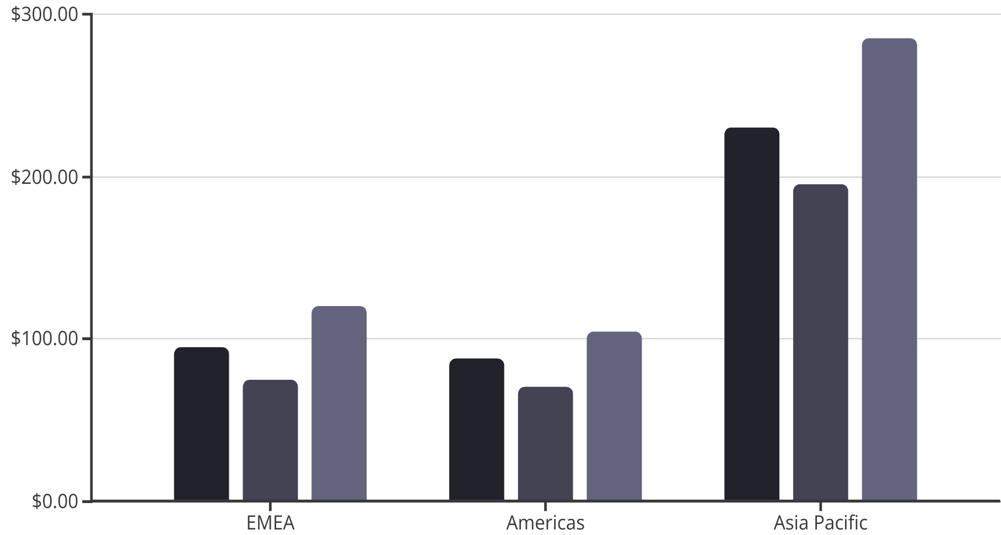
The Luxury Goods Industry
Exclusivity
Premium Quality
Diverse Offerings
Steady Growth
The luxury goods industry is defined by its exclusivity, with brands emphasizing high quality and limited availability.
Luxury goods are characterized by exceptional craftsmanship, materials, and attention to detail, justifying their premium pricing.
The luxury industry encompasses a wide range of products and services, from fashion and cosmetics to gastronomy and travel.
The luxury goods market is expected to reach €1.5 trillion by 2023, growing at a rate of 8-10% annually.
Luxury Goods Market by Region
FY 2019
FY 2020
E 2025
The luxury goods market is dominated by the Asia Pacific region, which accounted for over 50% of global sales in 2019. However, the Americas and EMEA regions are also significant contributors, highlighting the global nature of the luxury industry.

Slide 5
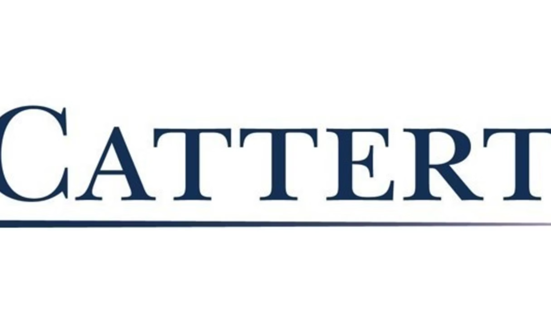
Acquirer Overview
Experienced Private Equity Firm
Focus on Consumer Industry
Collaborative Investment Approach
L Catterton is a well-established private equity firm with $38 billion in assets under management, founded in 1989 and headquartered in the United States.
L Catterton invests primarily in the consumer industry, including food and beverages, retail, restaurants, and consumer products, with typical investment sizes of $100 to $1000 million.
L Catterton's investment philosophy emphasizes a hands-on, collaborative approach with management teams, focusing on mid-market companies in North America, Western Europe, and Asia.
Target Overview
Storied Italian Heritage
Family-Owned Legacy
Iconic Product Portfolio
Founded in 1900, Tod's has over a century of experience crafting premium footwear, apparel, and accessories known for their timeless elegance and superior quality.
Owned and operated by the Della Valle family for three generations, Tod's has maintained its dedication to heritage, tradition, and meticulous craftsmanship.
Tod's is renowned for its iconic driving shoes featuring a pebbled leather sole and signature rubber pebble, appealing to a loyal following of discerning customers.
Public Listing and Growth
Proposed Privatization
Tod's went public in 2000 and has since grown its revenues and profits, reaching a market capitalization of €1.42 billion as of 2023.
The Della Valle family is in talks to sell a 36% stake to L Catterton for €512 million, valuing the company at an estimated €1.4 billion and taking it private.

Slide 6
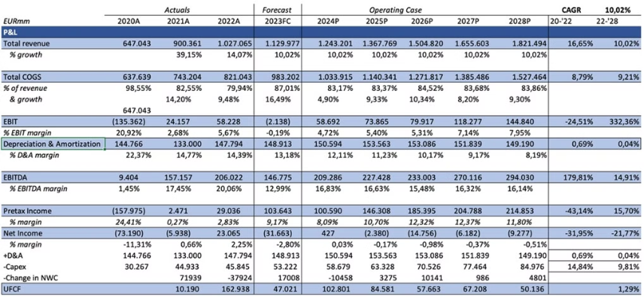
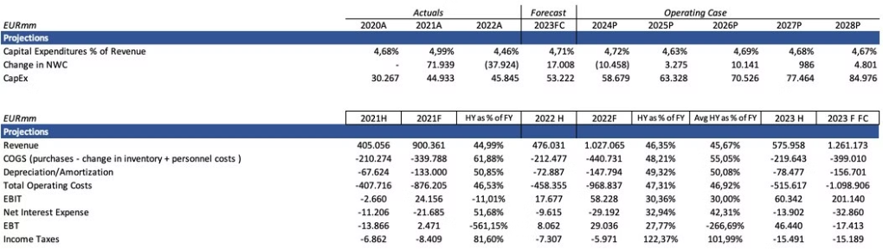
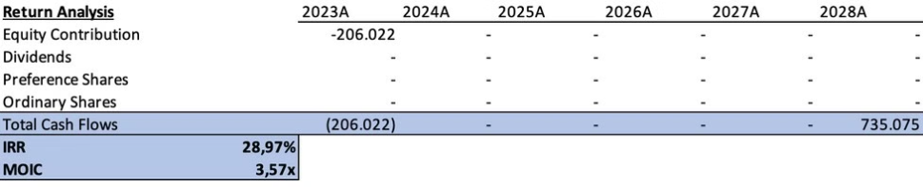
LBO Analysis
Entry Multiple
1.18x
Exit Multiple (2028)
2.50x
The LBO model assumes an entry multiple of 1.18x based on Tod's historical financial performance. The projected exit multiple in 2028 is 2.50x, reflecting anticipated growth and value creation over the investment horizon.
Prior to the transaction, the majority stakeholders were the Della Valle Family, controlling 50.9% of shares. L Catterton owned 6.5%. Post-transaction, L Catterton increased their ownership to 36%, while the Della Valle Family maintained their controlling stake.
Financial Forecast
The financial projections for the combined company show strong revenue growth of 10.02% and an EBITDA margin of 16% by FY2028, indicating an enterprise value of £1,187.69 million.
10.02%
16%
£1,187.69M
Revenue Growth
EBITDA Margin
Enterprise Value
Capital expenditures are forecasted to remain stable at 4.6% of revenue, supporting the company's growth plans.
4.6%
CapEx % of Revenue
The acquisition is expected to deliver an attractive return, with an equity contribution of £206 million, an exit EV of £735.075 million, an IRR of 28.97%, and a MOIC of 3.57x.
£206M
£735.075M
Equity Contribution
Exit EV
28.97%
3.57x
IRR
MOIC

Slide 7
Strengths and Opportunities of Tod's Delisting
Ongoing Family Control: The Dalla Valle family will retain 54% majority ownership, ensuring they maintain creative direction for the iconic Italian brand.
Improved Financial Position: Tod's has bolstered its finances in recent years, positioning it better to pursue this strategic move compared to its 2022 efforts.
Luxury Industry Expertise: Partnering with LVMH and L Catterton provides Tod's access to deep expertise and resources in the global luxury market, especially in the booming Chinese market.
Pursue Long-Term Goals: Delisting allows the Dalla Valle family to execute their turnaround vision without the constraints and pressures of public market demands.
Increased Investment Capacity: The partnership will provide Tod's additional capital to invest in strategic initiatives and capture growth opportunities, particularly in China.
Weaknesses and Threats of Tod's Delisting
Failed First Delisting Attempt: Tod's initial attempt to delist in 2022 failed due to an offer price seen as too low, highlighting challenges in the firm's waning popularity and profitability.
Underwhelming Valuation: The current 17.6% premium over the February 9th closing price is modest, barely exceeding Tod's 2000 IPO price, suggesting the company's valuation has changed little since listing.
Industry Consolidation Concerns: The deal can be viewed as a step towards a potential LVMH takeover, raising questions about industry concentration and minority shareholder treatment.
Dependence on Turnaround: Going private may provide flexibility, but Tod's needs to successfully execute its turnaround strategy without compromising independence or access to capital.

Slide 8
Glosary and Sources
Asset Turnover Ratio: The ratio indicates the efficiency of a firm to use its assets to generate revenue - calculated by dividing revenue by the total assets of a firm.
https://edition.cnn.com/2024/03/04/business/japans- nikkei-surpasses-40000-china-stocks-npc-intl- hnk/index.html
Capitalization Table: Breakdown of the company‘s ownership. It serves to show the pre and post transaction change in the composition of the equity in the company.
https://www.bain.com/about/media-center/press- releases/2023/global-luxury-market-projected-to-reach- 1.5-trillion-in-2023-a-new-record-for-the-sector-as- consumers-seek-luxury-experiences/
Current Ratio: The current ratio shows the ability of a firm to cover their short term obligations (liabilities) with their short-term assets - calculated by dividing current assets with current liabilities.
https://www.jpmorgan.com/insights/global- research/retail/luxury-market
https://www.forbes.com/sites/pamdanziger/2023/11/26/t he-resilience-of-luxury-brands-to-be-tested-in-2024/
Net Working Capital: The difference between operating assets and operating liabilities.
https://jingdaily.com/posts/tod-delisting-luxury- appetite-for-private-ownership
Senior Notes: Debt that a firm issues which has the most priority to be paid back in the case of a bankruptcy.
https://www.ft.com/content/8ea116ba-2fa5-406f-8984- 2bd29474f67d
Sweet Equity: any form of non-monetary equity that owners/managers of a company contribute to the business.
https://www.linkedin.com/pulse/strategic-delisting-tods- l-cattertons-influence-future-pallavi-sehgal-cxpuc/? trk=article-ssr-frontend-pulse_more-articles_related- content-card
Terminal Growth Rate: Assumption of the rate that a company is expected to grow forever.
https://www.fnlondon.com/articles/tods-success-boosts- italian-fashion-ipos-20001102
WACC: Cost of capital used to represent a firm's after-tax costs from all resources.

