Slide 1

spotify Data Analysis
An Exploratory Data Analysis (EDA) Story to Uncover Reliable Insights
Presented by: Md Saquib

Slide 2
Agenda
Project Overview
Dataset Analysis
Insights and Observations
Conclusion

Slide 3

overview
Objective
The objective of this analysis is to explore the Spotify Tracks dataset to uncover meaningful patterns and insights related to song characteristics, popularity trends, and artist performance.

Slide 4
Since the objective is to understand the factors that contribute to a track's popularity and to examine how these features vary across languages, genres, and time periods.
WE NEED TO STUDY THE FOLLOWING FEATURES:
Danceability – Measures how suitable a track is for dancing, considering rhythm stability, beat strength, and tempo.
Energy – Reflects the intensity and activity level of a song, capturing how dynamic or lively it feels.
Valence – Represents the musical positivity of a track; high valence sounds happy or cheerful, while low valence feels sad or moody.
Acousticness – Estimates how acoustic or non-electronic a track is; higher values indicate fewer synthesized or electronic sounds.
…….etc. (more audio features such as tempo and instrumentalness).

Slide 5


Analysis and Observations

Slide 6
Dataset analysis
Total Records: 62317 (With 22 attributes)
Each record represents a single track and includes:
Track Information: Includes the track name, artist, album, release year, language, and track URL.
Popularity Score: A numerical value representing how well the song is performing.
Audio Features: Captures characteristics such as danceability, energy, valence, acousticness, instrumentalness, speechiness, tempo, loudness, liveness, and more.
Musical Properties: Details the key, mode, and time signature of the track.

Slide 7
BASIC UNDERSTANDING OF THE DATASET:
📁 Categorical Columns:
🆔 track_id – Unique identifier assigned to each Spotify track.
🎵 track_name – Title or name of the song.
🎤 artist_name – Name(s) of the performing artist(s).
💿 album_name – Album in which the track is featured.
🔗 track_url – Direct Spotify link to play the track.
🖼️ artwork_url – URL of the album or track cover image.
📅 year – Release year of the track.
🌐 language – Primary language of the song's lyrics.

Slide 8
🎚️ Audio & Numeric Features
popularity – Integer score (0–100) indicating listener engagement and streaming frequency.
danceability – Measures how suitable a track is for dancing (0–1) based on rhythm, tempo, and beat stability.
energy – Overall intensity and activity level of the track (0–1).
acousticness – Probability that a track is acoustic rather than electronically produced (0–1).
instrumentalness – Likelihood that a track contains no vocals (0–1).
loudness – Average loudness in decibels (dB), typically ranging from –60 to 0.
speechiness – Indicates the presence of spoken words in the track.
liveness – Detects audience presence or live recording characteristics (0–1).
valence – Represents musical positivity or mood (0–1).
tempo – Speed of the song measured in beats per minute (BPM).
duration_ms – Total length of the track in milliseconds.
key – The musical key of the track (0–11).
mode – Musical mode: 1 = Major, 0 = Minor.
time_signature – Estimated number of beats per bar.

Slide 9
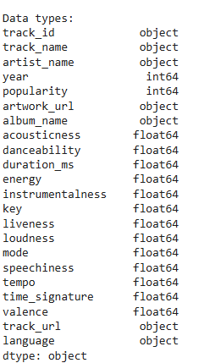


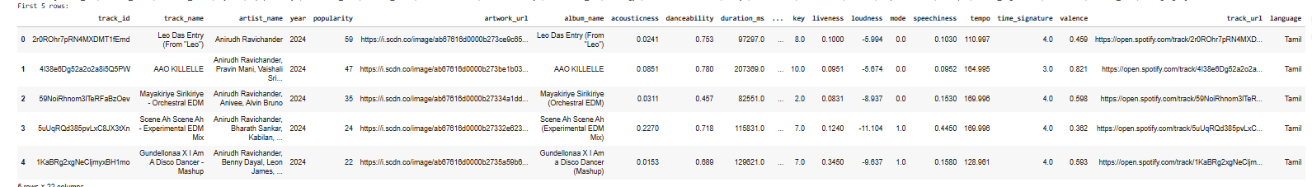
DEEPER LOOK AT THE DATSET
Columns and their datatypes
Initial Dataset Shape
Removing the Duplicates
First 5 Rows of the Dataset

Slide 10
Univariate analysis
What is Univariate Analysis?
Univariate analysis focuses on examining one variable at a time. It helps understand that variable’s distribution, range, central tendency, and overall statistical behavior.
In the upcoming slides, we will:
Study how each variable behaves independently using descriptive statistics.
Visualize numerical features through histograms, boxplots, and distribution plots.
Interpret each feature’s spread using metrics like mean, median, quartiles, and range.
Identify skewness, detect outliers, and observe concentration patterns for each attribute.

Slide 11
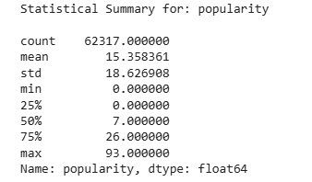
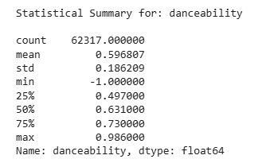
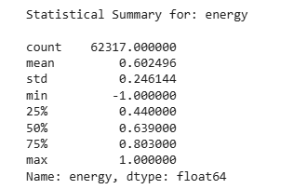
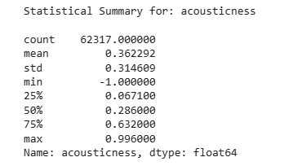
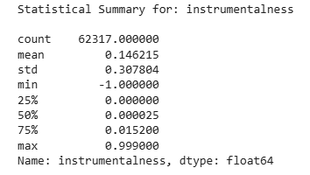
STASTICAL DATA
Let’s understand the dataset more clearly through visualization →

Slide 12
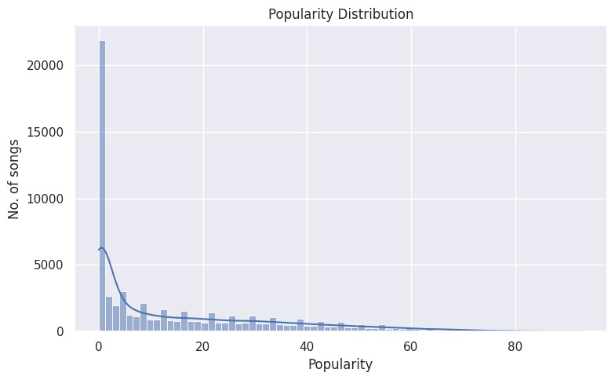
POPULARITY DISTRIBUTION
Most songs cluster in the moderate popularity range, indicating that extremely popular hits are relatively rare.
The distribution is right-skewed, with a small number of songs achieving very high popularity compared to the majority.
The KDE curve highlights a single main peak, suggesting that most tracks receive a similar, average level of listener engagement rather than extreme popularity.

Slide 13
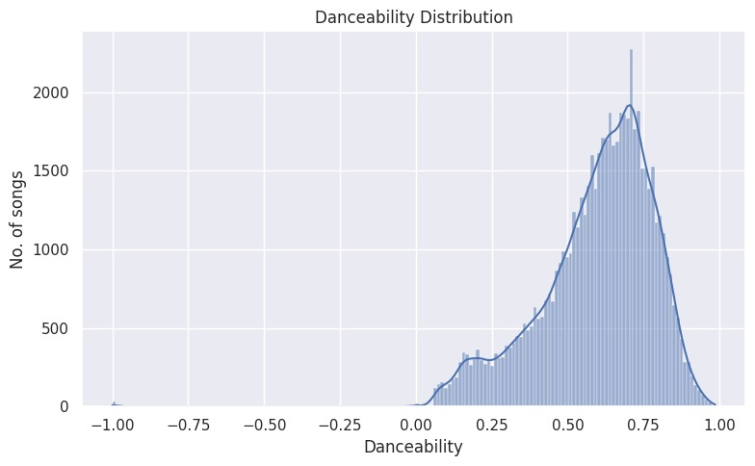
Danceability distribution
The danceability distribution shows that most tracks in the dataset have moderate danceability, clustering around 0.5–0.7. Extremely low or high danceable songs are rare, indicating the dataset is dominated by mainstream tracks with balanced rhythm and energy.

Slide 14
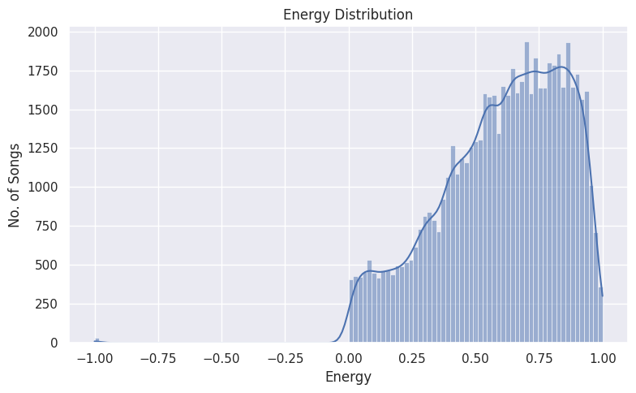
Energy distribution
Most songs have moderate to high energy (typically around 0.5–0.8), suggesting the dataset includes a majority of upbeat or lively tracks.
Very low-energy songs (calm or soft tracks) are less common, indicating fewer slow ballads or acoustic tracks
The distribution may show a slight right skew, meaning a small portion of songs are extremely energetic, possibly representing dance, electronic, or pop hits.

Slide 15
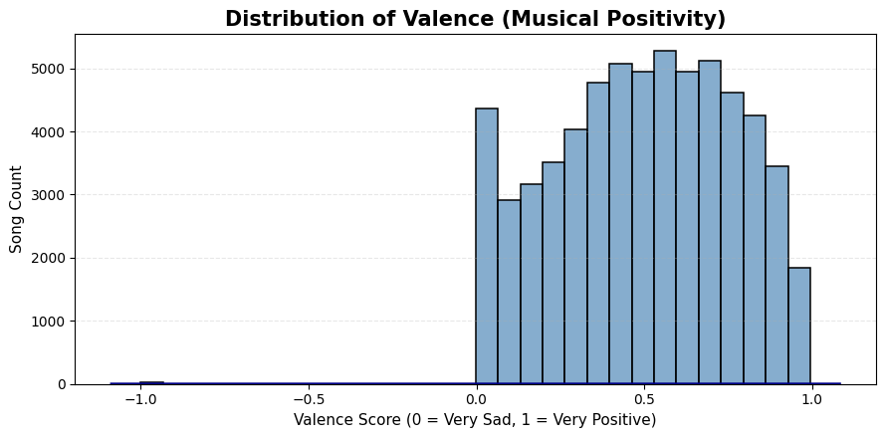
Valence
We observe that most songs have valence values between 0 and 1.
Very few tracks have valence scores close to 1.
This pattern suggests that listeners generally prefer happier, positive-mood songs over sad or low-valence ones.

Slide 16
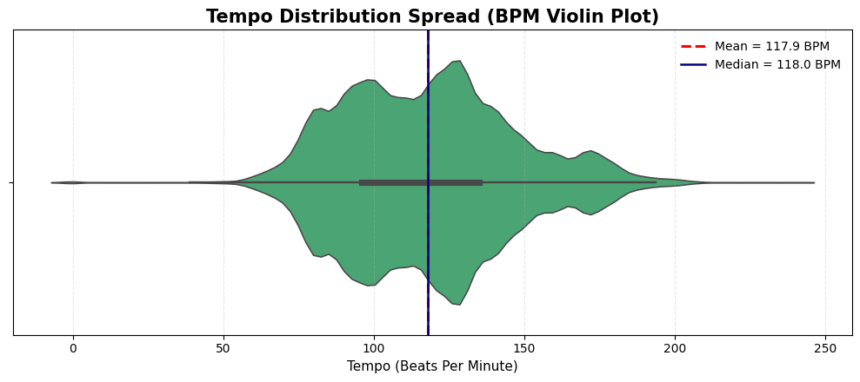
Tempo Distribution
Most songs cluster between ~100–130 BPM.
This tempo range is naturally engaging and comfortable for human perception.
It also aligns well with the typical structure of pop music, which often falls within this BPM range.

Slide 17
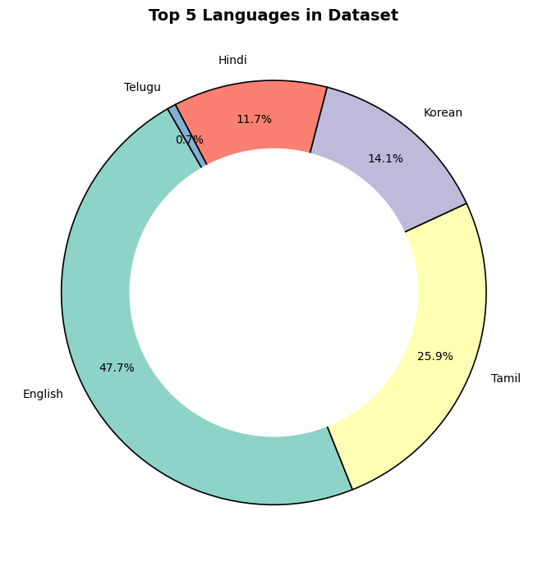
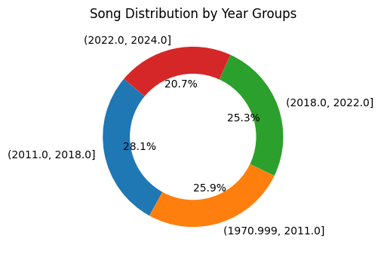
Univariate Analysis for Categorical Data
This suggests that most songs in the dataset are targeted toward a broad mainstream audience of a particular language.
This indicates that the observed popularity and audio features are influenced more by modern music styles rather than older ones.

Slide 18
Key insights
Popularity is heavily right-skewed, meaning only a small percentage of tracks achieve very high listener engagement.
Danceability is moderately high for most tracks, indicating that Spotify songs generally have a rhythmic and movement-friendly feel.
Energy levels are high in the majority of tracks, showing a preference for powerful, intense, and lively music.
Valence (emotional positivity) mostly lies between 0 and 1, suggesting listeners tend to prefer happier-sounding music over sad ones.
Tempo clusters around ~100–130 BPM, which aligns with the rhythm range naturally preferred by humans and commonly found in pop music.
Language distribution shows dominance of one primary language, with others forming smaller segments—indicating uneven linguistic representation.
Year-wise distribution shows most tracks belong to modern eras (2010–2020), suggesting the dataset is biased toward recent streaming-era music rather than older tracks.

Slide 19
bivariate analysis
What is Bivariate Analysis?
Bivariate analysis focuses on studying two variables together to identify how they relate and influence each other.
In the upcoming slides, we will ➝
Explore how different musical features relate when compared in pairs.
Use scatter plots to identify trends, patterns, and directional relationships.
Apply boxplots and grouped visual comparisons to analyze category-wise differences.
Examine how features such as tempo, danceability, duration, etc., connect with popularity.
Understand how combining two variables uncovers deeper insights than analyzing them individually.

Slide 20
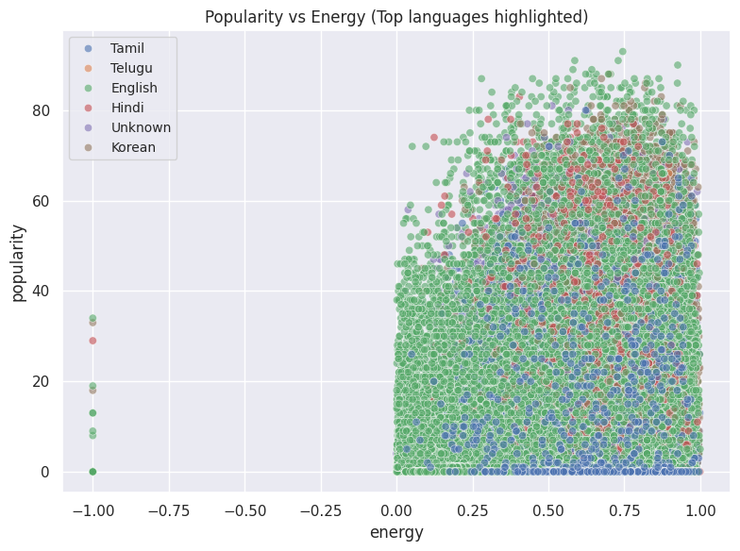
Popularity vs Energy (by language)
Moderate positive trend: Songs with higher energy tend to have slightly higher popularity across most languages, though the trend is not very strong.
Language-specific patterns: Some languages (e.g., English or Spanish) dominate the higher popularity and higher energy region, suggesting hits are more frequent in these languages.
Diverse spread: Popularity varies widely at all energy levels, indicating that energy alone does not determine a song’s success, and language may play a role in audience reach.

Slide 21
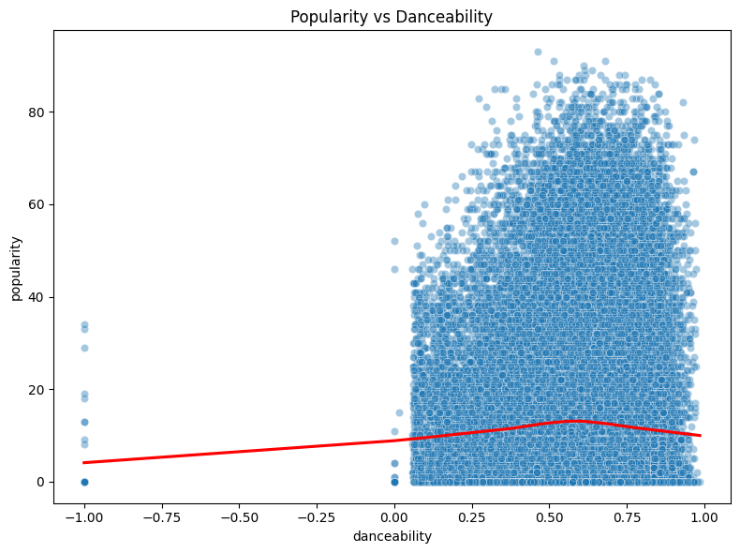
Popularity vs Danceability
Slight positive trend: The LOWESS curve suggests that songs with higher danceability tend to be somewhat more popular, but the relationship is not very strong.
Wide spread of popularity: Many moderately danceable songs have both low and high popularity, indicating danceability alone does not guarantee a hit.
Outliers: A few extremely popular songs exist across different danceability levels, showing that other factors (like artist, genre, or marketing) also influence popularity.

Slide 22
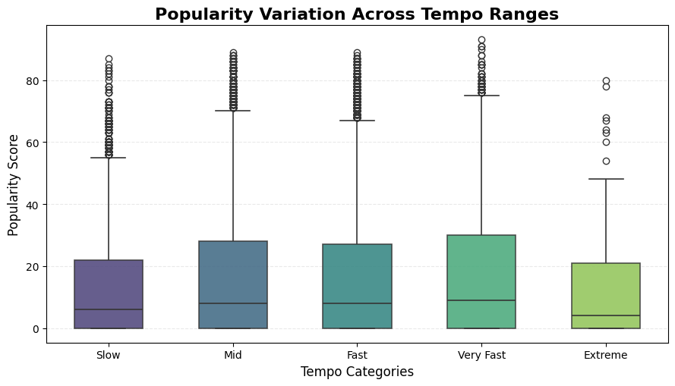
Popularity vs tempo
Popular tracks appear across all tempo ranges, showing that tempo alone does not determine a song’s success.
However, medium-fast BPM ranges (roughly 100–130 BPM) show wider popularity variation, suggesting they are more adaptable to mainstream genres.
Very slow or very fast tempos show less spread in popularity, meaning they are less commonly used in hit songs.

Slide 23
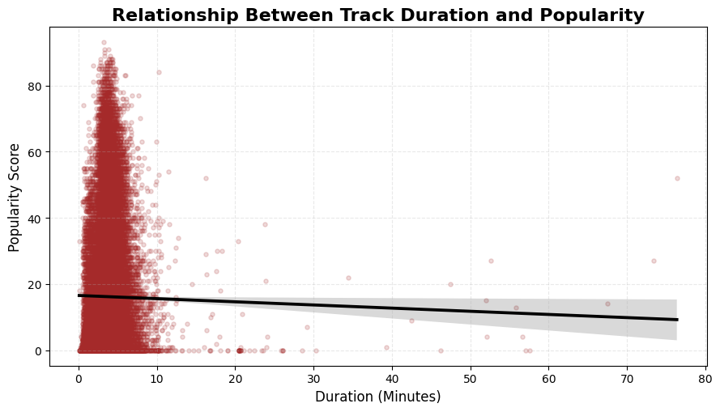
Popularity vs duration
Songs in the 2–8 min range, especially 3–4 mins, show higher popularity.
Shorter tracks get more replays, boosting visibility.
Their length makes them playlist-friendly and supported by streaming algorithms.

Slide 24
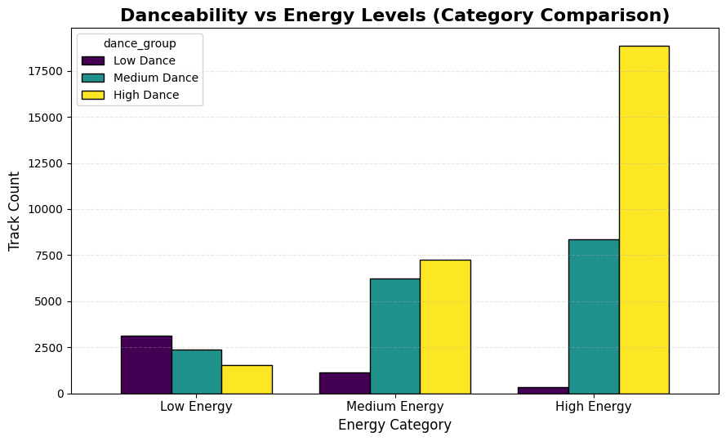
Danceability vs energy
A clear upward trend shows that energy and danceability rise together.
High-energy tracks usually have stronger rhythm, making them more dance-friendly.
Low-energy songs tend to have lower danceability, reflecting calmer, less rhythm-focused music.

Slide 25
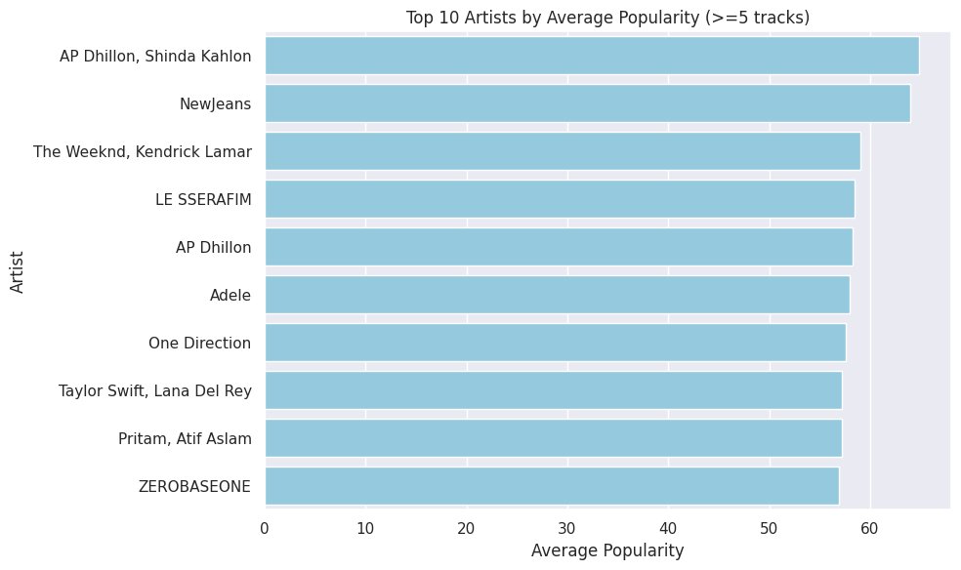
Top artists by avg popularity
Top artists dominate: A few artists consistently achieve higher average popularity across their tracks, highlighting their strong fanbase or mainstream appeal.
Track count filter: Only artists with 5 or more tracks are considered, ensuring the ranking reflects consistent performance rather than a single hit
Popularity gap: There may be noticeable differences between the top-ranked artist and others, indicating that certain artists significantly outperform peers in audience reach.

Slide 26
Key insights
There is a mild positive trend between popularity and danceability, meaning moderately danceable tracks show a slightly better chance of gaining listeners.
Popularity shows very weak dependence on tempo — hit songs appear across slow, medium, and fast BPM ranges.
Most popular songs fall within the common duration window of 2–4 minutes, while extremely short or very long tracks rarely perform as well.
Energy and danceability rise together, showing that songs with stronger rhythmic intensity are usually more movement-friendly and appealing.
A small group of artists consistently achieve higher average popularity, suggesting a strong fanbase or widespread mainstream reach. Only artists with 5+ tracks were considered, making the comparison more reliable and reducing the impact of one-hit anomalies.

Slide 27
multivariate analysis
What is Multivariate Analysis?
Multivariate analysis examines relationships among three or more variables simultaneously to understand how multiple features together influence outcomes.
In the upcoming slides, we will ➝
explore how multiple audio features relate to one another when analyzed together.
understand how combinations of attributes collectively influence a song’s popularity.
use a heatmap to visualize correlations between different musical features.
examine how energy and danceability jointly interact with popularity.
study how key song characteristics have evolved over the years through trend analysis.

Slide 28
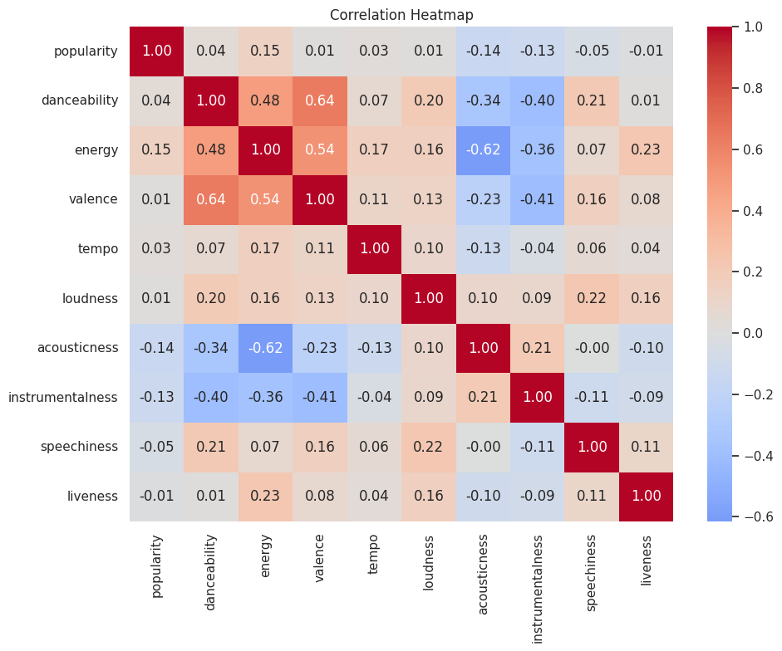
Correlation Heatmap
English dominance: English tracks often show higher median popularity compared to other languages, reflecting their wider global audience.
Wide variability: Popularity varies significantly within each language, indicating that hits can appear in any language but with different likelihoods.
Outliers: Some songs achieve exceptionally high popularity regardless of language, highlighting that individual hits can transcend general trends.

Slide 29
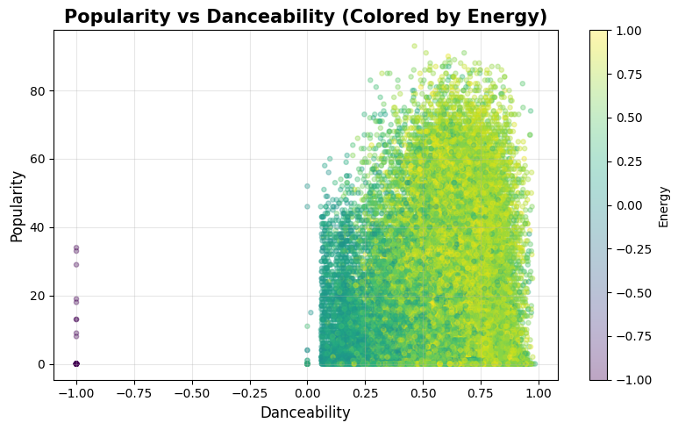
Popularity vs danceability vs energy
Songs with higher danceability often show higher energy, indicating both features rise together.
However, higher energy does not always translate to higher popularity — both energetic and calm tracks appear across the popularity scale.
This means energy is a strong driver of danceability, but not a strong predictor of popularity.

Slide 30
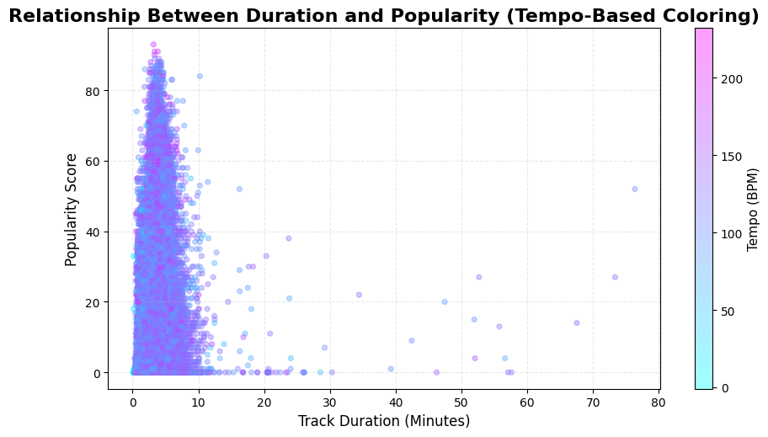
Popularity vs Duration vs Tempo
Popular tracks usually lie within the 2–4 minute duration range, which is the most listener-friendly length.
Across this range, tempo varies widely, meaning both slower and faster songs can achieve popularity.
This indicates that tempo and duration together shape listener engagement, rather than either feature alone determining popularity.

Slide 31
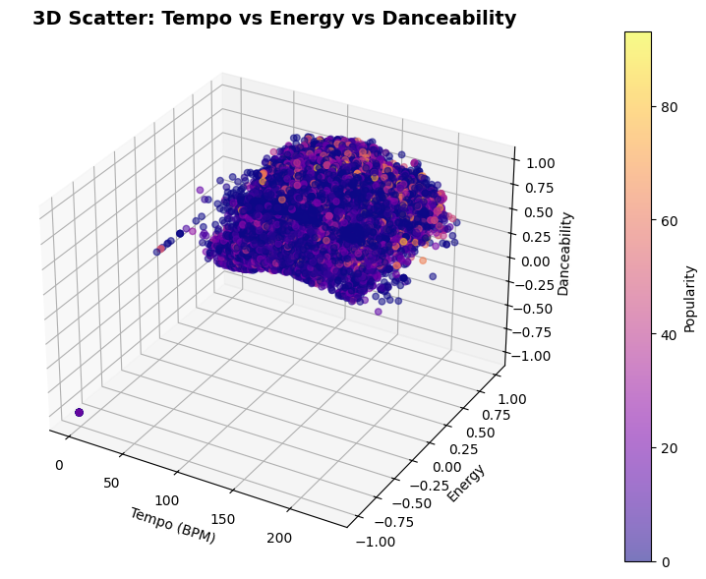
Tempo vs Danceability vs Energy vs Popularity
Faster-tempo tracks generally show higher energy, reflecting the natural link between speed and musical intensity.
Songs with higher energy often have higher danceability, reinforcing their strong rhythmic and movement-friendly nature.
Popularity (indicated by color intensity) is distributed across various tempo–energy combinations, meaning no single tempo or energy level guarantees a hit.

Slide 32
Key insights
Correlation analysis shows that danceability and energy trend together, while popularity has only weak connections with any single feature, indicating it is driven by multiple factors.
Multivariate visualizations reveal that popular songs typically fall in balanced musical ranges rather than at extreme levels of tempo, energy, or danceability.
Valence (emotional tone) and tempo display diverse combinations, showing that hit songs can be upbeat, slow, energetic, or even melancholic—musical diversity still succeeds.
The interaction of tempo, energy, and rhythmic drive highlights key structural patterns in modern music, yet overall success depends on broader audience preferences and cultural trends.
Overall, song popularity is a combined outcome of multiple interacting musical features, not a simple linear effect of any one attribute.

Slide 33
TIME SERIES ANALYSIS
POPULARITY - TIME
Older songs show higher average popularity because they have accumulated streams over a longer time span.
Classic or evergreen tracks retain cultural value and continue to be played across multiple generations.
Newer songs may experience short-term popularity spikes, but they haven’t had enough time to build long-term, sustained popularity.
Overall, popularity trends over time are shaped more by long-term listener behavior than by the release year alone.

Slide 34
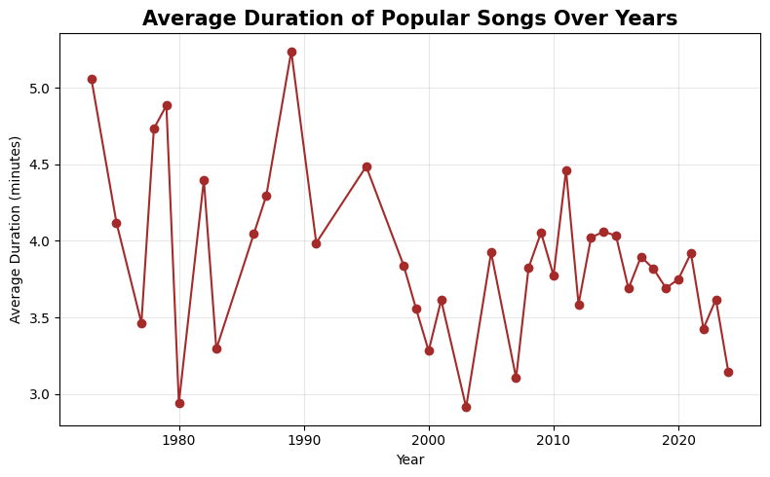
Duration - time
Average song duration has decreased over time, indicating a clear shift toward shorter tracks.
Older music often featured longer compositions, commonly exceeding 4–5 minutes.
Modern songs typically fall within 2–3 minutes, optimized for higher replay value and smoother playlist flow.
This trend reflects shorter attention spans and a streaming-friendly music structure, where concise tracks perform better.

Slide 35
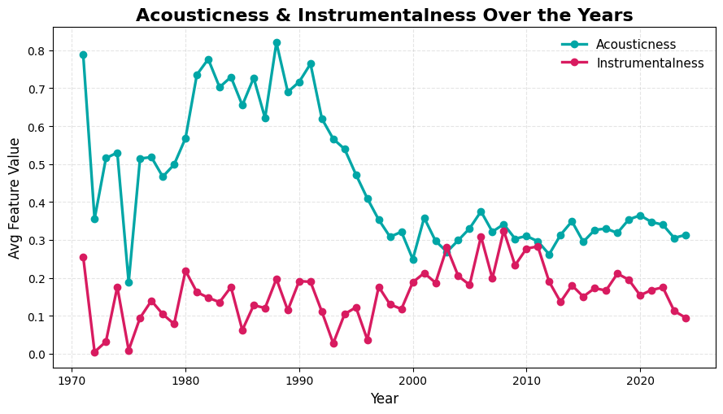
ACOUSTICNESS - INSTRUMENTALNESS
Over the decades, there has been a steady decline in acousticness, showing that music has gradually moved away from raw, natural-sounding instruments.
Instrumental tracks remain rare, as mainstream music continues to revolve mainly around vocals.
The overall trend reflects a clear industry preference for electronically produced and studio-enhanced sounds rather than traditional acoustic setups.
Modern listeners also seem to gravitate more toward vocal-heavy songs with polished, digitally shaped audio styles.

Slide 36
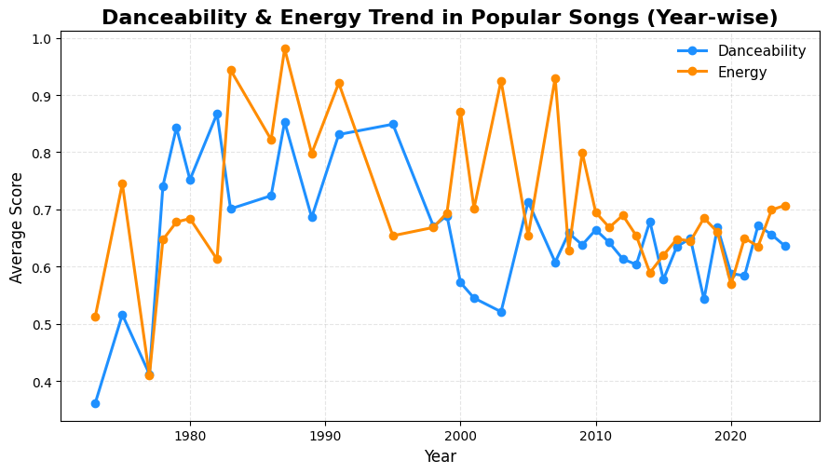
Danceability - energy
Popular tracks continue to maintain high energy levels over the years, suggesting a lasting listener preference for lively and dynamic music.
Danceability has increased in recent decades, highlighting a stronger focus on rhythm-centric and beat-driven production.
This rise in danceability aligns with modern trends shaped by clubs, social media platforms like TikTok and reels, and playlist-oriented listening habits.
When viewed together, energy and danceability show a clear industry shift toward upbeat, movement-friendly compositions that resonate well with contemporary audiences.

Slide 37
KEY INSIGHTS
Older tracks tend to score higher in popularity because they’ve had many years to gather streams and maintain their cultural presence.
Song lengths have reduced over time, with modern hits becoming shorter to boost replay value and keep listeners engaged quickly.
There is a noticeable drop in acousticness, while instrumentalness stays low, signaling a strong move toward digitally crafted, vocal-driven music.
Danceability has risen steadily, reflecting today’s preference for rhythm-heavy tracks that work well for clubs, social media trends, and short-form video content.
Energy has remained consistently high, suggesting that audiences continually gravitate toward upbeat, lively, and powerful music.
The long-lasting popularity of older songs highlights enduring listener loyalty and cultural longevity, strengthened over time through continuous streaming.

Slide 38
conclusion
Song popularity isn’t shaped by one feature alone—it results from the combined influence of energy, danceability, tempo, duration, and other musical elements.
Highly popular songs usually fall within balanced, mid-range values across several features, suggesting that listeners prefer well-rounded musical profiles.
Valence (emotional mood) shows only a weak link to popularity, indicating that audiences enjoy both cheerful and emotionally heavy tracks.
Long-term streaming behavior shows that older songs tend to accumulate more popularity, highlighting their lasting cultural presence.
Overall, a song’s success is multi-dimensional, shaped by listener habits, marketing factors, and changing music trends rather than any single musical characteristic.

Slide 39
FUTURE SCOPE
Explore genre-specific trends to understand how different styles of music have changed and evolved over time.
Apply lyric-based sentiment analysis to capture emotional depth that valence scores alone cannot represent.
Integrate external indicators such as social media trends, YouTube performance, and radio airplay to gain a wider perspective on popularity.
Implement machine learning models to predict song popularity using a combination of audio features.
Analyze demographic listening patterns across age groups and regions to identify audience-specific preferences.
Expand the study beyond Spotify, comparing popularity patterns across platforms like Apple Music and YouTube Music for broader insights.

Slide 40
THANK YOU!
PRESENTED BY : MD SAQUIB (GCECTB-R24-2024)

