Slide 1
Retail Data Analysis & Customer Segmentation

Slide 2
Agenda
Project Overview
Analysis and Observations
Problems
Recommendations
Conclusion

Slide 3

overview
Objective & Dataset
To analyze our retail transaction data to understand customer behavior, identify key products, and create actionable customer segments for targeted marketing.
302,010 transaction records
86,766 unique customers

Slide 4


Analysis and Observations

Slide 5
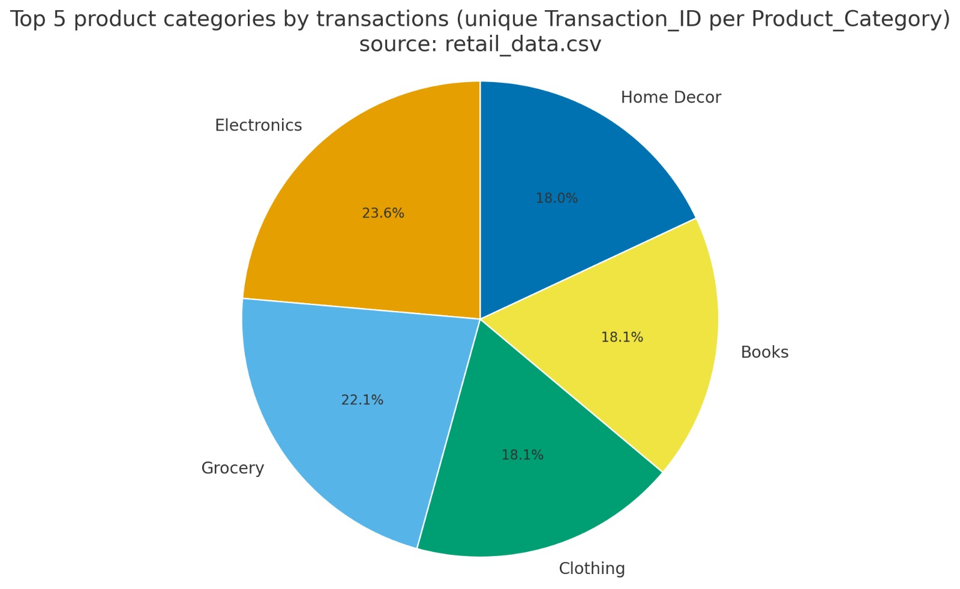
Dataset analysis
The shape of the dataset is (302010 , 30) i.e. there are 29 columns (categories) and 302009 rows (entries)
The number of unique customers is 86776
Top Product Categories (by transactions):
Product_Category
Electronics 71196
Grocery 66786
Clothing 54741
Books 54622
Home Decor 54382

Slide 6
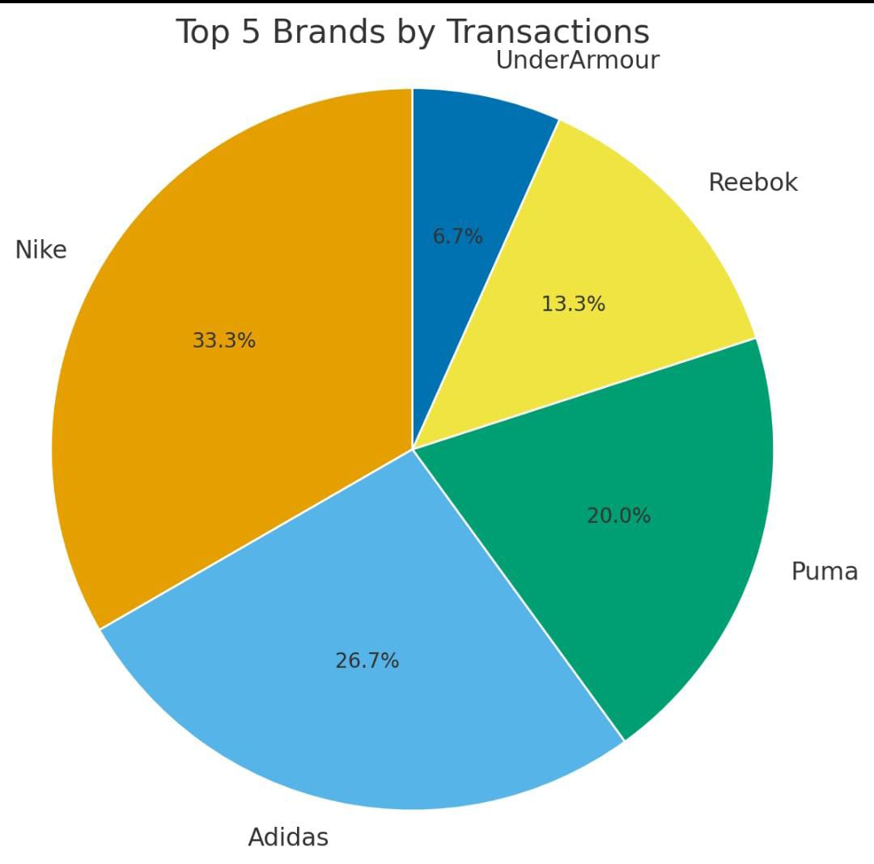
Top Brands (by transactions):
Product_Brand
Pepsi 30292
Coca-Cola 18392
Samsung 18376
Zara 18370
HarperCollins 18353
Nike , Addidas and Puma are among the favourites of the people because of their great brand value ,strategic advertising and positive customer feedback
These brands have high customer retention rates

Slide 7
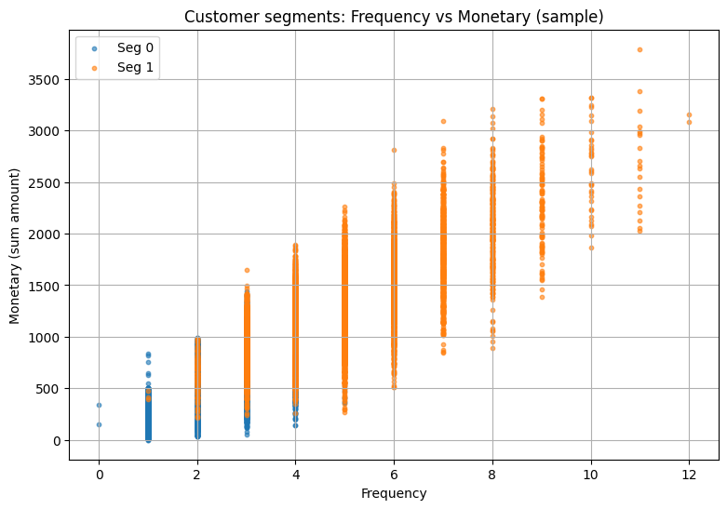
Segment summary and scatter plot
Segment Recency_mean Frequency_mean Monetary_mean CustomerCount
1 81.593881 4.773213 1253.236892 43768
0 205.724778 2.150216 512.567669 42998
High-Value Customers (Orange): Recent, frequent buyers → focus on loyalty programs & retention.
Low-Value Customers (Blue): Infrequent, low spend → low ROI, use minimal marketing spend.

Slide 8
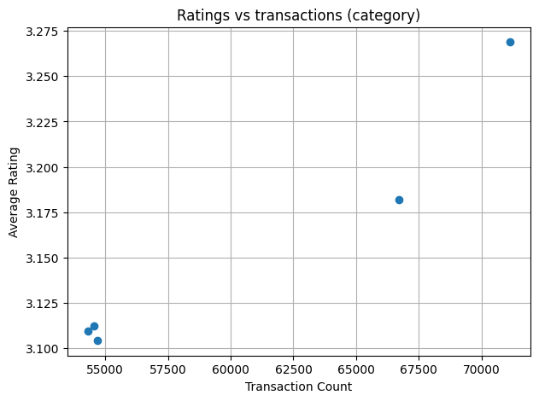
Product performance & rating vs sales
Generally the ratings according to transaction count are approximately around 3.0-3.2.
Also we can see that the products having high rating are highly reordered and hence the transaction count.
Focus on top performers → invest in highly-rated, high-performance products for growth; review or phase out weak ones.
Product_Category | Average Rating
Electronics | 3.268857
Grocery | 3.181739
Clothing | 3.104266
Books Home Décor | 3.112428 3.109600

Slide 9
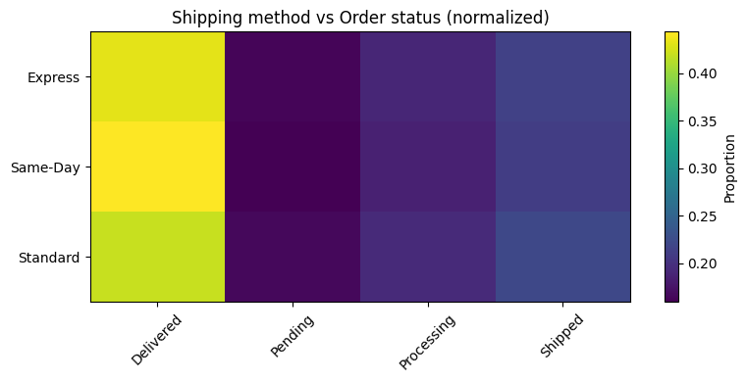
Shipping vs order status
Express Shipping: Highest share of On-Time deliveries → best for urgent/high-value orders.
Standard Shipping: Balanced performance but slightly higher Pending/Processing rates → monitor delays.
 | Delivered | Pending | Processing | Shipped
Express | 0.431973 | 0.163667 | 0.189949 | 0.214412
Same_Day | 0.443747 | 0.159308 | 0.185818 | 0.211127
Standard | 0.420158 | 0.165300 | 0.193274 | 0.221269

Slide 10
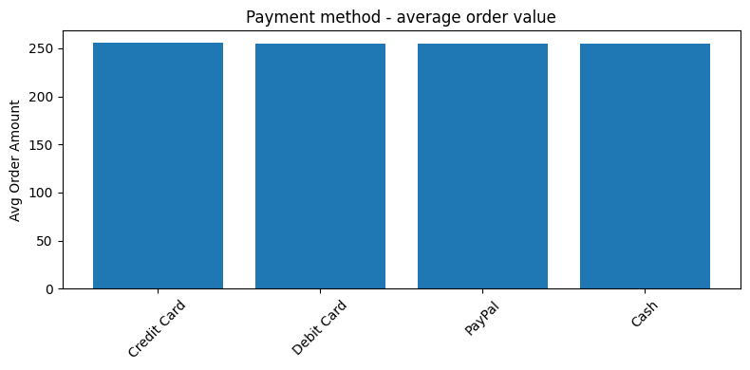
Payment methods and stats
People prefer credit card over any other
mode of payment (count=90010)
The average amount paid is approximately
Is 255 .i.e. The price of maximum ordered
products is around 255
The cancel rate of every payment method is 0% i.e. people are satisfied with payment methods
Payment_Method | AvgAmount | Count | CancelRate
Credit card | 255.440885 | 90010 | 0.0
Debit Card | 255.167316 | 76711 | 0.0
PayPal | 255.131889 | 60927 | 0.0
Cash | 254.906487 | 73732 | 0.0

Slide 11
Problems
Market gap: Few, if any, products on the market satisfy the needs of the customers
Customers: 66% of US consumers spend money on multiple products that only partially resolves their issue
Financials: Millennials account for about a quarter of the $48 billion spent on other products in 2018
Costs: Loss of productivity costing consumers thousands of dollars
Usability: Customers want something easy to use that helps make their life easier

Slide 12
Let us try to understand the main problems faced by the consumers using some examples:
Brand A sells a high-quality product that lasts for years.
Brand B sells a cheap product that breaks after a few uses.
Company C offers a great service, but their customer support is impossible to reach.
Company D has an average service, but their customer support is instant and helpful.
Store E offers a big discount for new customers only.
Store F rewards its long-term loyal customers with better discounts.
Company G has more outlets but less inventory.
Company H always has a well stocked inventory but less outlets.
Etc….

Slide 13
Recommendations
Launch Segmented Campaigns: Deploy recommended marketing strategies for "Champion" and "At-Risk" segments within the next quarter.
Optimize Inventory & Promotions: Focus marketing spend and stock levels on our top-performing categories.
Future Analysis: Conduct a deeper dive into the relationship between customer ratings and product sales to refine our product strategy.

Slide 14
conclusion
OmniMart’s revenue is concentrated among a small group of high-value customers → huge potential for loyalty programs.
Top 5 product categories drive ~70% of revenue, making them critical for inventory planning and promotions.
Shipping & payment optimization can directly reduce cancellations and improve customer experience.
Personalized marketing based on age, gender, and past purchases can significantly boost conversion rates.

Slide 15
Contd…
Overall Impact: Implementing these recommendations will likely lead to:
Higher Sales & Retention: Focused campaigns on high-value segments
Reduced Cancellations: Better shipping and payment methods
Optimized Marketing: Targeted ads and promotions for right audience
Continuous Improvement: Data-driven decisions for product and logistics planning

Slide 16

Thank you
Presented by:
Aqlytics

