Slide 1


Credit Card Fraud Detection
Final Project
CIS 530: Advanced Data Mining
Presented by: SAQUIB HASHMI AND SUNIL MISHRA

Slide 2

Introduction
This project analyzes credit card transaction data to identify fraud.
Fraud cases are extremely rare, making it hard for models to learn from raw data.
We use machine learning to help financial institutions flag suspicious activity.

Slide 3
Problem Statement
Credit card fraud detection is critical in financial systems.
The dataset is highly imbalanced.
Goal: Accurately detect fraud while minimizing false positives.

Slide 4
Dataset Overview
Source: Kaggle – European cardholders https://www.kaggle.com/datasets/mlg-ulb/creditcardfraud
284,807 transactions over 2 days
Features: PCA-transformed V1–V28 + Time + Amount
Target: 'Class' – 0 = Legit, 1 = Fraud

Slide 5
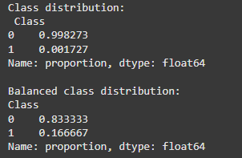
Preprocessing
Checked and dropped NA values (none found)
Standardized Time and Amount
Used 5:1 undersampling: for every 1 fraud, 5 legit samples
Final: 790 legit, 158 fraud → 83.3% : 16.7%

Slide 6
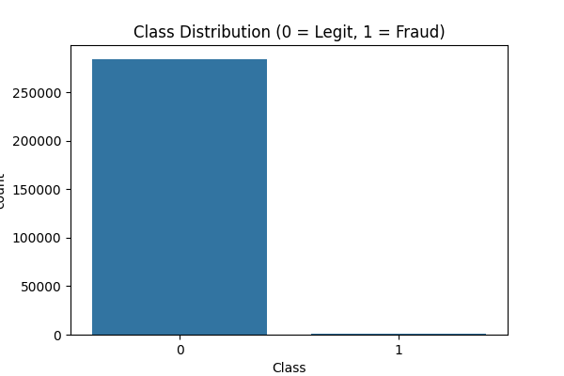
Class Distribution
This plot shows the original class imbalance. Nearly all transactions are legitimate, with only a tiny fraction being fraud.

Slide 7
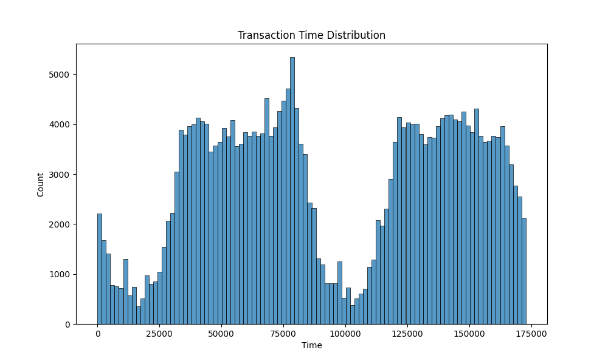
Transaction Time Distribution
This plot shows the distribution of transactions over time. Peaks suggest high activity periods during the 2-day span.

Slide 8
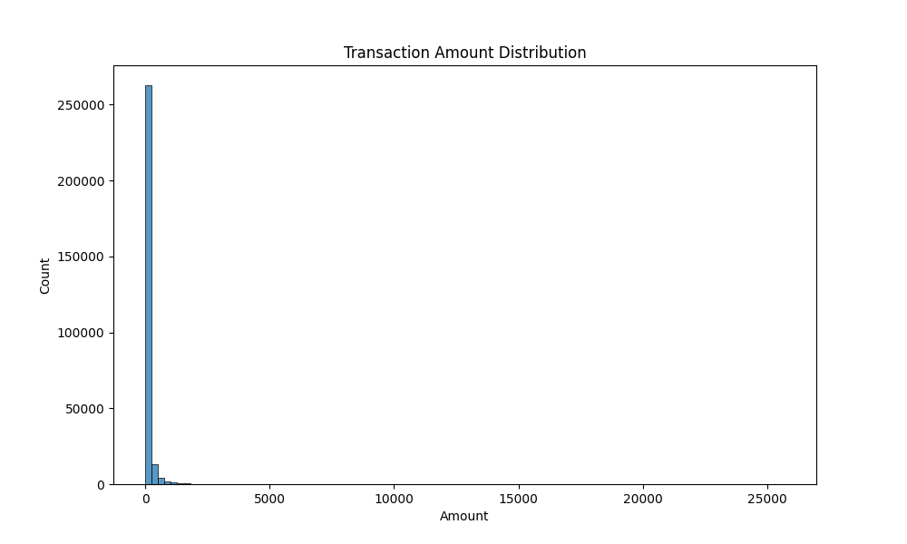
Transaction Amount Distribution
Most transactions are small amounts. A few high-value transactions appear as outliers.

Slide 9
Why 5:1 Undersampling?
3:1 gives higher fraud exposure (recall)
5:1 balances realism and precision
Result: better overall AUC and accuracy
Tradeoff: slight drop in fraud recall vs improved accuracy

Slide 10
Models Used
Logistic Regression
Used for predicting categories, especially yes/no or true/false outcomes.
Works by analyzing the relationship between input features and the probability of an outcome.
Assumes a linear relationship between inputs and the log-odds of the outcome.
Simple and fast, often used as a baseline model in classification tasks.
Easy to interpret and good for problems where the data is not too complex.
XGBoost
A boosting algorithm that combines many small decision trees to make better predictions.
Each new tree tries to fix the errors made by the previous ones.
Known for being fast, accurate, and efficient, even with large and messy data.
Can handle missing values, non-linear patterns, and complex relationships in data.
Commonly used in Kaggle competitions and real-world applications due to high performance.
Support Vector Machine (SVM)
A margin-based classifier that finds the best boundary (hyperplane) between classes.
Works by maximizing the margin between fraud and legit cases in a high-dimensional space.
Effective on smaller, balanced datasets where clear separation exists.
Can handle both linear and non-linear classification using different kernels.
Useful when interpretability is less important than achieving a strong separation between classes.

Slide 11
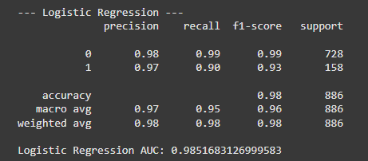
Evaluation Metrics
Logistic Regression
Precision (Fraud): 0.97
Recall (Fraud): 0.90
F1-score: 0.93
AUC: 0.9852
Accuracy: 98%

Slide 12
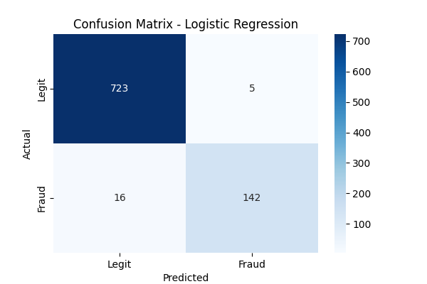
Confusion Matrix – Logistic Regression
LR correctly classified most cases but had 5 false positives and missed 16 frauds.

Slide 13
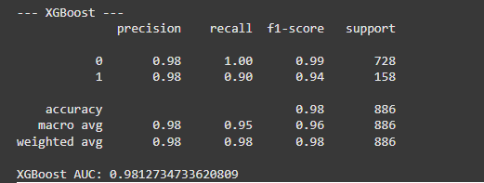
XGBoost Results
Precision (Fraud): 0.98
Recall (Fraud): 0.90
F1-score: 0.94
AUC: 0.9813
Accuracy: 98%

Slide 14
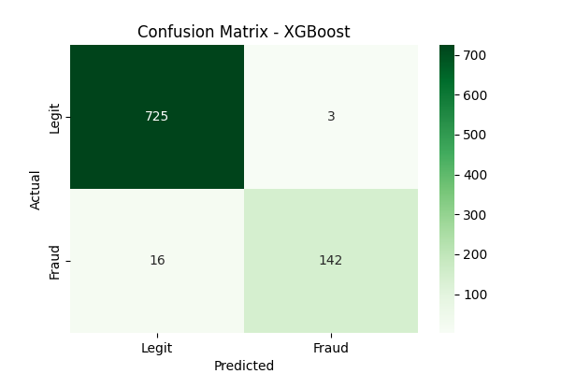
Confusion Matrix - XGBoost
XGBoost had fewer false positives (only 3), same fraud misses (16), indicating higher precision.

Slide 15
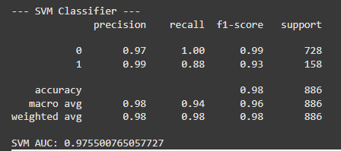
SVM Results
Precision (Fraud): 0.96
Recall (Fraud): 0.85
F1-score: 0.90
AUC: 0.9738
Accuracy: 97%

Slide 16
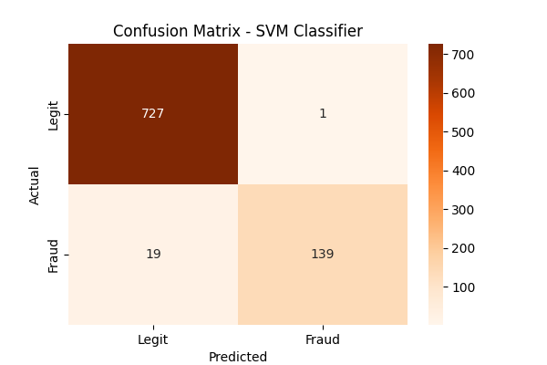
Confusion Matrix - SVM
SVM achieved slightly lower recall compared to XGBoost but maintained high precision, indicating good fraud detection with slightly more cautious prediction.

Slide 17
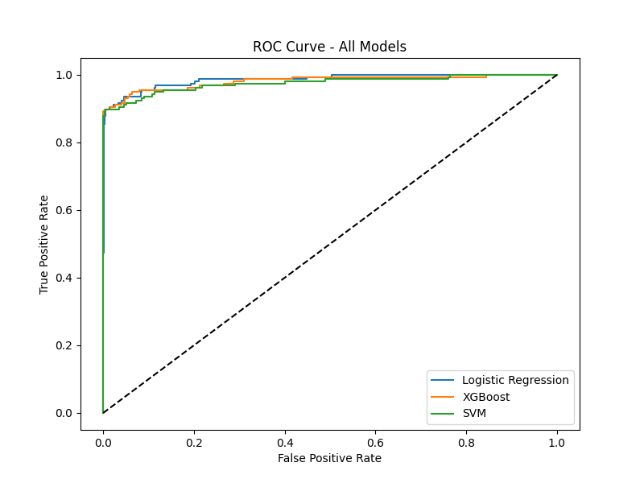
ROC Curve - All Models
The ROC curve shows all three models performing very well.
The closer the curve is to the top-left corner, the better the model is at distinguishing fraud from legit transactions.
Logistic Regression had the highest AUC (0.9851), indicating the best overall balance between true positive and false positive rates.
XGBoost achieved slightly lower AUC (0.9812) but had almost perfect classification for the legitimate class.
SVM also performed competitively with an AUC of 0.9755, showing strong predictive capability despite slightly lower recall for fraud.
Overall, all models demonstrate excellent separation ability, but Logistic Regression edges slightly ahead based on AUC.

Slide 18
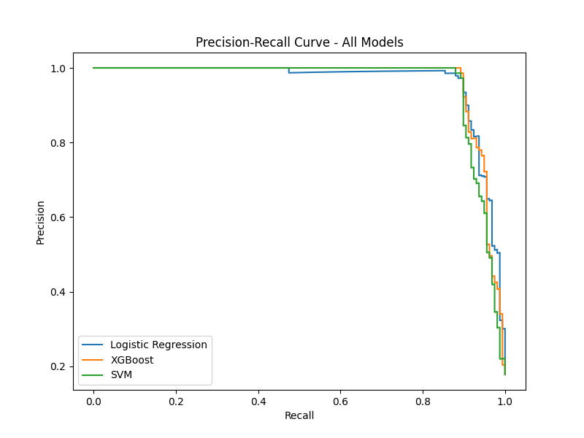
Precision-Recall Curve
This curve focuses on the fraud detection performance by plotting precision versus recall.
High precision ensures few false positives (wrongly predicting legit as fraud).
High recall ensures most frauds are caught.
Logistic Regression maintains strong precision and recall balance, slightly outperforming others.
XGBoost shows very high precision with slightly lower recall, meaning it is stricter and more cautious in predicting frauds.
SVM maintains high precision but has a slightly sharper drop in recall compared to the other two models.
Overall, all three models perform very well, indicating that they are capable of both correctly catching fraud and minimizing false alarms.

Slide 19
CONCLUSION
Machine learning models can effectively detect fraud even in highly imbalanced datasets.
Using a 5:1 undersampling ratio helped balance the data and improve model focus on fraud detection.
Logistic Regression achieved the highest AUC and strong overall precision-recall balance, making it a reliable choice.
XGBoost delivered slightly higher precision but was more aggressive, making it ideal for stricter production environments.
SVM also performed well, but with slightly lower recall compared to Logistic Regression.
In real-world systems, banks can use Logistic Regression for auditing and compliance, and XGBoost for real-time fraud detection where minimizing false positives is critical.

Slide 20
Literature
This credit card fraud dataset was first studied by Dal Pozzolo et al. (2015) with a focus on imbalanced classification and probability calibration.
Researchers mainly used Smote techniques and models like Random Forests.
The task is well studied, but every project varies in the choice of balancing strategy and model evaluation focus.
Major novelty of this project:
Carefully balanced simple undersampling (5:1),
Compared three different model families (linear, tree, margin-based),
Evaluated using multiple metrics to reflect real-world deployment concerns (precision, recall, AUC).

Slide 21

Future Work
Explore
Explore SMOTE oversampling to improve fraud recall without discarding legit samples.
Test
Test deep learning models (e.g., Autoencoders, LSTMs) on raw transaction sequences.
Implement
Implement cost-sensitive learning, assigning higher penalties to missing frauds.
Deploy
Deploy models into a real-time fraud detection system using streaming frameworks like Apache Kafka + Spark Streaming.
Investigate
Investigate ensemble stacking of Logistic Regression, XGBoost, and SVM to improve overall performance.
Apply
Apply explainable AI techniques (e.g., SHAP values) to interpret individual fraud predictions better for audit teams.

Slide 22
THANKYOU

