Slide 1
SRI SIDDHARTHA INSTITUTE OF TECHNOLOGY
DEPARTMENT OF INFORMATION SCIENCE AND ENGINEERING
ACADEMIC WEB DEVELOPMENT PROJECT
Onyx Reserve
A high-performance luxury automotive rental portal
TECHNICAL STACK
FOCUS AREA
HTML5 • CSS3 • PYTHON
Responsive Semantic UI
Presented by
Project Guide
Mohammed Saquib - 25ISO67
Manu MJ - 25IS061
Mrs. Rohini K S

Slide 2
INDUSTRY FRICTION
Lightweight by Design-
Beyond JavaScript
Modern automotive portals depend on heavy runtime frameworks for basic promotional layouts.
This template proves pure HTML5 semantics and CSS3 achieve superior performance and visual depth.

Slide 3

CORE MANDATES
Project Objectives
Semantic Structure
CSS-Only Logic
Fluid Adaptability
Native HTML5 tags over generic nesting.
Declarative styling without JavaScript overhead.
Seamless mobile execution via media queries.

Slide 4

AUDIENCE PROFILE
Primary Demographics
Corporate Executives: Streamlined premium booking flow.
Automotive Enthusiasts: Deep technical telemetry and
specifications.
High-Net-Worth Individuals: Frictionless luxury experience.

Slide 5

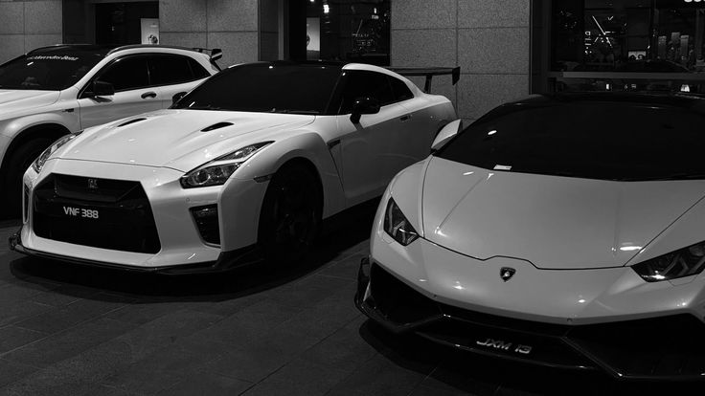
SYSTEM CAPABILITIES
Core Features
Dynamic Telemetry: Hover-activated CSS specification grids.
Sticky Navigation: CSS-driven scroll behavior and blur backing.
Native Validation: Browser-level form data checking.
Dark Aesthetics: High-contrast vanity layouts.

Slide 6
APPLICATION STRUCTURE
Site Architecture
01
02
03
04
Home
Fleet Catalog
Specs Matrix
Booking Gateway
Hero landing and brand introduction.
Grid-based vehicle inventory.
Tabular telemetry and performance data.
Native HTML5 consultation forms.

Slide 7
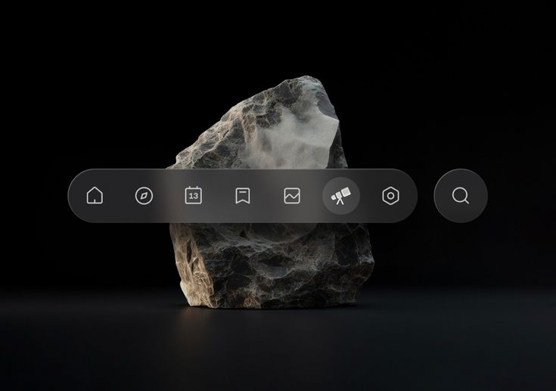
UI ANATOMY
Visual Strategy
Glassmorphism
Transparent backdrop-filter effects.
Deep Neutrals
High contrast visual foundation.
Performance Typography
Plus Jakarta Sans hierarchy mapping.

Slide 8
TECHNICAL FOUNDATION
Engineering Stack
HTML5 Structure
CSS3 Presentation
Semantics: Structured document layout tree.
Architecture: Flexbox and Grid systems.
Data Layout: Accessible table architectures.
Variables: Centralized token mapping.
Validation: Required input attributes.
Interactions: Hardware-accelerated transforms.

Slide 9
ROADMAP
Next Development Phases
Backend Integration: Python and Flask server-side routing.
Data Management: Dynamic inventory. Updates and manages data.
Payment Gateway: Secure transaction processing capabilities.

Slide 10
CONCLUSION
The website offers a fast and modern platform for hiring performance cars.
It successfully links a custom HTML and CSS frontend with a Python server to handle user data.
It features a fleet of cars, detailed technical specifications, and a functional booking form.
Adding online payments and user accounts would make it ready for real-world business deployment.

Slide 11
DEMONSTRATION & VIVA
Thank You
The current project connects a responsive customer-facing website, dynamic fleet browsing, detailed technical specifications, and booking validation through a Python Flask backend into one seamless application.

