Slide 1

FIR FILING SYSTEM
Database Management System (CSBB204)

Slide 2
INTRoduction
The Challenge
Traditional paper based FIR management system is prone to inefficiencies.
Regular Errors in filling FIR due to inexperience.
Key Objective
To create a digital centralized FIR filling system to streamline reporting procedures.
To auto-suggest appropriate Acts & Sections based on FIR to improve accuracy.

Slide 3
Technical APproach
Data Storage :
Using MySQL to store the records in appropriate tables
User Interface:
Using CSS JavaScript to design a user friendly easy to use interface.
Server :Using nodeJS for creating a server which processes each request made by user.

Slide 4
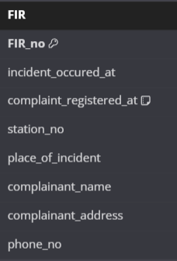
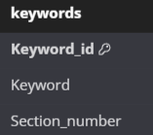
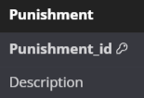
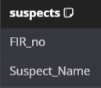
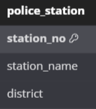
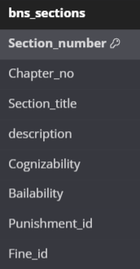
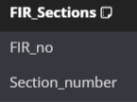
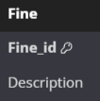

ER DIAGRAM

Slide 5
User Friendly INterface
Easy to use
User-Centric Design
Our user interface is designed to be intuitive and easy to navigate, requiring minimal prior experience.
A 'Help' option offers comprehensive guidance.
Our user-friendly home page presents every function clearly and simply, ensuring intuitive navigation.
Visual elements like pictures and flashcards add to the aesthetic appeal.
The design mimics official government websites, aligning with users' expectations for a familiar, trustworthy interface.

Slide 6
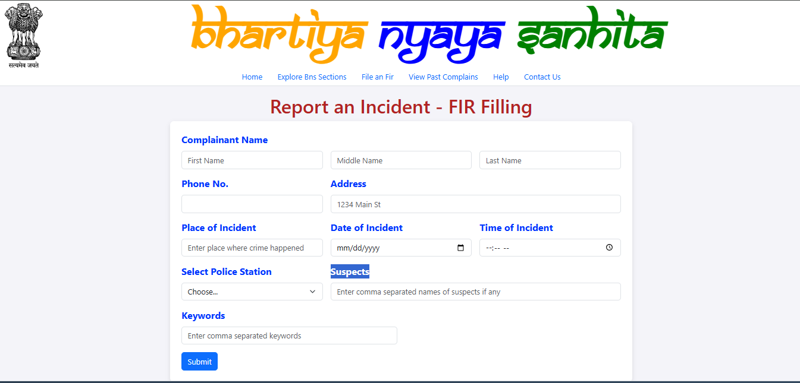

Slide 7
KEY Features
Automated Act and Section Selection
Explore BNS Sections
Auto-fills relevant legal acts and sections based on keywords during FIR filing.
Enhances accuracy by matching keywords with appropriate legal codes.
Dedicated section for browsing all chapters and acts in the Bharatiya Nyay Sanhita (BNS).
Provides brief overviews of each section for quick reference.
Simplifies access to legal information for better understanding and transparency.

Slide 8
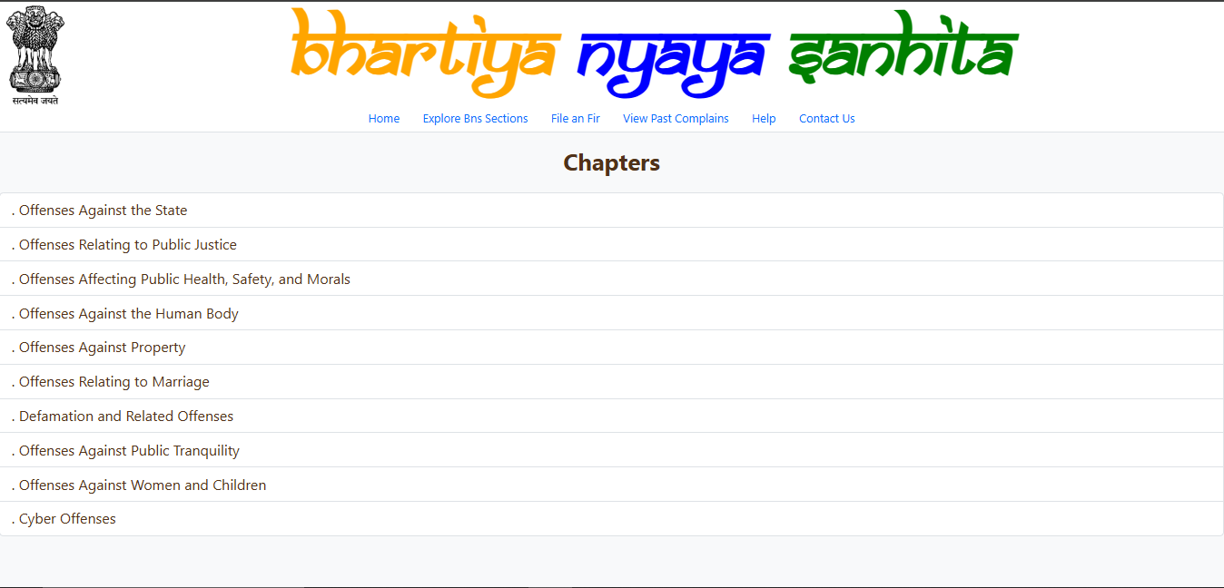



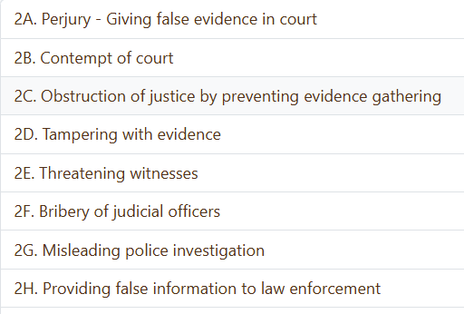
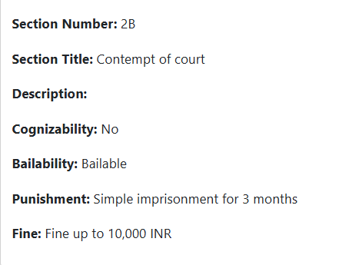

Slide 9
Search and Retrieval Functionality
Comprehensive Search
Detailed Reporting
Users will be able to search the FIR database using a variety of criteria, such as incident location, date, suspect information, and case status.
The system will generate detailed reports, including case summaries, crime statistics, and trend analyses, to support data-driven decision-making and resource allocation.

Slide 10
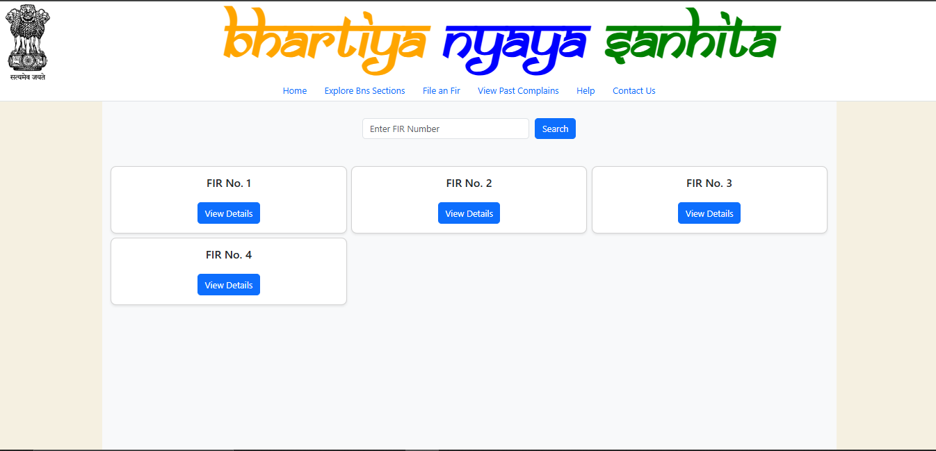

Slide 11
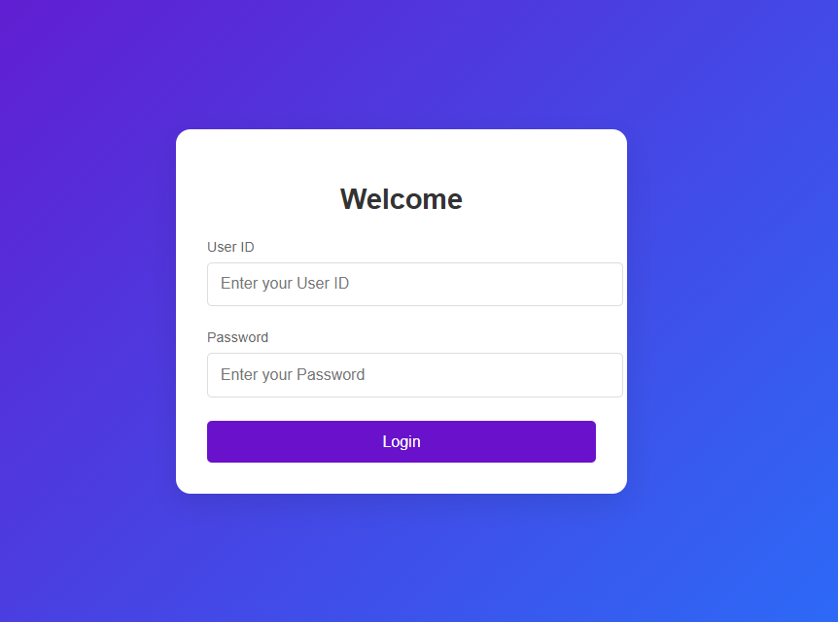
Security Features
Secure Login System
Our website incorporates a secure login mechanism, requiring users to input their User ID and Password.
Users cannot directly interact with or manipulate the database.
Critical information like FIR records, complainant details, and suspects remain protected, ensuring secure data storage.

Slide 12
THANK YOU
Sarthak Tomar (231210092)
Mohammad Tabseer (231210069)
Sandeep Moharana (231210091)

