Slide 1
One-Way ANOVA Cohen Chapter 12
EDUC/PSY 6600
Notes:
Code for the example:
library(tidyverse)
df <- data_frame(
outcome = c(8,10,9,10,9,7,8,5,8,5,4,8,7,5,7),
group = c(rep(1, 5), rep(2, 5), rep(3, 5))
) %>%
mutate(group = factor(group, labels = c("A", "B", "C")))
df %>%
group_by(group) %>%
furniture::table1()df %>%
ggplot(aes(group, outcome)) +
geom_jitter(alpha = .5) +
geom_boxplot(alpha = .5) +
theme_minimal()

Slide 2
“It is easy to lie with statistics. It is hard to tell the truth without statistics.” -Andrejs Dunkels

Slide 3
Motivating examples
Dr. Vito randomly assigns 30 individuals to 1 of 3 study groups to evaluate whether one of 2 new approaches to therapy for adjustment disorders with mixed anxiety and depressed mood are more effective than the standard approach. Participants are matched on current levels of anxiety and depressed mood at baseline. Scores from the BAI and BDI are collected after 2 months of therapy.
Dr. Creft wishes to assess differences in oral word fluency among three groups of participants: Right hemisphere stroke, left hemisphere stroke, and healthy controls. Scores on the COWAT are collected from 20 participants per group and the means of each group are compared.

Slide 4
Research Design Vocab
Experimental design
Participants are randomly assigned to levels and at least one factor is manipulated
Participants are randomly selected from multiple preexisting (observed) populations
Fixed or random effects
Fixed effects design: Levels of each factor systematically chosen by researcher
Random factors design: Levels of each factor are chosen randomly from a larger subset (rarer)
Independent (Between-Subjects) or Repeated (Within-Subjects) factors
Independent: Participants randomly allocated to each level of a factor
Repeated measures design: Participants are paired or a dependency exists (multiple observations)

Slide 5
Research Design Vocab
Experimental design
Participants are randomly assigned to levels and at least one factor is manipulated
Participants are randomly selected from multiple preexisting (observed) populations
Fixed or random effects
Fixed effects design: Levels of each factor systematically chosen by researcher
Random factors design: Levels of each factor are chosen randomly from a larger subset (rarer)
Independent (Between-Subjects) or Repeated (Within-Subjects) factors
Independent: Participants randomly allocated to each level of a factor
Repeated measures design: Participants are paired or a dependency exists (multiple observations)
If the levels of the grouping variable are highly ordinal or continuous in nature, regression or a rank type test will be more powerful than ANOVA
ANOVA is appropriate in cases where the groups are more nominal in nature.
Some variables can be construed as both!!! (e.g. Grade level)
probably want to analyze both ways

Slide 6
Analysis of Variance (ANOVA)
ANOVA designs can be used for…
Experimental research
Quasi-experimental studies
Field/observational research
Other names for 1-way ANOVA…
Single factor ANOVA
Univariate ANOVA
Simple ANOVA
Independent-ANOVA
Between-subjects ANOVA
Omnibus test for group (MEAN) differences
ONE Dependent Variable (DV)
“outcome”
Continuous (interval/ratio)
&
normally distributed
ONE Independent Variable (IV)
“predictor”
Categorical (nominal)
≥ 3 independent samples or groups
Factor with k levels

Slide 7
Example: noise & words memorized
Study to determine if noise inhibits learning (N = 15)
Students randomized to 1 of 3 groups (k = 3 & n = 5)
IV = grouping factor with 3 levels
Group A: No noise (no music, quiet room)
Group B: Moderate noise (classical music)
Group C: Extreme noise (rock music)
Participants are given 1 minutes to memorize list of 15 nonsense words
DV = # of correct nonsense words recalled

Slide 8
Steps of a Hypothesis test
State the Hypotheses (Null & Alternative)
Select the Statistical Test & Significance Level
Examples include: z, t, F, χ²
α level (commonly use .05)
One vs. Two tails (usually prefer 2)
Select random samples and collect data
Find the region of Rejection
Based on α & # of tails
Calculate the Test Statistic
Select the appropriate formula
May need to find degrees of freedom
Make the Statistical Decision

Slide 9
Hypotheses of ANOVA
Example: Noise & Words Memorized
Null Hypothesis:
The number of words recalled is the same regardless of the music/noise.
H₀: μ_{none} = μ_{moderate} = μ_{extreme}
Alternative Hypothesis:
At least one music/noise level results in a different number of words recalled.
H₁: Not H₀
Means: μ₁, μ₂, μ₃,…,μ_{k}
Variances: σ₁², σ₂², σ₃²,…, σ_{k}²
Many ways to reject H₀
NOT H₁: μ₁ ≠ μ₂ ≠ μ₃ ≠ μ_{k}
H₀: μ₁ = μ₂ = μ₃ =…= μ_{k}
H₁: Not H₀

Slide 10
Example: noise & words memorized
1. Enter data into R
# A tibble: 15 x 2
outcome group
<dbl> <fct>
1 8. A
2 10. A
3 9. A
4 10. A
5 9. A
6 7. B
7 8. B
8 5. B
9 8. B
10 5. B
11 4. C
12 8. C
13 7. C
14 5. C
15 7. C
2. Calculate the Group Means
3. Visualize the data
df %>%
group_by(group) %>%
furniture::table1(outcome)
───────────────────────────────────────
group
A B C
n = 5 n = 5 n = 5
outcome
9.2 (0.8) 6.6 (1.5) 6.2 (1.6)
───────────────────────────────────────
IV (groups)
DV (outcome)

Slide 11
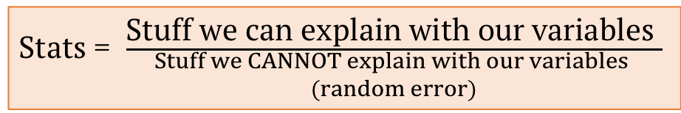
Link: Independent sample “t-test” & ANOVA
Same principle underlies many statistical tests
Stats = $\frac{\text{Stuff} \text{we} \text{can} \text{explain} \text{with} \text{our} \text{variables} }{\begin{aligned}Stuff we CANNOT explain with our variables \\ (random error)\end{aligned}}$
Numerator
MS_{B} : Compute variance between (among) sample means, multiply by n_{j}
Denominator
MS_{W} : Compute average of sample variances

Slide 12
Link: Independent sample “t-test” & ANOVA
Same question as before…
Do group means significantly differ?
Or…Do mean differences on DV ‘between’ groups EXCEED differences ‘within’ groups?
Between-groups differences
Differences in DV due to IV (group)
Within-groups differences
Differences in DV due to pooled random error or variation
Same analysis approach as before…

Slide 13
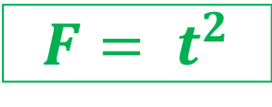
Link: Independent sample “t-test” & ANOVA
Same question as before…
Do group means significantly differ?
Or…Do mean differences on DV ‘between’ groups EXCEED differences ‘within’ groups?
Between-groups differences
Differences in DV due to IV (group)
Within-groups differences
Differences in DV due to pooled random error or variation
Same analysis approach as before…
$$F= t^{2}$$

Slide 14
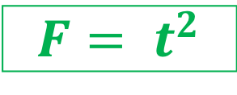
Link: Independent sample “t-test” & ANOVA
Same question as before…
Do group means significantly differ?
Or…Do mean differences on DV ‘between’ groups EXCEED differences ‘within’ groups?
Between-groups differences
Differences in DV due to IV (group)
Within-groups differences
Differences in DV due to pooled random error or variation
Same analysis approach as before…
$$F= t^{2}$$

Slide 15
Link: Independent sample “t-test” & ANOVA
Same question as before…
Do group means significantly differ?
Or…Do mean differences on DV ‘between’ groups EXCEED differences ‘within’ groups?
Between-groups differences
Differences in DV due to IV (group)
Within-groups differences
Differences in DV due to pooled random error or variation
Same analysis approach as before…
$$F= t^{2}$$

Slide 16
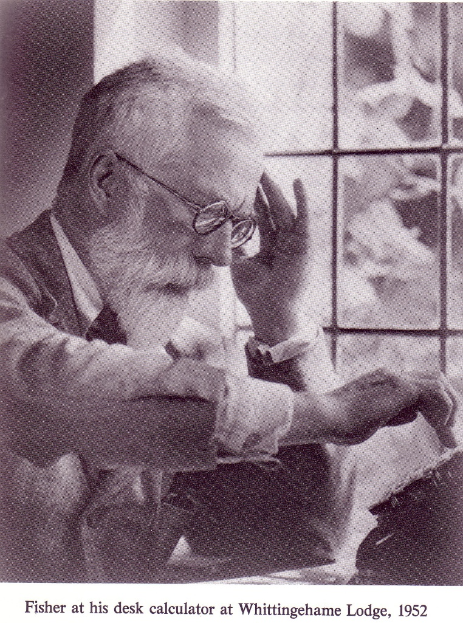
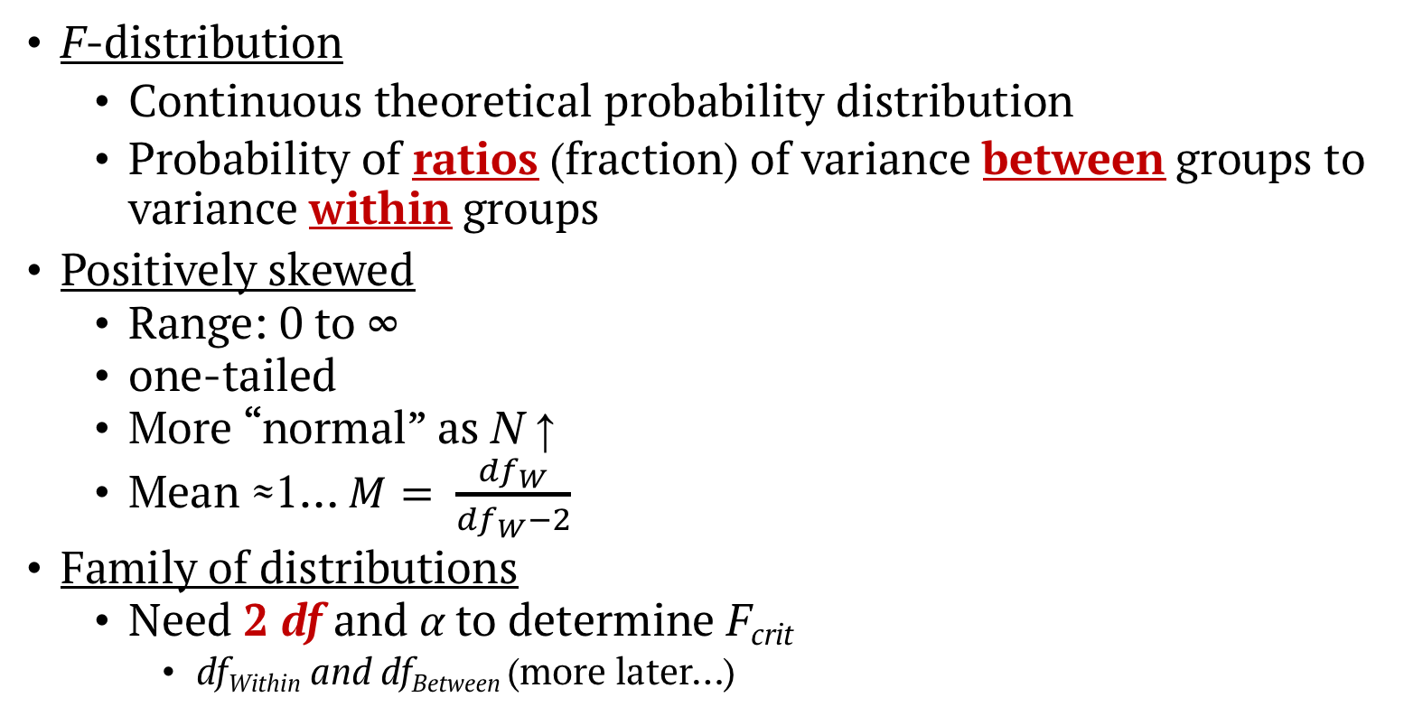
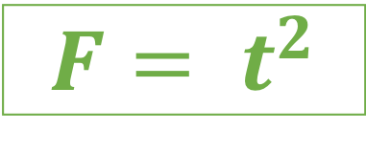
F-distribution
F-distribution
Continuous theoretical probability distribution
Probability of ratios (fraction) of variance between groups to variance within groups
Positively skewed
Range: 0 to ∞
one-tailed
More “normal” as N ↑
Mean ≈1… $M= \frac{{df}_{W}}{{df}_{W}−2}$
Family of distributions
Need 2 df and α to determine F_{crit}
df_{Within} and df_{Between} (more later…)
$$F= t^{2}$$
Sir Ronald A. Fisher (1920-40’s) & agricultural experiments…

Slide 17
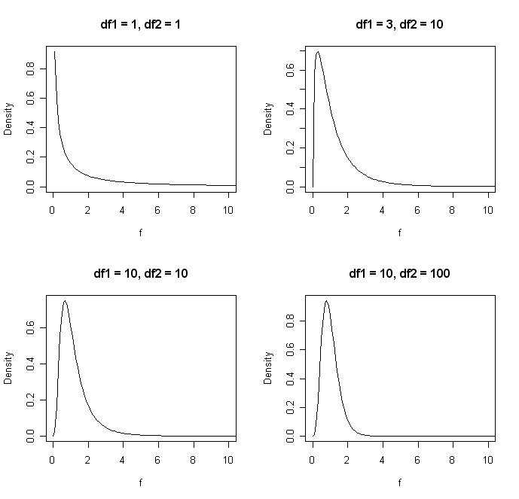
Sir Ronald A. Fisher (1920-40’s) & agricultural experiments…

Slide 18
Link: Independent sample “t-test” & ANOVA
Specific situation: 2 groups, when n₁ = n₂
Numerator: Variation between (among) group means
‘Variance’ of 2 means multiplied by n_{i}
Mean Square Between (MS_{B}) or Mean Square Treatment (MS_{T})
Denominator: Pooled variation within groups
Pooled variance (s_{p}²) = average of 2 variances when ns are equal
Mean Square Within (MS_{W}) or Mean Square Error (MS_{E})

Slide 19
Link: Independent sample “t-test” & ANOVA
‘Mean Square’ or MS
is another term for the variance
‘Square’: Refers to the sum of SQUARED (SS) deviations from the mean
Mean: AVERAGE of the SS deviations
SS is divided by N or N - 1 to yield variance
So, Mean of the sum of SQUARED deviations = Variance
All we want to know is whether
variation among group means exceeds that
variation within groups
Will create a ratio of the MSs, the F-statistic, to see if this ratio is significantly different from 1
Specific situation: 2 groups, when n₁ = n₂
Numerator: Variation between (among) group means
‘Variance’ of 2 means multiplied by n_{i}
Mean Square Between (MS_{B}) or Mean Square Treatment (MS_{T})
Denominator: Pooled variation within groups
Pooled variance (s_{p}²) = average of 2 variances when ns are equal
Mean Square Within (MS_{W}) or Mean Square Error (MS_{E})

Slide 20
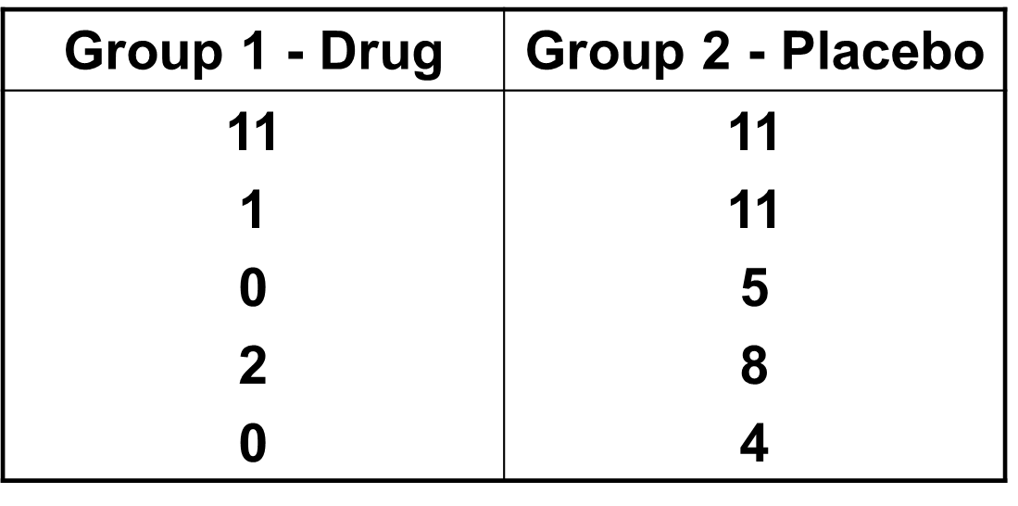

Prior example
Applying data from independent-samples t-test example
(drug v. placebo and depression)
Recall, t = 1.96, p = .085
1.96² = 3.84
$$t^{2}=F$$

Slide 21
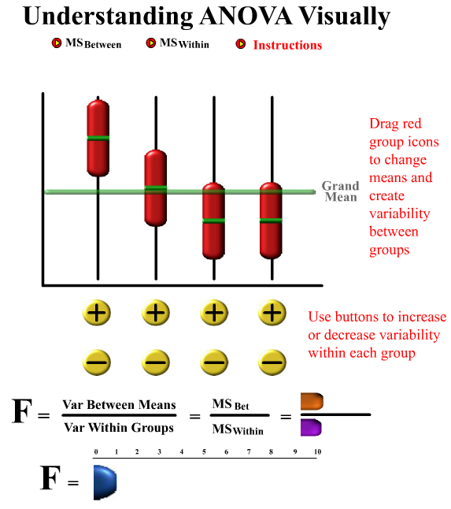
Interactive Applet
http://web.utah.edu/stat/introstats/anovaflash.html

Slide 22
Assumptions
Large or multiple violations will GREATLY increase risk of inaccurate p-values
Increased probability of Type I or II error
Independent, Random Sampling (for the IV) ← ensure by planning ahead!
For preexisting (observed) populations: randomly select a sample from each population
For experimental (assigned) conditions: randomly divide your sample (of convenience) for assignment to groups
Ensure no connection between subjects in the different groups (no matching!) ← MUST!!!
Normally distributed (DV)
Robust requirement…if samples are large, this isn’t as important
If not normal (or small samples)
alternatives: use the Krukal-Wallis H test
HOV: homogeneity of Variance (DV)
Since an average variance is computed for denominator of F-statistic, variance should be similar for all groups: σ₁² = σ₂² = σ₃² = … = σ_{k}²
σ_{e}², pooled (averaged) variance, must be representative of each group so that MS_{W} is accurate
Testing: Levene’s Test
All test for HOV are underpowered if samples are small, so you have to use judgement ;)
If NOT HOV
alternatives: Welch, Brown-Forsythe, etc.

Slide 23
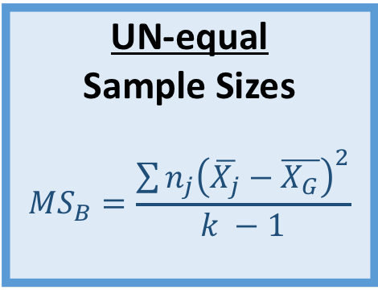

F-statistic: numerator = MS_{B}
Recall from CLT, relationship between
variance of population (σ²) &
variance of SDM (SE² =
One estimate of population variance (σ_{e}²)
Cannot compute population variance of all possible means as we only have a sample
Estimate population variance with sample means and multiply by sample size:
If H₀ true, MS_{B} = σ_{e}²
Have drawn k independent samples
From the SAME population
(i.e. group differences = 0)
Equal
Sample Sizes
$${MS}_{B}=n∙s_{\overline{X}}^{2}$$
UN-equal
Sample Sizes
$${MS}_{B}=\frac{\sum{n_{j}{\left(\overline{X_{j}}−\overline{X_{G}}\right)}^{2}}}{k −1}$$
If H₀ false, MS_{B} ≠ σ_{e}²
MS_{B} reflects BOTH
population variance
AND
group differences

Slide 24

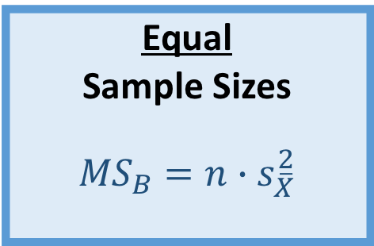

Example: noise & words memorized
───────────────────────────────────────
group
A B C
n = 5 n = 5 n = 5
outcome
9.2 (0.8) 6.6 (1.5) 6.2 (1.6)
───────────────────────────────────────
1. Find grand mean:
2. Find the SD of the means:
3. Multiply by n
$\overline{X_{G}}=\frac{9.2+6.6+6.2}{3}=\frac{22}{3}=7.33$
$$s_{\overline{X}}^{2}=\frac{{\left(9.2−7.33\right)}^{2}+{\left(6.6−7.33\right)}^{2}+{\left(6.2−7.33\right)}^{2}}{3−1}=\frac{5.3067}{2}=2.65$$
Equal
Sample Sizes
$${MS}_{B}=n∙s_{\overline{X}}^{2}$$
$${MS}_{B}=5∙2.65=13.267$$

Slide 25

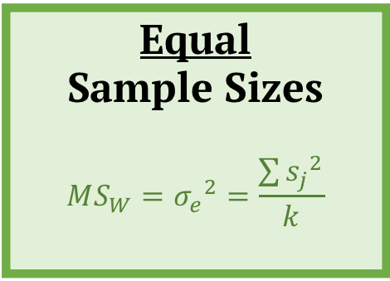
F-statistic: denominator = MS_{W}
Second estimate of population variance (σ_{e}²)
Pooling sample variances yields best estimate
σ₁²= s₁² ; σ₂²= s₂²; … ; σ_{j}² = s_{j}²
Average subgroup (j) variance: σ_{e}² = s_{e}²
Goal should be to obtain equal ns
BUT…
1 group > 50% larger other group: too much
k = # subgroups
j denotes the j-th subgroup
Regardless of whether H₀ true:
MS_{W} = σ_{e}²
Not affected by group MEANS
Equal
Sample Sizes
$${MS}_{W}={σ_{e}}^{2}=\frac{\sum{{s_{j}}^{2}}}{k}$$
UN-equal
Sample Sizes
$${MS}_{W}={σ_{e}}^{2}=\frac{\sum{{{\left(n_{j}−1\right)s}_{j}}^{2}}}{n_{T}−k}$$

Slide 26
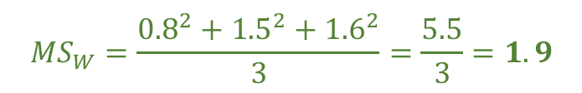
Example: noise & words memorized
1. Average the VARIANCES’s:
───────────────────────────────────────
group
A B C
n = 5 n = 5 n = 5
outcome
9.2 (0.8) 6.6 (1.5) 6.2 (1.6)
───────────────────────────────────────
$${MS}_{W}=\frac{{0.8}^{2}+{1.5}^{2}+{1.6}^{2}}{3}=\frac{5.5}{3}=1.9$$
Equal
Sample Sizes
$${MS}_{W}={σ_{e}}^{2}=\frac{\sum{{s_{j}}^{2}}}{k}$$

Slide 27
Logic of “anova”
In ANOVA, 2 independent estimates of same population (error) variance are computed: σ², now called σ_{e}²
MS_{B} : Variance between group means corrected by sample sizes (n_{j})
MS_{W} : Average variance within groups
Ratio of 2 estimates of population variance
Hence the term Analysis of Variance, instead of something related to means comparisons (even though that is what we are interested in doing)
Increased variance among means indicates means are spread out & likely differ from one another or come from different populations
Large F-ratio indicates differences among means is NOT likely due to chance
ANOVA is
Between-Group Measure of Variation Due to Estimate of Random Variation (Error)
+
Effect of IV (Group)
Within-Group Estimate of
Random Variation (Error)

Slide 28
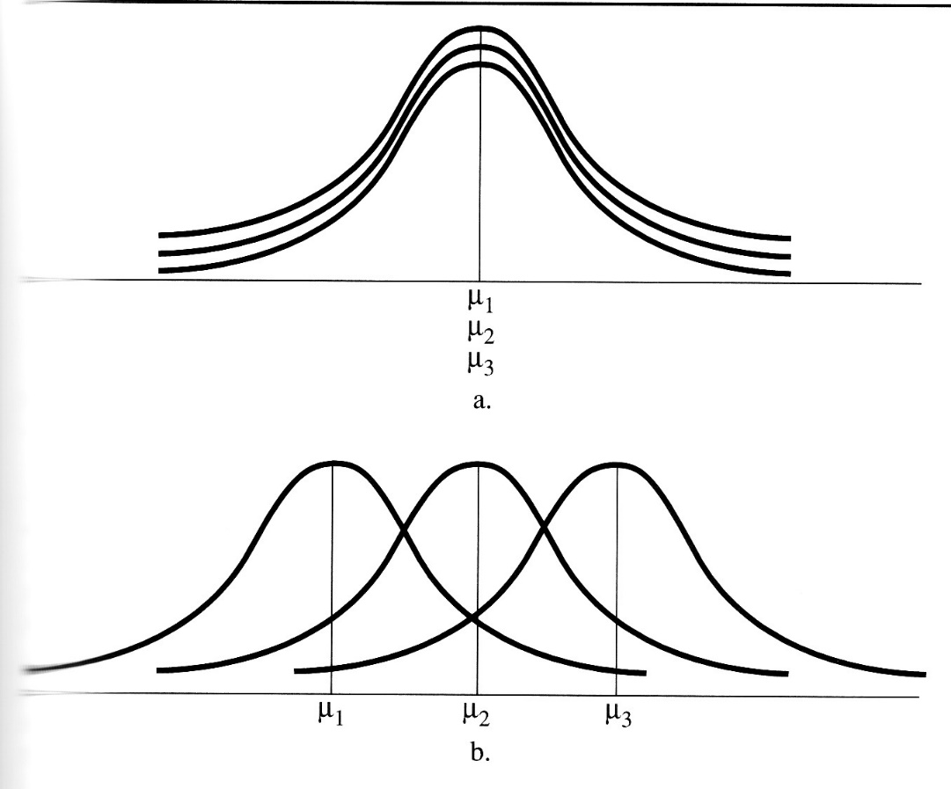
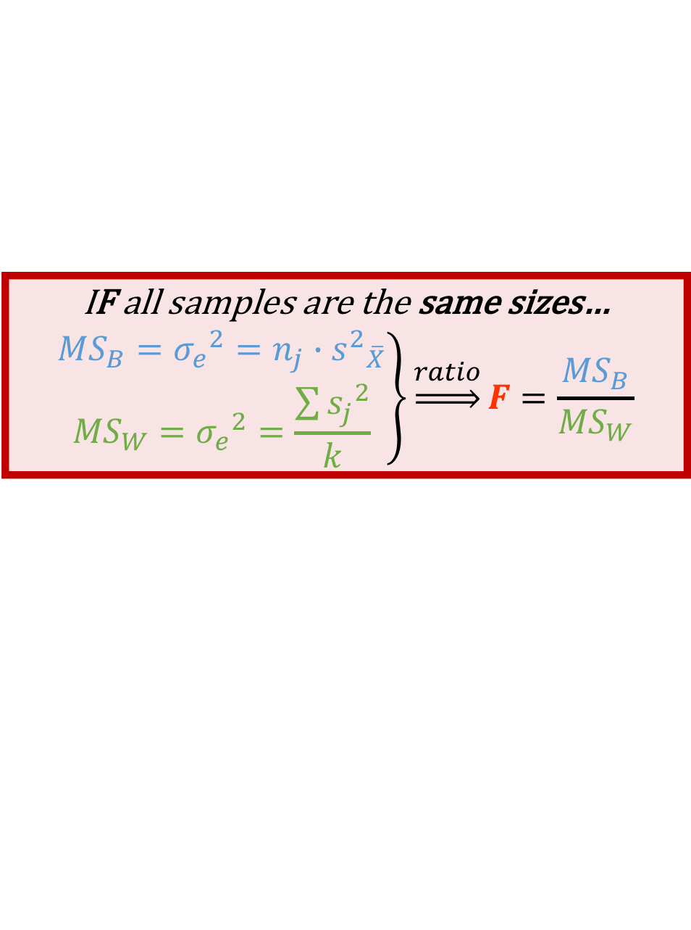
Logic of “anova”
IF all samples are the same sizes…
$$\left.\begin{matrix}{MS}_{B}={σ_{e}}^{2}=n_{j}∙{s^{2}}_{\overline{X}} \\ {MS}_{W}={σ_{e}}^{2}=\frac{\sum{{s_{j}}^{2}}}{k}\end{matrix}\right\}\underset{⇒}{ratio}F=\frac{{MS}_{B}}{{MS}_{W}}$$
When estimates of σ_{e}² (variances) are…
Equal: Fail to reject H₀
All means come from same population
Both are estimates of the same population variance σ_{e}²
F-ratio ≈ 1
Unequal: Reject H₀
Unlikely that all means come from same population
Effect of IV surpasses random error/variation within groups
F-ratio significantly > 1, MS_{B} > MS_{W}

Slide 29
CALCULATIONS:
SUMMARY STATS KNOWN
(shown on previous few slides)
SUM OF SQUARES (SS) APPROACH
(alternate formulas here)
2 Approaches
Can ‘partition’ total variation in DV due to group effects (IV) and error
SS_{Total} = SS_{Between} + SS_{Within}

Slide 30



Total
How different are ALL individuals from the “GRAND MEAN”
Inner Sum: individuals in each subgroup
Outter Sum: subgroups in the whole
Between
How different are “GROUP MEANS” from the “GRAND MEAN”
Within
How different are individuals from their “GROUP’s MEAN”
Inner Sum: individuals in each subgroup
Outter Sum: subgroups in the whole
$${df}_{T}=n_{T}−1$$
$${df}_{B}=k−1$$
$${df}_{w}=n_{T}−k$$
Can ‘partition’ total variation in DV due to group effects (IV) and error
SS_{Total} = SS_{Between} + SS_{Within}

Slide 31
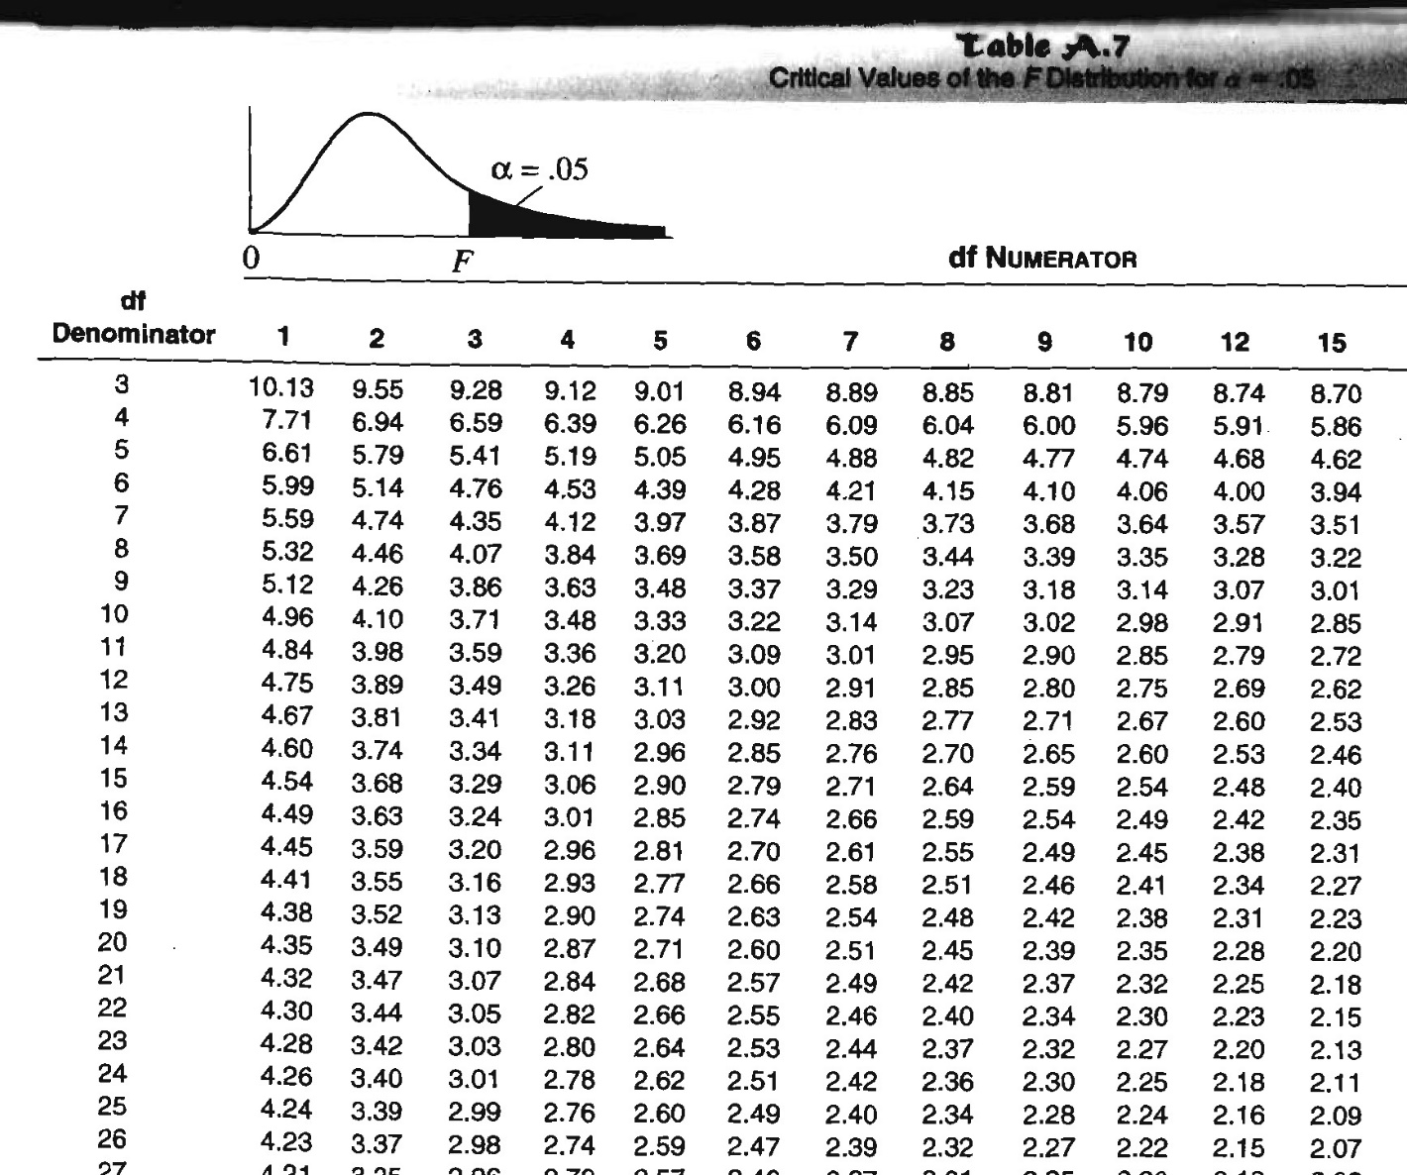
F-statistic
F_{crit} → F-distribution table
(different table per α)
Across the top: find df_{B}
Down the side: find df_{W}
If H₀ is true, MS_{B} = MS_{W}
F-statistic ≈ 1
Both are estimates of variance of same population
If H₀ is false, MS_{B} > MS_{W}
F-statistic exceeds F_{crit} by some amount
At least one mean significantly differs from another

Slide 32



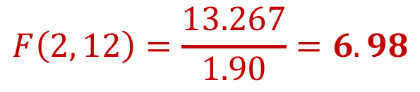
Example: noise & words memorized
Test statistic: F-score observed
Critical Value: F-crit for α=.05
$$df= \left(3−1, 15−3\right)=\left(2, 12\right)$$
$${MS}_{B}=13.267$$
$${MS}_{W}=1.9$$
$$F\left(2, 12\right)=\frac{13.267}{1.90}=6.98$$

Slide 33

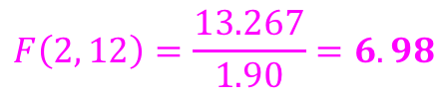
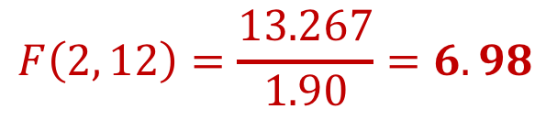
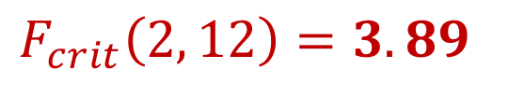
Example: noise & words memorized
Critical Value: F-crit for α=.05
$$F_{crit}\left(2, 12\right)=3.89$$
Test statistic: F-score observed
$$df= \left(3−1, 15−3\right)=\left(2, 12\right)$$
$$F\left(2, 12\right)=\frac{13.267}{1.90}=6.98$$
$$F\left(2, 12\right)=\frac{13.267}{1.90}=6.98$$
Conclusion:
AT LEAST ONE noise/music levels has a different mean # of words memorized.
In fact it is the no noise/music condition that has the most words memorized.
What type of music is playing doesn’t seem to make as much of a difference.

Slide 34
R Code: ANOVA
df %>%
group_by(group) %>%
furniture::table1(outcome)
Same as with t-tests
───────────────────────────────────────
group
A B C
n = 5 n = 5 n = 5
outcome
9.2 (0.8) 6.6 (1.5) 6.2 (1.6)
───────────────────────────────────────
df %>%
car::leveneTest(outcome ~ group,
data = .,
center = mean)
Levene's Test for Homogeneity of Variance (center = mean)
Df F value Pr(>F)
group 2 2.8213 0.09902 .
12
---
Signif. codes: 0 ‘***’ 0.001 ‘**’ 0.01 ‘*’ 0.05 ‘.’ 0.1 ‘ ’ 1
What does this tell us?

Slide 35
R Code: ANOVA
df %>%
group_by(group) %>%
furniture::table1(outcome)
───────────────────────────────────────
group
A B C
n = 5 n = 5 n = 5
outcome
9.2 (0.8) 6.6 (1.5) 6.2 (1.6)
───────────────────────────────────────
df %>%
car::leveneTest(outcome ~ group,
data = .,
center = mean)
Levene's Test for Homogeneity of Variance (center = mean)
Df F value Pr(>F)
group 2 2.8213 0.09902 .
12
---
Signif. codes: 0 ‘***’ 0.001 ‘**’ 0.01 ‘*’ 0.05 ‘.’ 0.1 ‘ ’ 1
aov_4() function performs ANOVA
fit_anova <- df %>%
afex::aov_4(outcome ~ group + (1|id),
data = .)
(1|id) tells it the ID variable

Slide 36
R Code: ANOVA
fit_anova <- df %>%
afex::aov_4(outcome ~ group + (1|id),
data = .)
fit_anova
fit_anova$anova
Anova Table (Type 3 tests)
Response: outcome
Effect df MSE F ges p.value
1 group 2, 12 1.90 6.98 ** .54 .010
---
Signif. codes: 0 ‘***’ 0.001 ‘**’ 0.01 ‘*’ 0.05 ‘+’ 0.1 ‘ ’ 1

Slide 37
R Code: ANOVA
fit_anova <- df %>%
afex::aov_4(outcome ~ group + (1|id),
data = .)
fit_anova
fit_anova$anova
Anova Table (Type 3 tests)
Response: outcome
Effect df MSE F ges p.value
1 group 2, 12 1.90 6.98 ** .54 .010
---
Signif. codes: 0 ‘***’ 0.001 ‘**’ 0.01 ‘*’ 0.05 ‘+’ 0.1 ‘ ’ 1
Anova Table (Type III tests)
Response: dv
Sum Sq Df F value Pr(>F)
(Intercept) 806.67 1 424.5614 9.847e-11 ***
group 26.53 2 6.9825 0.009745 **
Residuals 22.80 12
---
Signif. codes: 0 ‘***’ 0.001 ‘**’ 0.01 ‘*’ 0.05 ‘.’ 0.1 ‘ ’ 1

Slide 38
R Code: ANOVA
fit_anova <- df %>%
afex::aov_4(outcome ~ group + (1|id),
data = .)
fit_anova
fit_anova$anova
Reaches into the fit_anova object and grabs this more informative table
Anova Table (Type 3 tests)
Response: outcome
Effect df MSE F ges p.value
1 group 2, 12 1.90 6.98 ** .54 .010
---
Signif. codes: 0 ‘***’ 0.001 ‘**’ 0.01 ‘*’ 0.05 ‘+’ 0.1 ‘ ’ 1
Anova Table (Type III tests)
Response: dv
Sum Sq Df F value Pr(>F)
(Intercept) 806.67 1 424.5614 9.847e-11 ***
group 26.53 2 6.9825 0.009745 **
Residuals 22.80 12
---
Signif. codes: 0 ‘***’ 0.001 ‘**’ 0.01 ‘*’ 0.05 ‘.’ 0.1 ‘ ’ 1

Slide 39
R Code: ANOVA
df %>%
ggplot(aes(group, means)) +
stat_summary()

Slide 40
Measures of Association
Term preferred over “Effect size” for ANOVA
Amount or % of variation in DV explained/accounted for by knowledge of group membership (IV)
Correlation between grouping variable (IV) and outcome variable (DV)
4 measures:
Eta-squared (η²)
Omega-squared (ω²)
Cohen’s f
Intra-class Correlation Coefficients (ρ)
ω² is least biased, but unfamiliarity and ‘difficulty’ of computation have limited use
η² probably sufficient in many cases

Slide 41
Measures of Association: eta-squared
η² : Measure of % reduction in error IN THIS DATA (SAMPLE)
SS_{Total} = Error in DV around grand mean
SS_{Within}= Error around group means
By knowing group membership we reduce error by SS_{Between} = SS_{Total} – SS_{Within}
% reduction in error expressed as:
η² can be biased with sample data
Adjusted η² =
Compute using information from ANOVA summary table
η² = SS_{B} / SS_{T}
η²_{adj} = 1 – (MS_{W} / MS_{T})
Range: 0 to 1
Small: .01 to .06
Medium: .06 to .14
Large: > .14

Slide 42


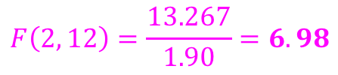
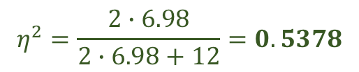
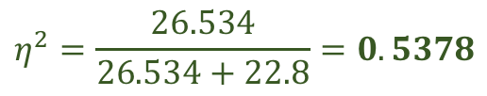
Example: noise & words memorized
${MS}_{W}=1.90\underset{⇒}{"SS = MS/df}{SS}_{B}=1.9∗\left(12\right)=$22.8
$$df= \left(3−1, 15−3\right)=\left(2, 12\right)$$
$$F\left(2, 12\right)=\frac{13.267}{1.90}=6.98$$
${MS}_{B}=13.267\underset{⇒}{"SS = MS/df}{SS}_{B}=13.267∗\left(2\right)=26.53$4
Using SS
Using F & df’s
$$η^{2}=\frac{26.534}{26.534+22.8}=0.5378$$
$$η^{2}=\frac{2∙6.98}{2∙6.98+12}=0.5378$$

Slide 43
Example: noise & words memorized
${MS}_{W}=1.90\underset{⇒}{"SS = MS/df}{SS}_{B}=1.9∗\left(12\right)=$22.8
$$df= \left(3−1, 15−3\right)=\left(2, 12\right)$$
$$F\left(2, 12\right)=\frac{13.267}{1.90}=6.98$$
${MS}_{B}=13.267\underset{⇒}{"SS = MS/df}{SS}_{B}=13.267∗\left(2\right)=26.53$4
Using SS
Using F & df’s
$$η^{2}=\frac{26.534}{26.534+22.8}=0.5378$$
$$η^{2}=\frac{2∙6.98}{2∙6.98+12}=0.5378$$
Conclusion
The type of noise/music in the room accounts for 54% of the variation
in the number of words each person was able to memorize

Slide 44
Measures of Association: OMEGA-squared
ω² : Measure of % reduction in error IN THIS POPULATION (ESTIMATE TRUTH)
Alternative for “fixed-effects” ANOVA
More conservative than η² (and less biased)
Range: 0 to 1 (can be negative when F < 1)
Same interpretation as η²
Compute using information from ANOVA summary table
Equation for fixed effects ANOVA only
Range: 0 to 1
Small: .01 to .06
Medium: .06 to .14
Large: > .14

Slide 45
Measures of association: Cohen’s f
Traditional effect size index
Not a measure of association
Generalization of Cohen’s d to ANOVA
Compute using ANOVA summary information
Converting from f to ω² →

Slide 46
Measures of Association: Intra-class correlation coefficient (ICC)
Measure of association for random-effects ANOVA
At least 6 ICCs available
Type selected depends on data structure
Range: 0 to 1
Commonly used measure of agreement for continuous data
Basic form:
Measures extent to which observations within a treatment are similar to one another relative to observations in different treatments

Slide 47
APA Results
Methods
Describe statistical and sample size analyses
Describe factor and its levels
Results of data screening
Results
Reporting F-test:
F(df_{B}, df_{W}) = F-statistic, p = / <, measure of association and effect/effect size, power (optional)
Don’t need to include MSE (or MS_{W}) as Cohen suggests
Discuss any follow-up tests, if any (next lecture)
Method
“A one-way ANOVA was used to test the hypothesis that the means of the three groups (Control, Moderate Noise, and Extreme Noise) were different following the experiment. A sample size analysis conducted prior to beginning the study indicated that five participants per group would be sufficient to reject the null hypothesis with at least 80% power if the effect size were moderate (Cohen’s f = .95).”
Results
“Results indicated a significant difference among the group means, F(2, 12) = 6.98,
p < .01, ω² = .44”

Slide 48
ANOVA vs. multiple t-tests
Why not run series of independent-samples t-tests?
Could, and will usually get same results, but this approach becomes more difficult under 2 conditions:
Large k
k(k-1) / 2 different t-tests!
Factorial designs
Danger of increased risk of Type I error when conducting multiple t-tests on same data set
In next lecture we explain ways to potentially limit this risk

Slide 49
Power: use G*Power

