Slide 1
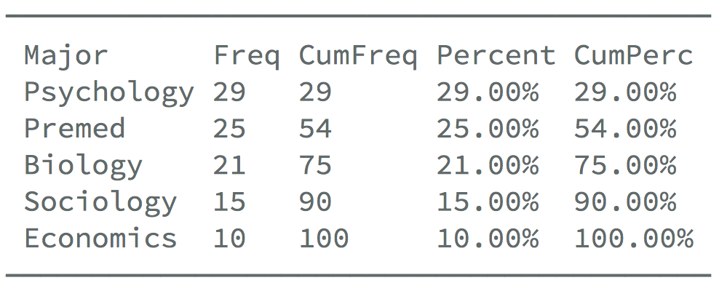
R Cheatsheet for EDUC 6600
Preparing Your Data
**Before starting, load the tidyverse: library(tidyverse)**
1
2.1
2.2
Reading in Your Data
Clean Your Data (Part 1)
Clean Your Data (Part 2)
If your data is a CSV
The pipe %>% takes what is before it and brings it into the next function (can be read as “then”)
factor() creates a categorical variable (nominal)
library(rio)
d <- import(“path/to/my_file.csv”)
d_new <- d %>%
mutate(var_f = factor(var))
# Not real code
me %>% wake_up() %>% exercise() %>%
eat_breakfast() %>% shower()
If your data is an SPSS file
case_when() gives values based on a condition
library(rio)
d <- import(“path/to/my_file.sav”)
Mutate means to add or change a variable
d_new <- d %>%
mutate(v2 = case_when(var == 1 ~ “val”))
d_new <- d %>%
mutate(salary_yr = salary_mnth * 12)
To get the mean of each observation across vars
If your data is an Excel file
library(rio)
d <- import(“path/to/my_file.xlsx”)
Filter means to subset the rows
library(furniture)
d_new <- d %>%
mutate(mean = rowmeans(var1, var2))
d_females <- d %>%
filter(sex == “female”)
If your data is in other formats, come talk to me or Google it
3
Get frequencies of your variables
Get means and SDs of many (or all) of your variables
See your data
library(furniture)
tableF(data, var1)
View(data)
Check Your Data
library(furniture)
table1(data,
var1, var2, var3)
Get a bunch of info
library(psych)
describe(data)

