Slide 1
Chapter 8 Power & Effect Size
For EDUC/PSY 6600

Slide 2
“
Cohen (1994): “Next, I have learned and taught that the primary product of research inquiry is one or more measures of effect size, not p values.” (p. 1310).
Abelson (1995): “However, as social scientists move gradually away from reliance on single studies and obsession with null hypothesis testing, effect size measures will become more and more popular” (p. 47).
”

Slide 3
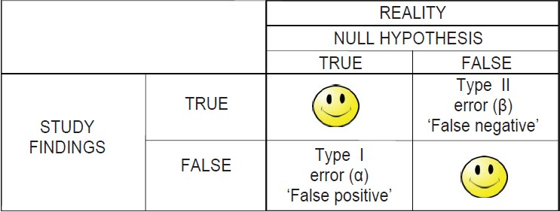
Types of Errors
When we conduct a hypothesis test, we wither reject or fail to reject the Null Hypothesis. Our decision usually causes four outcomes:

Slide 4
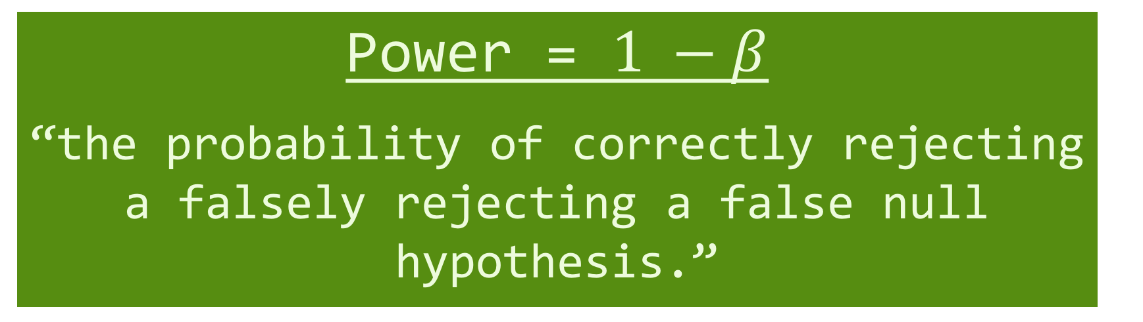
Types of Errors
When we conduct a hypothesis test, we wither reject or fail to reject the Null Hypothesis. Our decision usually causes four outcomes:
Power = $1 −β$
“the probability of correctly rejecting a falsely rejecting a false null hypothesis.”

Slide 5
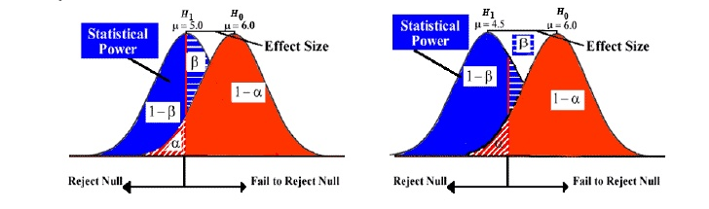
Effect Sizes
Notes:
$η^{2}$and $r_{pb}^{2}$
association between grouping variable (IV) and continuous DV
Ranges from 0 to 1
With only 2 groups,
results are same

Slide 6
Effect Sizes
Cohen’s d | Interpretation
.2 | Small
.5 | Moderate
.8 | Large
Notes:
In standard deviation units

Slide 7

Effect Sizes
$η^{2}$ (eta squared) and $r_{pb}^{2}$
association between grouping variable (IV) and continuous DV
Ranges from 0 to 1
With only 2 groups, results are same

Slide 8
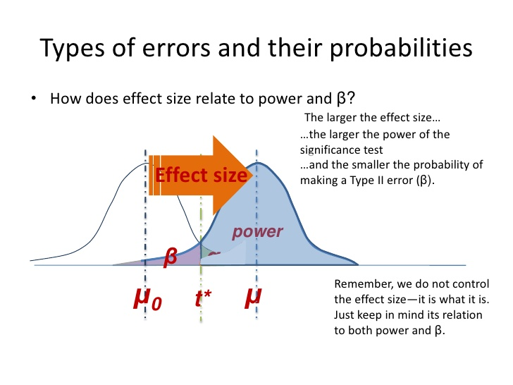
What affects power?
Sample Size
Larger sample = more power
Effect Size
Larger Effect size = more power
Alpha Level
Higher Alphas = more power
Directionality
One tail = more power

Slide 9
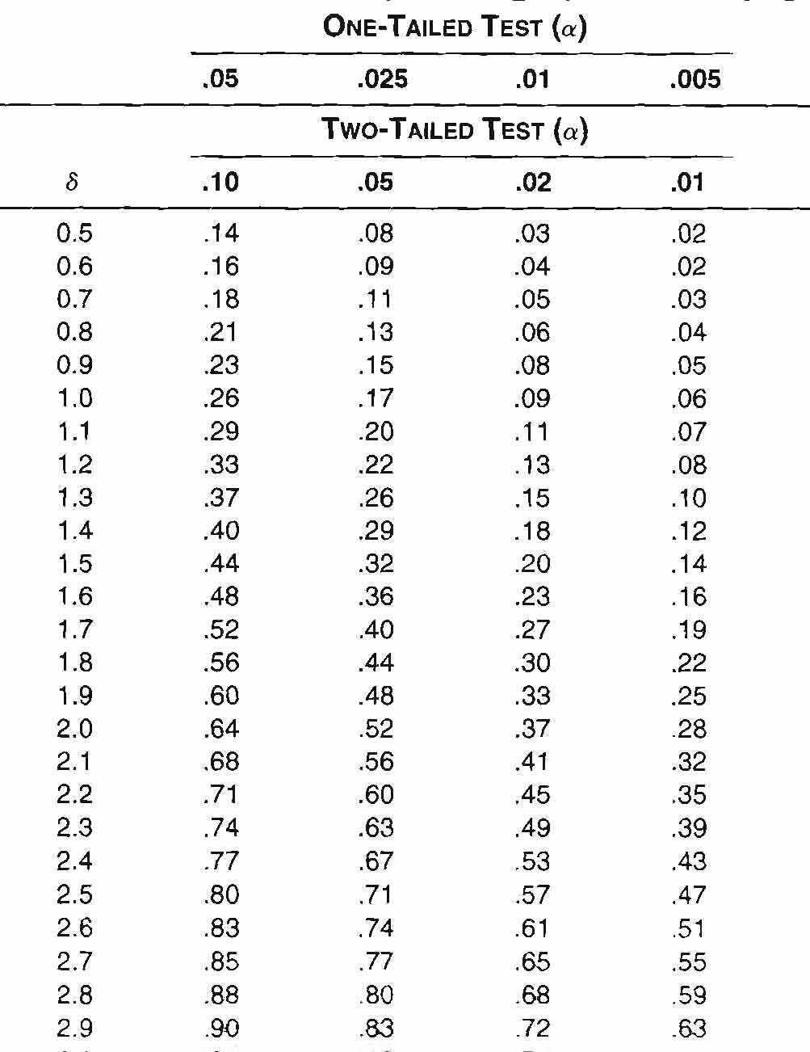
Power Analysis
Non-centrality parameter is calculated by:
Since it’s assumed that the…
Variances are same in 2 groups
ns are same in 2 groups
...and since σ is often assumed to be 1…
…the equation is simplified…

Slide 10
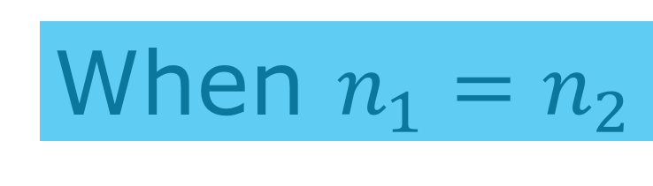
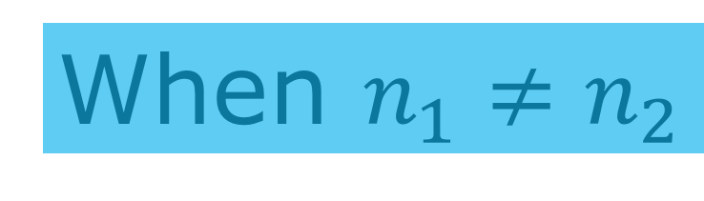
When $n_{1}=n_{2}$
When $n_{1}≠n_{2}$
Notes:
When $n_{1}=n_{2}$
Post hoc
δ → Power via Table A.3
n = # cases in any one group
a priori
n per group necessary for specified power
When $n_{1}≠n_{2}$
Post hoc
Conservative approach: use smaller n in previous formulae
Ineffective if ns vastly different or small
Liberal approach: compute
harmonic (not arithmetic) mean (the top equation)
Then, use the second.
a priori
Always plan for equal n’s
Never throw out data just to make your n’s equal!

Slide 11
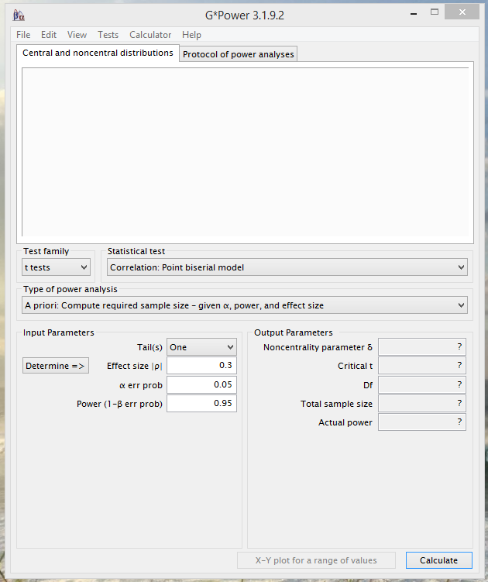
G-Power
Download at: http://www.gpower.hhu.de/

Slide 12
Chap 8: section A
These exercises make it clear to the student that:
d is just the number of standard deviations that separate two population means, and
g is the number of standard deviations (based on pooling the sample variances and taking the square-root) separating the sample means.
Exercise 9 requires students to draw the connection between a calculated t and delta; large ts are usually associated with large deltas, and small ts usually with small deltas. Of course, the alternate hypothesis distribution shows that t can occasionally come out very differently from delta

Slide 13
Chap 8: section B
The most important purpose of these exercises is not to prepare students for power analyses of their own future experiments (although that is one of the purposes), but to deepen students’ understanding of null hypothesis testing, and increase their appreciation for the need to supplement hypothesis testing with estimates of effect size or confidence intervals. Some students get confused when they realize that an estimate of power is only as good as the estimate of effect size upon which it is based, but that determining the effect size is usually the purpose (or should be) of the experiment. … The center of the AHD (i.e., delta) is determined by both the true effect size and the sample sizes. The last few exercises are concerned with refining students’ abilities to estimate the power of a study already conducted.

