Slide 1

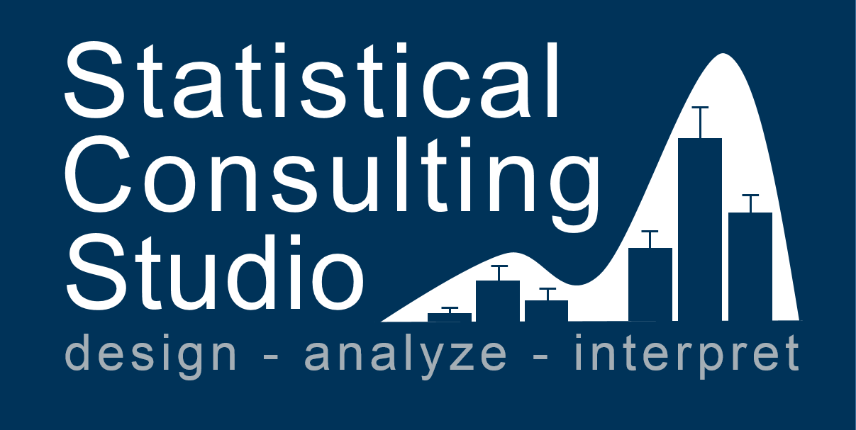

Slide 2
Workshops

Slide 3


Slide 4
Feb. 9, 2018

