Slide 1




What should I“Git”? Building Blocks for Reproducibility
Dr. Sarah Schwartz
Nov. 16, 2018
www.SarahSchwartzStats.com

Slide 2
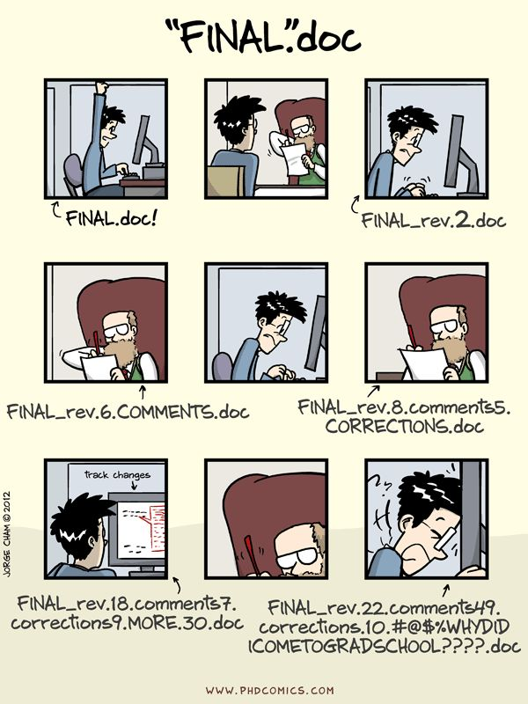

Slide 3
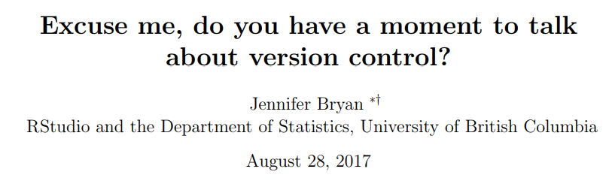
What is version control?
https://pdfs.semanticscholar.org/2575/6e04f126da30e26b447801a5e2d3e51e3154.pdf

Slide 4
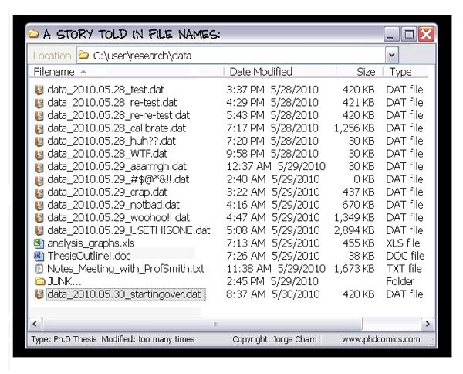

Slide 5
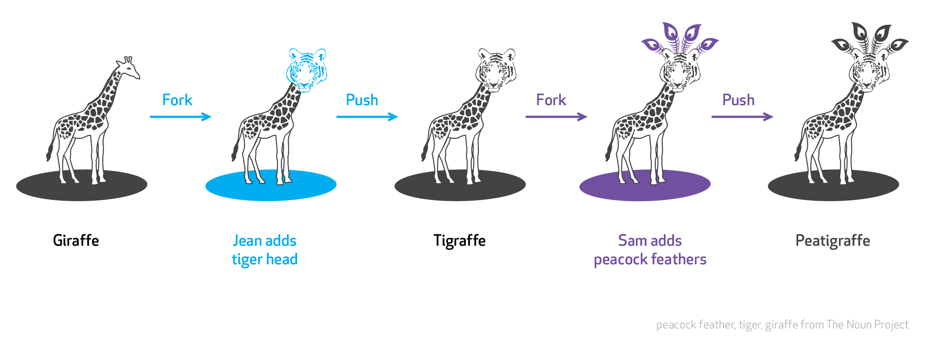

Slide 6
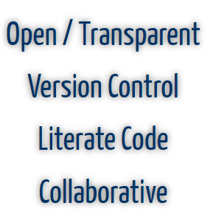
What is Reproducible Research?

Slide 7
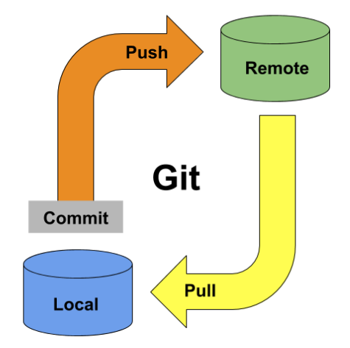
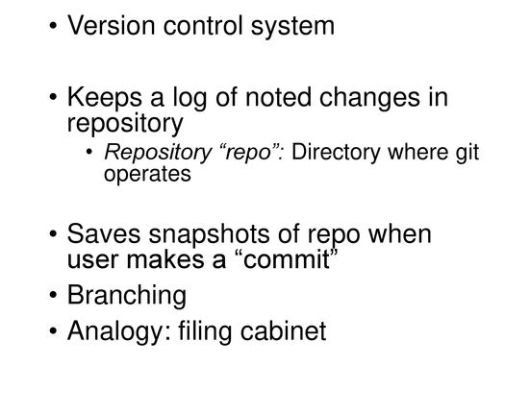
What is Git?

Slide 8
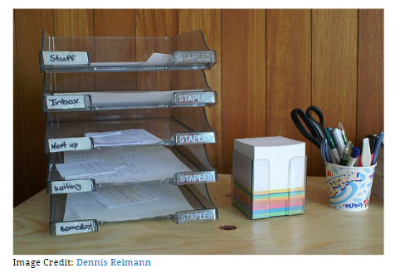
What are Repositories?

Slide 9
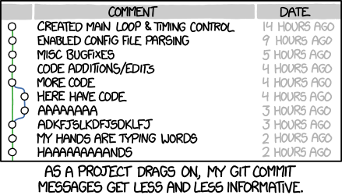
What are Commit Comments?

Slide 10

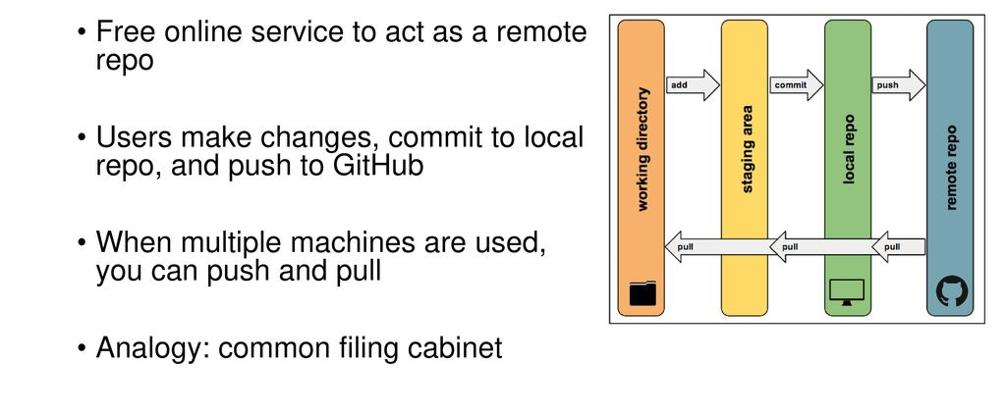
What is GitHub?
https://github.com/

Slide 11
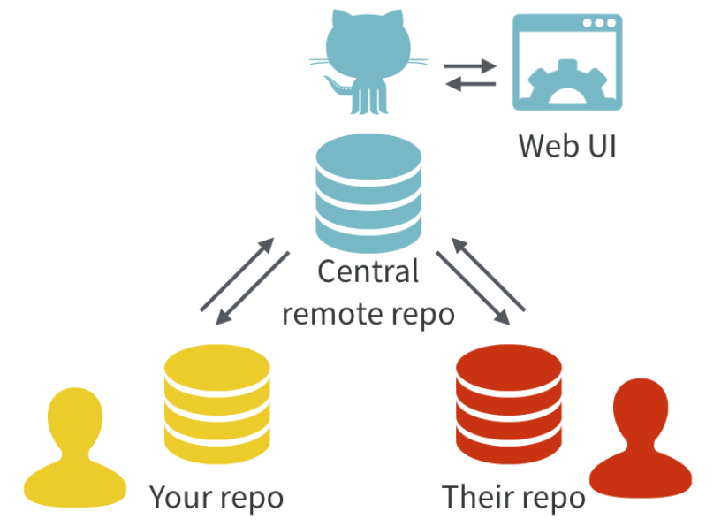

Slide 12
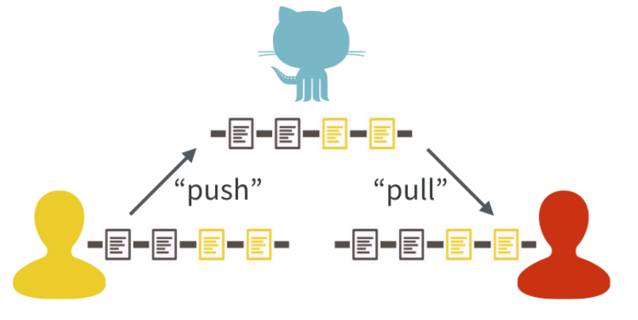

Slide 13
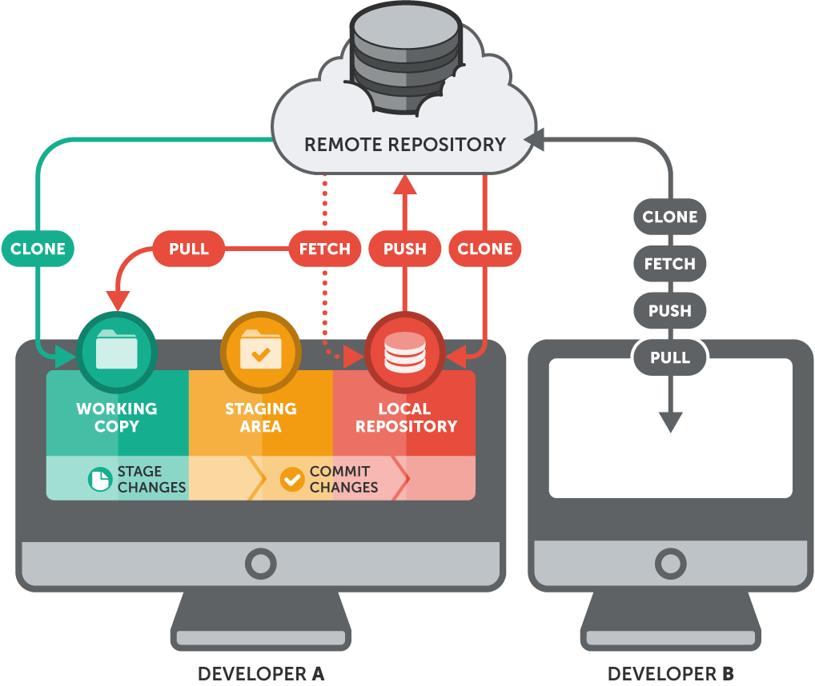

Slide 14
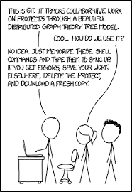
How to Implement?

Slide 15
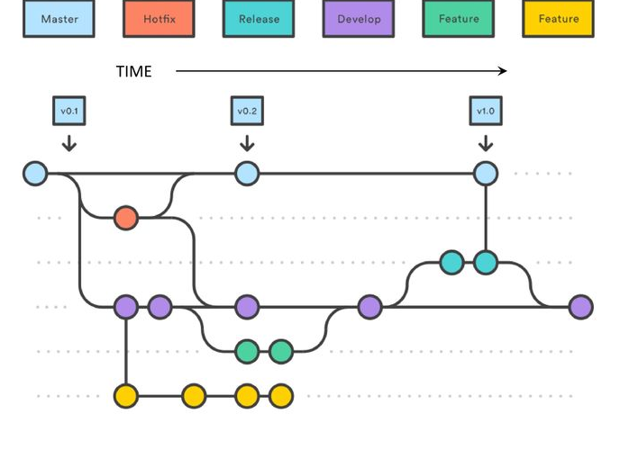

Slide 16
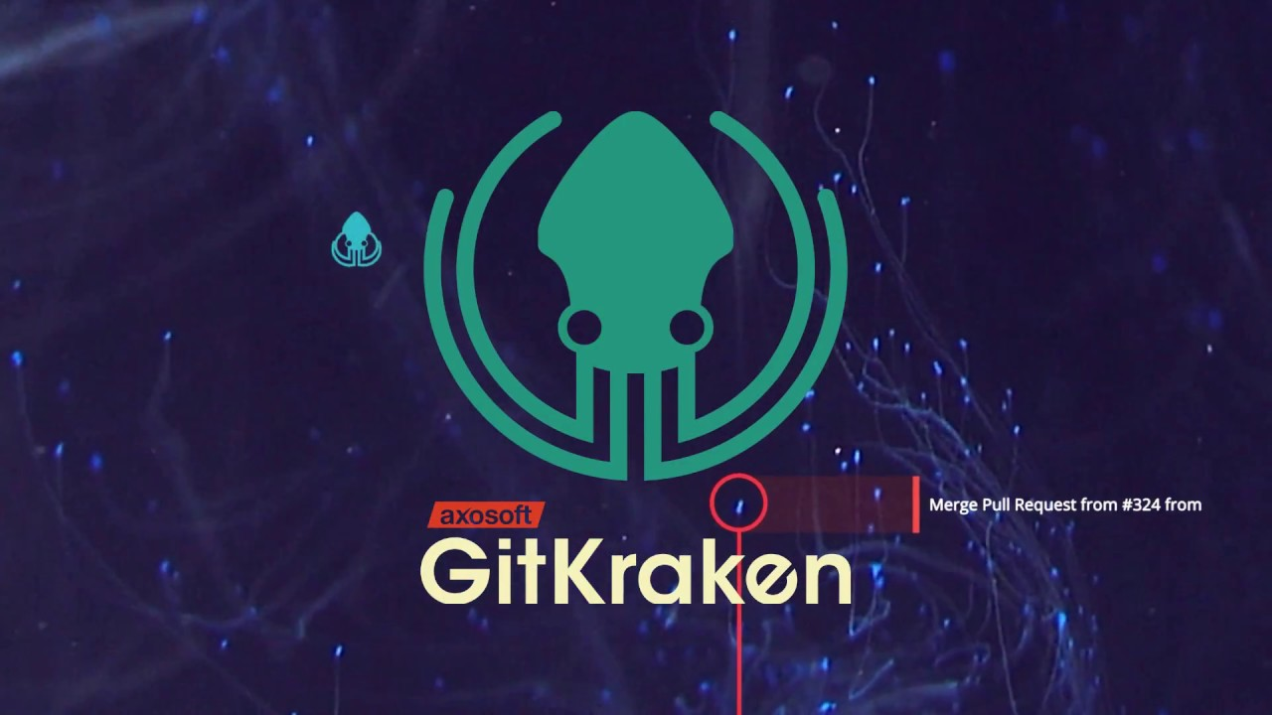

What is GitKracken?
https://www.gitkraken.com/

Slide 17
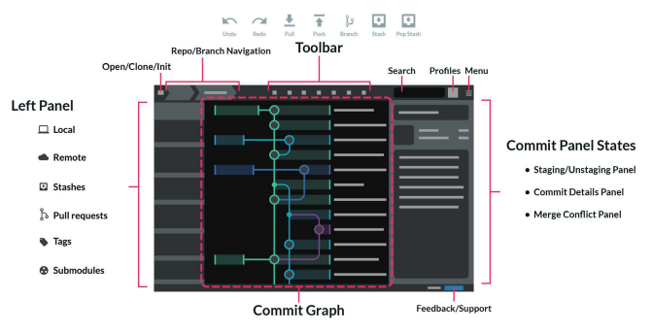
https://www.gitkraken.com/downloads/gitkraken-cheat-sheet-v1.6.pdf
https://github.com/firstcontributions/first-contributions/blob/master/gitkraken-tutorial.md
https://support.gitkraken.com/start-here/guide/
https://blog.axosoft.com/gitkraken-tips/

Slide 18
