Slide 1



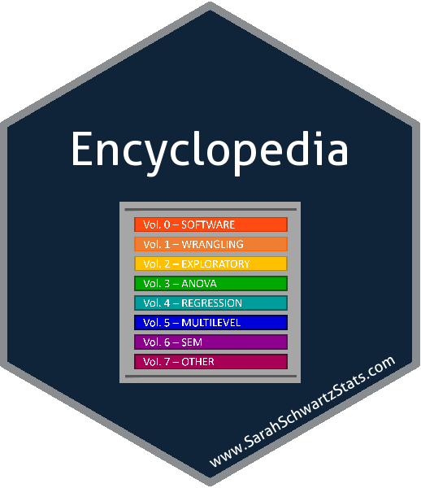

OUT-OF-CLASS LECTURES
Chapter 14
2-way Factorial ANOVA
Sleep x Stimulant Example Walk-through
Barry Cohen’s Textbook Example
Covid-19
March 31, 2020

Slide 2
OUT-OF-CLASS LECTURES
Chapter 14
2-way Factorial ANOVA
Lecture slides
(example in separate video)
Covid-19
March 31, 2020

Slide 3

Virtual
Office Hours
HW 13
Multiple Comparisons: pairwise & linear contrasts
Items # 5 & 6
HW 12
One-way, independent groups ANOVA
Items with APA methods/results
March 25, 2020

Slide 4
OUT-OF-CLASS LECTURES
Chapter 13
Multiple Comparisons Procedures
Lecture slides, part 2 of 2
Includes example in R (afex & emmeans)
linear contrast statements: by hand and code
Covid-19
March 23, 2020

Slide 5
OUT-OF-CLASS LECTURES
Chapter 13
Multiple Comparisons Procedures
Lecture slides
(excludes linear contrast statements)
Covid-19
March 23, 2020

Slide 6
HOMEWORK
HELP
Chapter 4
Standardized Scores & the Normal Distribution
4B #6: IQ (mu = 100, sd=15) -> sample w/M = 108
Jan. 24, 2020

Slide 7
OUT-OF-CLASS LECTURES
Chapter 4
Standardized Scores & the Normal Distribution
Lecture Slide Examples Worked
Jan. 24, 2020

Slide 8
OUT-OF-CLASS LECTURES
Chapter 4
Standardized Scores & the Normal Distribution
Lecture slides 25-43
(Second half)
Jan. 24, 2020

Slide 9
INCLASS LECTURES
Chapter 12
One-way Independent Groups ANOVA
Second half, chapter slides
Mostly Examples, Using R, and HW Help
March 11, 2020

Slide 10
INCLASS LECTURES
Chapter 12
One-way Independent Groups ANOVA
First half, chapter slides
Mostly New Material Presentation
March 9, 2020

Slide 11
INCLASS LECTURES
Chapter 9
Correlation
Second half, chapter slides
Chapter 10
Simple Linear Regression
chapter slides (majority)
Feb. 19, 2020

Slide 12
INCLASS LECTURES
Chapter 8
Effect Size & Power Analysis
Chapter slides
Demo G*Power software
Homework Help
Chapter 9
Correlation
First half, chapter slides
Feb. 12, 2020

Slide 13
INCLASS LECTURES
Chapter 7
Independent Samples t-Test for Means
Mostly Homework Helps
Feb. 10, 2020

Slide 14
INCLASS LECTURES
Chapter 6
Confidence Interval Estimation: The t Distribution
Lecture slides
(second half)
Homework Helps
Feb. 5, 2020

Slide 15
INCLASS LECTURES
Chapter 6
Confidence Interval Estimation: The t Distribution
Lecture slides
(second half)
Homework Helps
Feb. 5, 2020

Slide 16
INCLASS LECTURES
Chapter 5
Intro to Hypothesis Testing: 1 sample z-Test
Finish discussion
Homework questions
Chapter 6
Confidence Interval Estimation: The t Distribution
Lecture slides
(first half)
Feb. 3, 2020

Slide 17
INCLASS LECTURES
Chapter 3
Variable/Scale, Rounding & Summation
Finish discussion
Homework questions
Chapter 4
Standardized Scores & the Normal Distribution
Lecture slides
(first half)
Jan. 22, 2020

Slide 18
INCLASS LECTURES
Chapter 1
Variable/Scale, Rounding & Summation
Finish discussion
Homework questions
Chapter 2
Exploring Data with Plots
Lecture slides
Homework questions
Jan. 15, 2020

