Slide 1
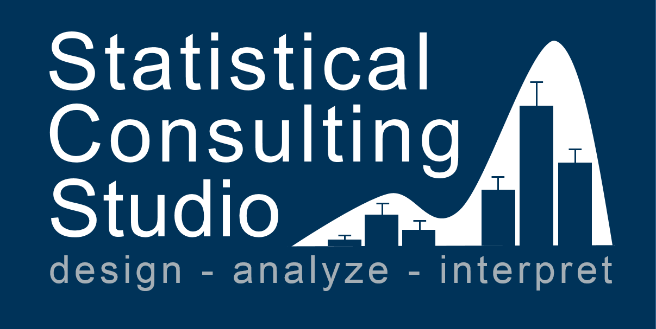
Workshops

Slide 3


Slide 4
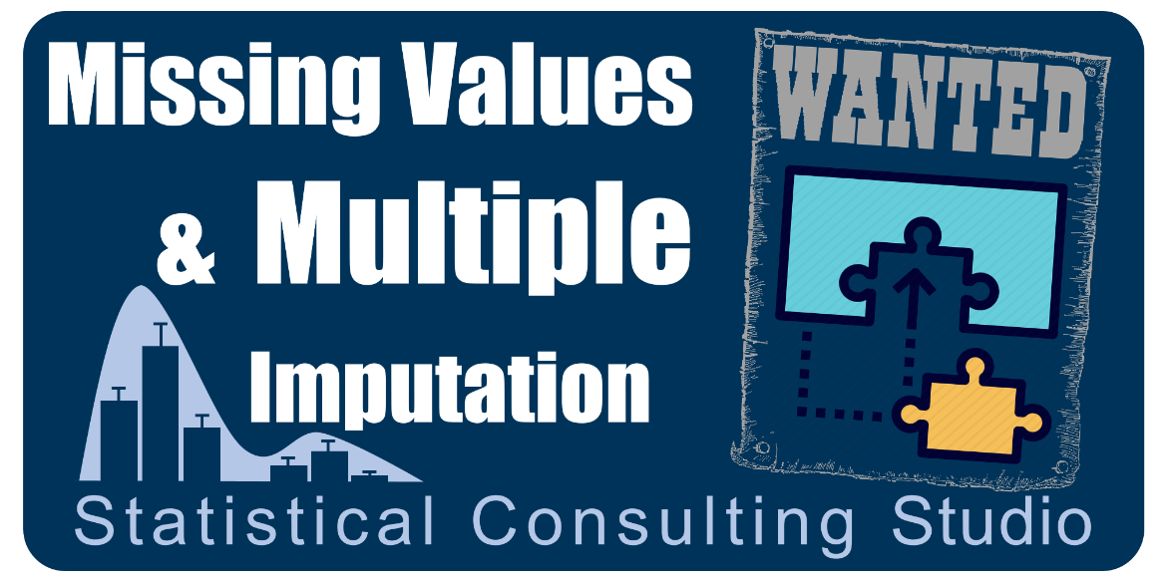
Spring 2021

Slide 5


Slide 6

Feb. 9, 2018

