Slide 1
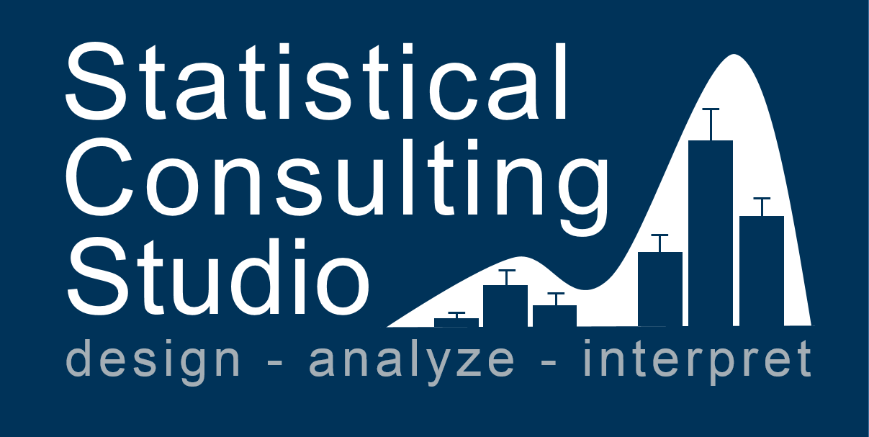
Workshops

Slide 3


Slide 4
Feb. 9, 2018

