Slide 1

Arduino
Session 2
Sara Almohands

Slide 2

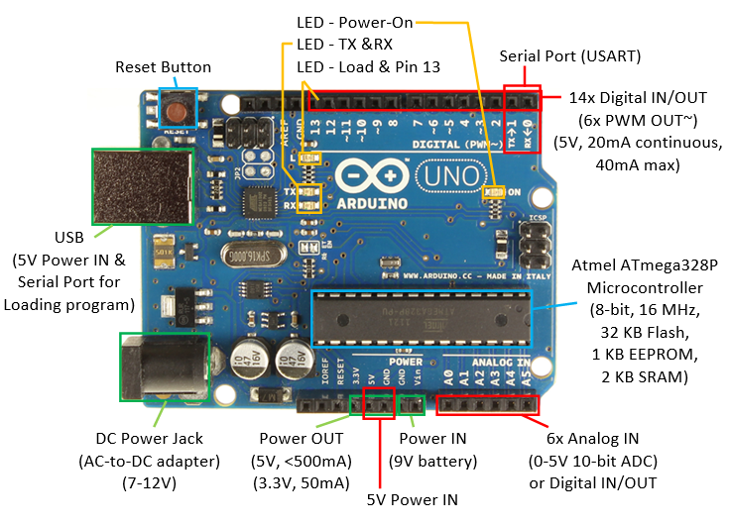
Arduino Uno structure:

Slide 3
Firmware::
Tow types of code executing on a simple micro controller:
Application code:
Executes the system's main functionality.
We write this code.
2. Firmware:
Low level code: Supports the main function.
USP interface, power modes, reset, etc.

Slide 4
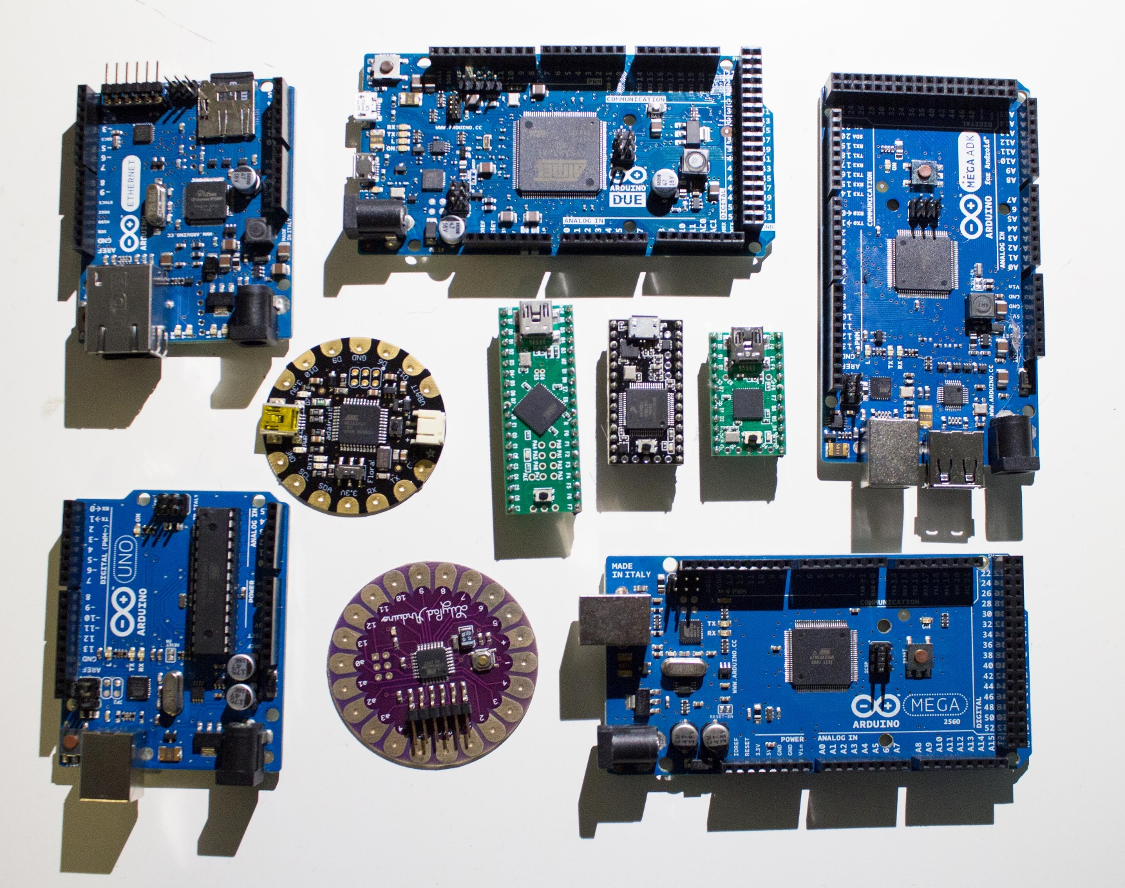
Arduino platform types:

Slide 5
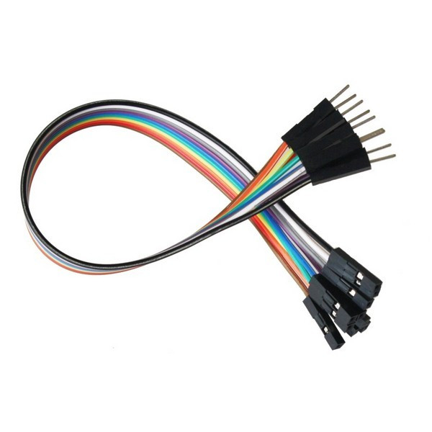
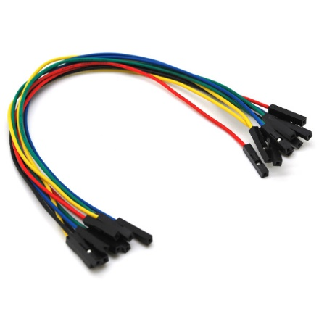
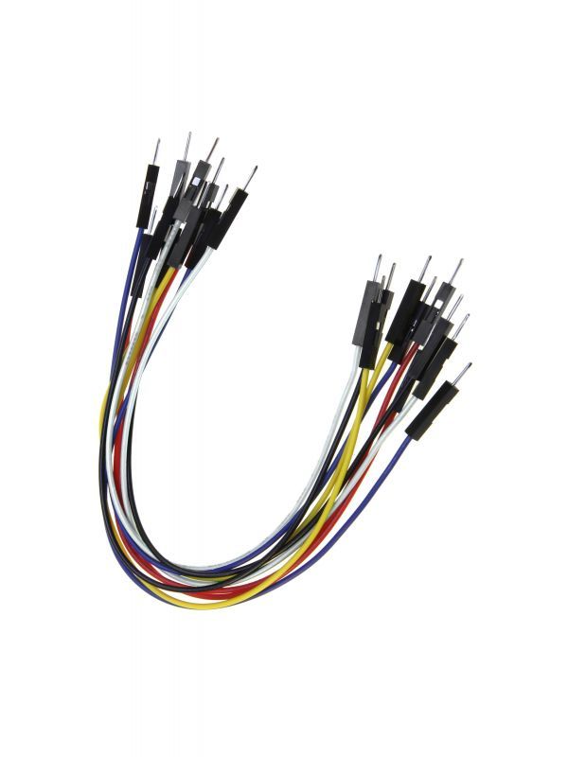
Jumper wires:

Slide 6
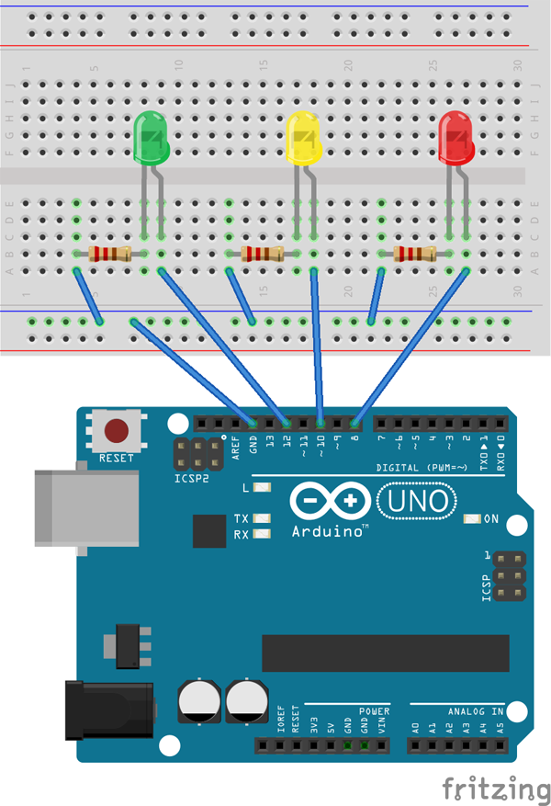
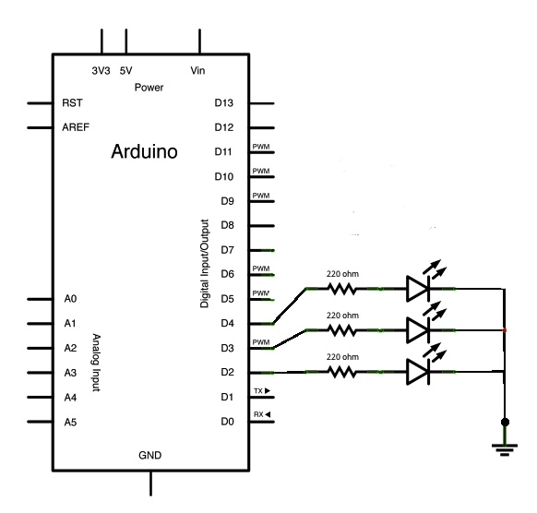
Traffic light circuit:

Slide 7
Coding

Slide 8
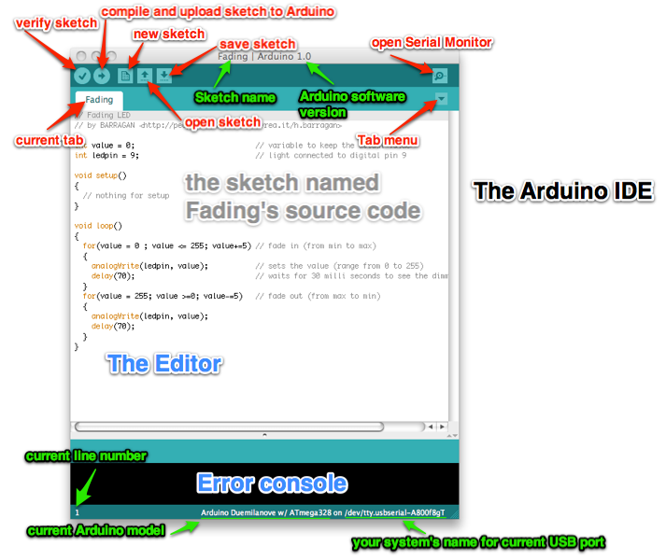
Arduino IDE

Slide 9
Basics:
char, const, int, float, double.
Delay.
Void setup, void loop.
Signs: ; .. () .. {} .. //.. /* */
= , +, -, *, /, %, ==, !=, <, >, <=, >=
expression | equivalent to...
y += x; | y = y + x;
x -= 5; | x = x - 5;
x /= y; | x = x / y;
price *= units + 1; | price = price * (units+1);
++X , X+=1 | X = X + 1

Slide 10
Arduino traffic light code:
First simple code.
Second code (Macro definition, delay, for loop).

Slide 11
End for now

