Slide 1
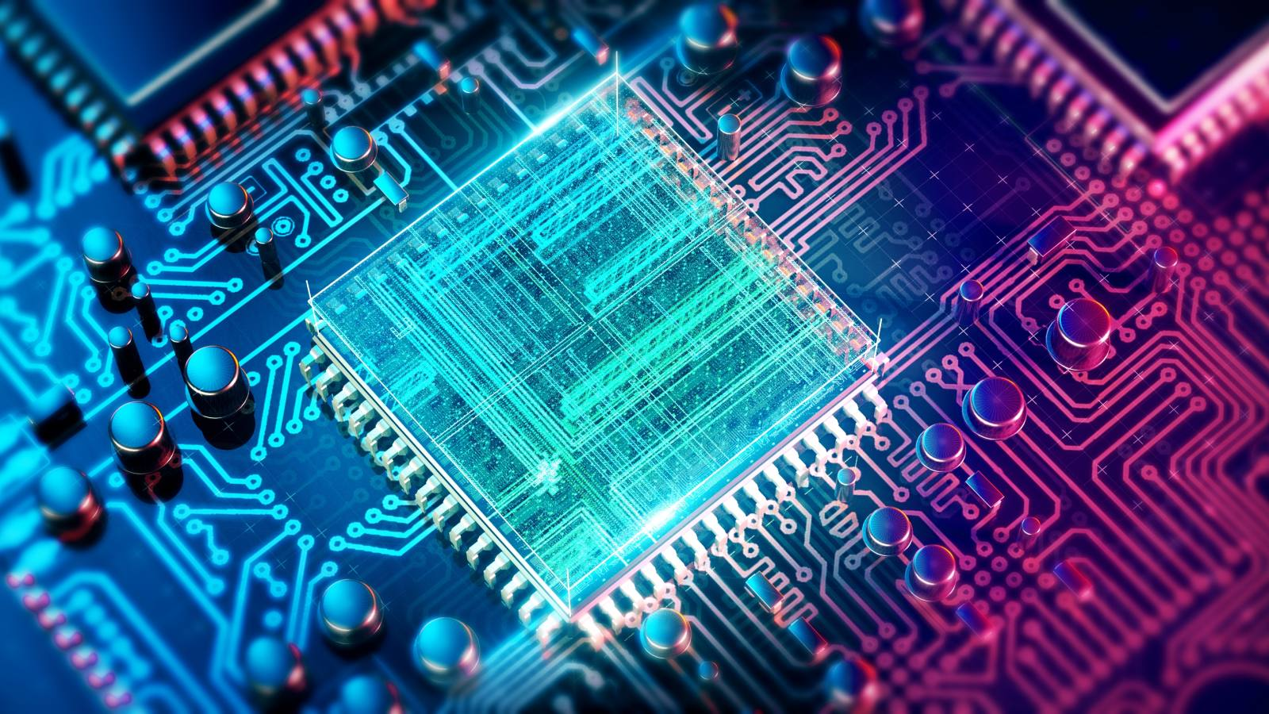
Bluetooth car
Session 4
Sara Almohands

Slide 2

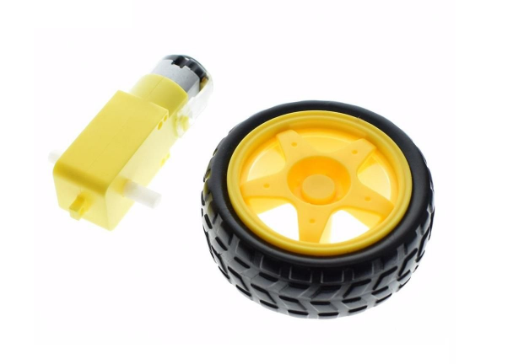
Robot wheels:

Slide 3
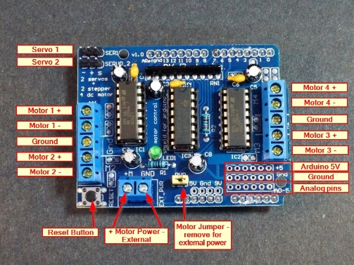
Motor shield:

Slide 4
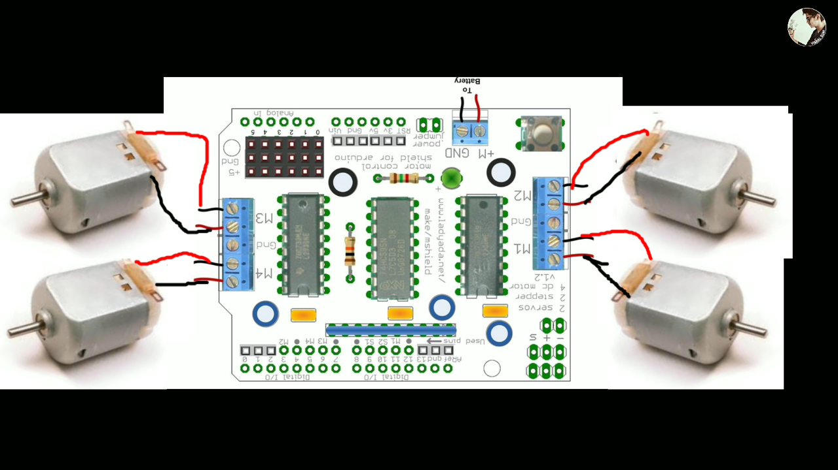
Wheels:

Slide 5
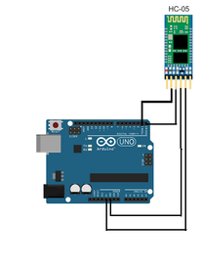
Connections:

Slide 6
Line follower
Sara Almohands

Slide 7
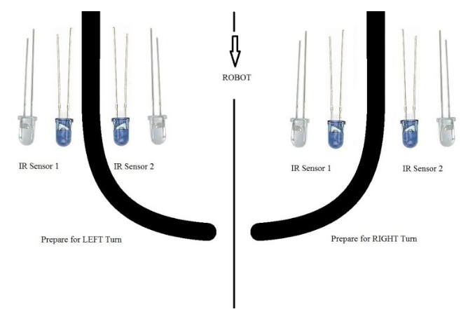
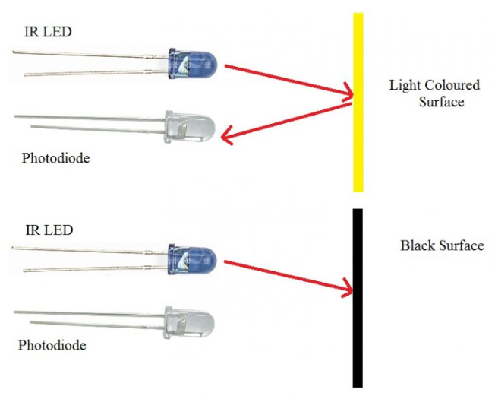
IR Sensor Module:

Slide 8
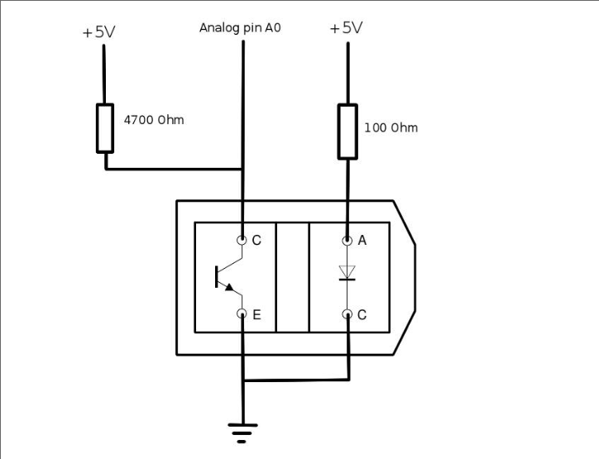
IR connection:

Slide 9
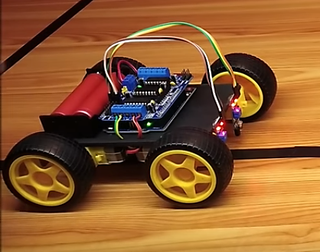
Whole robot:

Slide 10
End for now

