Slide 1
Spring系列框架
指导老师：张良
主讲人：K12部丁丹

Slide 2
内容提要
Spring 家族
Spring Framework
Spring boot
Spring cloud

Slide 3
01
_{Spring 家族}

Slide 4
Spring 家族
Spring IO Platform
Spring Boot
Spring Framework
Spring Cloud Data Flow
Spring Cloud
Spring Data
Spring Integration
Spring Batch
Spring Security
......

Slide 5
Spring Framework
IOC
AOP
Spring MVC、Spring WebFlux
JDBC、JPA、JMS
......
XML配置
基于注解的组件扫描
基于Java的配置

Slide 6
01
_{Spring Boot}

Slide 7
Spring Boot
stand-alone
Embed Tomcat, Jetty or Undertow
'starter' POMs
Automatically configure
production-ready features such as metrics, health checks and externalized configuration

Slide 8
01
_{Spring Cloud}

Slide 9
Spring Cloud
Spring Cloud Config
Spring Cloud NetFlix (Eureka、Hystrix、Ribbon、Feign、Zuul、Archaius)
Spring Cloud Bus
Spring Cloud Cluster
Spring Cloud Cloudfoundry
Spring Cloud Consul
Spring Cloud Stream
Spring Cloud AWS
......

Slide 10
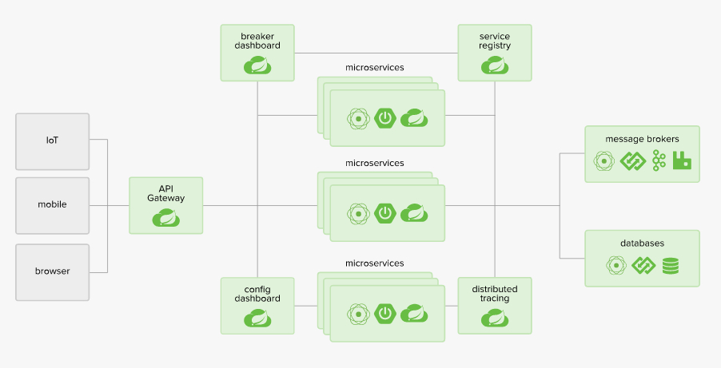
Spring Cloud
基于Spring Cloud分布式系统架构

Slide 11
Thanks

