Slide 1





Fraud Analysis
Big Data Project
Prepared By:
1.Sara Gamal
2.Eman Ibrahim
3.Yousef Osama
4.Nesma abd-el kadar

Slide 2

Problem Statement
This project aimed to enhance financial services by building smart systems for fraud detection, customer analytics, and economic forecasting. Using a transaction fraud dataset, we analyzed and visualized data to uncover patterns and key fraud indicators, developing solutions to improve security, customer engagement, and data-driven decision-making.

Slide 3
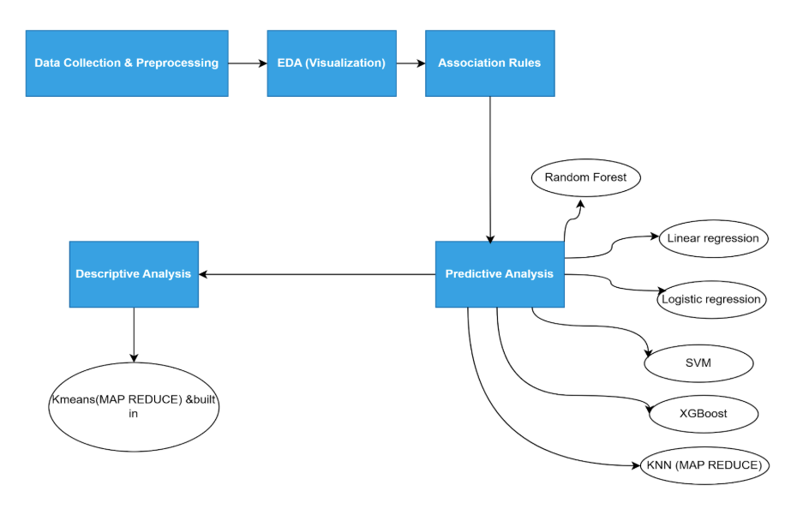
Project Pipeline

Slide 4


Transaction Insights
01
Analysis of Common Transaction Types
02
Time-Based Transaction Behavior Analysis
03
Association of Transaction Features
4
Transaction Error Rates
5
Fraud detection

Slide 5
Analysis of Common Transaction Types & Time Based Analysis
Common Transaction Types
Fraud Prevention
Operational Efficiency
Top categories: Grocery stores, supermarkets, miscellaneous food stores, restaurants, and pharmacies.
High fraud rates in Cruise Lines (35.4%) and Music Stores (37%) highlight the need for targeted monitoring.
Example: Cruise Lines fraud linked to online purchases and resale potential, justifying enhanced security measures.
Midday and weekend transaction peaks inform resource allocation for real-time monitoring.
Low fraud in high-frequency categories (e.g., grocery stores) allows focus on niche, high-risk areas.

Slide 6
Association of Transaction Features
Technical Overview
Customer Experience
Metrics evaluated:
Support: Frequency of rule occurrence in the dataset.
Confidence: Reliability of the rule
Lift: Strength of association compared to independent occurrence
Most high-value transactions are related to online payments
Medium-valued transactions are related to grocery stores and supermarkets.

Slide 7
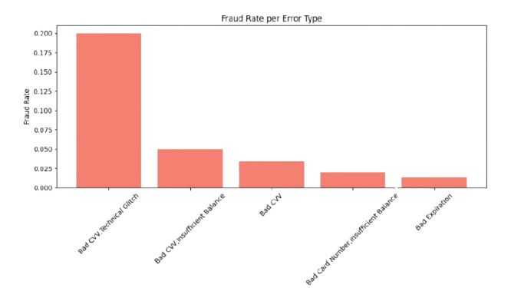
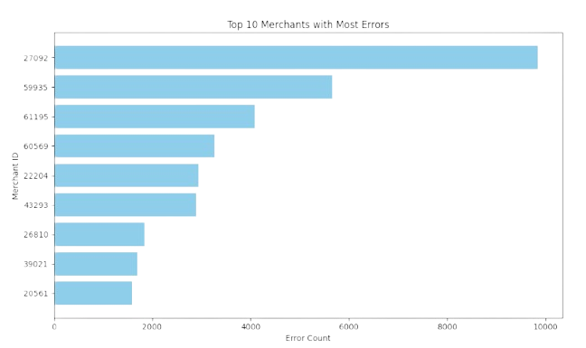
Transaction Error Rates
Technical Part:
Identified prevalent error types impacting transaction success (e.g., authorization failures, technical glitches).
Certain error types correlate with higher fraud rates, suggesting errors may mask fraudulent activities or indicate vulnerabilities in merchant systems.
Business Part:
High Error Merchants: The top 10 merchants with frequent errors (e.g., due to system integration issues) lead to customer frustration and potential transaction abandonment, impacting revenue.
Error-Fraud Correlation: Error types with high fraud rates indicate potential exploitation by fraudsters or system weaknesses, necessitating targeted interventions.

Slide 8
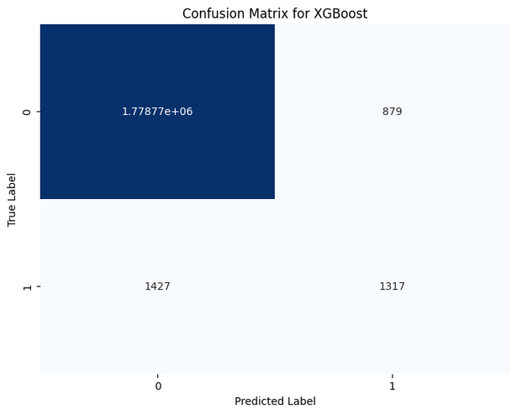
Fraud detection
Technical Part:
Preprocessing: Dropped sensitive columns, simplified merchant_city, handled missing values.
Feature Engineering: Used VectorAssembler, computed Pearson correlation matrix.
Results:
XGBoost achieved 95.2% accuracy, 99.86% F1-score.
Business Part:
Minimized Financial Losses: Advanced fraud detection models (XGBoost, 95.2% accuracy) identify high-risk transactions, reducing chargebacks and fraudulent losses.

Slide 9
User Insights
How Transaction Patterns Reveal Fraud Risks
01
Spikes in Transaction Frequency per User
05
Unusual Transaction Amounts Per User
06
Fraud Distribution by Merchant City and Transaction Description
02
Uncommon Merchant Interaction Patterns
07
Customer Segmentation Based on Transaction Behavior
03
Overspending Patterns Detection
08
Predicting Customer Credit Score
04

Slide 10
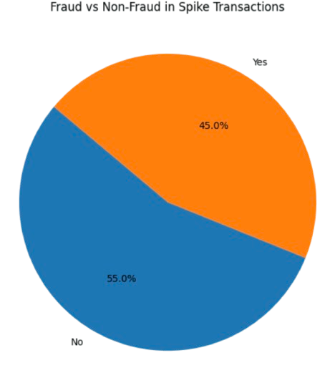
01
Spikes in Transaction Frequency per User
Technical Part:
A spike is flagged if :
Transactions Count > μ + 10σ
Goal:
Detect days with extreme spikes in user transactions to uncover potential fraud activity..
Business Part:
Insight:
Spike days show a high fraud link — nearly half are fraud.
Value:
Detect risky users early.
Cut fraud losses fast.

Slide 11
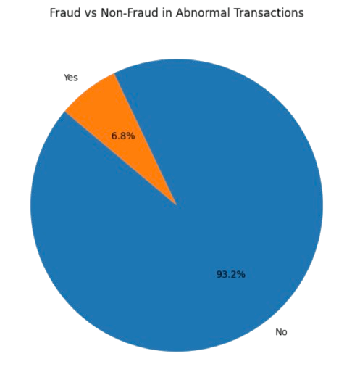
02
Unusual Transaction Amounts Per User
Technical Part:
A transaction is flagged if:
Amount > μ + 15σ
Goal:
Spot extreme spending anomalies tied to fraud.
Business Part:
Insight:
Abnormally high transactions often signal fraud risk.
Value:
Catch high-value frauds early.
Protect revenue from major financial hits.

Slide 12
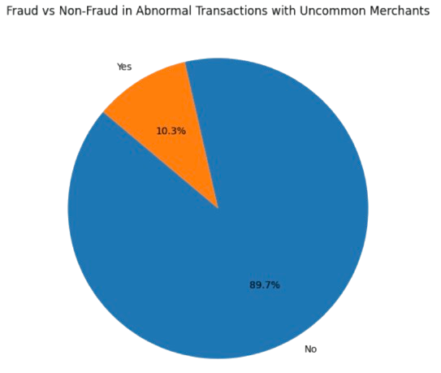
03
Uncommon Merchant Interaction Patterns
Technical Part:
Uncommon Merchant is :
A merchant is flagged if a user transacted with them ≤ 2 times.
Goal:
Detect unusual merchant interactions that could indicate fraud.
Business Part:
Insight:
Rare merchant activity may suggest suspicious behavior.
Value:
Uncover hidden fraud patterns.
Strengthen customer transaction profiling.

Slide 13
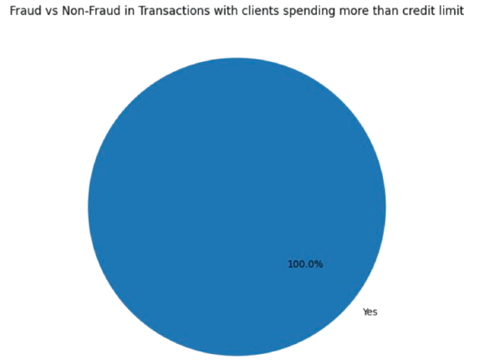
04
Overspending Patterns Detection
Technical Part:
Overspending Detection flagged if:
Transaction Amount>Credit Limit
Goal:
Identify users consistently spending beyond their credit limit to spot potential fraud risks.
Business Part:
Insight:
Overspending behavior is a strong indicator of financial risk and possible fraud.
Value:
Early detection of high-risk users.
Reduce credit losses and protect customer portfolios.

Slide 14
05
How Transaction Patterns Reveal Fraud Risks
Observation :
We observed an increase in the percentage of fraudulent transactions as our analysis was performed through several stages and constraints.

Slide 15
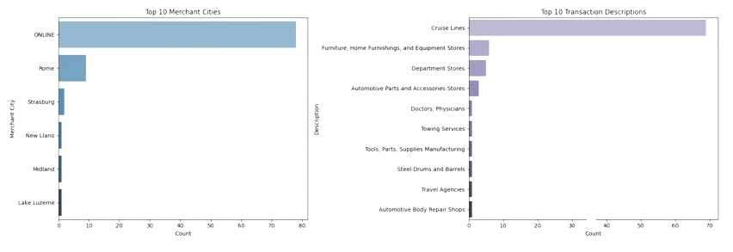
Fraud Distribution by Merchant City and Transaction Description
06
Does it make any sense for “Cruise Lines” to be the most frequent fraud description of unusual users' transactions?
Actually, yes, if someone steals a credit card, they might use it to buy non-essential things like travel, furniture, etc.
Cruise bookings may show up because:
They’re hard to trace (online purchases, international companies)
There's potential resale value (people reselling cruise tickets at discounts)

Slide 16
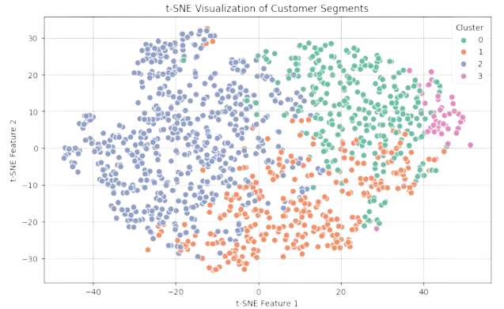
07
Customer Segmentation Based on Transaction Behavior
Technical Part:
Segmented users based on total spending, average spending, transaction frequency, and credit card limits.
Removed irrelevant or high-cardinality features.
Scaled data and applied K-Means clustering (k=2 to 9).
Evaluated the optimal number of clusters using the silhouette score and training cost.
Business Part:
Insight:
Segmentation reveals distinct customer behavior patterns.
Value:
Tailor marketing, and improve fraud detection and risk management.

Slide 17
08
Predicting Customer Credit Score
Technical Part:
Used 90% (1097 users) for training and 10% (122 users) for testing.
Applied Lasso Linear Regression (L1) to predict customer credit scores.
Lasso regression helps in feature selection by penalizing less important features, reducing overfitting.
Business Part:
Insight:
The model identifies key features that influence credit scores.
Value:
Improved credit assessments: Better predict customer creditworthiness, leading to more accurate loan approvals and risk assessments.
Cost reduction: Minimize defaults and improve financial decision-making by identifying high-risk customers early.
Personalized offers: Tailor credit offers to customer risk levels, optimizing product offerings and increasing customer satisfaction.

Slide 18


