Slide 1
Quality Assessment for Alinma bank app
Group 3

Slide 2
Introduction
The purpose of this report: is to ensure the quality of the Alinma android application by applying static analysis using the Mobile Security Framework tool.
The Goal : describe this report along with recommended mitigations based on our knowledge to make the app useful, strong, secure, and accessible.

Slide 3
APPLICATION PERMISSIONS
Take pictures and videos
Read/Modify/Delete external storage contents
Network based,GPS location

Slide 4
Takes pictures and videos
Description :
Allows application to take pictures and videos with the camera at any time.

Slide 5
MANIFEST ANALYSIS
•Clear text traffic isEnabled For App
•Application Data Can be Backed up
• Broadcast Receiver
•Content Provider is not Protected.
• Protection level permission of the services is not checked

Slide 6
Clear text traffic is Enabled
Description :
Cleartext is transmitted or stored text that has not been subjected to encryption and is not meant to be encrypted .
Mitigations :
Text must be encrypted because network attackers can eavesdrop on transmitted data and also modify it without being detected

Slide 7
CODE QUALITY ANALYSIS
•Classes Name are variables
•Variables name are meaningless
•The source code is poor of documentation
•Classes are not coherent
•Method names are character
•Alignment are not vertical

Slide 8
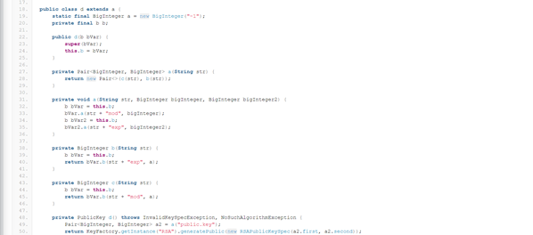
The Source Code Is Poor Of Documentation

Slide 9
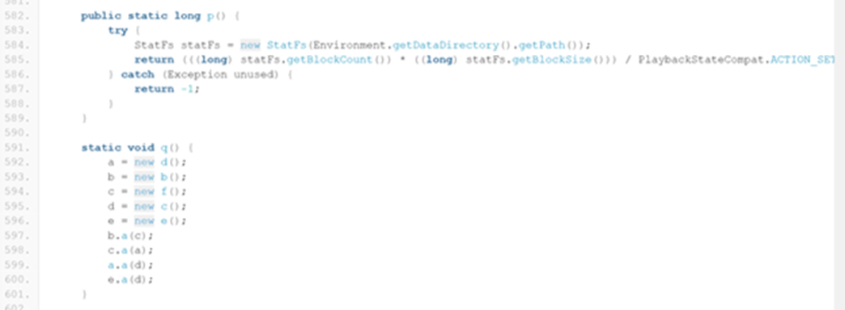

Slide 10
Solution:
Use standard documentation like java has javaDoc.

Slide 11
DESIGN PATTERN
As we navigate through the code we have noticed the design patterns are observer and adapter which makes software less brittle , because it follows the standards.
Observer is a behavioral design pattern that allows you to establish a subscription mechanism for many objects to be notified of events that occur on the object they're observing.
Adapter is convert the interface of a class into another interface clients expect.It follows the principle of clean code “ DRY “.

Slide 12
COHESION AND COUPLING
High cohesion because all methods in the class support central purpose.
Low coupling since it uses design patterns that support of loose coupling such as observer pattern as shown in previous section.

Slide 13
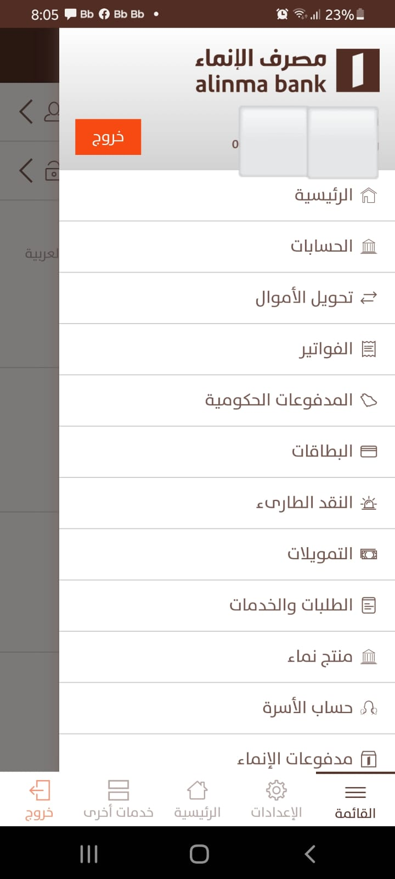
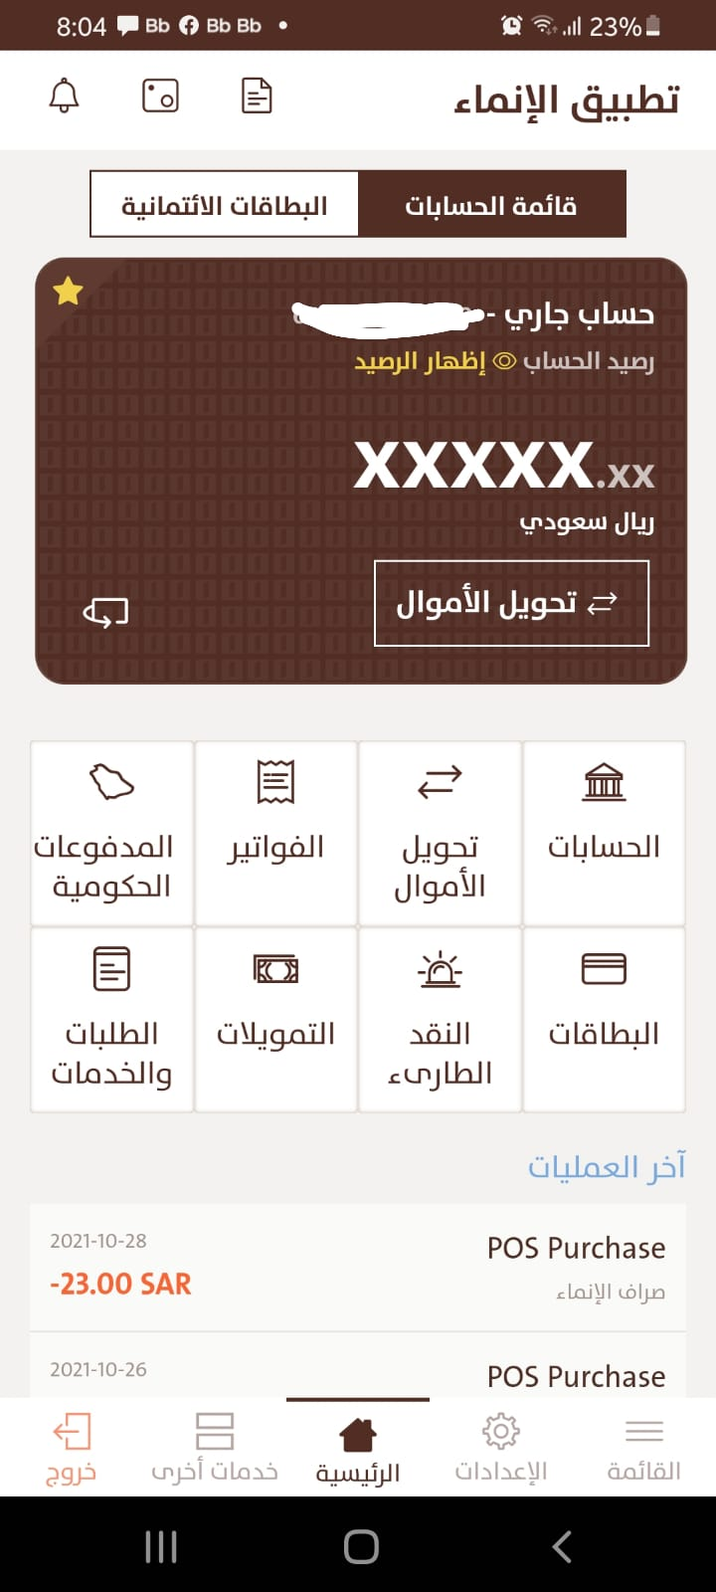
GUI
GUI is very explicit ,the application opens with one click and you can easily find the buttons and scroll the app efficiency and it is familiar to find what we need.

Slide 14
CONCLUSION
The security score is 25/100, which is quite poor for banking apps, according to MobSF. To provide users with reliability, the security score must be raised
We've noticed that application permissions, such as accessing secondary storage, taking images, and monitoring locations, need to be further restricted.
manifest analysis provides is a list of critical issues that must be handled, such as data decryption, content protection, and a number of different networking issues.
In future , we expect that the issues will be solved as we suggested above and the code will follow the standard of clean code .

