Slide 1
Requirements Determination

Slide 2
Introduction
The systems development process transforms the existing (as is) system into the proposed (to be) system
Requirements determination
The single most critical step of the entire SDLC
Changes can be made easily in this stage
Most (>50%) system failures are due to problems with requirements
The iterative process of OOSAD is effective because:
Small batches of requirements can be identified and implemented incrementally
The system will evolve over time

Slide 3
Requirements Determination
Purpose: to convert high level business requirements (from the system request) into detailed requirements that can be used as inputs for creating models
What is a requirement?
A statement of what the system must do or a characteristic it must have
Will later evolve into a technical description of how the system will be implemented
Types:
Functional: relates to a process or data
Non-functional: relates to performance or usability

Slide 4
Requirements Definition
Functional & non-functional requirements listed in outline format
May be prioritized
Provides information needed in subsequent workflows
Defines the scope of the system

Slide 5
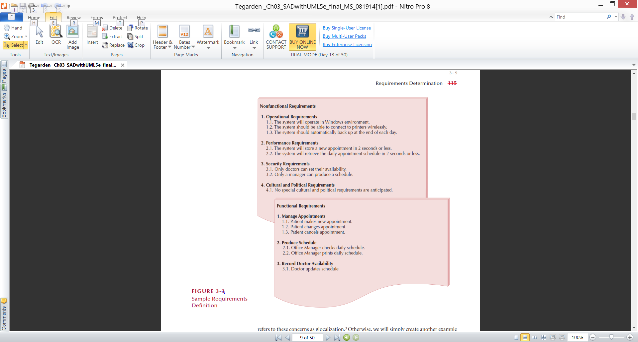
Sample of Requirements Definition

Slide 6
Determining Requirements
Business & IT personnel need to collaborate
Strategies for problem analysis:
Root cause analysis
Duration analysis
Activity-based costing
Informal benchmarking
Outcome analysis
Technology analysis
Activity elimination

Slide 7
Determining Requirements
Requirements are best determined by systems analysts and business people together
Techniques for identifying requirements
Interviews, questionnaires and/or observation
Joint application development (JAD)
Document analysis

Slide 8
Creating a Requirements Definition
Determine the types of functional and non-functional requirements applicable to the project
Use requirements-gathering techniques to collect details
Analysts work with users to verify, change and prioritize each requirement
Continue this process through analysis workflow, but be careful of scope creep
Requirements that meet a need but are not within the current scope can be added to a list of future enhancements

Slide 9
Problems in Requirements Determination
Analyst may not have access to the correct users
Requirements specifications may be inadequate
Some requirements may not be known in the beginning
Verifying and validating requirements can be difficult

Slide 10
Requirements Analysis Strategies
Problem analysis
Ask users to identify problems with the current system
Ask users how they would solve these problems
Good for improving efficiency or ease-of-use
Root cause analysis
Focus is on the cause of a problem, not its solution
Create a prioritized list of problems
Try to determine their causes
Once the causes are known, solutions can be developed

Slide 11
Requirements Analysis Strategies(Cont.)
Duration analysis
Determine the time required to complete each step in a business process
Compare this to the total time required for the entire process
Large differences suggest problems that might be solved by:
Integrating some steps together
Performing some steps simultaneously (in parallel)
Activity-based costing
Same as duration analysis but applied to costs
Informal benchmarking
Analyzes similar processes in other successful organizations

Slide 12
Requirements Analysis Strategies(Cont.)
Outcome analysis
What does the customer want in the end?
Technology analysis
Apply new technologies to business processes & identify benefits
Activity elimination
Eliminate each activity in a business process in a “force-fit” exercise

Slide 13
The System Proposal
Combines all material created in planning & analysis
Included sections:
Executive summary
Provides all critical information is summary form
Helps busy executives determine which sections they need to read in more detail
The system request
The workplan
The feasibility analysis
The requirements definition
Current models of the system (expected to evolve)

