Slide 1

DEPARTMENT OF INFORMATION SCIENCE AND ENGINEERING
Mini_Project_Final
Phase Presentation
Title: AI-Powered Gesture –Driven Smart Slide Navigation System
Presented by:
1. Sana Anjum (4GW23IS040)
2. Saranya G (4GW23IS044)
3. Sneha Patel A V (4GW23IS049)
4. Swathi S (4GW23IS056)
Under the Guidance of
Dr. Chaya P
Associate Professor
Department of Information Science and Engineering GSSSIETW, Mysuru
1
Notes:
1

Slide 2
CONTENTS
Introduction
Proposed System with Objectives
Present System
Literature Survey
Requirement Specifications
System Architecture
Data Flow Diagrams
Methodology
Implementation
Test Cases
Advantages and Applications
Results and Snapshots
Conclusion and References
2

Slide 3
1. INTRODUCTION
Presentations are a fundamental tool for communication in education, business, and professional settings. However, the way we control them has remained largely unchanged.
Traditional methods rely on physical devices like keyboards, mouse or remote clickers. These tools create a significant constraint:
They restrict the presenter's natural movement.
They break the natural flow and rhythm of the delivery.
This dependence on hardware highlights a critical need for a more intuitive, flexible, and engaging method of presentation control.
3
Notes:
3

Slide 4
2. PROPOSED SYSTEM
Presentations are fundamental across education and business, but their control has stagnated.
We remain dependent on physical hardware like keyboards and clickers, which physically tethers the presenter.
This restriction breaks the natural rhythm of delivery and severely limits movement and stage presence.
Ultimately, this divides attention, forcing the presenter to focus on a device instead of connecting with the audience.
This project introduces an AI-driven, hands-free system to solve these core limitations.
4

Slide 5
2. AIM & OBJECTIVES
To design and develop a real-time gesture-controlled presentation system that leverages computer vision and hand-tracking technologies to enable seamless slide navigation, customizable gesture-to-action mapping, and interactive control through an intuitive interface.
To capture real-time hand gestures through a laptop webcam and process them using OpenCV, MediaPipe for accurate recognition.
To map recognized gestures into presentation controls such as slide navigation, pointer display, drawing, and erasing.
To provide flexibility by allowing users to customize gesture-to-action mappings effectively.
To design a user-friendly interface with live webcam overlay and performance metrics, and varied testing conditions.
5

Slide 6
3. PRESENT SYSTEM
Existing System:
In conventional presentation systems, users rely on hardware input devices such as keyboards, mice, or remote clickers. These methods often cause interruptions and reduce the speaker’s focus and audience engagement.
Limitations:
Manual interaction interrupts the presentation flow.
Dependence on external devices limits mobility.
Accessibility issues for people with physical challenges.
Lack of automation and real-time adaptability.
No AI-based customization support.
6

Slide 7
4. LITERATURE SURVEY
Sl.No | Title | Author(s) | Description | References | Year | Limitations
1. | Gesture Driven Presentation Control | D. Sirisha | Real-time interactive control using Media pipe & Open CV | IEEE Transactions on Human-Machine Systems. | 2024 | Limited gestures; restricted to specific commands can expand gesture set and improve accuracy.
2. | Enhancing Presentation Dynamics with Real-time Hand Gesture Recognition. | Divya Upadhyay | Review of methods for gesture-based presentation | IEEE Access | 2024 | Review only lacks experiments highlights research gap in practical implementaion.
3 | Approach for Dynamic Hand Gesture Recognition in Human-Robot Interaction | Arpneek Kaur, Sandhya Bansal | ML-based dynamic gesture recognition for human-robot interaction | IEEE Robotics and Automation Letters | 2024 | Requires large datasets; delay in real-time interaction.
4 | A Continuous Real-time Hand Gesture Recognition Method based on Skeleton | Thi-Lan Le | Skeleton-based recognition system using TD-Net for detection & recognition | IEEE Sensors Journal | 2024 | Limited to skeleton-based input; performance may degrade in complex backgrounds
5 | AI-Based Computer Vision Techniques and Expert Systems | Yasunari Matsuzaka, Ryu Yashiro | Review of AI-based CV & expert systems in medical and HCI | MDPI Sensors | 2023 | Mostly review; lacks experimental validation; gap in presentation-specific application.
7

Slide 8
4.LITERATURE SURVEY
6 | Hand Gesture Recognition Using Convolutional Neural Networks | Vijay Madaan, Neha Sharma | CNN-based gesture recognition; 99.97% accuracy | Chitkara University Journal of Engineering | 2023 | High dataset accuracy; lacks real-time validation
7 | Hand Sign & Gesture Recognition System | Priyal Raj | Recognition of signs & gestures for communication | IEEE Access | 2023 | Needs extension beyond sign language
8 | Hand Gesture based AI Controller for Presentation, Virtual Drawing and System Volume Management | Akshay Kumar. | Gesture recognition for multiple controls | Amrita Vishwa Vidyapeetham / GEHU / Uttaranchal | 2023 | Complex; error margin increases; GPU needed
9 | Gesture Based Model using Deep Learning | Anuja Dixit . | DL model for gesture-based slide control | AJ Garg Engineering College Journal. | 2023 | Needs real-world testing; can extend with better datasets & robustness.
10 | Efficient Gesture-Based Presentation Controller Using Transfer Learning Algorithm | Shaik Faiz Ahamed | Transfer learning for gesture control | ICCCI Conference Proceedings | 2023 | Limited to pretrained models; high compute required.

Slide 9
4. LITERATURE SURVEY
11 | Dynamic Hand Gesture Recognition | Subash Chandra Bose Jaganathan | ML-based dynamic gesture recognition in real-time | VIT Bhopal Journal of Engineering | 2023 | Needs optimization for speed & dataset; focused on gestures
12 | Smart Presentation System Using Hand Gestures | Bhairavi Pustode. | Smart presentation system using CV for slide control | Research Square | 2023 | Early-stage; limited hardware testing.
13 | Controlling PowerPoint Presentation using Hand Gestures in Real-Time | Ch Sai Charan, K Meenakshi, V Bhavani Reddy, V Kashyap | Control PowerPoint using gestures + speech-to-text | IEEE Access | 2023 | Limited scope; accuracy drops in poor lighting.
14 | Automated Digital Presentation Control using Hand Gesture Technique | Salonee Powar | Gesture-based PowerPoint controller | ICACC Conference Proceedings | 2022 | Limited gestures; lighting affects accuracy; can improve robustness & gesture variety.
15 | Hand Gesture Recognition Based on Computer Vision: A Review of Techniques | Munir Oudah . | Review of CV techniques for gesture recognition | MDPI Sensors | 2020 | Review only; lacks practical system; identifies methods for use in project implementation.

Slide 10
5. REQUIREMENT SPECIFICATION
FUNCTIONAL REQUIREMENTS
Gesture Capture: The webcam should capture real-time video frames of the presenter’s hand movements.
Gesture Recognition: The AI model processes these frames and classifies gestures like pinky up, thumb up, 3 fingers or fist.
Command Execution: Recognized gestures are mapped to presentation actions such as next slide, previous slide, pause, or highlight.
User Interface: Displays live camera feed with recognized gesture label and visual feedback.
Custom Gesture Mapping: Allows users to define their own gesture-to-command mappings.
12
Notes:
11

Slide 11
5. REQUIREMENT SPECIFICATION
NON-FUNCTIONAL REQUIREMENTS
Accuracy:
Gesture detection ≥ 90% under lighting and backgrounds.
Performance:
Latency ≤ 200 milliseconds per gesture.
Usability:
Simple interface, minimal configuration required.
Portability:
Runs on Windows,Mac,Linux.
Security:
Webcam data remains local, No cloud data is stored
13
Notes:
11

Slide 12
5. REQUIREMENT SPECIFICATION
HARDWARE REQUIREMENTS:
Intel i5 (≥2.0 GHz)
RAM: 16 GB
Storage: 500 GB HDD
Integrated Laptop Webcam .
SOFTWARE REQUIREMENTS:
OS: Windows 10 or higher/ Linux / Mac
IDE: Visual Studio Code with Python Extension
Languages: Python (AI).
Libraries: OpenCV, MediaPipe, PyAutoGUI .
15
Notes:
12

Slide 13
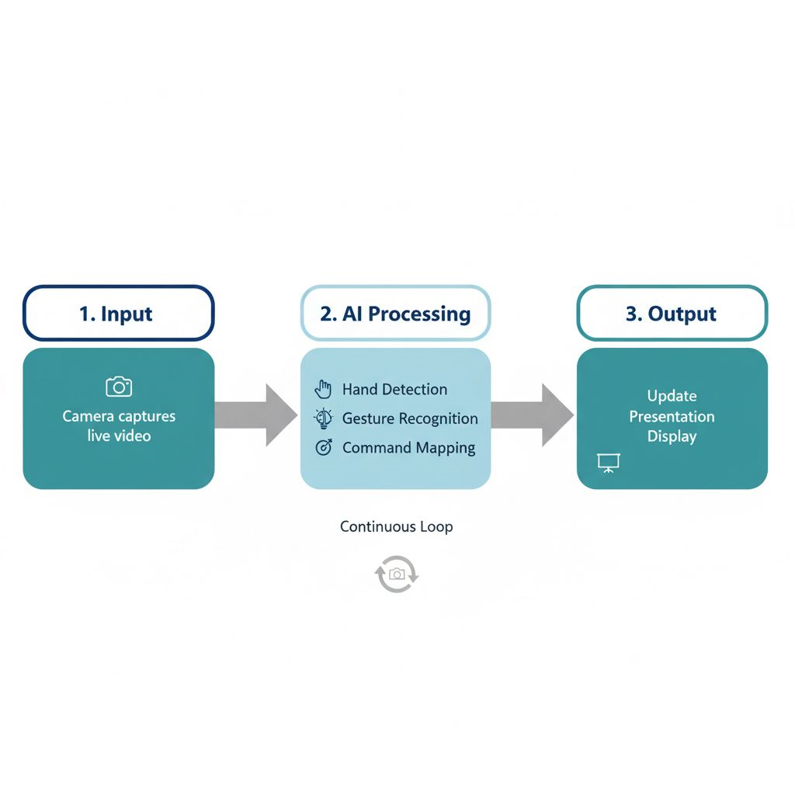
6. SYSTEM ARCHITECTURE
Fig 1: System architecture
16
Notes:
13

Slide 14
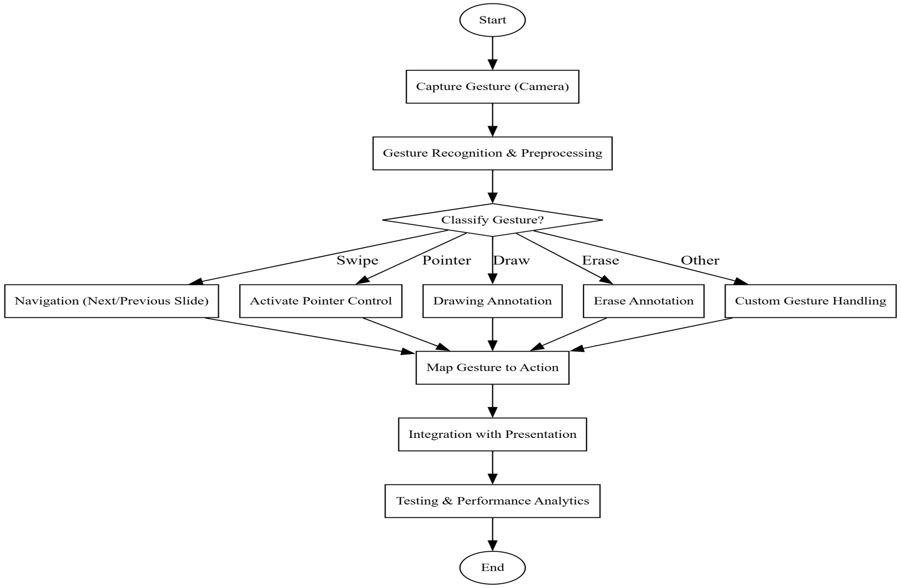
7. DATA FLOW DIAGRAM
Fig 2 .Data Flow Diagram
17

Slide 15
8. METHODOLOGY
Data Collection
Capture real-time hand gestures (swipe, palm, fist, two fingers, three fingers) using a webcam.
Collect samples under varied lighting conditions, backgrounds, and hand sizes to ensure robustness.
Preprocessing
Resize and normalize webcam frames for consistency.
Apply image enhancements (e.g., brightness correction) to improve input quality.
Gesture Recognition & Integration
Use MediaPipe with opencv to extract hand landmarks and classify them into defined gesture classes.
Provide support for adding custom gestures through rule-based mapping.
Integration with Presentation Control
Map recognized gestures to presentation actions such as next/previous slide, pointer, drawing, and erasing.
User Interface & Customization
Provide a live webcam feed with detected gesture overlay.
Allow customization of gesture mappings.
Testing & Performance Evaluation
Evaluate system performance across different users and environments.
Record metrics such as recognition accuracy, latency, and reliability.

Slide 16
9. IMPLEMENTATION
def setup_gesture_detection(self):
# Initialize our core components
self.cap = cv2.VideoCapture(0)
self.detector = HandDetector(detectionCon=0.7, maxHands=1)
# Real-time processing loop
while True:
success, frame = self.cap.read()
hands, frame = self.detector.findHands(frame)
if hands:
# Process detected hands
self.handle_gesture_recognition(hands[0])
21
Notes:
20

Slide 17
9. IMPLEMENTATION
def process_gestures(self):
while self.is_running:
success, frame = self.cap.read()
frame = cv2.flip(frame, 1)
# Hand detection
hands, frame = self.detector.findHands(frame)
if hands and len(hands) > 0:
hand = hands[0]
fingers = self.detector.fingersUp(hand)
# Gesture recognition
if fingers == [0, 0, 0, 0, 1]: # Pinky up = Next slide
pyautogui.press('right')
elif fingers == [1, 0, 0, 0, 0]: # Thumb up = Previous slide
pyautogui.press('left')
19

Slide 18
9. IMPLEMENTATION
# Customizable gesture mappings
GESTURE_MAPPINGS = {
'next_slide': [0, 0, 0, 0, 1], # Pinky up
'previous_slide': [1, 0, 0, 0, 0], # Thumb up
'pointer': [0, 1, 1, 0, 0], # Index + Middle
'draw': [0, 1, 0, 0, 0], # Index up
'erase': [0, 1, 1, 1, 0] # Three fingers
}
def execute_gesture(self, fingers):
for gesture_name, finger_pattern in self.GESTURE_MAPPINGS.items():
if fingers == finger_pattern:
self.perform_action(gesture_name)
break
20
Notes:
19

Slide 19
10. TEST CASES
Case Number | Scenario | Expected Result | Actual Result | Status
1 | Presenter shows ‘Pinky Up’ gesture | System moves to next slide | Next slide displayed successfully | Pass
2 | Presenter shows Thumb Up’ gesture | System moves to previous slide | Previous slide displayed successfully | Pass
3 | Presenter shows ‘Index Finger Up’ gesture | System activates drawing mode | Drawing enabled on current slide | Pass
4 | Presenter shows ‘Two fingers Up’ gesture | System activates pointer mode | Red pointer appears on screen | Pass
5 | Presenter shows ‘Three Fingers Up’ gesture | System erases annotations | All drawings cleared from slide | Pass

Slide 20
11. ADVANTAGES
Hands-free operation: Allows smooth and uninterrupted presentations.
Accessibility: Enables physically challenged individuals to present easily.
Improved engagement: Presenter maintains eye contact and audience focus.
No external hardware required: Reduces cost and setup complexity.
Customizable gestures: Adapts to user preferences.
AI integration: Encourages adoption of smart interaction systems.
24

Slide 21
11. APPLICATIONS
Academic and Corporate Presentations – Hands-free slide control during seminars and conferences.
Online Education Platforms – Teachers can change slides while explaining without touching devices.
Virtual Meetings – Smooth control during webinars and video conferences.
Accessibility Support – Beneficial for users with mobility or physical limitations.
Human-Computer Interaction Research – Foundation for AI gesture-based user interfaces.
Interactive Public Kiosks – Touchless control for public displays or museum installations.
25

Slide 22
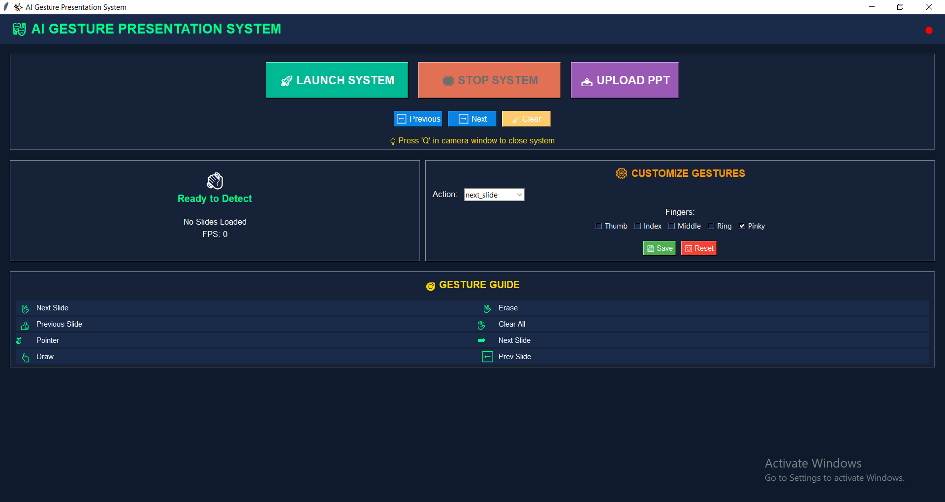
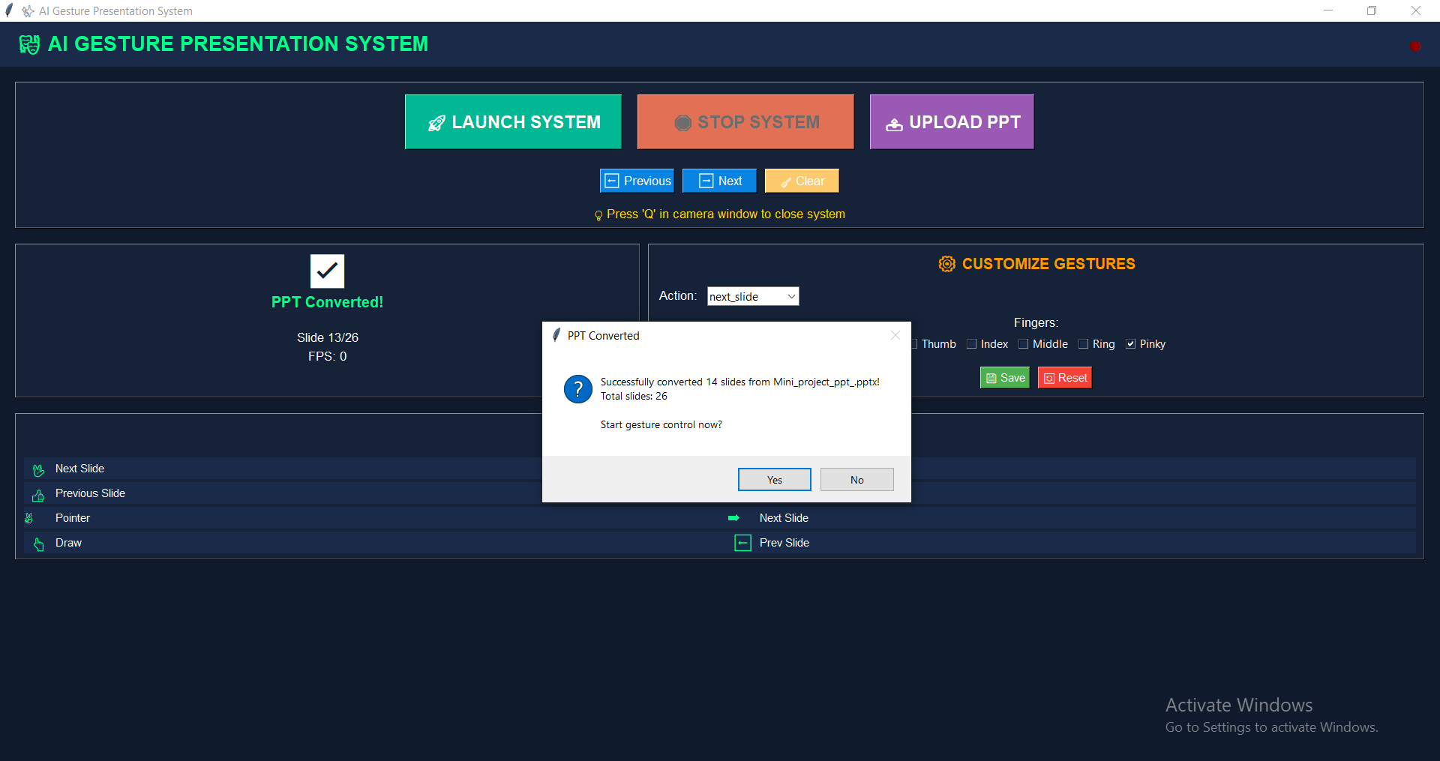
12. RESULTS
Fig 3: UI Interface for Gesture Presentation System
Fig 4: Uploading PPT to the system
26

Slide 23
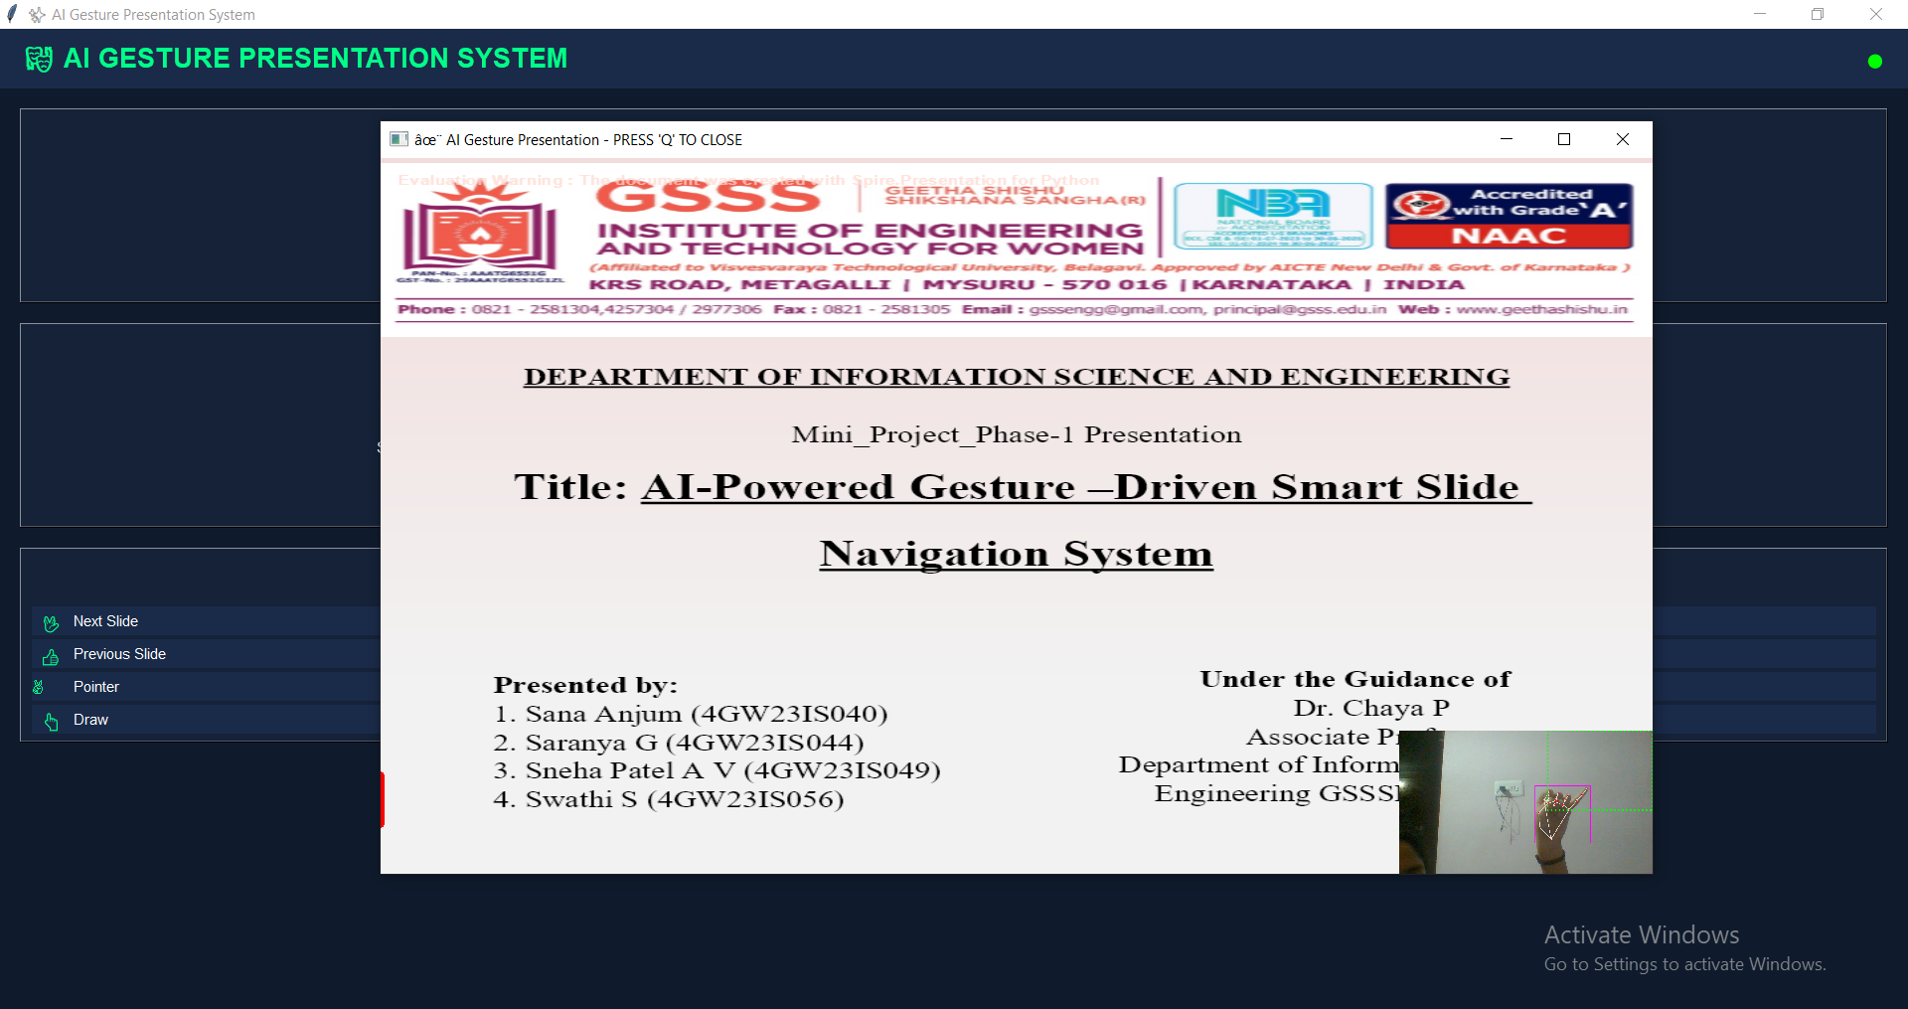
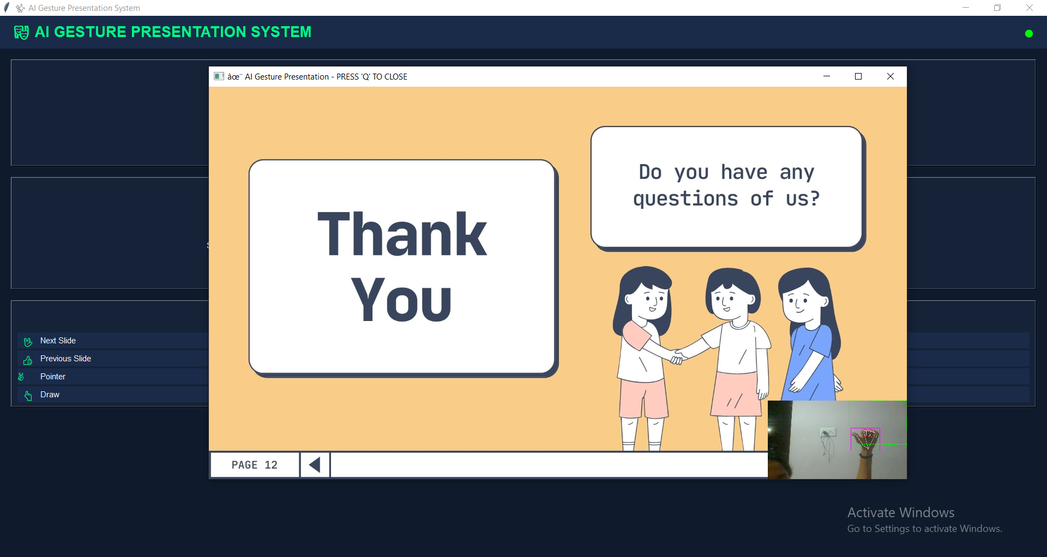
12. RESULTS
Fig 5: Gesture for next slide
Fig 6:Gesture for previous slide
28

Slide 24
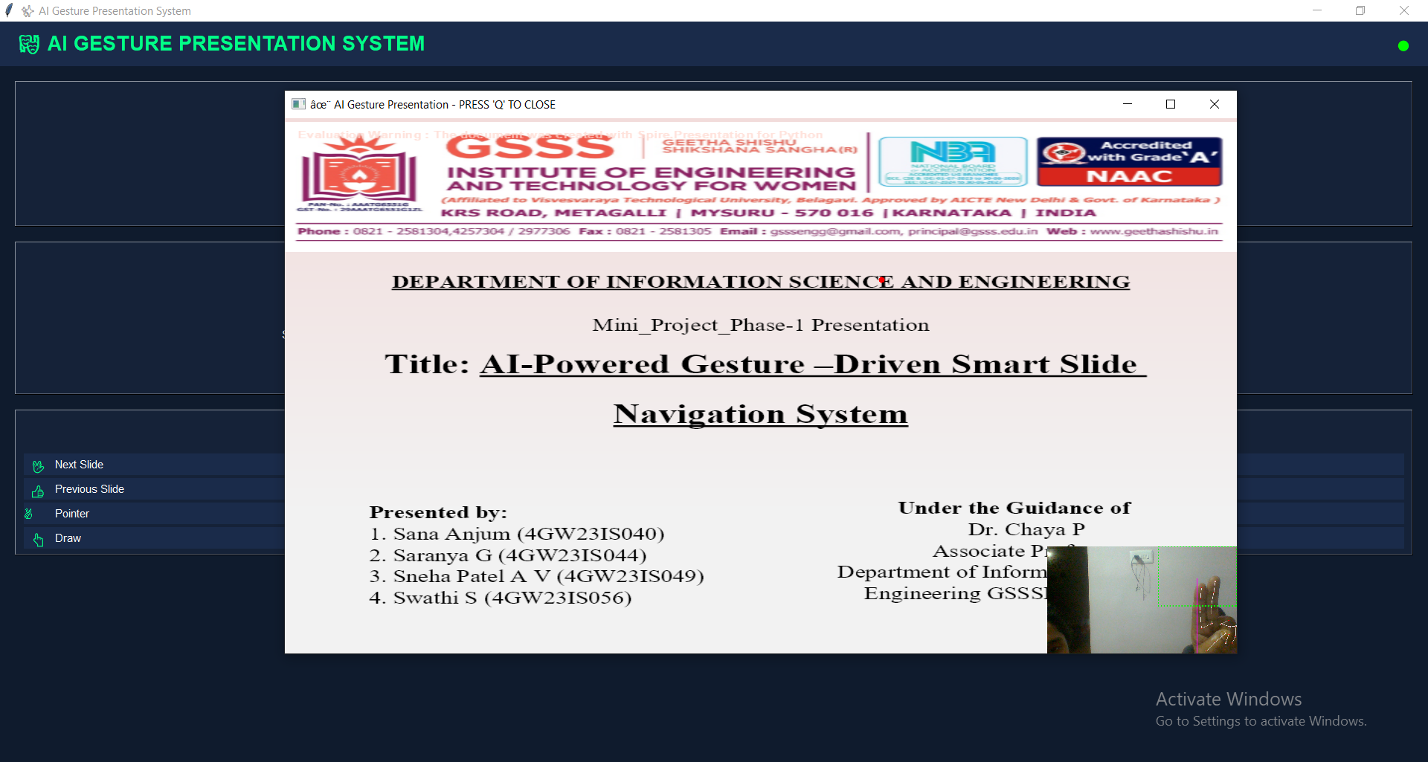
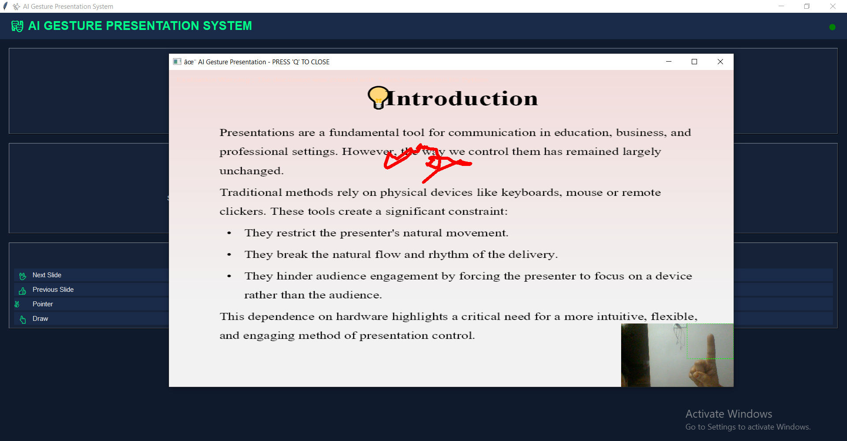
12. RESULTS
Fig 7: Gesture for pointer function
Fig 8: Gesture for Annotation function
30

Slide 25
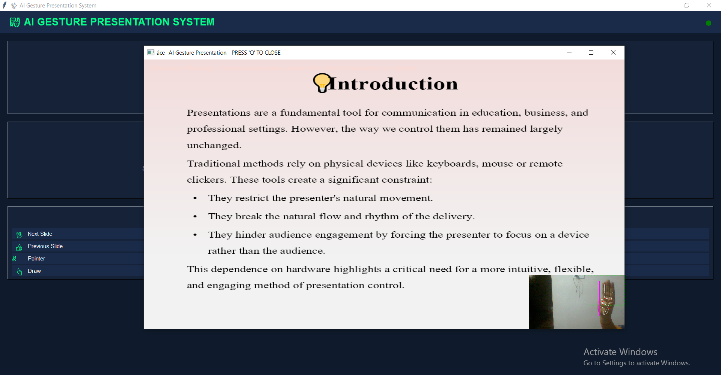
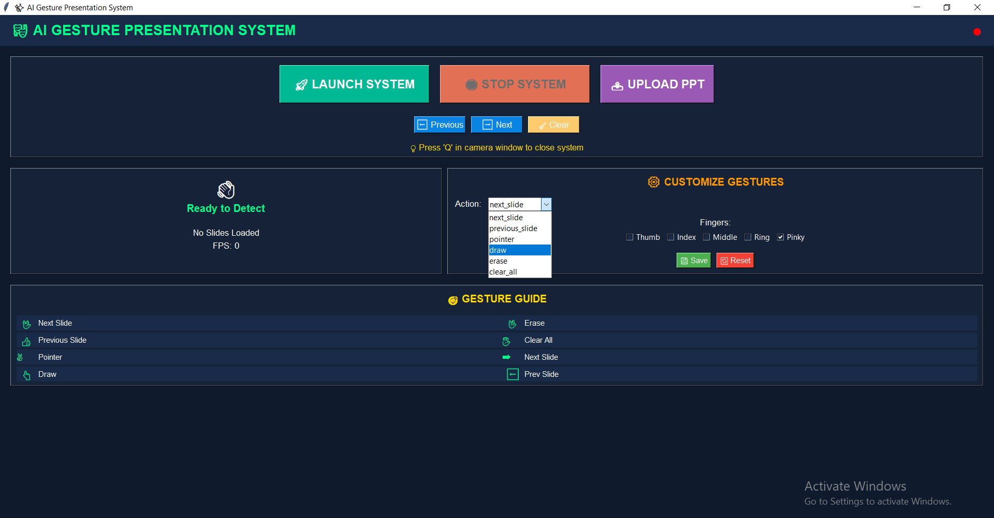
12. RESULTS
Fig 9: Gesture for Erasing Function
Fig 10: Gesture Customization tab
32

Slide 26
13. CONCLUSION
The project successfully demonstrates a hands-free, AI-based system for controlling presentations using hand gestures.
It enhances efficiency, accessibility, and user interaction, removing the need for external devices like remotes or keyboards.
The solution promotes a seamless and engaging presentation experience, making it useful for education, corporate, and accessibility applications.
Overall, this work highlights the potential of AI and Computer Vision in building smart, intuitive human–computer interfaces.
34

Slide 27
14. REFERENCES
[[1] D. Sirisha, G. S. Reddy, R. U. Sri, R. Hemanth, and P. M. Kalyan, “Gesture Driven Presentation Control,” Int. J. Eng. Sci. Adv. Technol. (IJESAT), vol. 24, no. 5, May 2024.
[2] D. Upadhyay, P. Sati, and N. Jain, “Enhancing Presentation Dynamics with Real-Time Hand Gesture Recognition: A Review,” IEEE Access, 2024.
[3] A. Kaur and S. Bansal, “A Machine Learning Based Approach for Dynamic Hand Gesture Recognition in Human-Robot Interaction,” IEEE Robotics and Automation Letters, 2024.
[4] T. L. Le, “A Continuous Real-Time Hand Gesture Recognition Method Based on Skeleton,” IEEE Sensors Journal, 2024.
[5] Y. Matsuzaka and R. Yashiro, “AI-Based Computer Vision Techniques and Expert Systems,” AI, vol. 4, no. 1, pp. 289–302, Feb. 2023.
[6] V. Madaan and N. Sharma, “Hand Gesture Recognition Using Convolutional Neural Networks,” Chitkara University Journal of Engineering, 2023.
[7] P. Raj, M. Singh, S. Pandey, and Y. Singh, “Hand Sign & Gesture Recognition System,” IEEE Access, 2023.
[8] A. Kumar, H. Anandaram, R. Pandey, K. Joshi, K. Alam, and S. Chaudhary, “Hand Gesture Based AI Controller for Presentation, Virtual Drawing and System Volume Management,” Amrita Vishwa Vidyapeetham / GEHU / Uttaranchal Univ. Research Publication, 2023.
35

Slide 28
REFERENCES
[9] A. Dixit, S. Jain, A. Kazmi, Aakanksha, and K. Manorama, “Gesture Based Model Using Deep Learning,” Ajay Kumar Garg Engineering College Journal, 2023.
[10] S. F. Ahamed, S. Srithar, P. Sandeep, and T. Paraselli, “Efficient Gesture-Based Presentation Controller Using Transfer Learning Algorithm,” IEEE Conf. Computer Communication and Informatics (ICCCI), Jan. 2023.
[11] S. C. B. Jaganathan, K. Basak, K. R., S. Verma, T. Prakash, and A. Mital, “Dynamic Hand Gesture Recognition,” VIT Bhopal University Technical Report, 2023.
[12] B. Pustode, V. Pawar, V. Pawar, T. Pawar, and S. Pokale, “Smart Presentation System Using Hand Gestures,” Research Square Preprint, Feb. 2023.
[13] C. S. Charan, K. Meenakshi, V. B. Reddy, and V. Kashyap, “Controlling PowerPoint Presentation Using Hand Gestures in Real-Time,” IEEE Access, 2023.
[14] S. Powar, S. Kadam, S. Malage, and P. Shingane, “Automated Digital Presentation Control Using Hand Gesture Technique,” IEEE Conf. Advances in Computer Communication (ICACC), 2022.
[15] M. Oudah, A. Al-Naji, and J. Chahl, “Hand Gesture Recognition Based on Computer Vision: A Review of Techniques,” Journal of Imaging, vol. 6, no. 73, pp. 1–23, Jul. 2020.
36

Slide 29
THANK YOU
37

