Slide 1

DEPARTMENT OF INFORMATION SCIENCE AND ENGINEERING
Mini_Project_Phase-1 Presentation
Title: AI-Powered Gesture –Driven Smart Slide Navigation System
Presented by:
1. Sana Anjum (4GW23IS040)
2. Saranya G (4GW23IS044)
3. Sneha Patel A V (4GW23IS049)
4. Swathi S (4GW23IS056)
Under the Guidance of
Dr. Chaya P
Associate Professor
Department of Information Science and Engineering GSSSIETW, Mysuru

Slide 2
📑 Contents
Title of the Project
2. Introduction
3. Aim & Objectives
4. Justification of the project
5. Related Work (Literature Review)
6. System Requirements:
a. Hardware Requirements
b. Software Requirements
7. Proposed Methodology
8. Expected outcomes of the project
9. References

Slide 3
💡 Introduction
Presentations are a fundamental tool for communication in education, business, and professional settings. However, the way we control them has remained largely unchanged.
Traditional methods rely on physical devices like keyboards, mouse or remote clickers. These tools create a significant constraint:
They restrict the presenter's natural movement.
They break the natural flow and rhythm of the delivery.
They hinder audience engagement by forcing the presenter to focus on a device rather than the audience.
This dependence on hardware highlights a critical need for a more intuitive, flexible, and engaging method of presentation control.

Slide 4
🎯 Aim and Objectives
To design and develop a real-time gesture-controlled presentation system that leverages computer vision and hand-tracking technologies to enable seamless slide navigation, customizable gesture-to-action mapping, and interactive control through an intuitive interface.
To capture real-time hand gestures through a laptop webcam and process them using OpenCV, MediaPipe for accurate recognition.
To map recognized gestures into presentation controls such as slide navigation, pointer display, drawing, and erasing.
To provide flexibility by allowing users to customize gesture-to-action mappings effectively.
To design a user-friendly interface with live webcam overlay and performance metrics, and varied testing conditions.

Slide 5
📢 Justification
Presenters often rely on traditional input devices like keyboards, mouse or clickers, which can limit mobility and interrupt the flow of presentations.
This project introduces an AI-powered gesture-controlled system that enables intuitive, hands-free slide navigation and interaction.
By leveraging computer vision and machine learning, it ensures accurate real-time gesture recognition.
A simple user interface and performance analytics enhance usability and effectiveness.
This solution improves accessibility, engagement, and flexibility in presentations across educational, professional, and public speaking contexts.

Slide 6
📚 Literature Review
Sl.No | Title | Author(s) | Description | References | Year | Limitations
1. | Gesture Driven Presentation Control | D. Sirisha | Real-time interactive control using Media pipe & Open CV | IEEE Transactions on Human-Machine Systems. | 2024 | Limited gestures; restricted to specific commands can expand gesture set and improve accuracy.
2. | Enhancing Presentation Dynamics with Real-time Hand Gesture Recognition. | Divya Upadhyay | Review of methods for gesture-based presentation | IEEE Access | 2024 | Review only lacks experiments highlights research gap in practical implementaion.
3 | Approach for Dynamic Hand Gesture Recognition in Human-Robot Interaction | Arpneek Kaur, Sandhya Bansal | ML-based dynamic gesture recognition for human-robot interaction | IEEE Robotics and Automation Letters | 2024 | Requires large datasets; delay in real-time interaction.
4 | A Continuous Real-time Hand Gesture Recognition Method based on Skeleton | Thi-Lan Le | Skeleton-based recognition system using TD-Net for detection & recognition | IEEE Sensors Journal | 2024 | Limited to skeleton-based input; performance may degrade in complex backgrounds
5 | AI-Based Computer Vision Techniques and Expert Systems | Yasunari Matsuzaka, Ryu Yashiro | Review of AI-based CV & expert systems in medical and HCI | MDPI Sensors | 2023 | Mostly review; lacks experimental validation; gap in presentation-specific application.

Slide 7
6 | Hand Gesture Recognition Using Convolutional Neural Networks | Vijay Madaan, Neha Sharma | CNN-based gesture recognition; 99.97% accuracy | Chitkara University Journal of Engineering | 2023 | High dataset accuracy; lacks real-time validation
7 | Hand Sign & Gesture Recognition System | Priyal Raj | Recognition of signs & gestures for communication | IEEE Access | 2023 | Needs extension beyond sign language
8 | Hand Gesture based AI Controller for Presentation, Virtual Drawing and System Volume Management | Akshay Kumar. | Gesture recognition for multiple controls | Amrita Vishwa Vidyapeetham / GEHU / Uttaranchal | 2023 | Complex; error margin increases; GPU needed
9 | Gesture Based Model using Deep Learning | Anuja Dixit . | DL model for gesture-based slide control | AJ Garg Engineering College Journal. | 2023 | Needs real-world testing; can extend with better datasets & robustness.
10 | Efficient Gesture-Based Presentation Controller Using Transfer Learning Algorithm | Shaik Faiz Ahamed | Transfer learning for gesture control | ICCCI Conference Proceedings | 2023 | Limited to pretrained models; high compute required.

Slide 8
11 | Dynamic Hand Gesture Recognition | Subash Chandra Bose Jaganathan | ML-based dynamic gesture recognition in real-time | VIT Bhopal Journal of Engineering | 2023 | Needs optimization for speed & dataset; focused on gestures
12 | Smart Presentation System Using Hand Gestures | Bhairavi Pustode. | Smart presentation system using CV for slide control | Research Square | 2023 | Early-stage; limited hardware testing.
13 | Controlling PowerPoint Presentation using Hand Gestures in Real-Time | Ch Sai Charan, K Meenakshi, V Bhavani Reddy, V Kashyap | Control PowerPoint using gestures + speech-to-text | IEEE Access | 2023 | Limited scope; accuracy drops in poor lighting.
14 | Automated Digital Presentation Control using Hand Gesture Technique | Salonee Powar | Gesture-based PowerPoint controller | ICACC Conference Proceedings | 2022 | Limited gestures; lighting affects accuracy; can improve robustness & gesture variety.
15 | Hand Gesture Recognition Based on Computer Vision: A Review of Techniques | Munir Oudah . | Review of CV techniques for gesture recognition | MDPI Sensors | 2020 | Review only; lacks practical system; identifies methods for use in project implementation.

Slide 9
System Requirements
⚙ Hardware Requirements
Intel i5 processor
RAM: 8 GB
Storage: 500 GB SSD
Integrated Laptop Webcam .
GPU: NVIDIA
💻 Software Requirements
OS: Windows 10 or higher/ Linux / Mac
IDE: Visual Studio Code with Python Extension
Languages: Python 3.8 or higher.
Libraries: OpenCV, MediaPipe, PyAutoGUI .

Slide 10
🛠 Proposed Method
🎥 Data Collection
Capture real-time hand gestures (swipe, palm, two fingers, three fingers) using a webcam.
Collect samples under varied lighting conditions, backgrounds, and hand sizes to ensure robustness.
🖼 Preprocessing
Resize and normalize webcam frames for consistency.
Apply image enhancements (e.g., brightness correction) to improve input quality.
✋ Gesture Recognition
Use CNN+MediaPipe with OpenCV to extract hand landmarks.
Train/classify gestures into defined gesture classes using rule-based approach.
🖥 Integration with Presentation Control
Map recognized gestures to presentation actions such as next/previous slide, pointer, drawing, and erasing.
Ensure real-time response for smooth slide navigation.
🎨 User Interface & Customization
Provide a live webcam feed with detected gesture overlay.
Allow customization of gesture mappings and support for adding new gestures.
🧪 Testing & Performance Evaluation
Evaluate system performance across different users and environments.
Record metrics such as recognition accuracy, latency, and reliability.

Slide 11
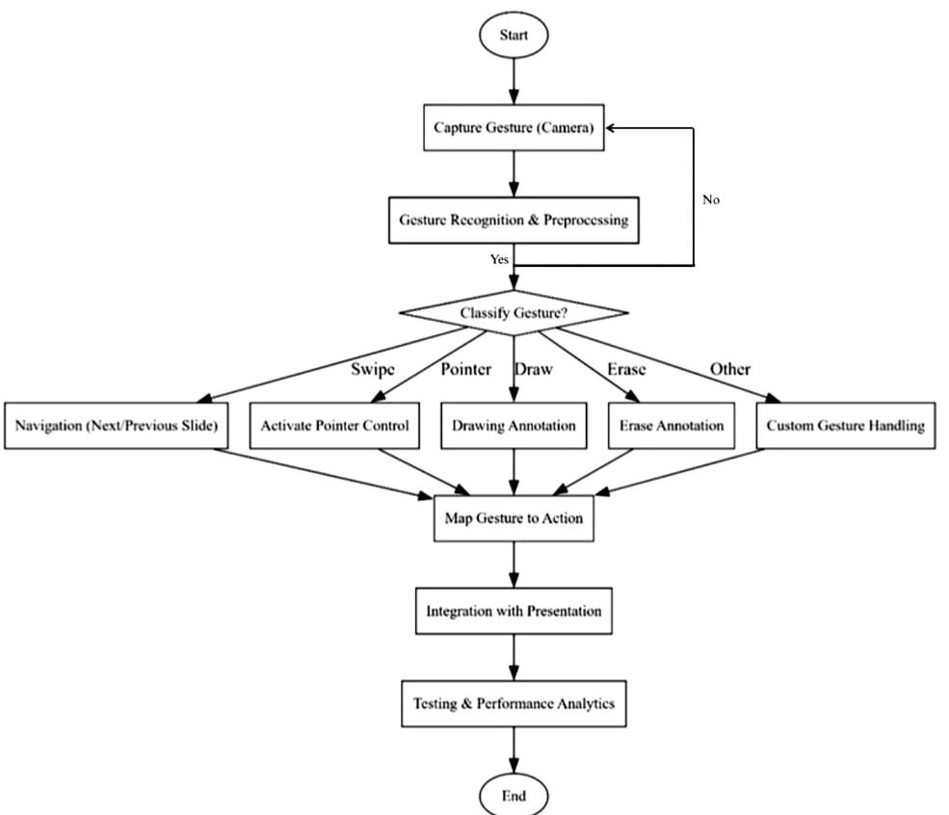
🔄 Flowchart

Slide 12
✅ Expected Outcomes
To achieve reliable real-time recognition of default gestures while also supporting the addition of custom gestures for extended functionality.
To enable seamless and low-latency control of presentations, including slide navigation, pointer movement, drawing, and erasing actions.
To provide users with flexibility by allowing gesture-to-action remapping and customization through an intuitive interface.
To ensure robust system performance under varied users, lighting conditions, and environments, with measurable metrics such as accuracy and latency.

Slide 13
📖 References
[1] D. Sirisha, G. S. Reddy, R. U. Sri, R. Hemanth, and P. M. Kalyan, “Gesture Driven Presentation Control,” Int. J. Eng. Sci. Adv. Technol. (IJESAT), vol. 24, no. 5, May 2024.
[2] D. Upadhyay, P. Sati, and N. Jain, “Enhancing Presentation Dynamics with Real-Time Hand Gesture Recognition: A Review,” IEEE Access, 2024.
[3] A. Kaur and S. Bansal, “A Machine Learning Based Approach for Dynamic Hand Gesture Recognition in Human-Robot Interaction,” IEEE Robotics and Automation Letters, 2024.
[4] T. L. Le, “A Continuous Real-Time Hand Gesture Recognition Method Based on Skeleton,” IEEE Sensors Journal, 2024.
[5] Y. Matsuzaka and R. Yashiro, “AI-Based Computer Vision Techniques and Expert Systems,” AI, vol. 4, no. 1, pp. 289–302, Feb. 2023.
[6] V. Madaan and N. Sharma, “Hand Gesture Recognition Using Convolutional Neural Networks,” Chitkara University Journal of Engineering, 2023.
[7] P. Raj, M. Singh, S. Pandey, and Y. Singh, “Hand Sign & Gesture Recognition System,” IEEE Access, 2023.
[8] A. Kumar, H. Anandaram, R. Pandey, K. Joshi, K. Alam, and S. Chaudhary, “Hand Gesture Based AI Controller for Presentation, Virtual Drawing and System Volume Management,” Amrita Vishwa Vidyapeetham / GEHU / Uttaranchal Univ. Research Publication, 2023.

Slide 14
[9] A. Dixit, S. Jain, A. Kazmi, Aakanksha, and K. Manorama, “Gesture Based Model Using Deep Learning,” Ajay Kumar Garg Engineering College Journal, 2023.
[10] S. F. Ahamed, S. Srithar, P. Sandeep, and T. Paraselli, “Efficient Gesture-Based Presentation Controller Using Transfer Learning Algorithm,” IEEE Conf. Computer Communication and Informatics (ICCCI), Jan. 2023.
[11] S. C. B. Jaganathan, K. Basak, K. R., S. Verma, T. Prakash, and A. Mital, “Dynamic Hand Gesture Recognition,” VIT Bhopal University Technical Report, 2023.
[12] B. Pustode, V. Pawar, V. Pawar, T. Pawar, and S. Pokale, “Smart Presentation System Using Hand Gestures,” Research Square Preprint, Feb. 2023.
[13] C. S. Charan, K. Meenakshi, V. B. Reddy, and V. Kashyap, “Controlling PowerPoint Presentation Using Hand Gestures in Real-Time,” IEEE Access, 2023.
[14] S. Powar, S. Kadam, S. Malage, and P. Shingane, “Automated Digital Presentation Control Using Hand Gesture Technique,” IEEE Conf. Advances in Computer Communication (ICACC), 2022.
[15] M. Oudah, A. Al-Naji, and J. Chahl, “Hand Gesture Recognition Based on Computer Vision: A Review of Techniques,” Journal of Imaging, vol. 6, no. 73, pp. 1–23, Jul. 2020.

