Slide 1
Book genre prediction
Done by:
Ezzeldein 206879 Sara Amjad 212071
Ahmed Sameh 211392 Abdulrahman Ayman 211896

Slide 2
Table of contents
01
Dataset
02
Preprocessing
03
Skip-gram
04
CBOW
05
Glove
06
Comparison
Notes:
Note: you can add between 3 and 6 sections, the structure can vary. The numbers have to be kept

Slide 3
01
Dataset
You can enter a subtitle here if you need it

Slide 4
Dataset
Type of dataset.
Num of data.
Labelled classes.
Distribution plot

Slide 5
Dataset
Type of dataset.
Num of data.
Labeled dataset
4658

Slide 6
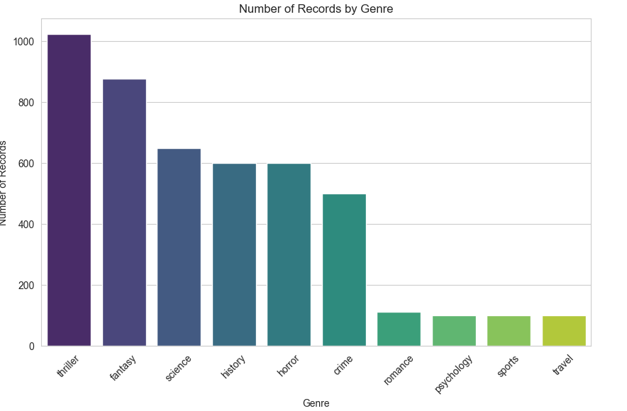
Dataset
Labelled classes
Distribution plot

Slide 7
02
Preprocessing

Slide 8
Preprocessing
Over & under sampling
Remove stop word
Stemming
Text Cleaning
Tokenization
Label Encoder

Slide 9
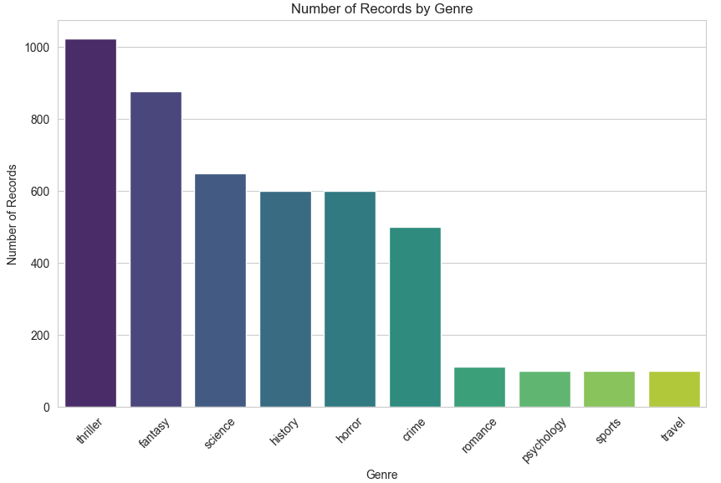
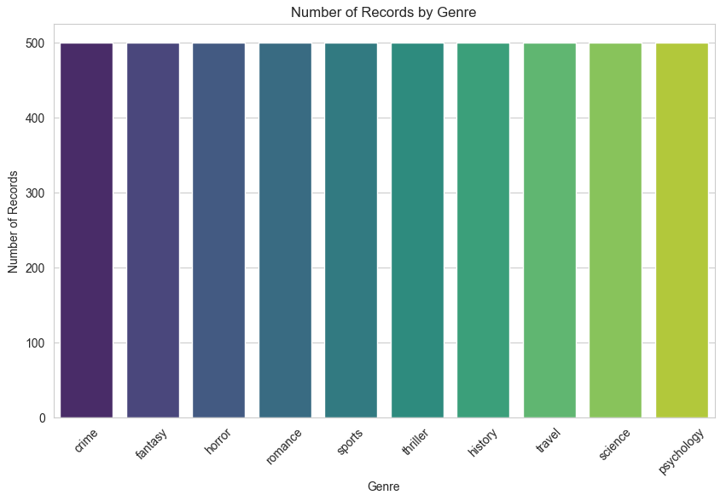
Preprocessing
Over & under sampling
Before
After

Slide 10
Preprocessing
Text Cleaning
remove backslash
remove everything except alphabets
remove whitespaces
convert text to lowercase

Slide 11
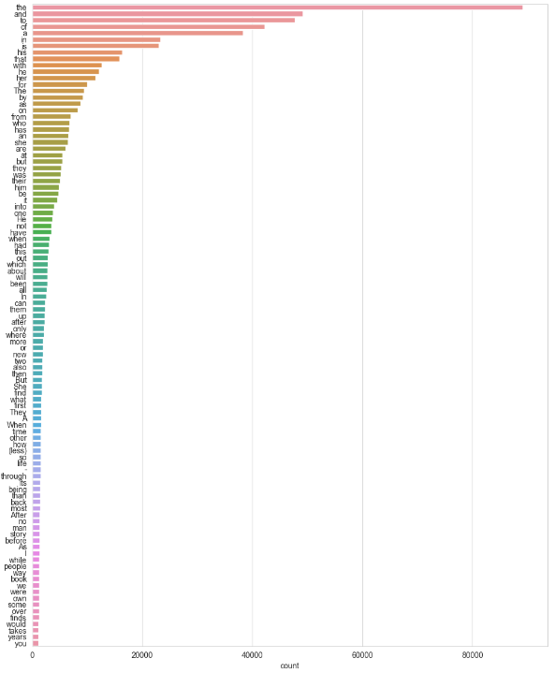
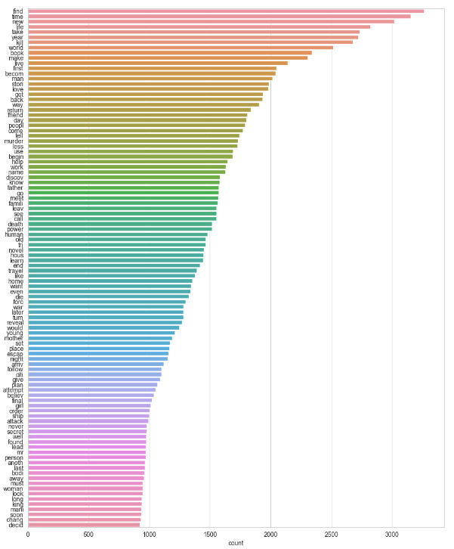
Preprocessing
Remove stop word
Before
After

Slide 12
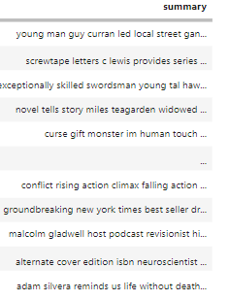
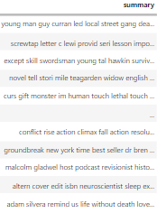
Preprocessing
Stemming
Before
After

Slide 13






Preprocessing
Label Encoder
T
1

Slide 14
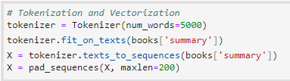
Preprocessing
Tokenization

Slide 15
03
Skipgram

Slide 16
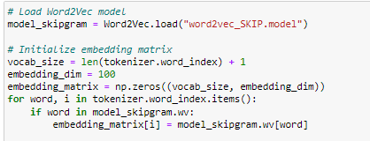
Skipgram
Word embeddings

Slide 17
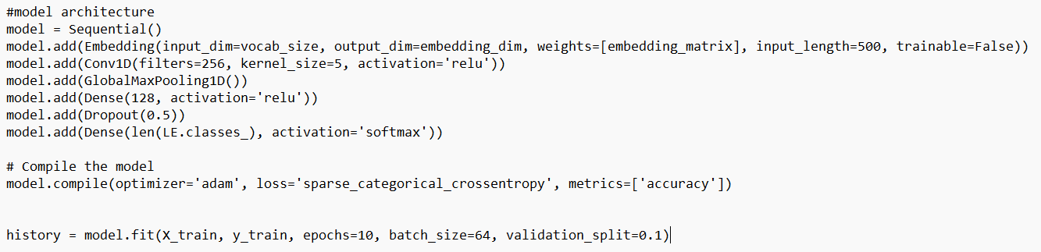
Skipgram
CNN Model

Slide 18
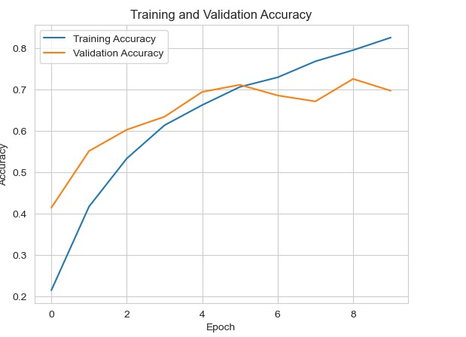
Skipgram
Learning Curve

Slide 19
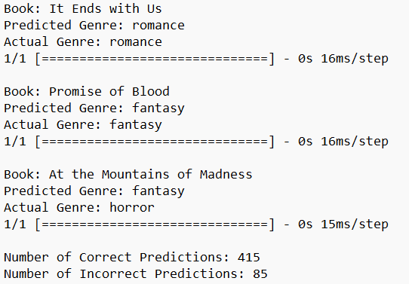
Skipgram
Prediction

Slide 20
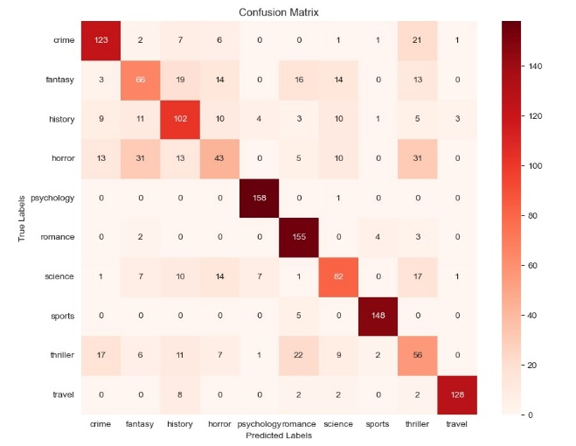
Skipgram
Confusion matrix

Slide 21
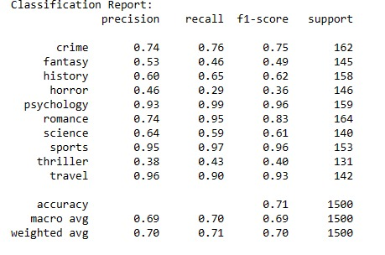
Skipgram
Classification Report

Slide 22
04
Cbow

Slide 23
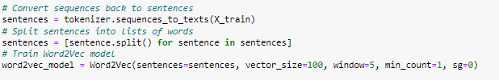
Cbow
Word2vec Training

Slide 24
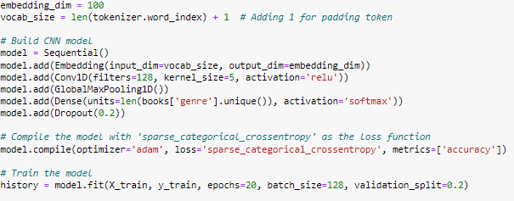
Cbow
CNN Model

Slide 25
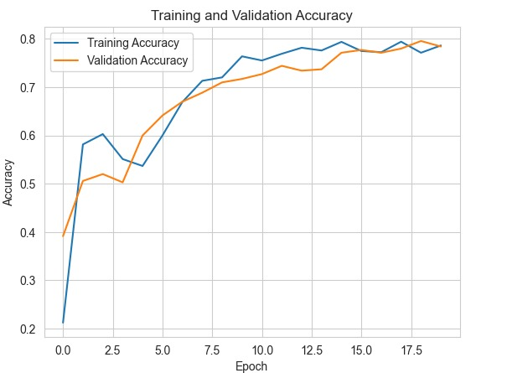
Cbow
Learning Curve

Slide 26
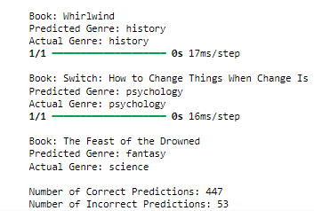
Cbow
Prediction

Slide 27
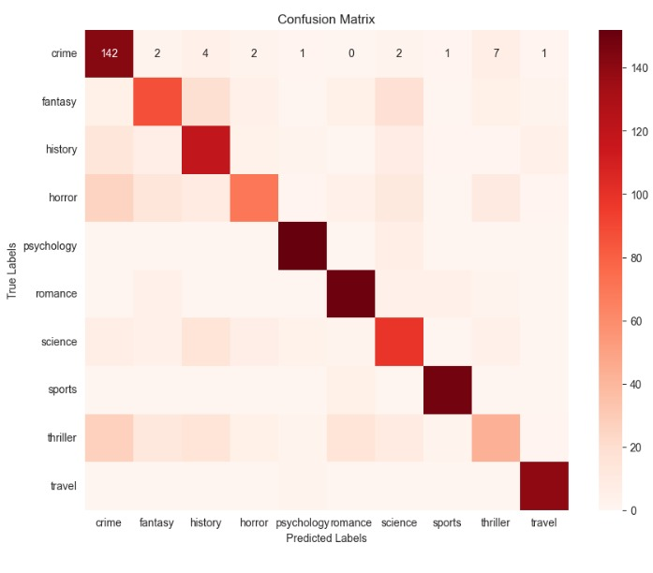
Cbow
Confusion matrix

Slide 28
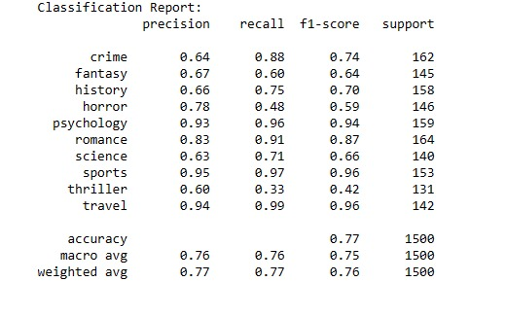
Cbow
Classification Report

Slide 29
05
Glove

Slide 30
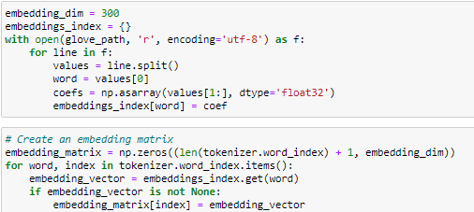
Glove
Word embeddings

Slide 31
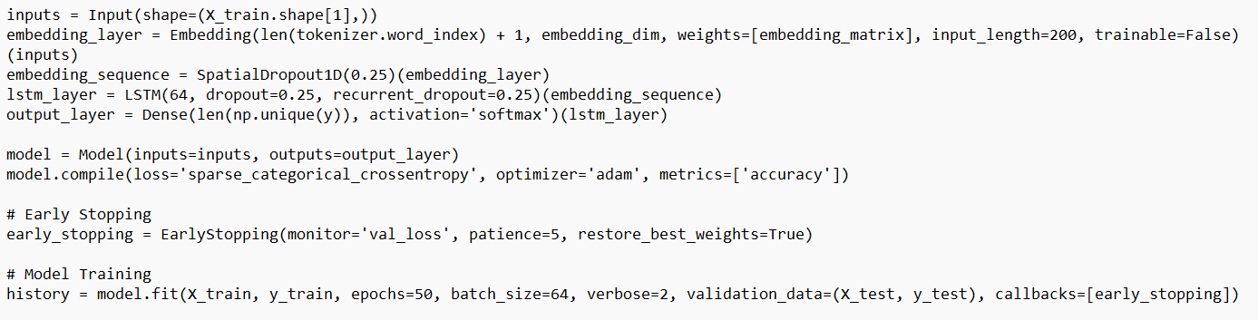
Glove
Lstm Model

Slide 32
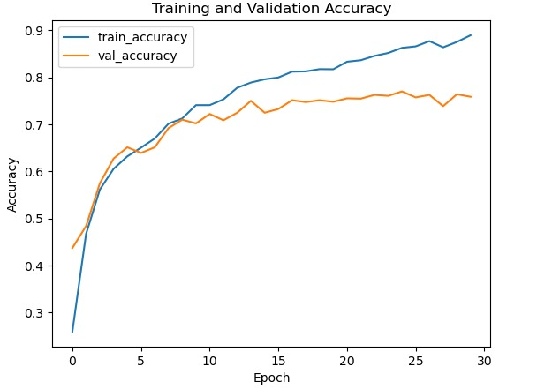
Glove
Learning Curve

Slide 33
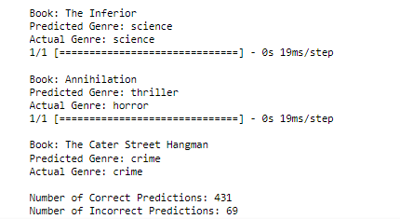
Glove
Prediction

Slide 34
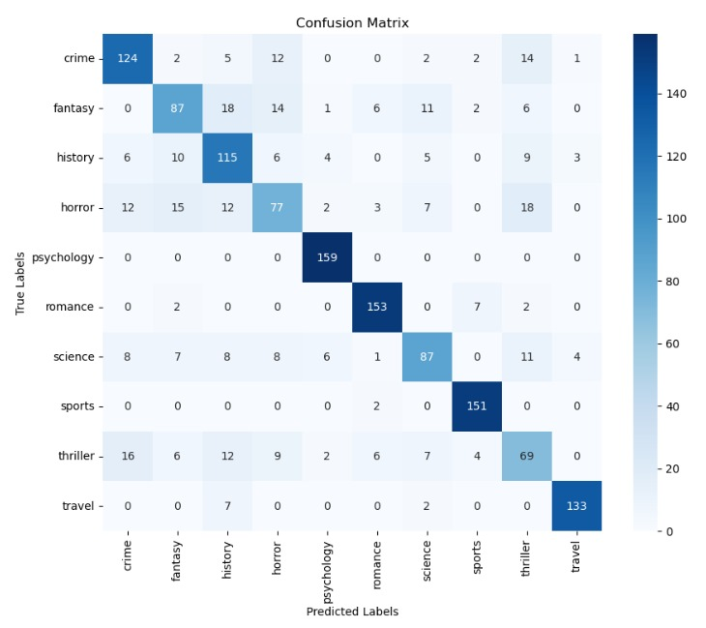
Glove
Confusion matrix

Slide 35
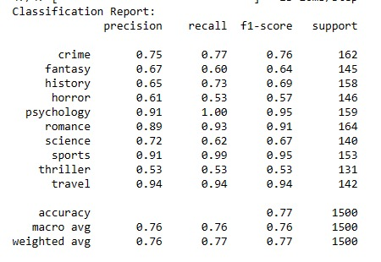
Glove
Classification Report

Slide 36
06
Comparison

Slide 37
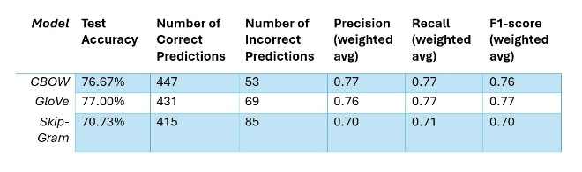
Comparison
Comparison Table

