Slide 1


CASE STUDY : 04
Air Quality Prediction in Urban Areas

Slide 2
Team
SR | TEAM ID | NAME | ROLE
1 | S4F_CP_Team_12219 | SARAVANA KUMAR. R | Team Leader
2 | S4F_CP_Team_12219 | RAHUL. S | Team Member 1
3 | S4F_CP_Team_12219 | ASIF.T | Team Member 2
4 | S4F_CP_Team_12219 | NANDHAKUMAR. S | Team Member 3
5 | S4F_CP_Team_12219 | ADITHYA M | Team Member 4

Slide 3
Content
Abstract
Problem Statement
Objective
Data Collection and Preparation
Proposed Solution (Methodology)
Model Performance Evaluation
Screenshots / Demonstration (video)
Future Scope
Conclusion
Notes:
Abstract
Problem Statement (Clearly define the challenge)
Objective (State your project's goal)
Background and Research (Discuss existing solutions, trends, and gaps)
Data Collection and Preparation (Focus on data sources, cleaning, and augmentation)
Proposed Solution (Methodology)
Model Architecture (e.g., CNN, U-Net, YOLOv5)
Key Techniques (e.g., Transfer Learning, Image Augmentation)
Model Performance Evaluation
Metrics (Accuracy, Precision, Recall, IoU, etc.)
Graphs (Confusion Matrix, ROC Curve, etc.)
Screenshots / Demonstration (Visual proof of system functionality)
Future Scope (Improvements, scalability, and integration ideas)
Conclusion (Summarize results and impact)
Q&A Session
3

Slide 4
Abstract
This case study explores the application of machine learning in predicting air quality levels in urban areas, with a focus on the challenges posed by air pollution and the potential for AI to provide timely insights.By leveraging extensive datasets that include air quality metrics, traffic data, and weather conditions, this study seeks to develop a predictive model for Air Quality Index (AQI) and discusses its integration into city management systems

Slide 5
Problem Statement
Air pollution poses a serious risk to public health and the environment in urban settings.Traditional air quality monitoring methods are insufficient due to limited sensor coverage and real-time data reporting.There is a pressing need for advanced predictive models that utilize existing data sources to accurately forecast air quality levels.

Slide 6
Objective
The primary objective of this study is to develop a machine learning model capable of predicting air quality indices (AQI) for urban areas 24 hours in advance, and to explore the integration of this model into existing traffic management systems to facilitate pollution reduction strategies.

Slide 7
Data Collection and Preparation
The dataset comprises three years of air quality measurements (PM2.5, PM10, NO2, CO), alongside corresponding traffic data and meteorological conditions.Data preprocessing steps will include handling missing values, normalizing data, and feature selection to ensure the model is trained on relevant input variables.

Slide 8
Proposed Solution (Methodology)
The methodology involves selecting appropriate machine learning algorithms, such as Random Forest, Gradient Boosting, or Neural Networks, to predict AQI.The model will be trained using historical data, incorporating cross-validation techniques to avoid overfitting.Hyperparameter tuning will be conducted to optimize model performance.

Slide 9
Model Performance Evaluation
Model performance will be evaluated using metrics such as Mean Absolute Error (MAE), Root Mean Squared Error (RMSE), and R-squared values.A comparison of different algorithms will be presented to identify the best-performing model for AQI prediction.

Slide 10
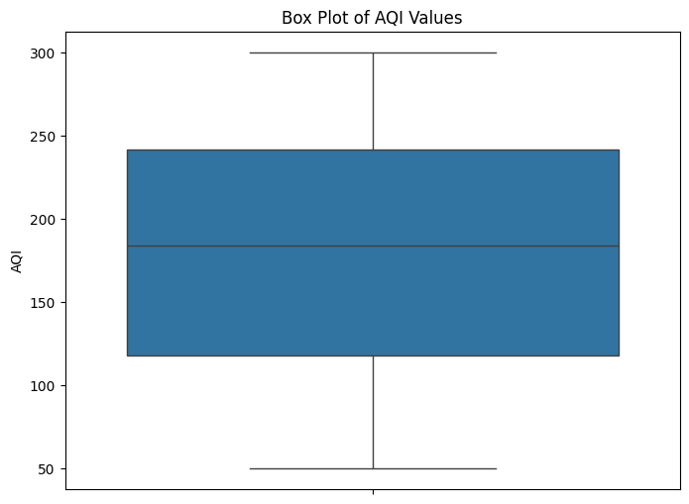
Screenshots / Demonstration (video)
GITHUB LINK: https://github.com/Sara8456/AI-and-green-skills-case-study-4

Slide 11
Future Scope
Future work will explore the integration of the predictive model with traffic management systems to enable real-time decision-making and pollution mitigation.Additionally, potential expansions to include socioeconomic data and its impact on air quality predictions will be investigated.

Slide 12
Case study 4:Questions
1. How can machine learning models be used to predict air quality levels?
Machine learning models can predict air quality by analyzing historical data (e.g., pollutants, weather, traffic) and identifying patterns. The trained model can then forecast future AQI levels based on input features like weather forecasts and current pollutant concentrations.
2. Which features in the dataset are likely to have the most significant impact on air quality?
Key features include:
Pollutant levels (PM2.5, PM10, CO, NO2, SO2, ozone)
Weather conditions (temperature, humidity, wind speed)
Traffic data (vehicle count, congestion)
Time of day/seasonality
Industrial activity
Geographical factors (location, topography)

Slide 13
3. Build a model to predict AQI for the next 24 hours.
from sklearn.ensemble import RandomForestRegressor
from sklearn.model_selection import train_test_split
import pandas as pd
# Load data
data = pd.read_csv('air_quality_data.csv')
# Features and target
features = data[['PM2.5', 'PM10', 'NO2', 'CO', 'Temperature', 'Humidity', 'Traffic_Density']]
target = data['AQI']
# Train-test split
X_train, X_test, y_train, y_test = train_test_split(features, target, test_size=0.2, random_state=42)
# Model training
model = RandomForestRegressor()
model.fit(X_train, y_train)
# Prediction for next 24 hours
predicted_aqi = model.predict(X_test)

Slide 14
4. How can this model be integrated with a city's traffic management system to reduce pollution?
The AQI prediction model can feed into traffic systems, allowing dynamic traffic routing to reduce congestion in high-pollution areas, adjust signal timings to minimize idling, and promote cleaner transport options like public transit or carpooling based on forecasted pollution levels.
5. Discuss the role of AI in mitigating air pollution in developing countries.
AI can help by providing low-cost pollution monitoring, optimizing traffic and public transport, recommending energy-efficient practices, managing industrial emissions, and supporting data-driven policies to reduce pollution, all of which are crucial for developing countries with limited resources.

Slide 15
Conclusion
This case study highlights the critical role of AI in enhancing air quality prediction capabilities in urban areas. By leveraging machine learning, cities can proactively address air pollution, ultimately leading to improved public health outcomes and environmental sustainability.

