Slide 1

VECTORS
Team 3

Slide 2
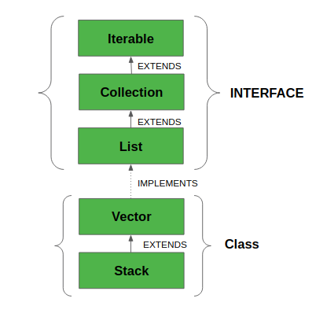
Java Vector
A vector can be
Defined as a dynamic array that can grow on own vector will grow when more elements are added to it and will shrink when elements are removed from it.

Slide 3
Example of code
Class Declaration
public class CodeVectorsExample {
public static void main(String[] args) {
// Creating a vector (array) of integers
int[] numbers = {1, 2, 3, 4, 5};
// Accessing and printing elements of the vector
for (int i = 0; i < numbers.length; i++)
{ System.out.println("Element at index " + i + ": " + numbers[i]);
}
}
}
Main Method
Array Creation and Initialization
Loop to Access and Print Array Elements:

Slide 4
Driver class
public static void main(String[] args) {
// Creating an instance of CodeVectorsExample
CodeVectorsExample example = new CodeVectorsExample();
// Invoking the main method of CodeVectorsExample
example.main(args);
}
}

Slide 5
Output:
Element at index 0: 1
Element at index 1: 2
Element at index 2: 3
Element at index 3: 4
Element at index 4: 5
- The output shows each element of the array along with its index.

Slide 6
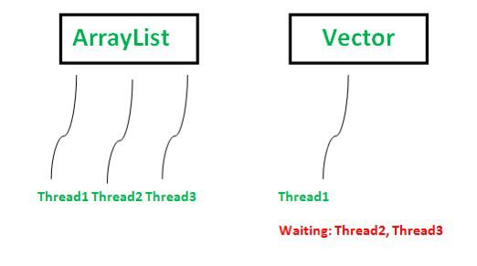
Vectors vs Arraylist
Vector is like the dynamic array which can grow or shrink its size.
Unlike Array, we can store n-number of elements in it as there is no size limit

Slide 7
