Slide 1


GRADUATION PROJECT PROPOSAL
EGX Automated Market
Data Pipeline
An automated, quality-controlled data platform for Egyptian stock-market analytics
Presented By:
Sara Ashraf
Malak Tamer
Malak Ahmed
Salma Sherif
Ziad Ragab
Saif Ramadan

Slide 2
1. Proposal
What we intend to build
Build a scheduled pipeline that turns raw Egyptian stock-market records into trusted, analysis-ready data.
COLLECT
TRUST
ANALYZE
Retrieve historical and, where supported, new market records from an approved source.
Preserve raw data, clean it reproducibly, and run explicit quality checks.
Publish metrics, SQL views, charts, and summaries for researchers and analysts.
02

Slide 3
2. Problem and proposed solution
Local use case: Egyptian Exchange (EGX)
PROBLEM TO VALIDATE
OUR SOLUTION
• Market records may arrive in different formats or from separate sources
• Manual cleaning and repeated calculations take time
• Missing values, duplicates, and inconsistent timestamps can distort analysis
• A one-time CSV download does not provide a monitored daily process
• A repeatable ingestion process with retries and incremental loading
• Raw-data retention plus standardized clean tables
• Automated data-quality rules and audit logs
• SQL analytics for returns, moving averages, volatility, and volume changes
• Charts and a concise data-quality report
Important: the project will demonstrate the solution on real data; it will not claim to predict prices or guarantee investment returns.
03

Slide 4
Target users and project outputs
Designed for research and data reliability—not financial advice
FINANCIAL RESEARCHERS
STUDENTS & EDUCATORS
DATA TEAMS
Compare historical performance, activity, and volatility across listed companies.
Explore real local market data through reproducible SQL queries and charts.
Inspect pipeline runs, record counts, and data-quality failures.
Final deliverables
• Automated Airflow DAG and Python modules
• SQL Server schema, ERD, and data dictionary
• Test suite and data-quality report
• 10–12 analytical SQL queries and views
• Time-series charts and findings summary
• README, architecture diagram, and live demo
04

Slide 5
3. Tech stack
Each tool has a clear responsibility
Python + Requests
Spark
API ingestion, retries, validation
Profiling, type conversion, deduplication, metrics
SQL Server
Apache Airflow
Raw JSONB, clean records, metrics, audit tables
Scheduling, dependencies, retries, run history
SQL
Docker Compose + GitHub
CTEs, LAG, window functions, ranking, views
Repeatable setup, collaboration, code review
Matplotlib / Plotly
MongoDB
Price, return, volume, and volatility charts
Original JSON document store if needed
05

Slide 6
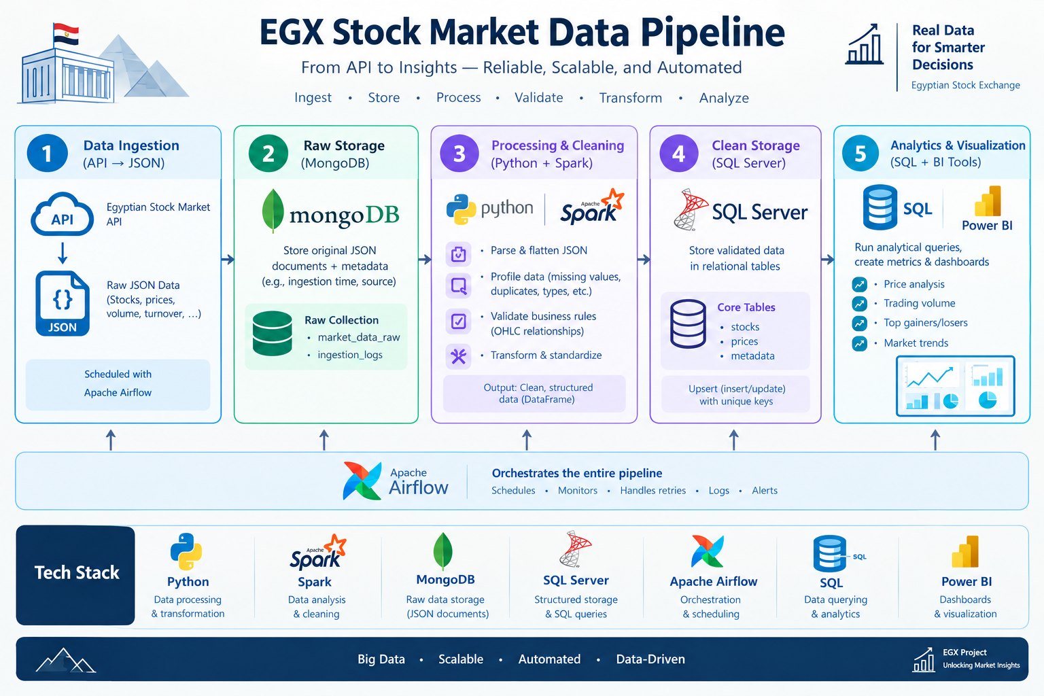
4. Data architecture and flow
End-to-end pipeline
06

Slide 7
5. Data profiling and engineering fixes
These are checks to run on the real sample—not claimed findings
Potential issue
How to detect it
Engineering response
Late / repeated loads
Compare max timestamp and run audit
Incremental extraction; idempotent upsert; track freshness
Missing values / gaps
Null counts; compare expected sessions
Flag gaps; distinguish holidays from missing records
Duplicate records
Duplicate symbol + timestamp keys
Deduplicate by documented rule; enforce unique constraint
Wrong data types
Inspect schema and parse failures
Convert numeric strings; parse timestamps with explicit timezone
Invalid prices
Negative/zero values; high < low; low > high
Quarantine invalid rows; log reasons; never silently discard
Outliers / volume spikes
Range checks; robust statistical thresholds
Flag for review; keep valid market events
07

Slide 8
What will the data help us answer?
Examples of analysis outputs
PERFORMANCE
RISK / VOLATILITY
TRADING ACTIVITY
Daily return, cumulative return, monthly ranking, moving averages.
Rolling volatility, maximum drawdown, unusually large price moves.
Volume spikes, turnover trends, records with unusual activity.
Validation matters
• Cross-check selected metrics computed in Pandas against SQL results.
• Test formulas on a small hand-calculated sample before scaling up.
• Describe the outputs as historical analysis, not guaranteed predictions or investment recommendations.
08

Slide 9
6. Six-week timeline
Adapted from the team's existing plan
W1
W2
W3
W4
W5
W6
Validate data source + license
Agree schema; sample profiling
→
Build ingestion, raw tables
Cleaning rules + unit tests
→
Connect end-to-end flow
Incremental load + metrics
→
Schedule Airflow DAG
Retries, logs, SQL query pack
→
Data-quality report
Cross-checks + failure tests
→
Finalize docs and charts
Fresh-clone demo + presentation
09

Slide 10
Team responsibilities
Six owners, one integrated pipeline
M1 | Project lead & orchestration
M2 | API ingestion
M3 | Database architect
Airflow DAG, Docker, logging, integration
(Airflow DAG file, Docker Compose setup, logging config, architecture diagram, release tag, final demo run)
Extraction, validation, retry, incremental/backfill
(Extraction module with validation, retry logic, incremental and backfill modes, unit tests, MongoDB loader, ingestion README section)
SQL Server design and loading
(DDL,ERD,INDEXES,UPSERT,DATA DICTIONARY)
M4 | Transformation
M5 | SQL analytics
M6 | Data quality & visualization
Turning raw JSON into clean tables and metrics
(Cleaning module, metrics module (returns, moving averages, volume stats, volatility), unit tests, transformation notes)
Analysis inside the database
(10 -12 queries with window functions and CTEs, SQL views, cross-check report, analytical findings summary)
Trust in the data and how it looks
(Quality-check functions, dq_results table, data-quality report (PDF), time series charts, test plan, final README, slides)
Use Git branches, pull requests, weekly notes, and test evidence so each member can defend their contribution.
10

Slide 11
Feasibility, risks, and decisions
What we must confirm before implementation
RISKS
MITIGATIONS
• EGX historical or intraday data may require payment or permission
• API may not cover all tickers or the required history
• Free request quotas may prevent large backfills
• Intraday volume increases storage and testing needs
• Ask for educational access or a sample file first
• Start with a small pilot; record the exact source and license
• Cache responses, use incremental loads, retry with backoff
• Use daily history as fallback, but agree with instructor whether its scale qualifies
11

Slide 12
THANK YOU
12

