Slide 1


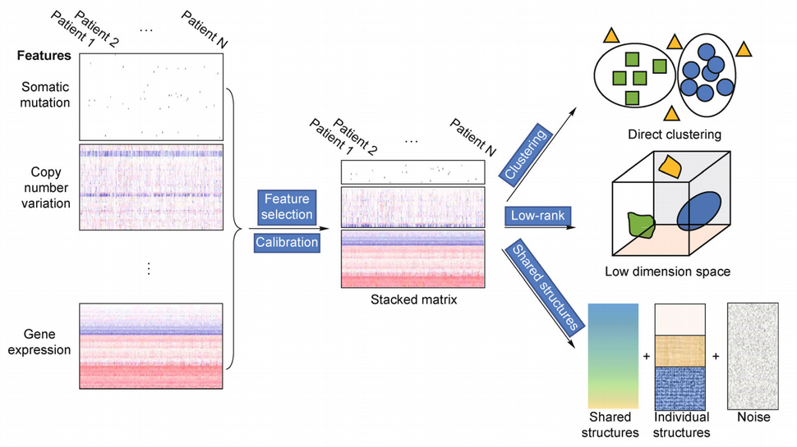



Unsupervised Machine Learning MultiOmics Integration
Physalia course
Nikolay Oskolkov, MRG Group Leader, NIRI, Riga, Latvia
@NikolayOskolkov
@oskolkov.bsky.social
Personal homepage:
https://nikolay-oskolkov.com
Image adapted from Wang et al., Quantitative Biology 4, p.58, 2016

Slide 2
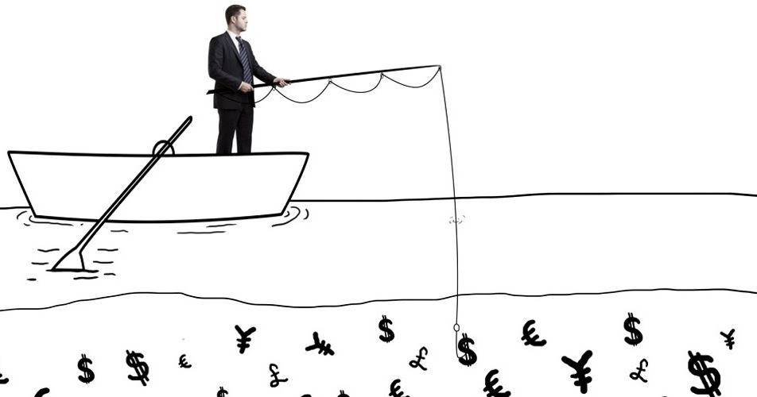
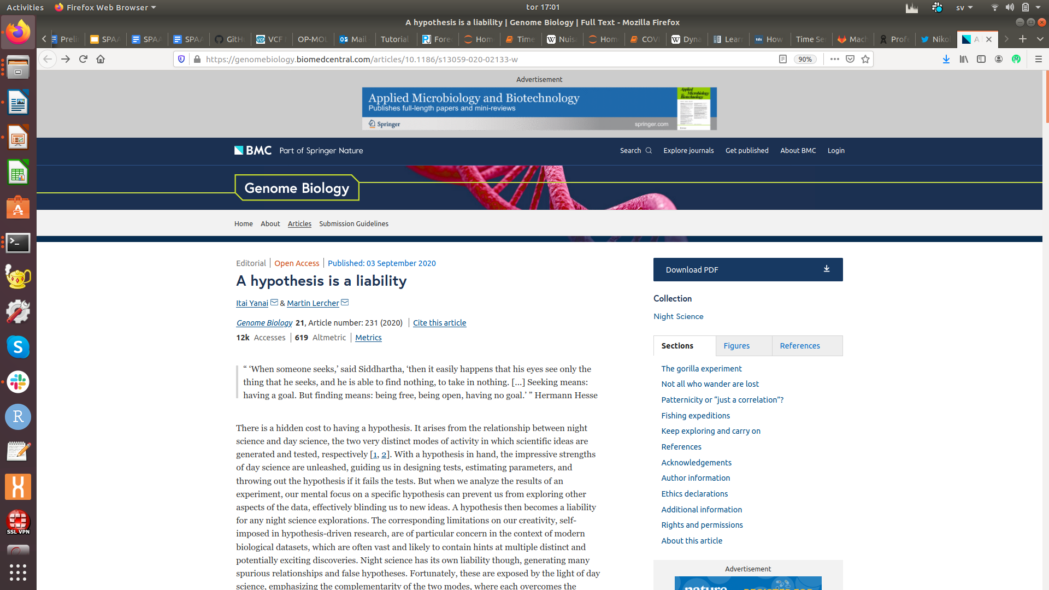
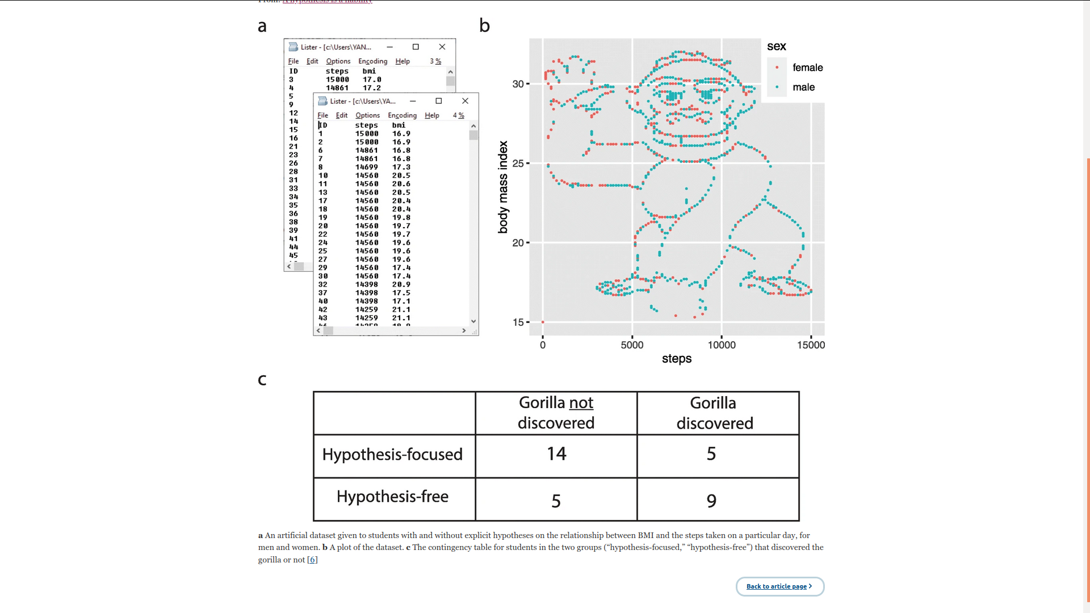
Find me something in my data
Fishing
expedition
- I do not understand your biological hypothesis
- I do not have any

Slide 3
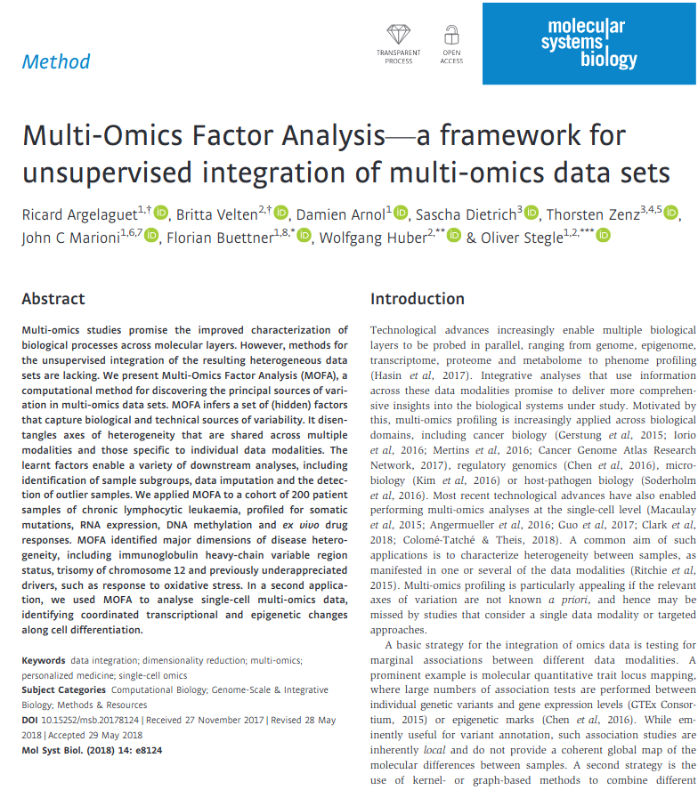
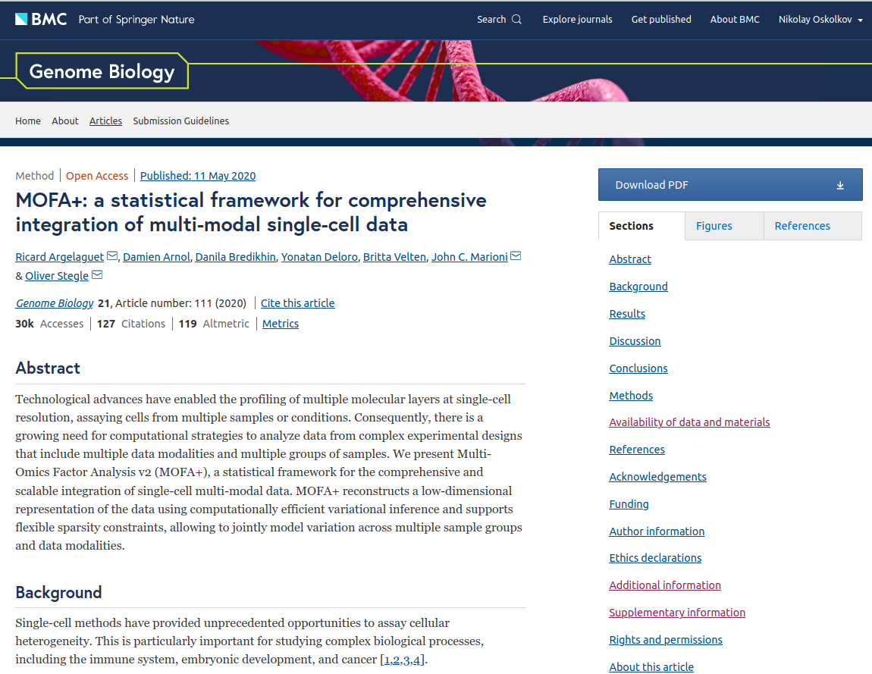
MOFA (general) and MOFA+ (single cell)

Slide 4
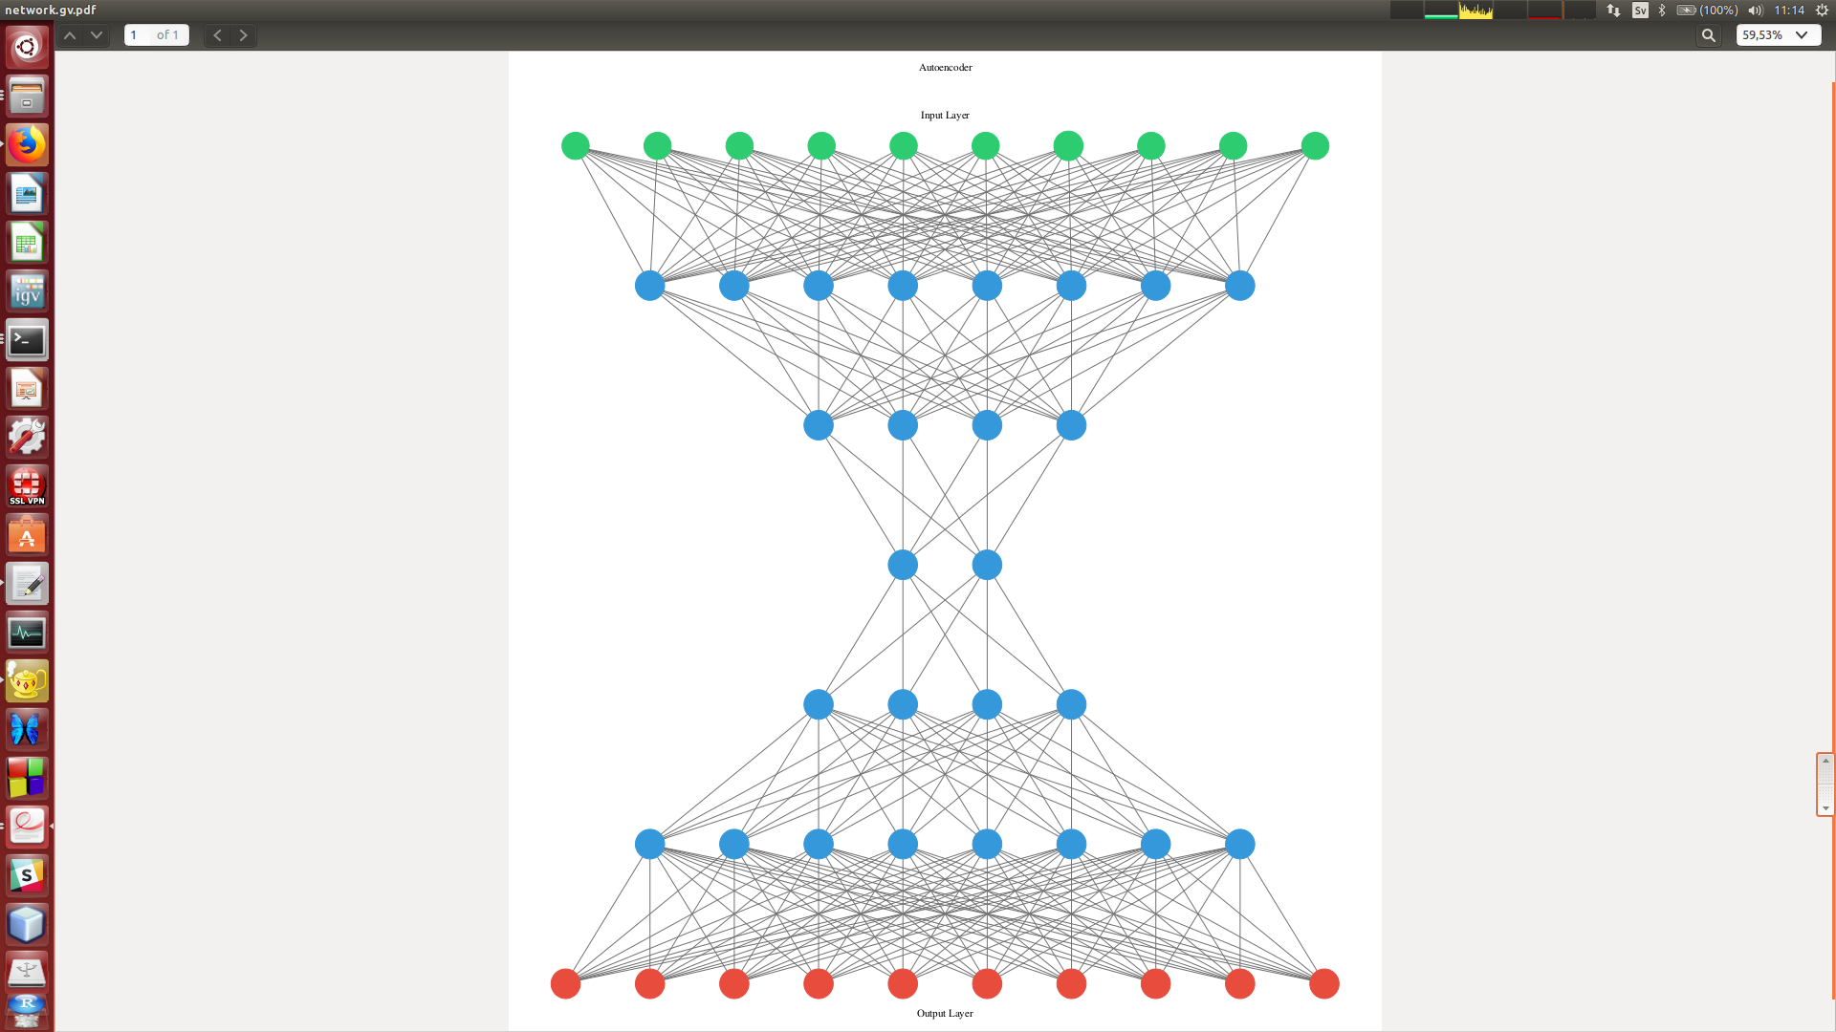
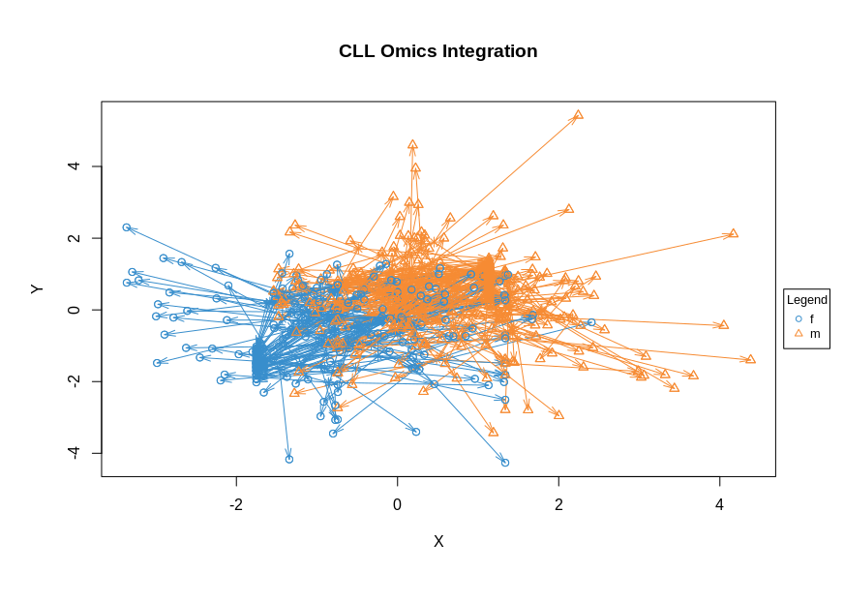
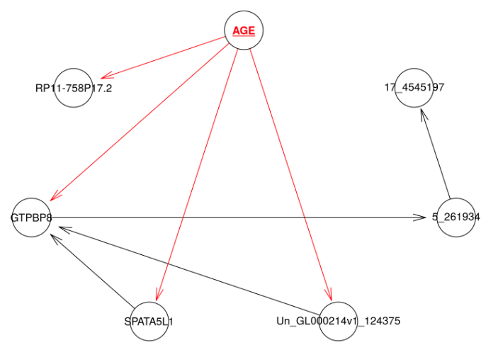
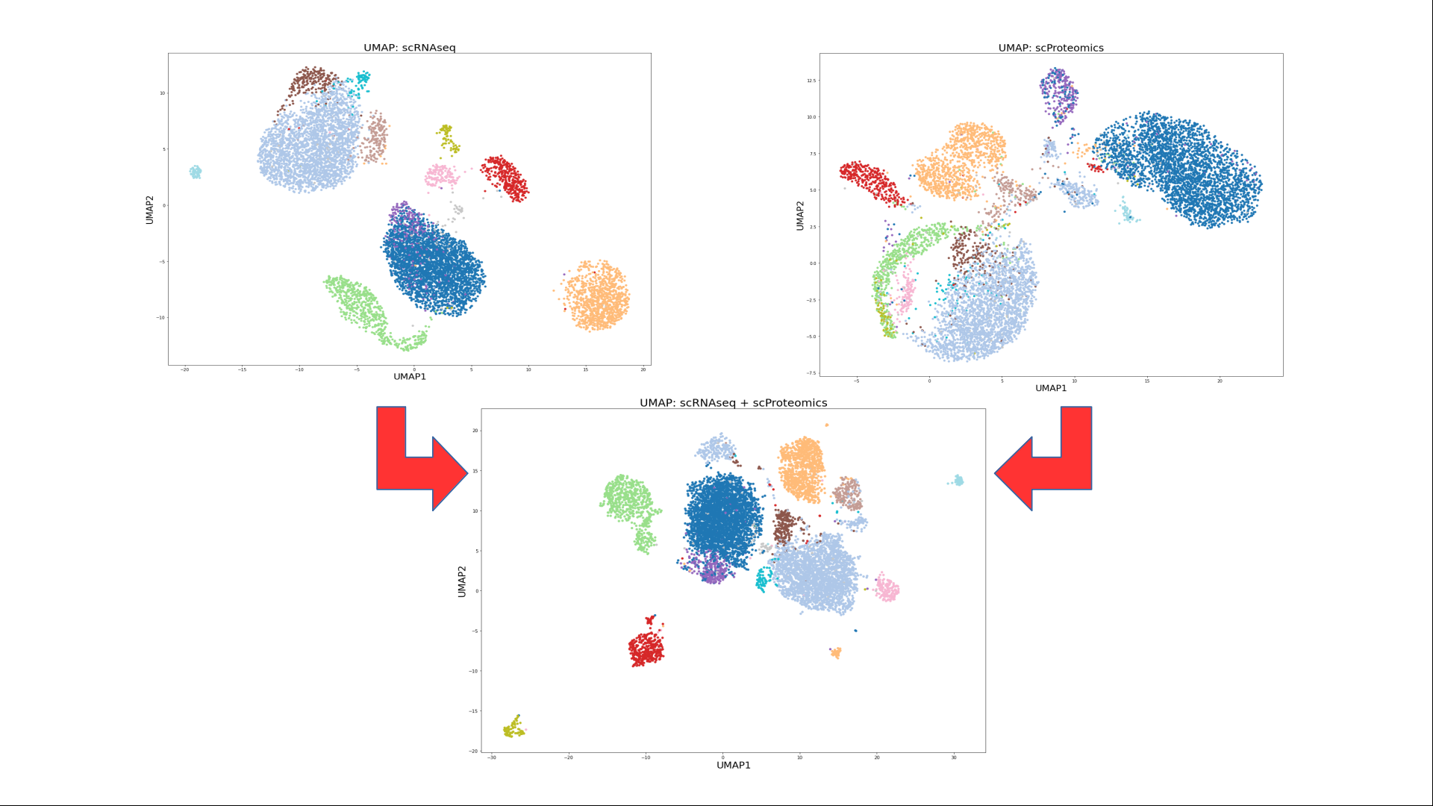
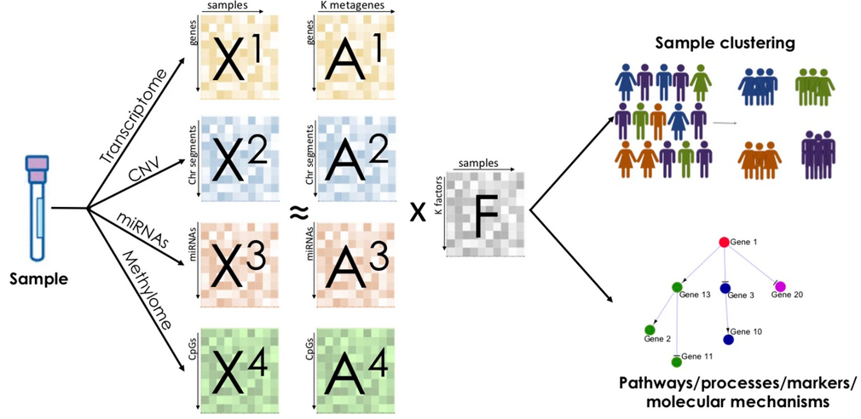

Overview of Integrative Methods
Convert to common space
Extract common variation
Combine via Bayes rule
PLS / CCA
Bayesian
networks
Neural nets
and
graphs
Bayesian
factor
analysis
UMAP

Slide 5
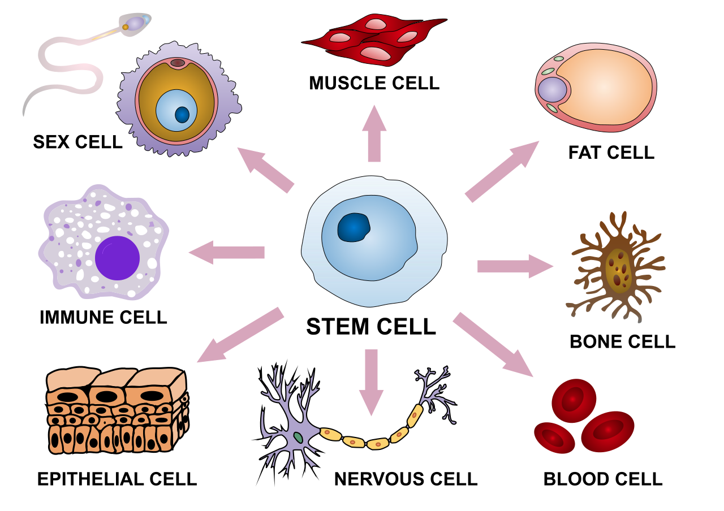
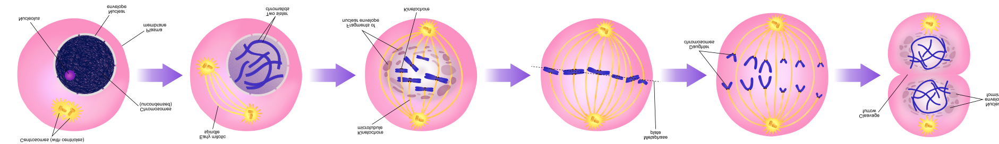
Factor Analysis: Common Axes of Variation
CELL TYPE
CELL CYCLE
L₁
L₂
P₁
P₂
P₃
N
N
N
Gene expression
Methylation
Genetic mutation

Slide 6
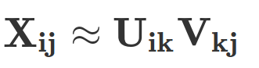
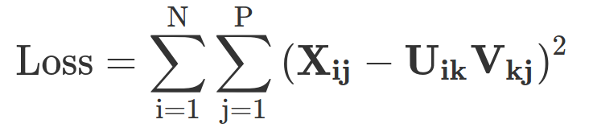
Mathematics of matrix factorization
P
D
P
x
V_{kj}
D
N
X_{ij}
≈
N
U_{ik}
Loadings
Data
Low-dimensional
data representation
(embeddings)

Slide 7
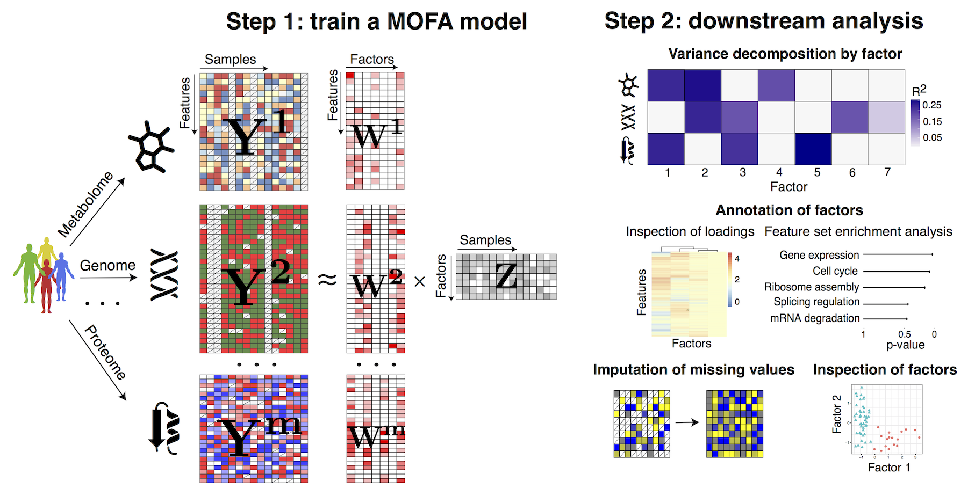
Multi-Omics Factor Analysis (MOFA)
R. Argelaguet et al., Mol. Syst. Biol. 2018

Slide 8
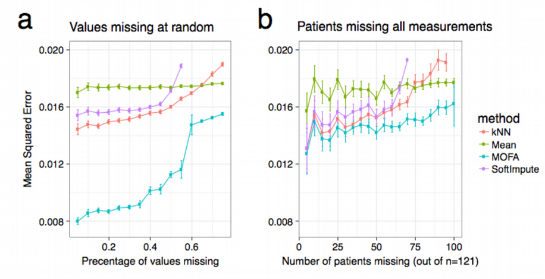
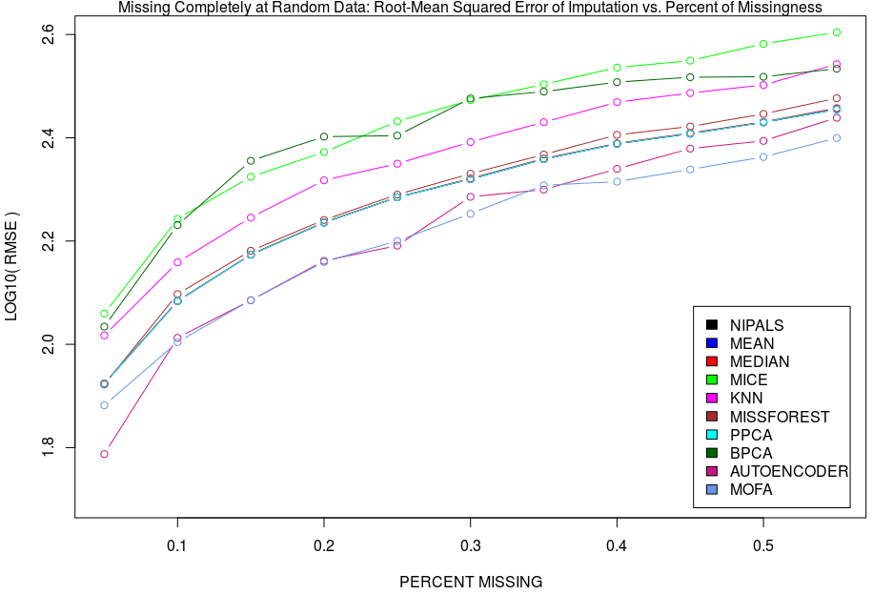
MOFA: imputation of missing values
Bayesian framework is insensitive to missing data, priors compensate
for the lack of data

Slide 9
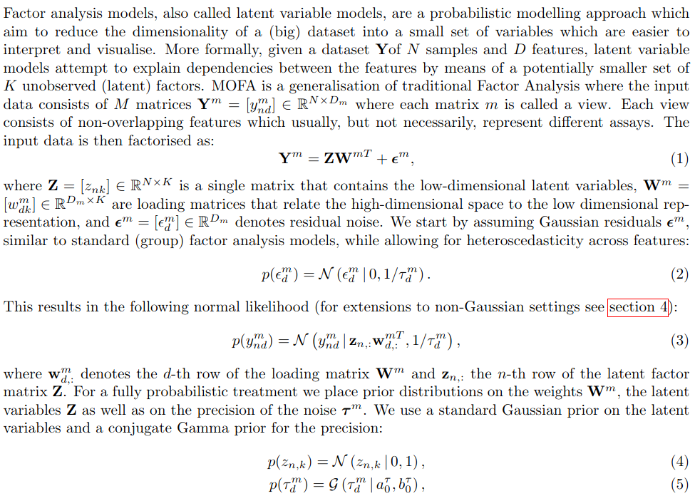
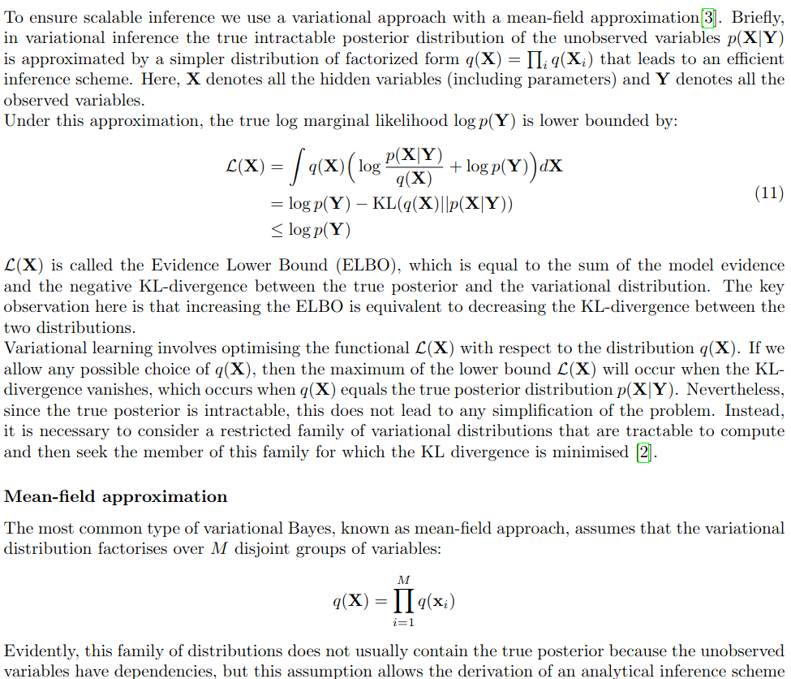
MOFA: Bayesian Group Factor Analysis
R. Argelaguet et al., Mol. Syst. Biol. 2018
R. Argelaguet et al., Mol. Syst. Biol. 2018

Slide 10
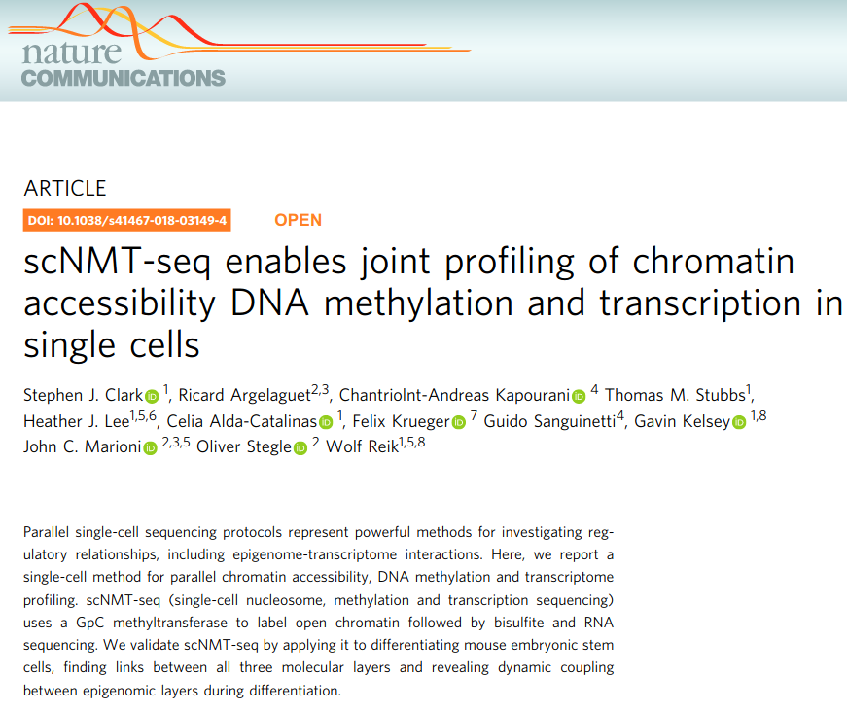
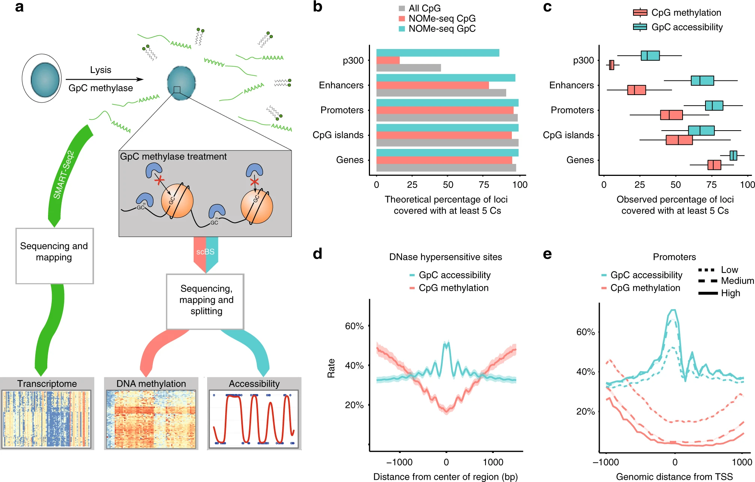
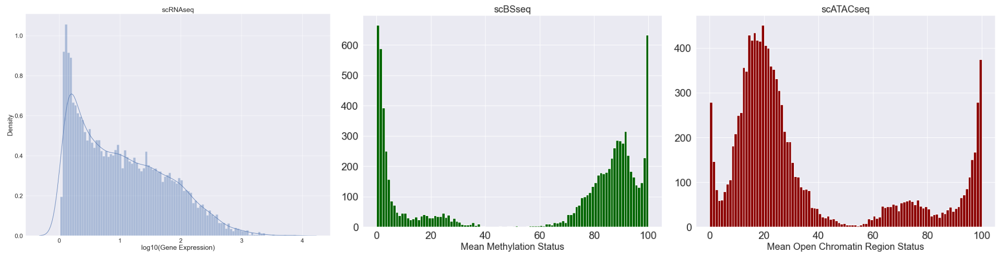
MOFA application for scNMTseq

Slide 11
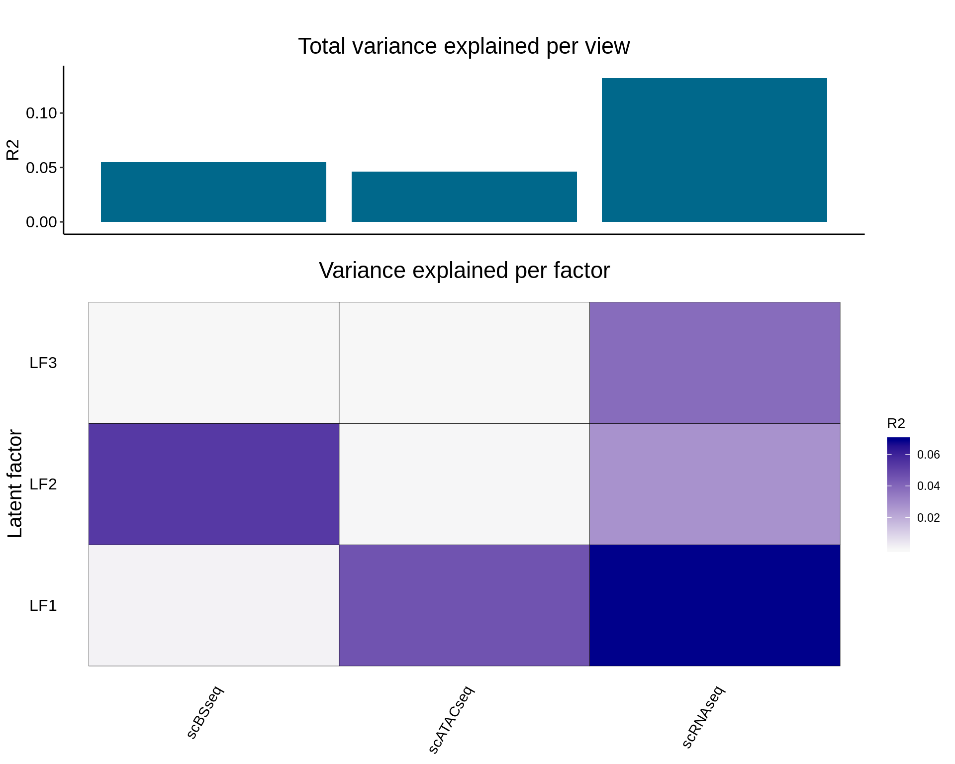
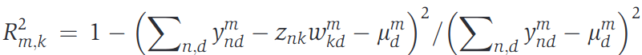
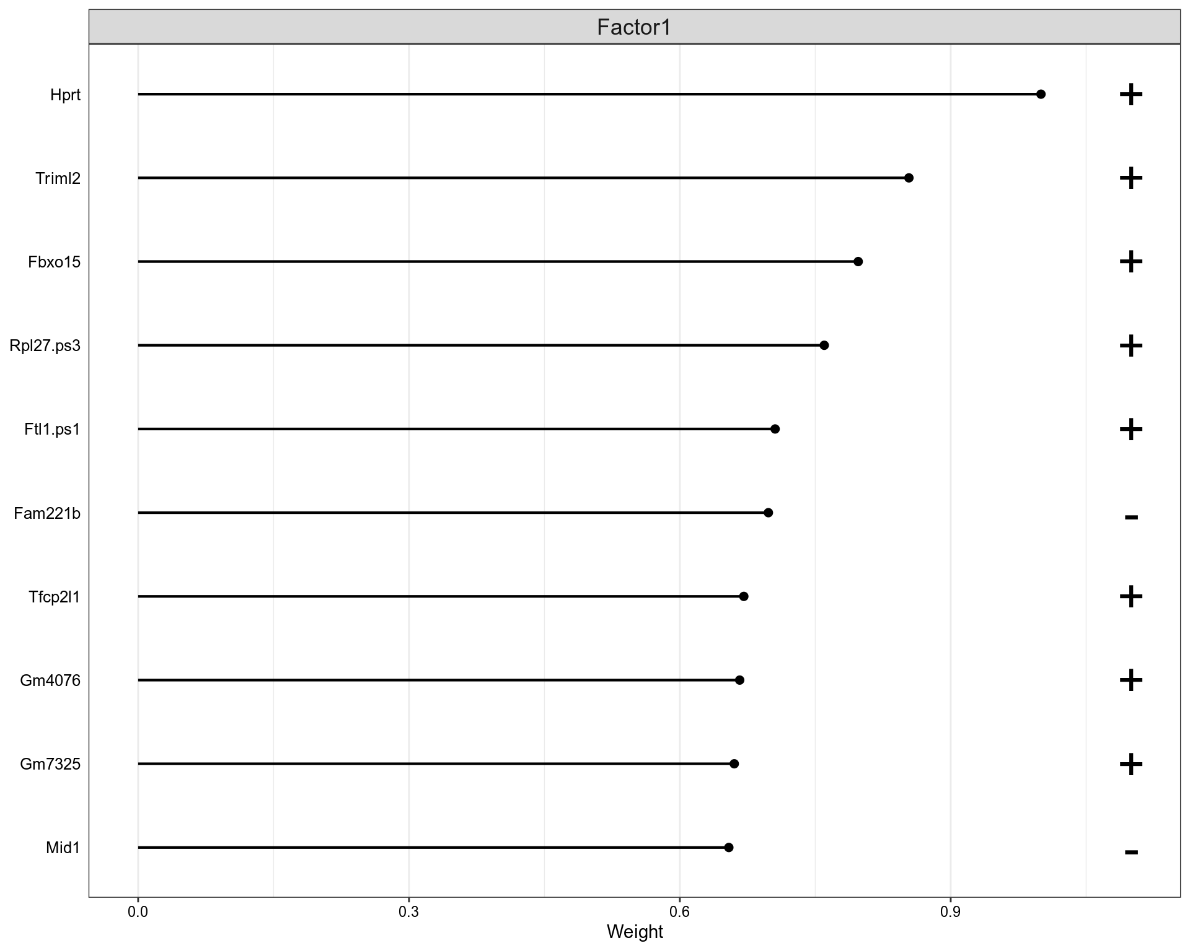
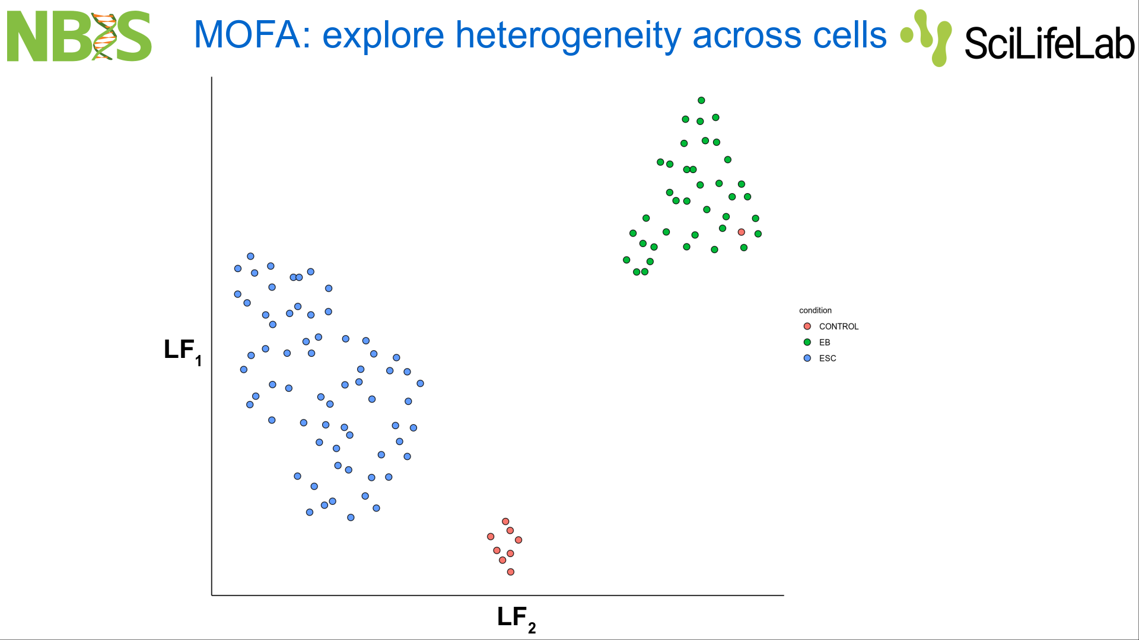
MOFA: Omics contributions to Latent Factors

Slide 12
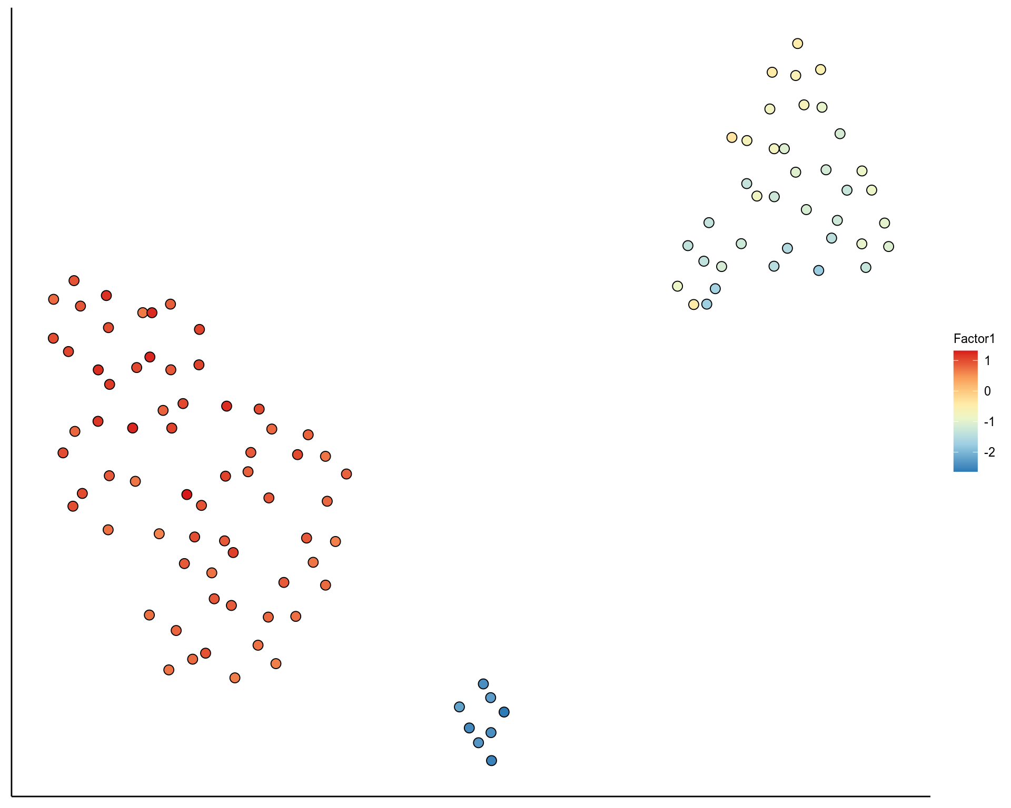
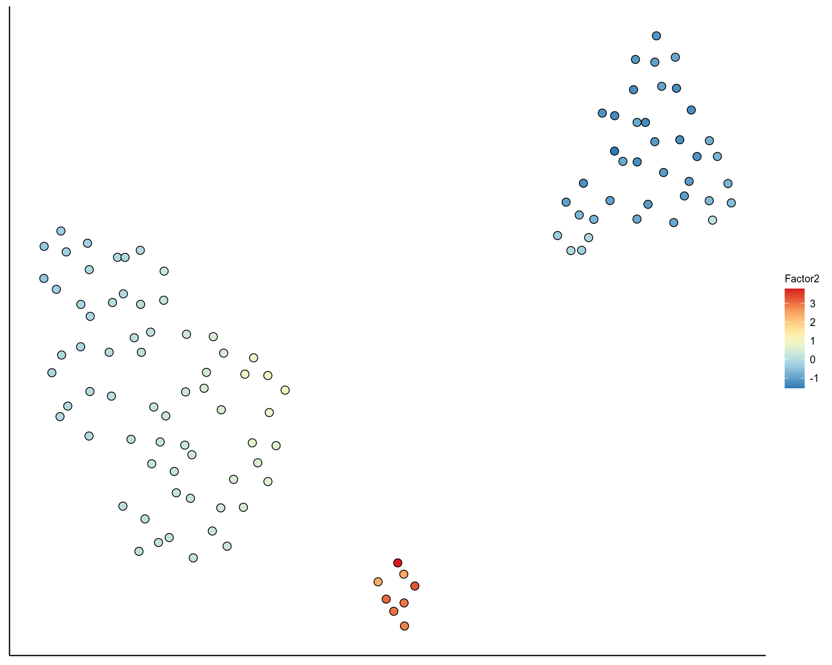
MOFA: Omics contributions to Clusters

Slide 13
Other unsupervised integrative Omics methods

Slide 14
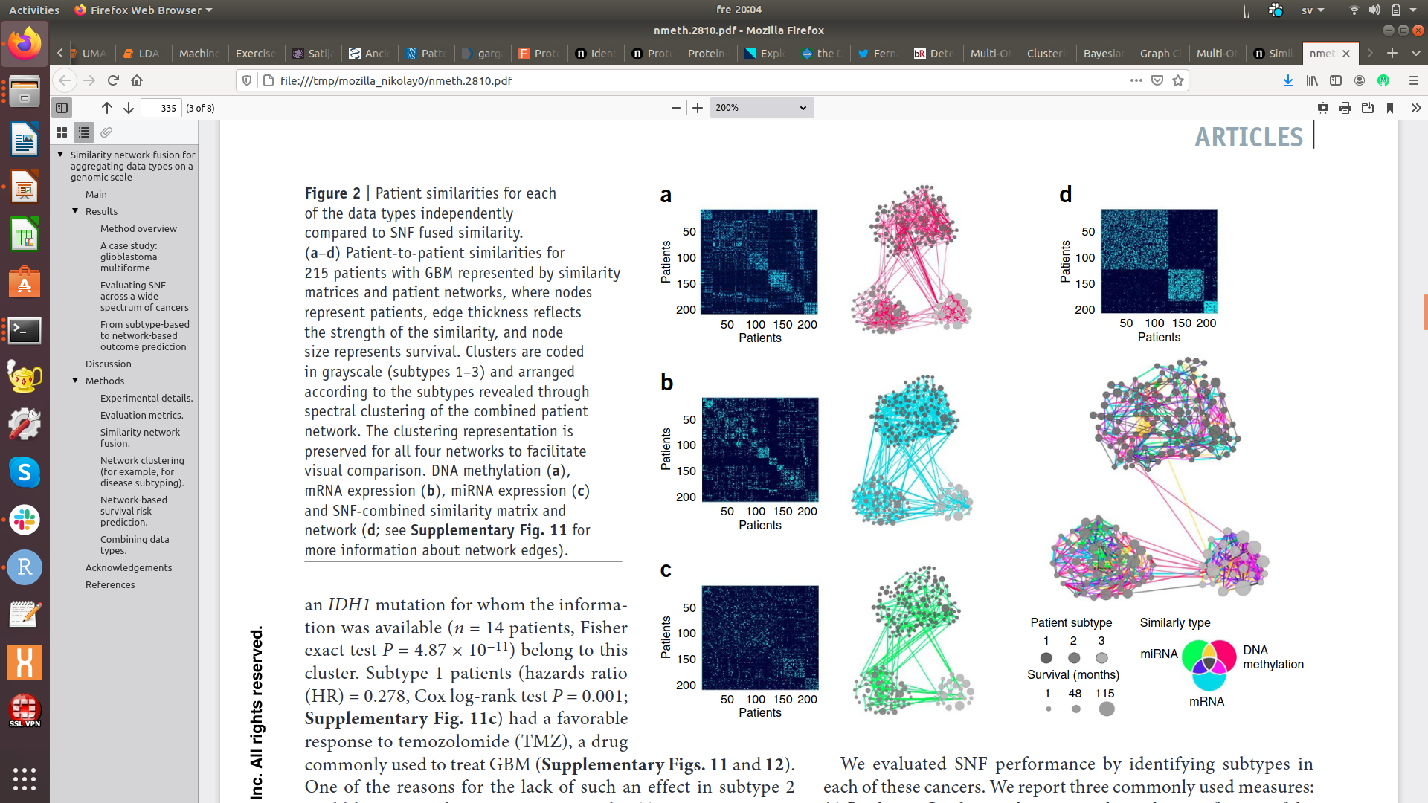
Similarity Network Fusion (SNF)
Wang B., Mezlini A., Demir F. et al. Nat Methods 11, 333–337 (2014)

Slide 15
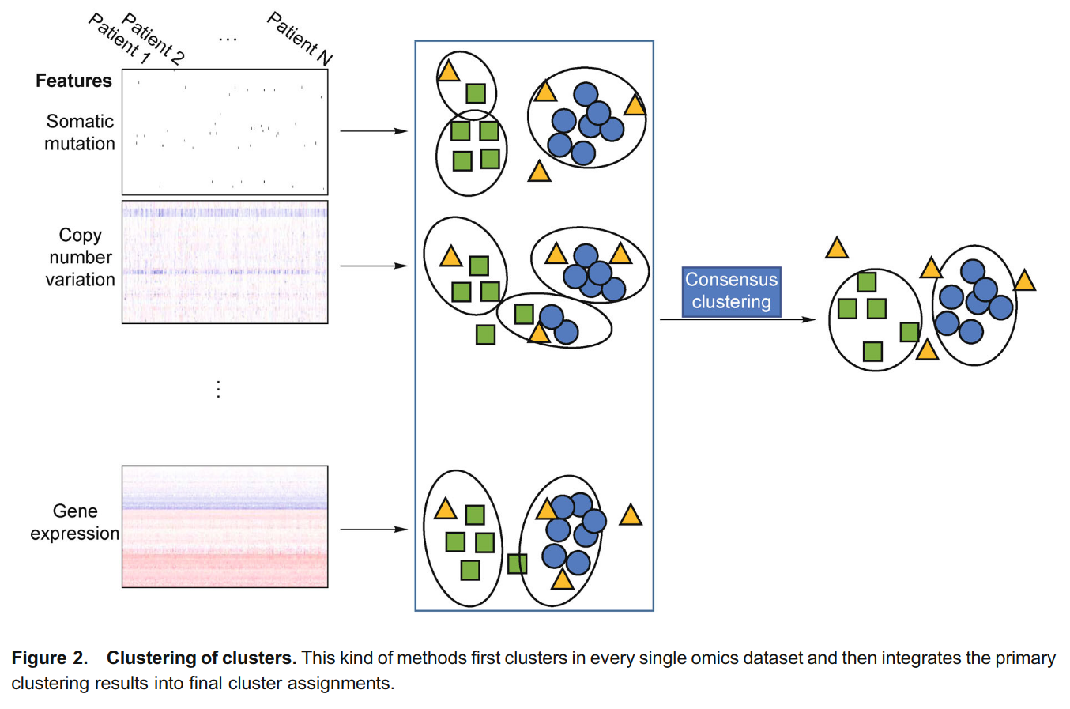
Clustering of Clusters (COC)
Wang et al., Quantitative Biology 2016, 4(1): 58–67

Slide 16
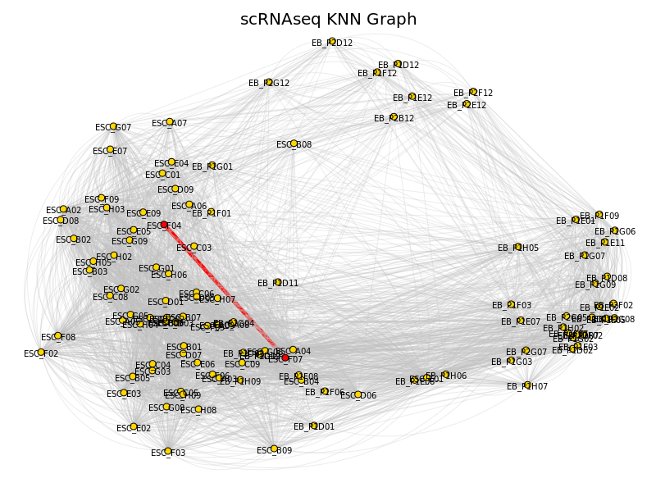
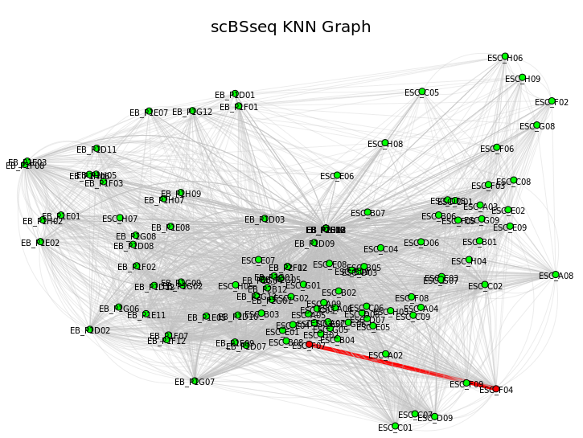
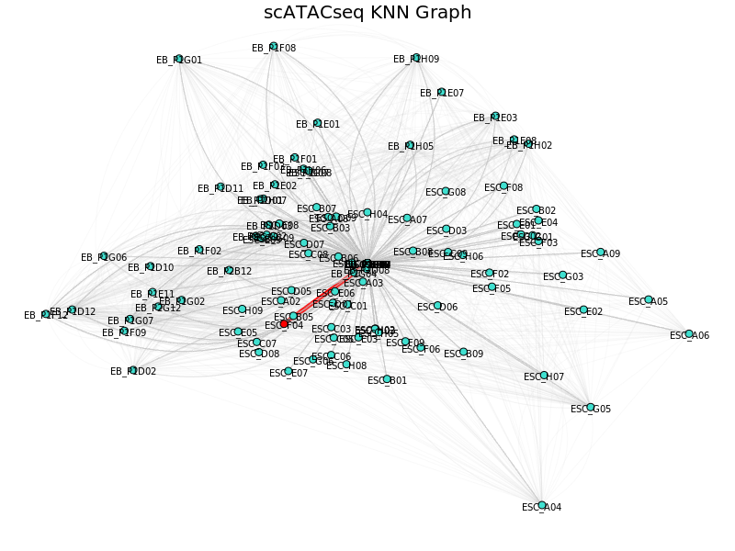
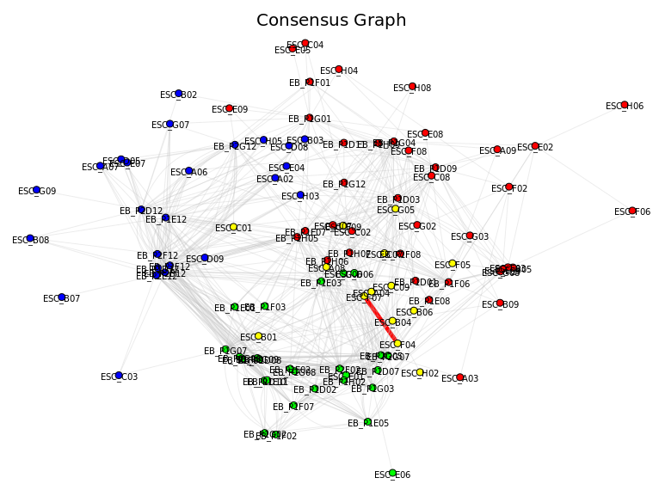
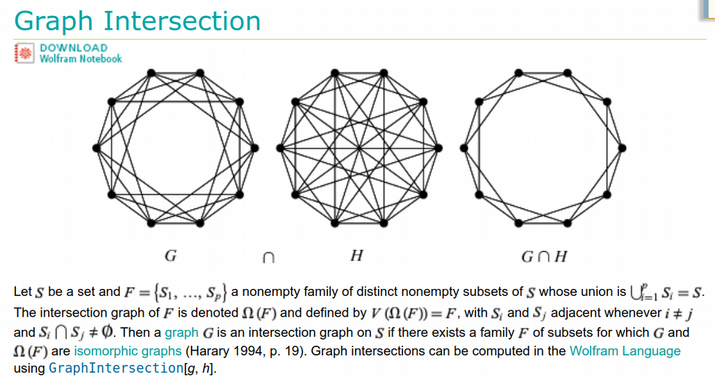
Graph Intersection Method
Hamming distance
Euclidean distance
Hamming distance
Keep edges consistently
present across the Omics
Oskolkov et al., unpublished

Slide 17
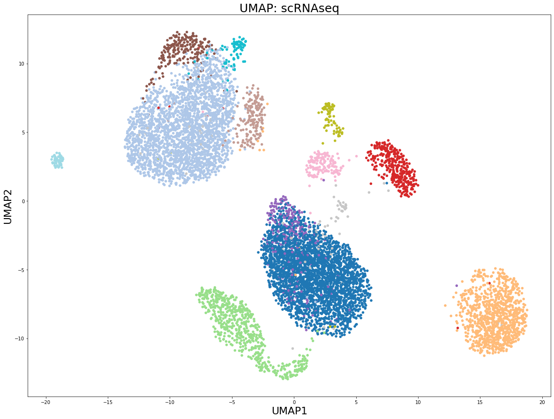
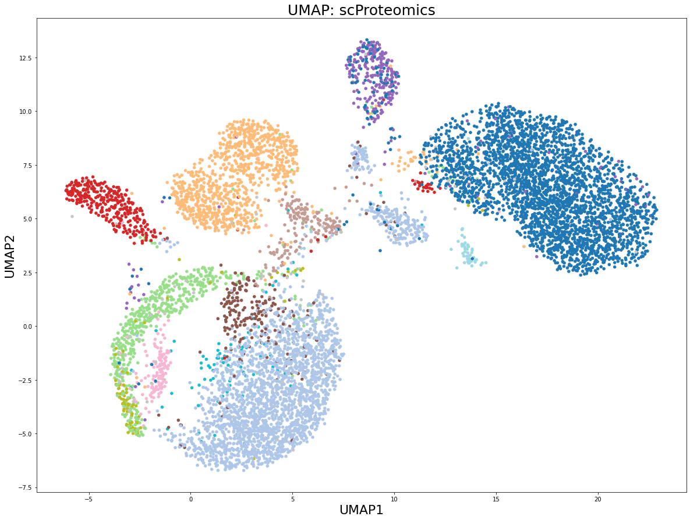
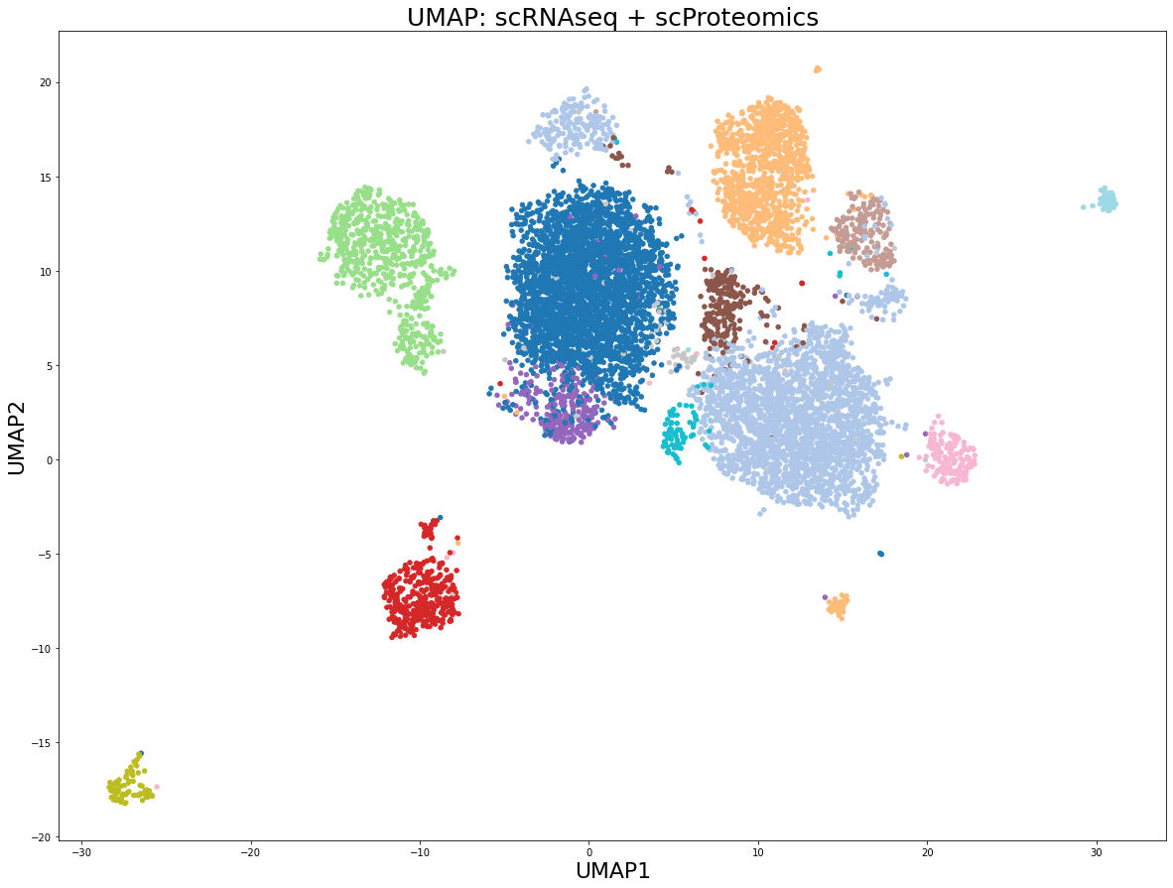
UMAP for data integration: CITEseq
Oskolkov et al., unpublished

Slide 18
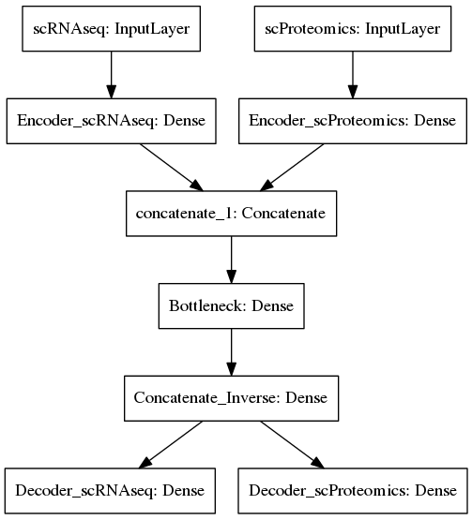
Autoencoder for data integration
Autoencoder:
unsupervised
neural network
Single Cell analysis is unsupervised
1) Dimensionality Reduction
2) Clustering

Slide 19
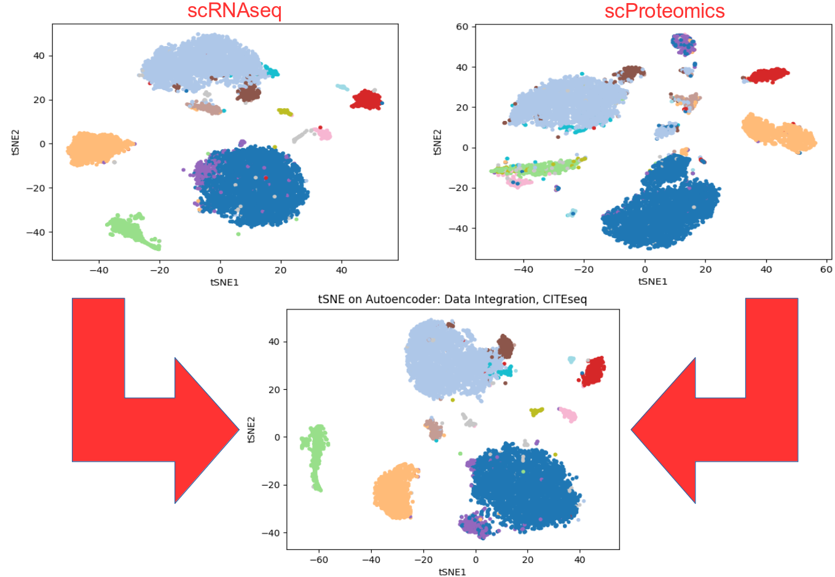
Autoencoder for data integration: CITEseq
Oskolkov et al., unpublished

Slide 20
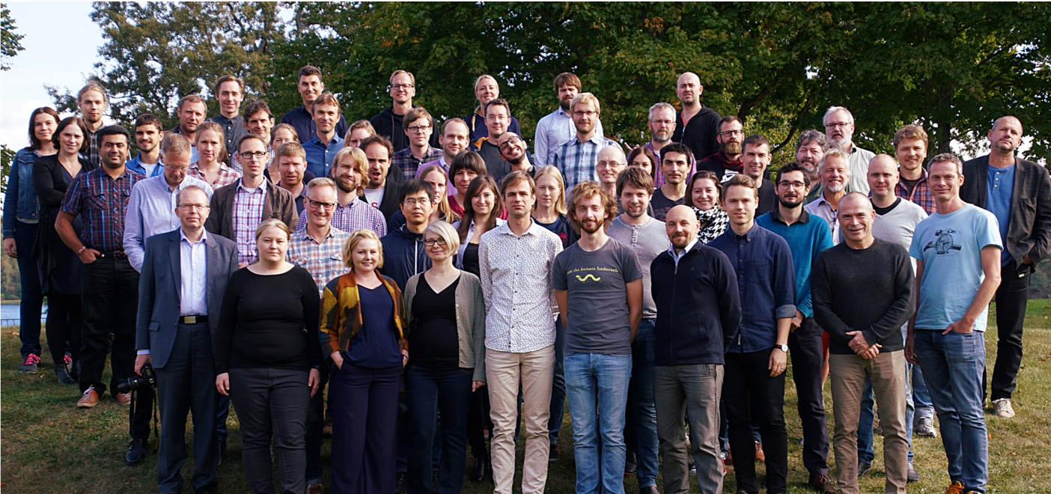



National Bioinformatics
Infrastructure Sweden (NBIS)

