Slide 1
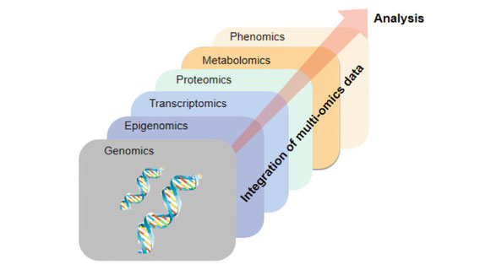
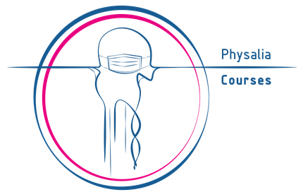
Machine Learning for Multi-Omics Integration
Physalia course
Course outline and practical information
Nikolay Oskolkov, Group Leader (PI) at NIRI, Riga, Latvia

Slide 2
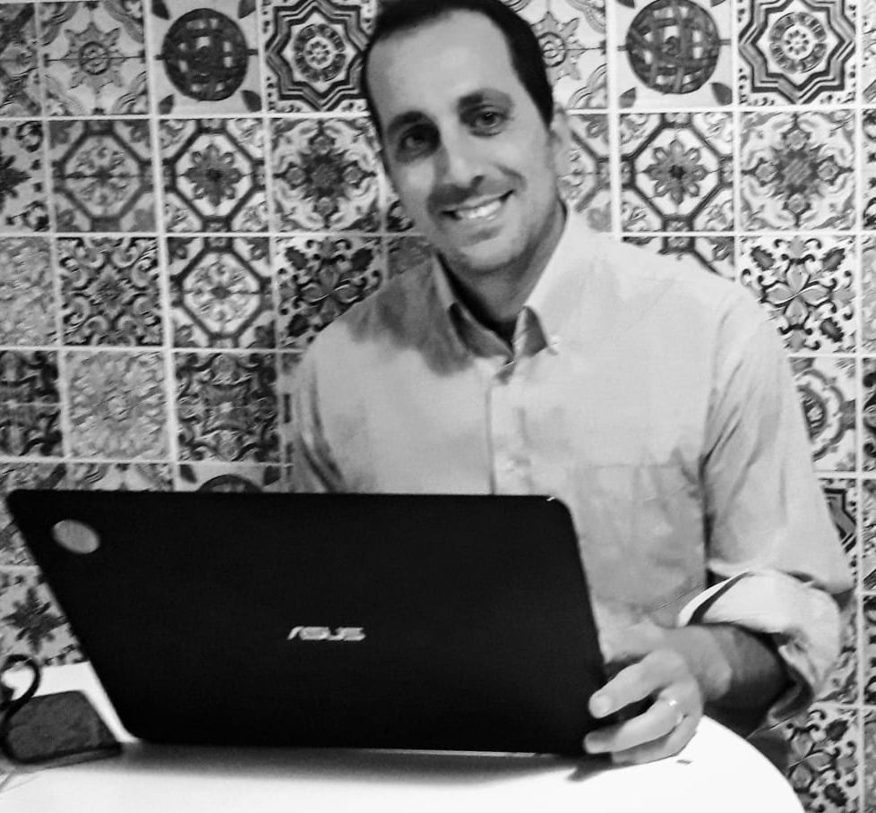
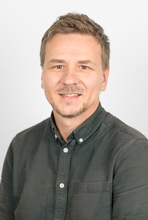



About us
Organizer: Carlo Pecoraro, Physalia courses
info@physalia-courses.org
Instructor:
Dr. Nikolay Oskolkov, MRG Group Leader, NIRI, Riga
nikolay.oskolkov@niri.lv
@NikolayOskolkov
Personal homepage:
https://nikolay-oskolkov.com
@oskolkov.bsky.social

Slide 3


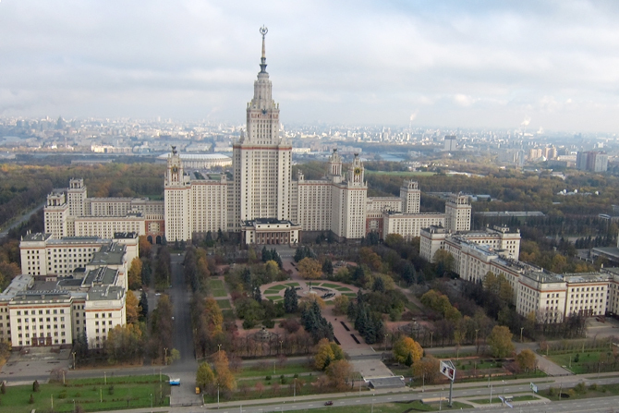

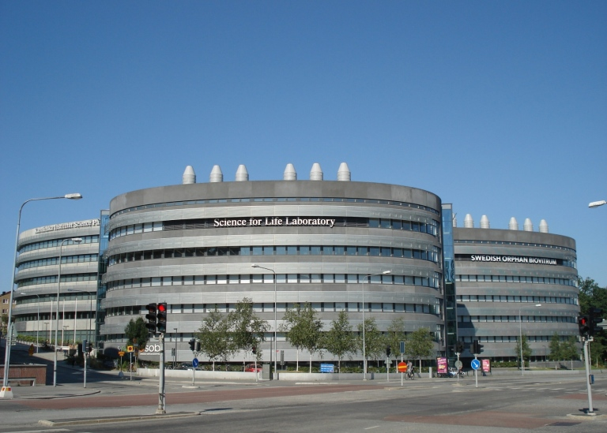
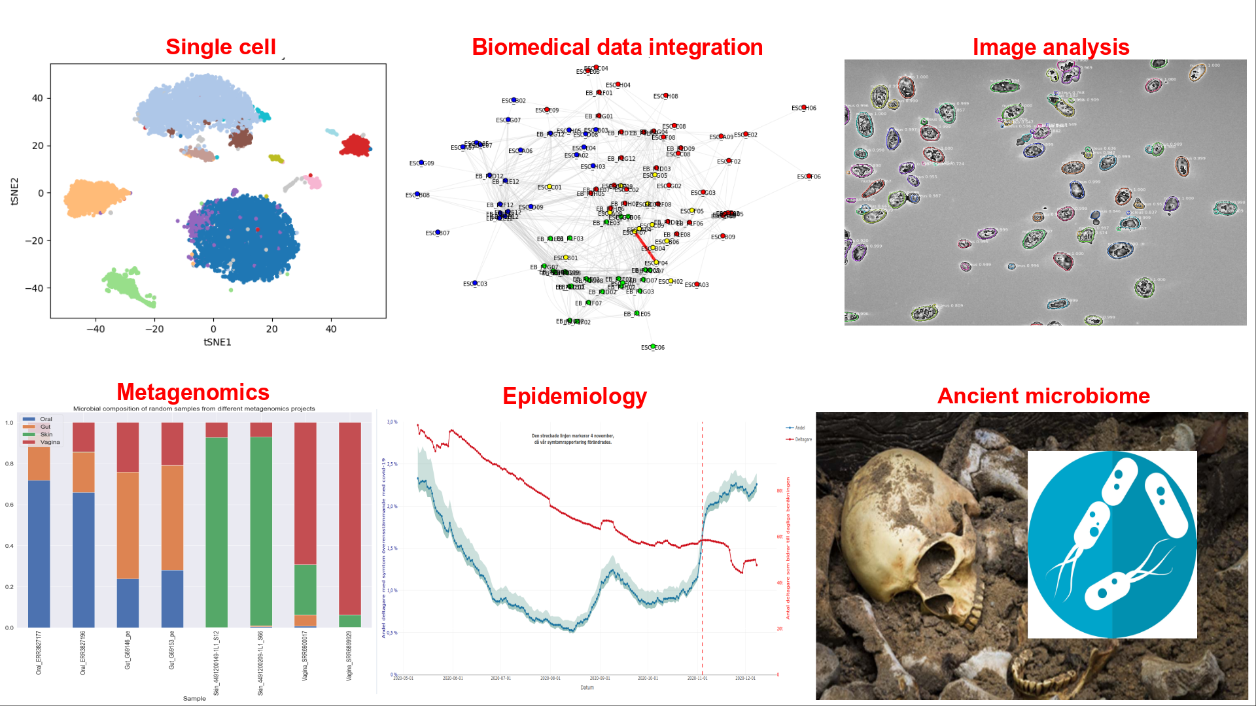
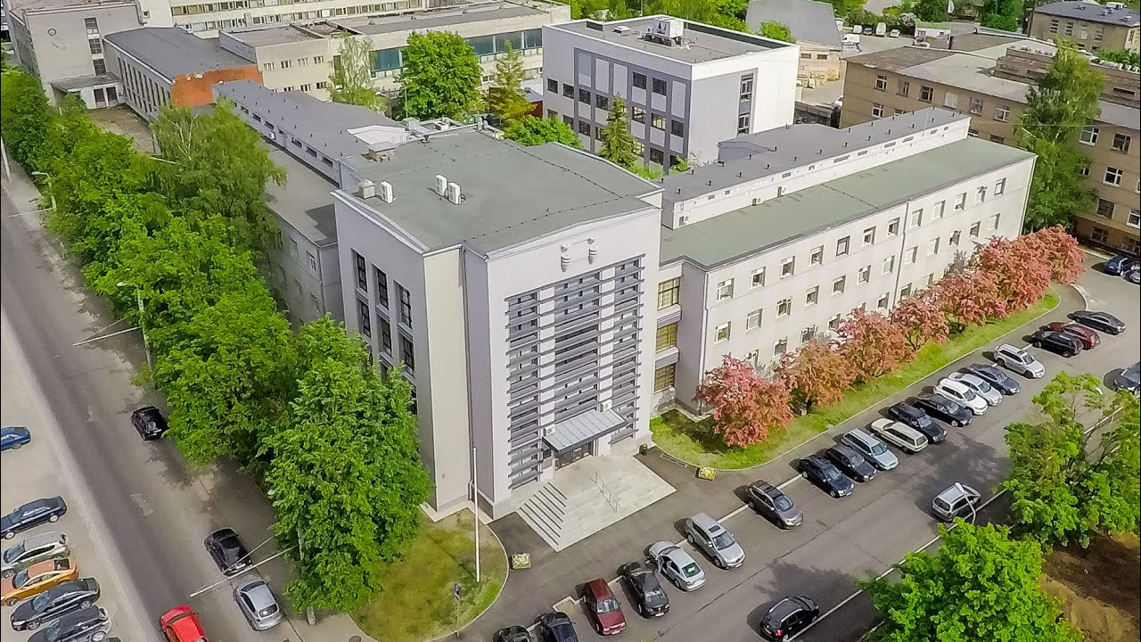
Brief introduction: who am I
2007 PhD in theoretical physics in Moscow, Russia
2011 medical genomics at Lund University, Sweden
2016 bioinformatician at NBIS SciLifeLab, Sweden
2025 Metabolic Research Group leader, NIRI, Latvia
60+ publications; h-index = 28; 4,600+ citations
Moscow State University
Lund University
SciLifeLab
NIRI=LIOS+BMC

Slide 4
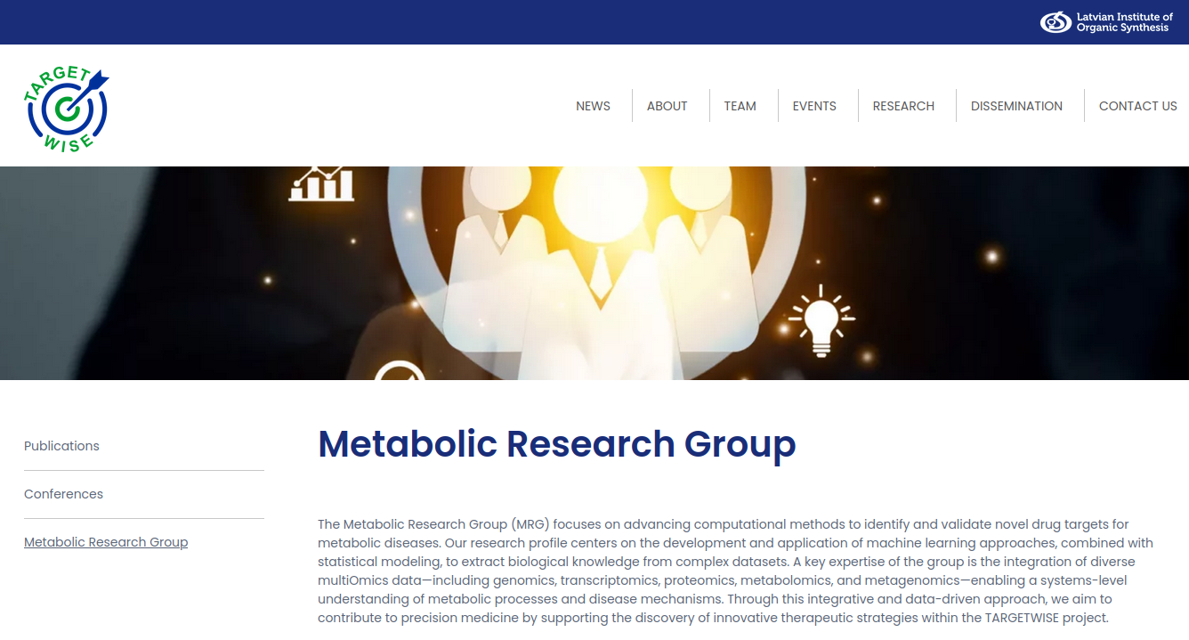
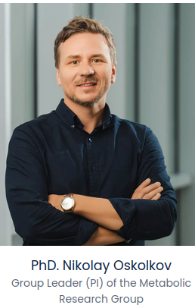
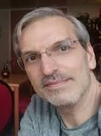
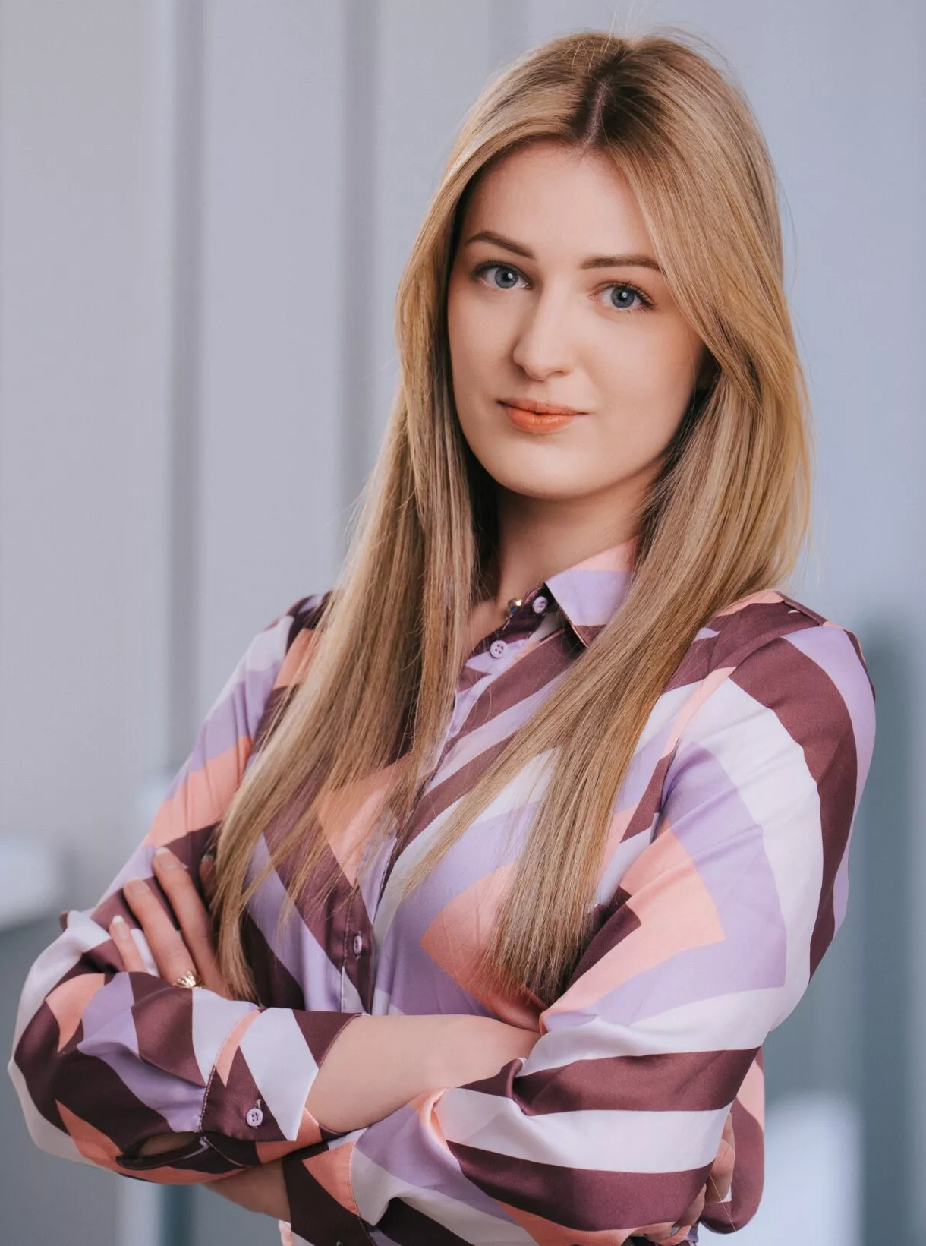
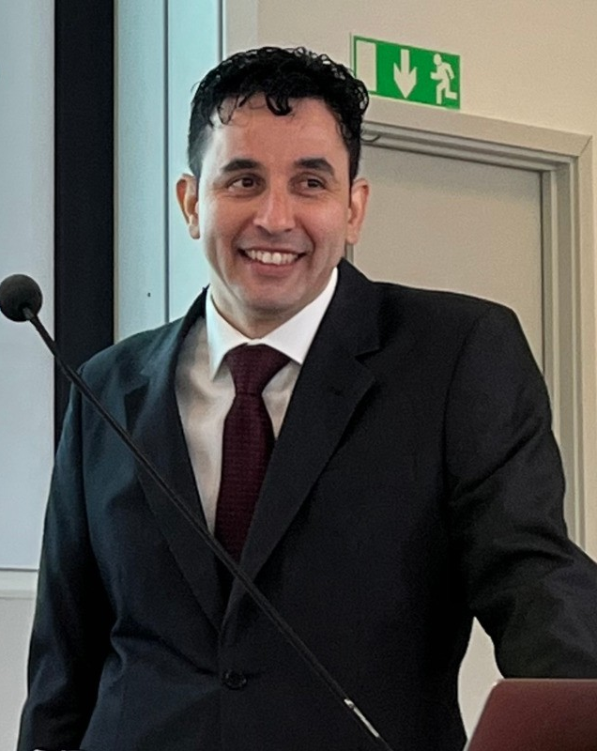
Metabolic Research Group at NIRI
Mohammad Banabazi, postdoc
in Metabolic Research Group
1 more postdoctoral fellow and 1 PhD student to be hired
If you know anyone who might be interested,
please contact me!
Kristina Grausa, PhD student
in Metabolic Research Group
Daniel Rivas, MD, postdoc
in Metabolic Research Group

Slide 5


About you
Name
University / Institute / Company
Research interest(s)
Previous experience with computational analysis and bioinformatics
Motivation to join the course
Expectations from the course

Slide 6
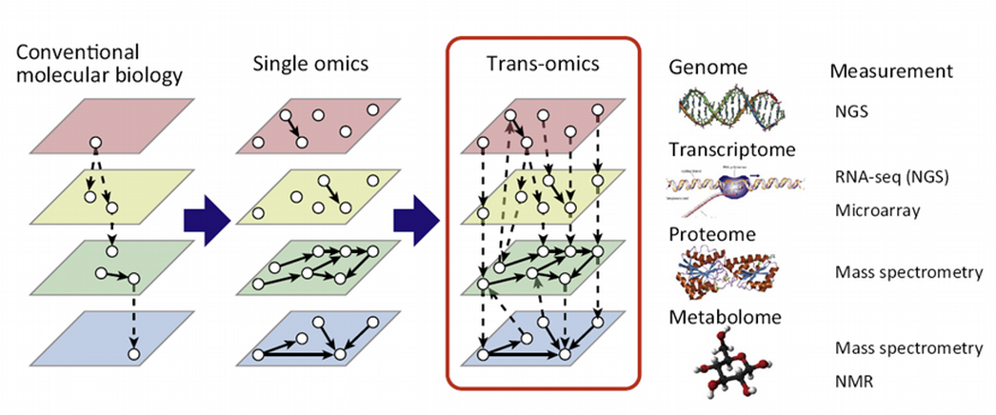
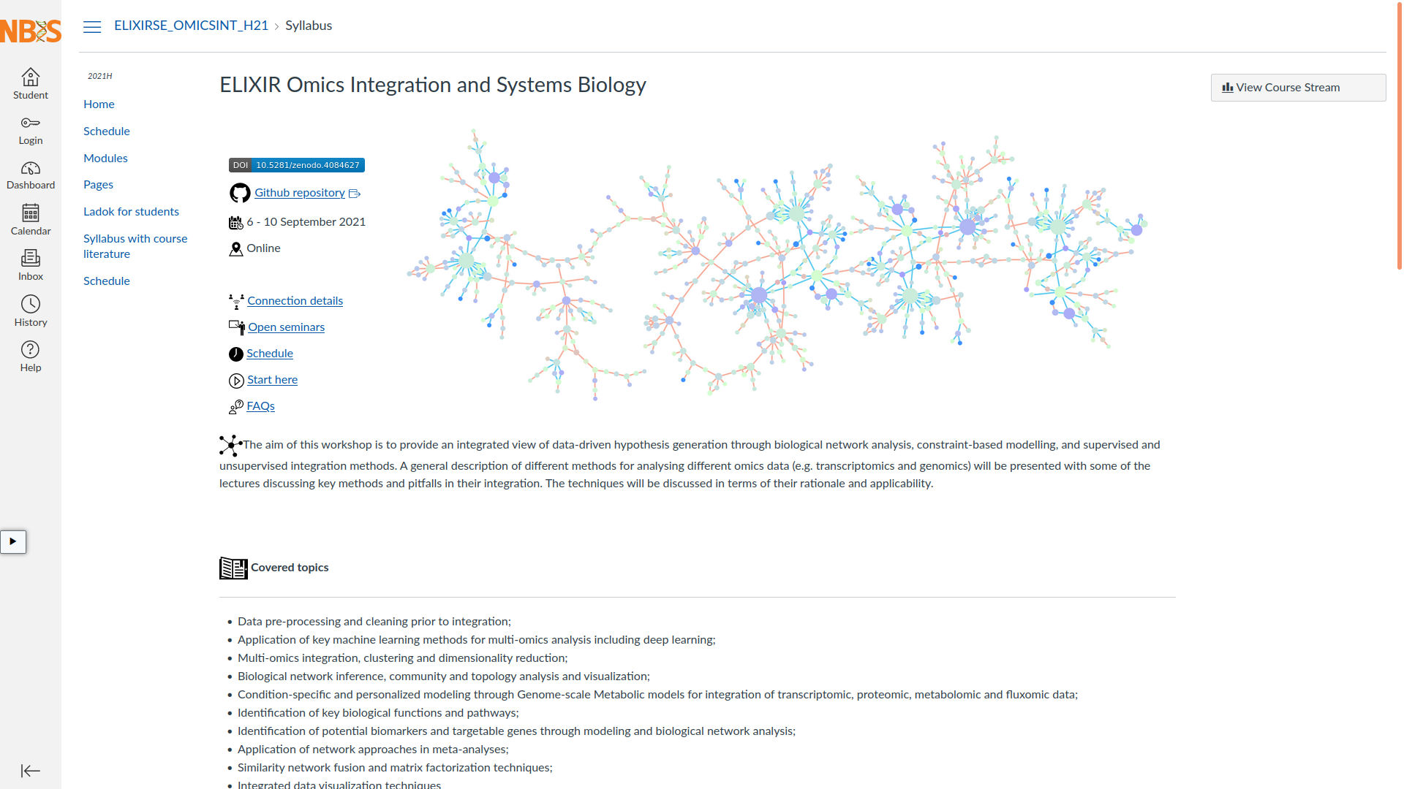
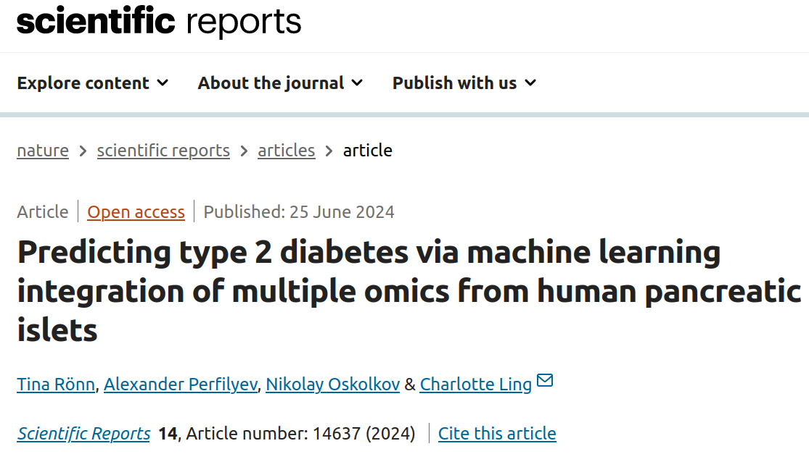


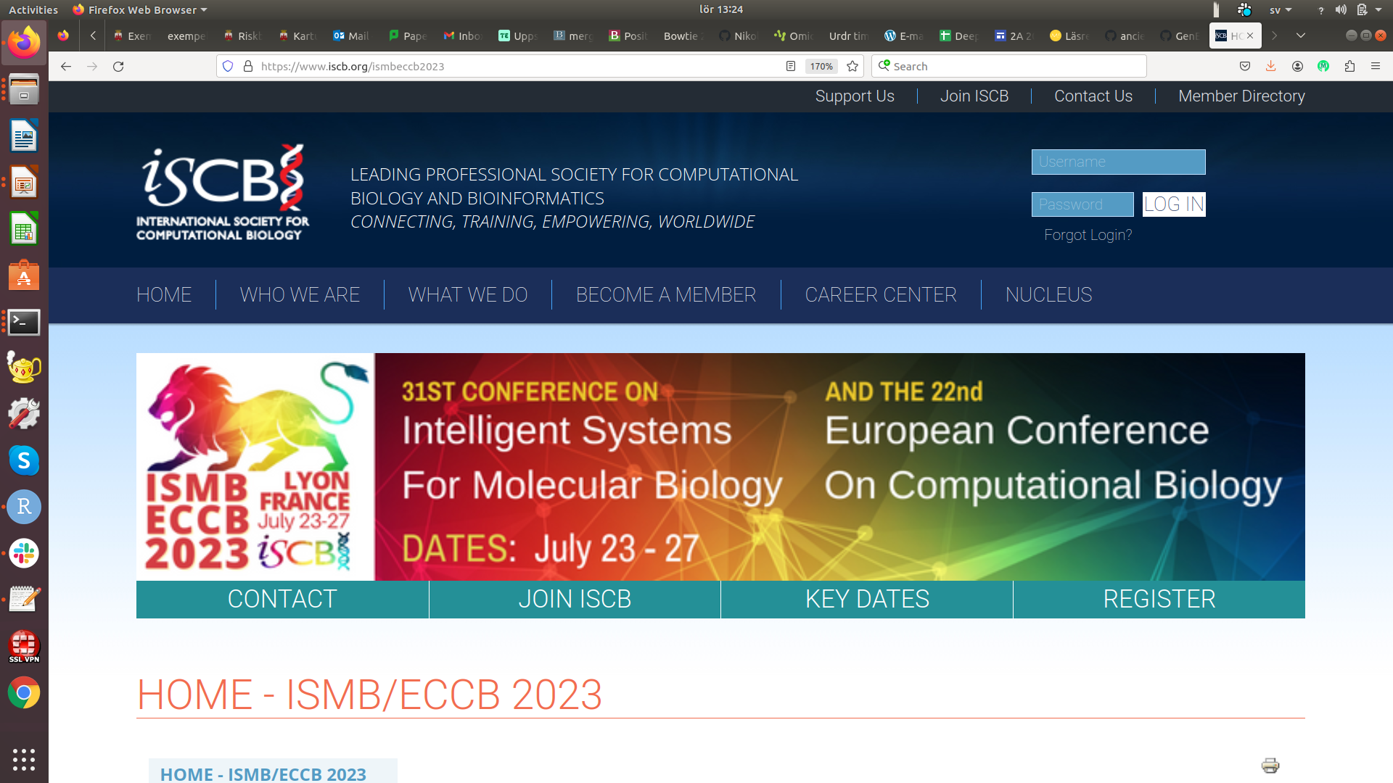
Multi-Omics begins: 2015 – until now
Yugi et al., Trends Biotechnol. 2016
https://github.com/NBISweden/workshop_omics_integration
The course was purchased by
Last runs: February 2023 (online), 94 applications
October 2024 (onsite), 49 applications
February 2025 (online), 123 applications
Rönn et al.,
Scientific Reports 2024

Slide 7
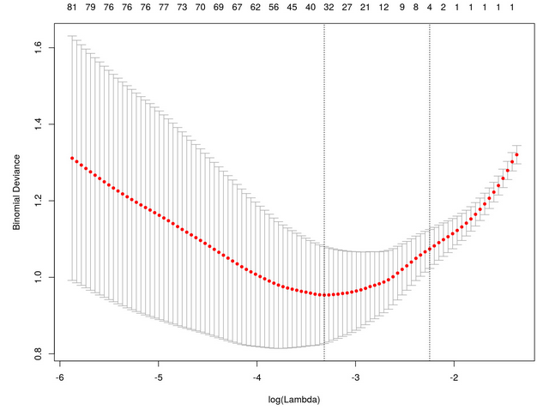
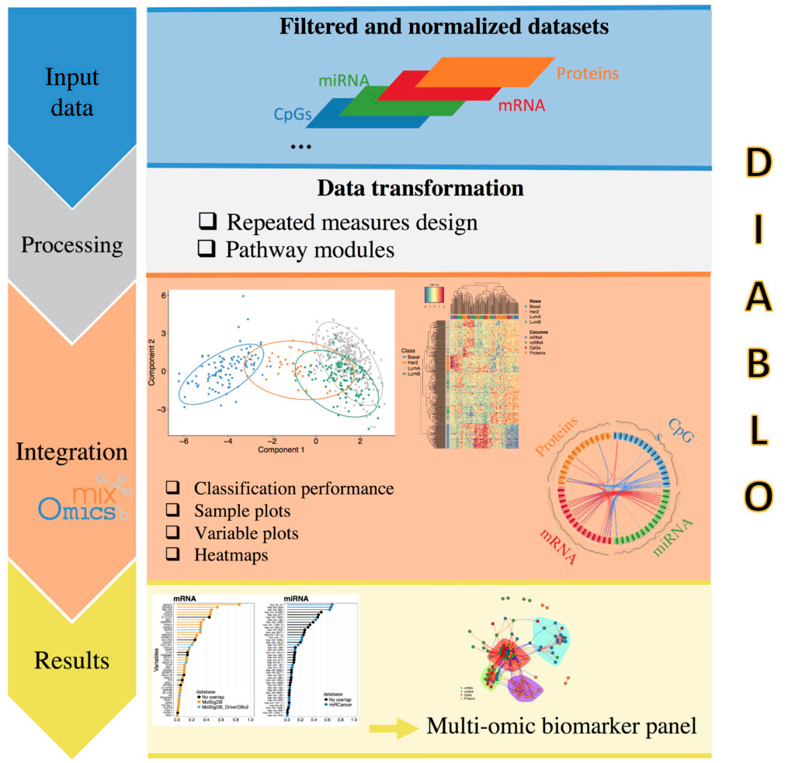

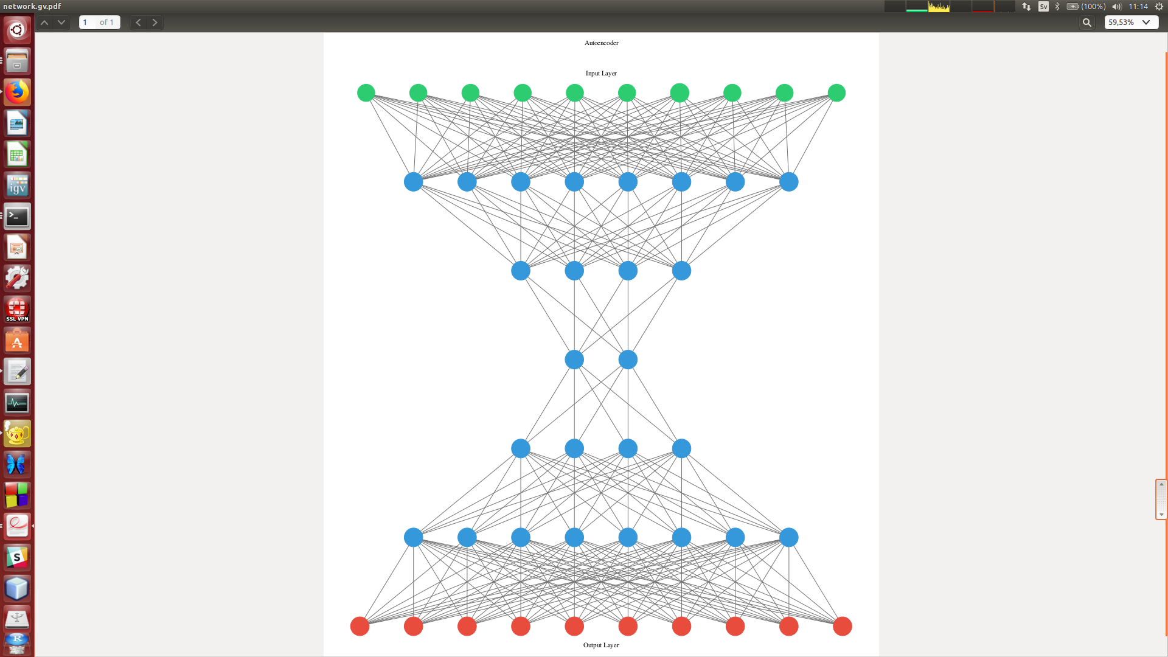
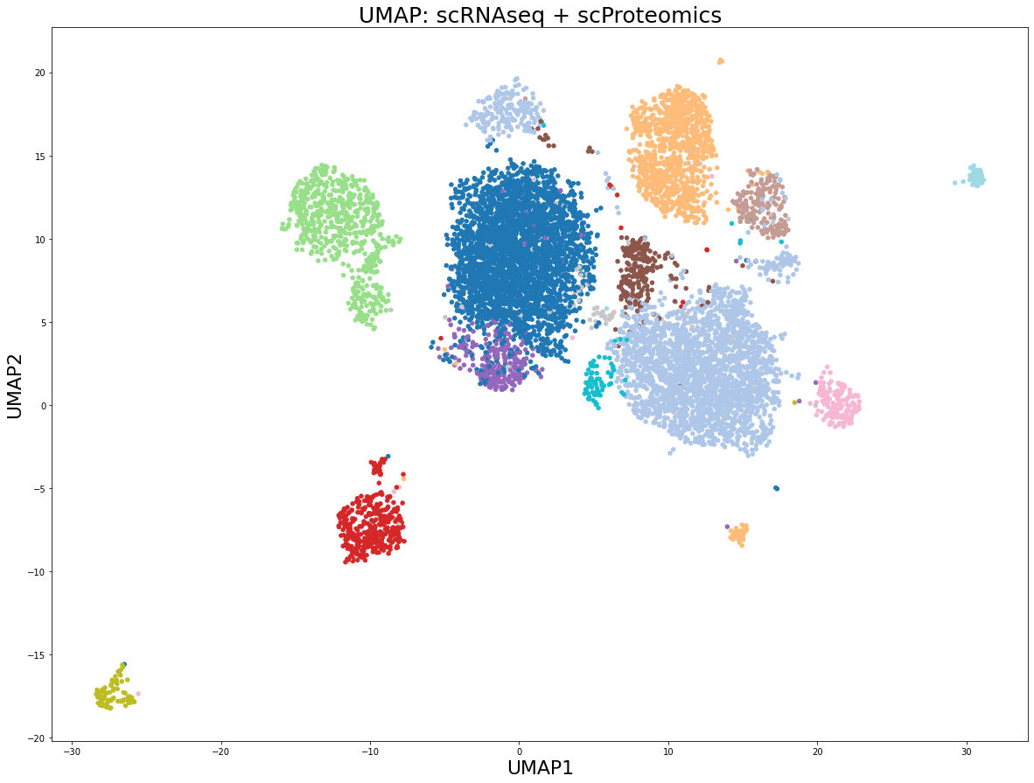
Course outline
Day 1: introduction of machine learning concepts for data integration, feature selection and supervised Omics integration
Day2: unsupervised Omics integration, factor analysis and graph intersection, neural networks for Omics integration
Day3: dimension reduction methods and UMAP for Omics integration, horizontal and vertical integration of single cell data

Slide 8
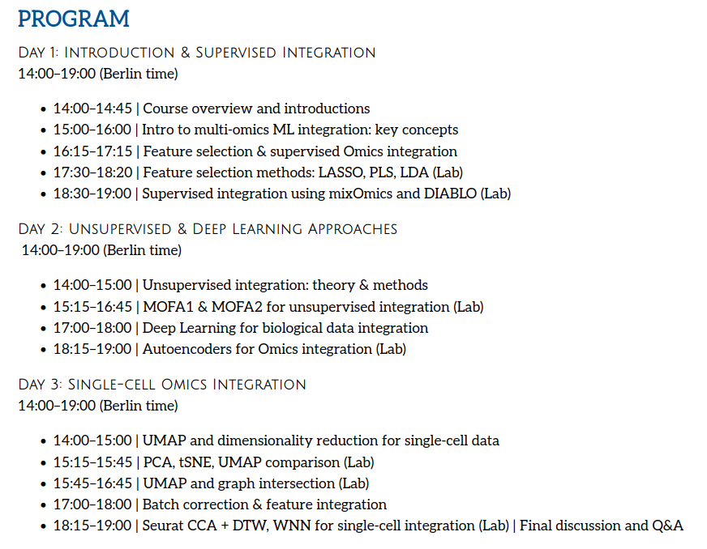
Course program

Slide 9
Housekeeping rules
Please ask your questions anytime, it is ok to interrupt me, or you can raise your hand and ask. You can also ask questions in the slack workspace for this course.
The course includes 6 lectures (~1 h each) and 7 practicals (~1 h each), there is a 15-20 min break after each lecture and each practical. We can potentially make longer breaks if needed.
During practicals, we will use Rmarkdown and Jupyter notebooks. At the end of each practical, I will use rendered html-versions of the notebooks to go through command lines with my explanations.
The material is based on data and problems from computational biology, however the concepts discussed are general and can be applied for other types of data.

Slide 10
Practical information: GitHub and Rstudio
The course will take place from 2 pm to 7 pm (Berlin time)
Links to the Rstudio server will be posted in the Slack channel
The course GitHub repository containing lectures and exercises is:
https://github.com/NikolayOskolkov/Physalia_MLOmicsIntegration_2026
Please bookmark this address!

Slide 11
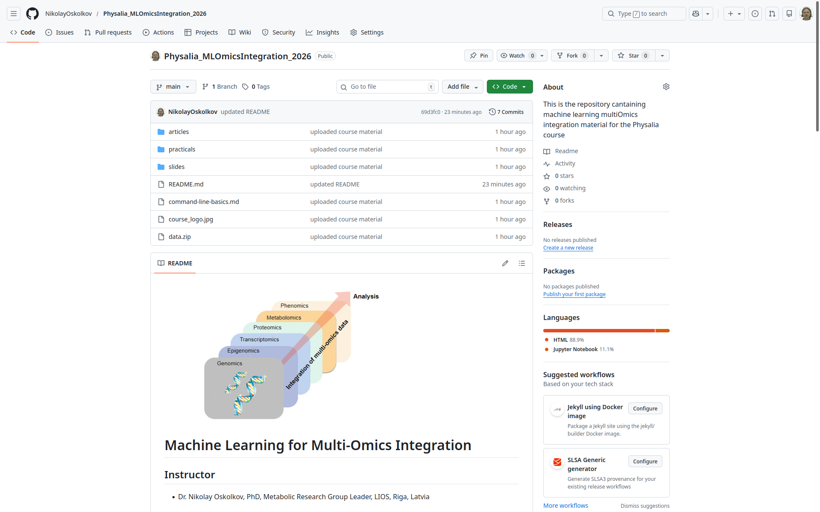

Slide 12
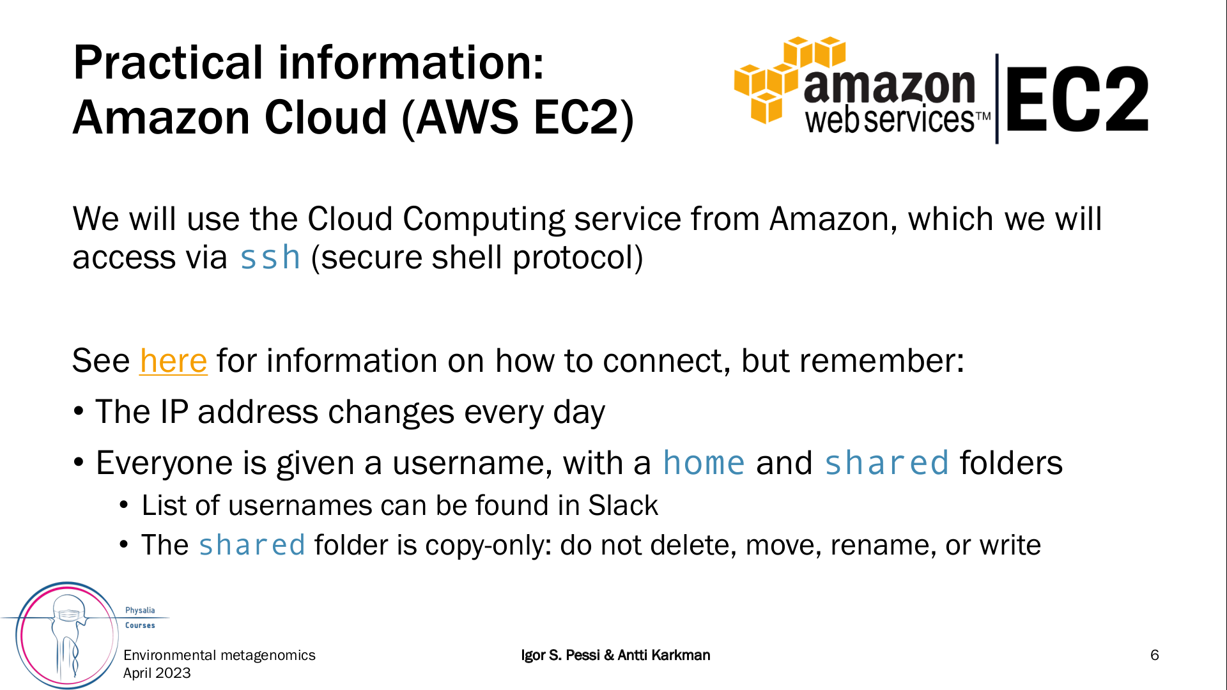
ssh -i multiomics.pem -X ubuntu@54.244.40.220
However, most of the time you will be using Rstudio server
(for R exercises) and Google Colab (for Python exercises)!

Slide 13
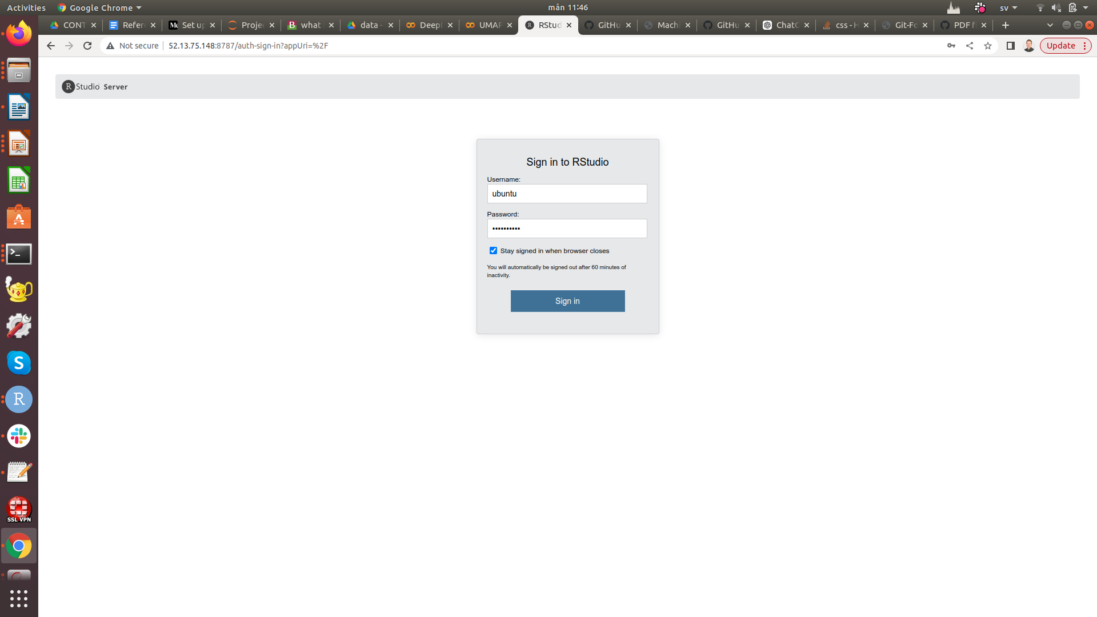
To connect to Rstudio server type in your browser:
http://52.13.75.148:8787/auth-sign-in
Username: ubuntu
Password: rstudio26
Please provide your username, e.g. user1, here!

Slide 14
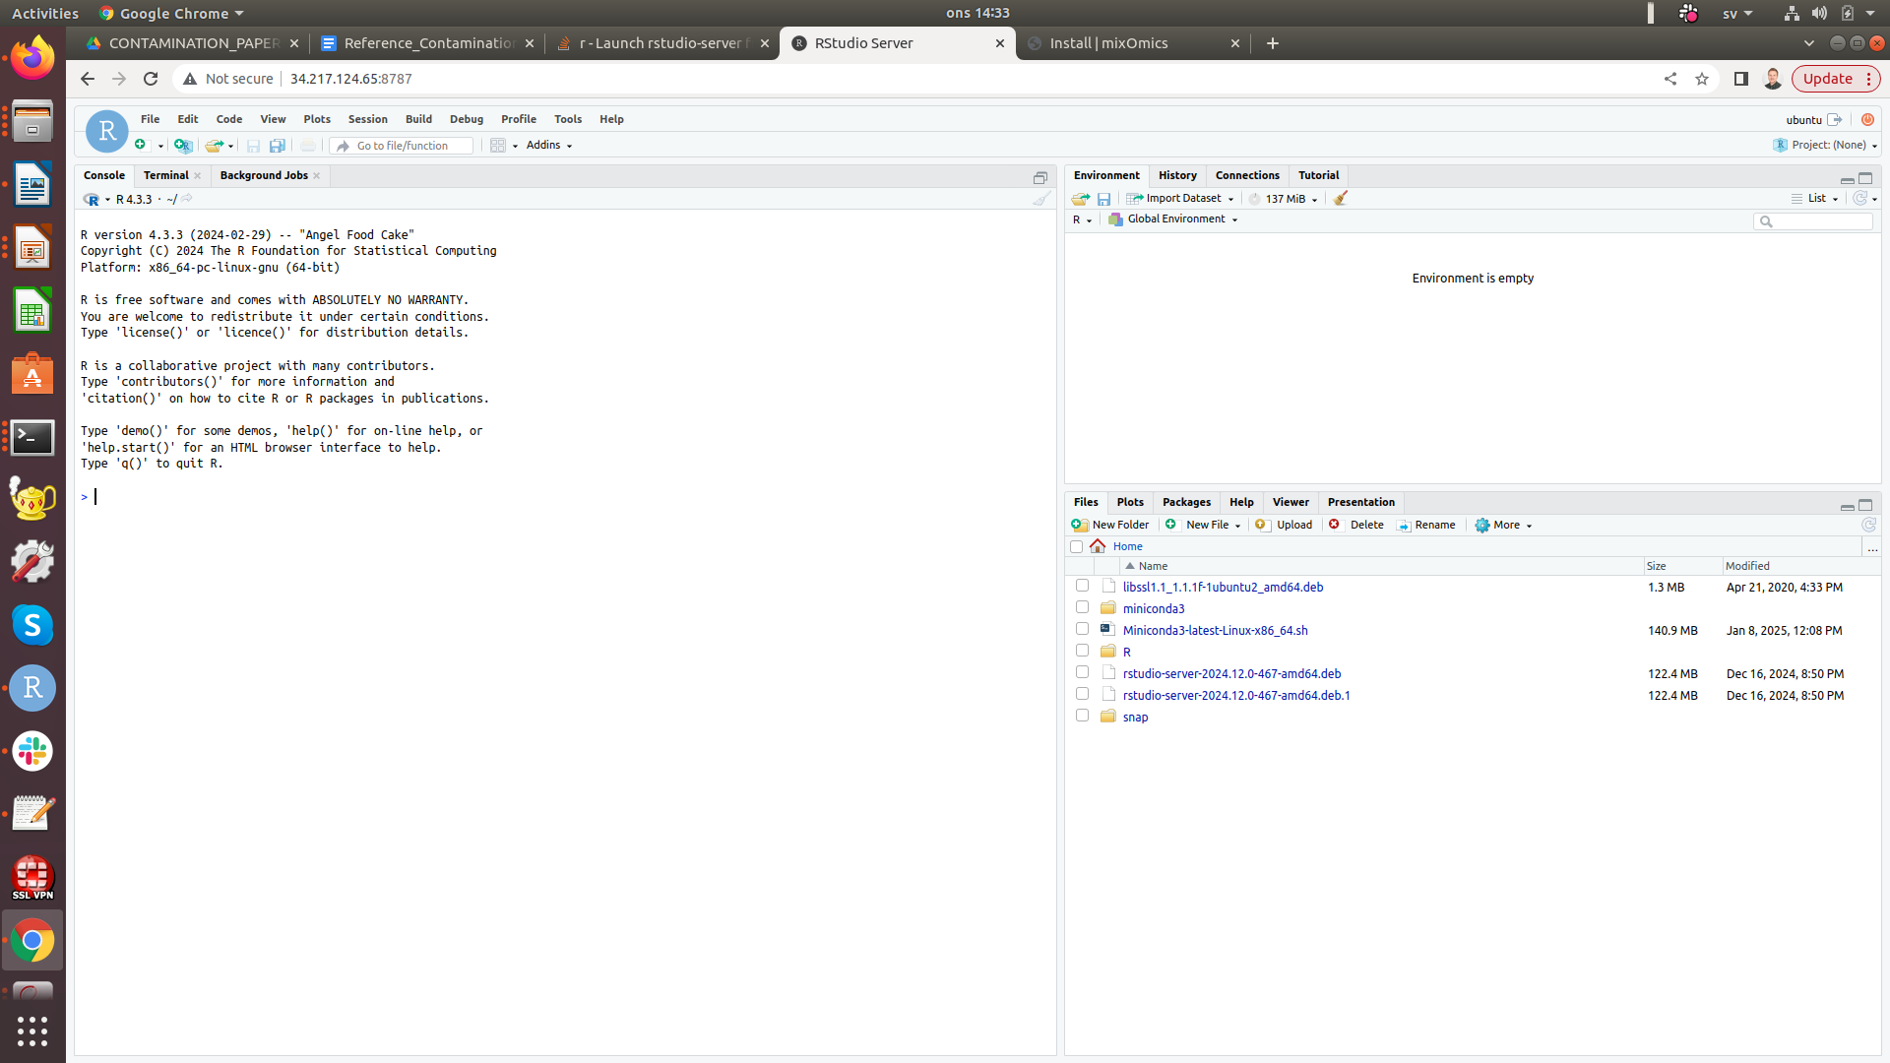

Slide 15
Plan B (in case of network problems): install locally
if (!require("BiocManager", quietly = TRUE))
install.packages("BiocManager")
BiocManager::install("mixOmics")
BiocManager::install("MOFA2")
install.packages("rmarkdown")
install.packages("knitr")
install.packages("glmnet")
install.packages("Rtsne")
install.packages("uwot")
BiocManager::install(c('AnnotationFilter','BiocGenerics','GenomeInfoDb',
'GenomicFeatures','GenomicRanges','IRanges','Rsamtools','S4Vectors','TFBSTools',
'ggbio','motifmatchr','AnnotationDbi'))
install.packages("Seurat", dependencies = TRUE)
install.packages("Signac", dependencies = TRUE)

Slide 16
To run Jupyter notebooks on Google Colab please do the following:
1. Clone this repo: https://github.com/NikolayOskolkov/Physalia_MLOmicsIntegration_2026
2. Unzip the data.zip folder locally and upload it to your Google drive
3. Start the Jupyter notebook from the Google drive and mount your google drive:
#Mount Google Drive to Colab
from google.colab import drive
drive.mount('/content/drive')
!ls -l /content/drive/MyDrive/
import os
os.chdir("/content/drive/MyDrive/data")
N.B. you need a Google account
to be able to run Google Colab!

Slide 17
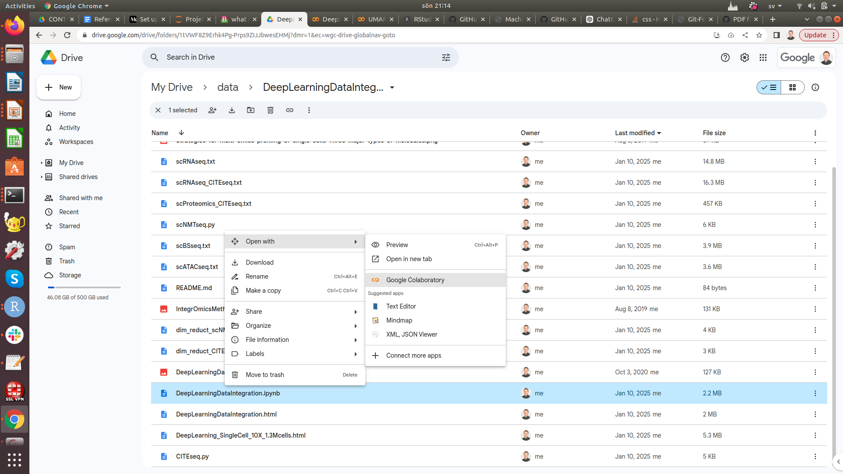

Slide 18
