Slide 1
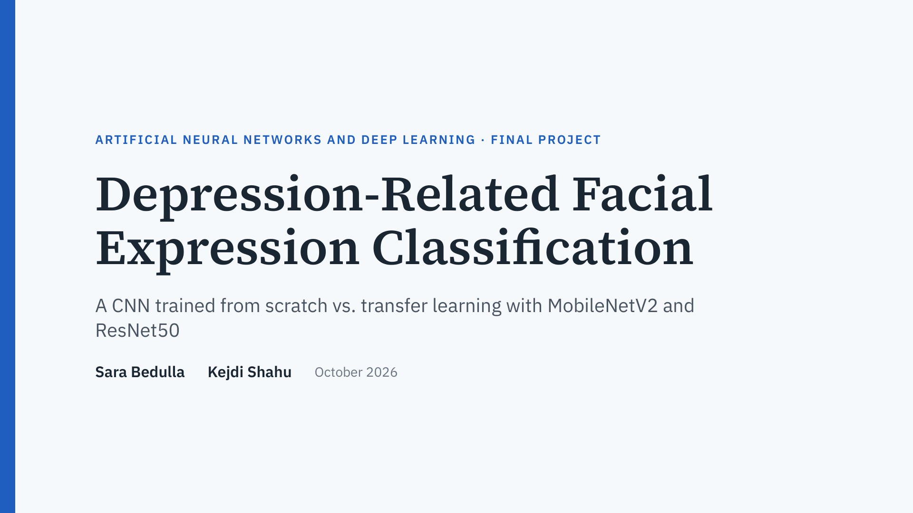
Notes:
Presenter: Sara. Introduce the team and the topic: classifying facial expressions linked to depression, and comparing a CNN we trained from scratch with two pretrained transfer-learning models, MobileNetV2 and ResNet50. Sara built the data pipeline and the scratch CNN; Kejdi built the transfer-learning models, the evaluation and the comparison.

Slide 2
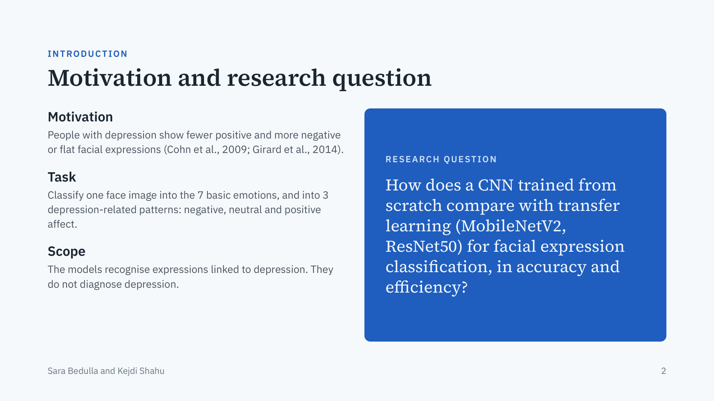
Notes:
Presenter: Sara. Studies of depression find reduced positive and more negative or flat facial affect. Automatic facial expression recognition could help summarise this behaviour, so our task has two levels: the 7 basic emotions, and 3 depression-related patterns. Be clear that this is expression recognition, not diagnosis. Then read the research question: is it better to train a CNN from scratch on faces, or reuse ImageNet knowledge through transfer learning?

Slide 3
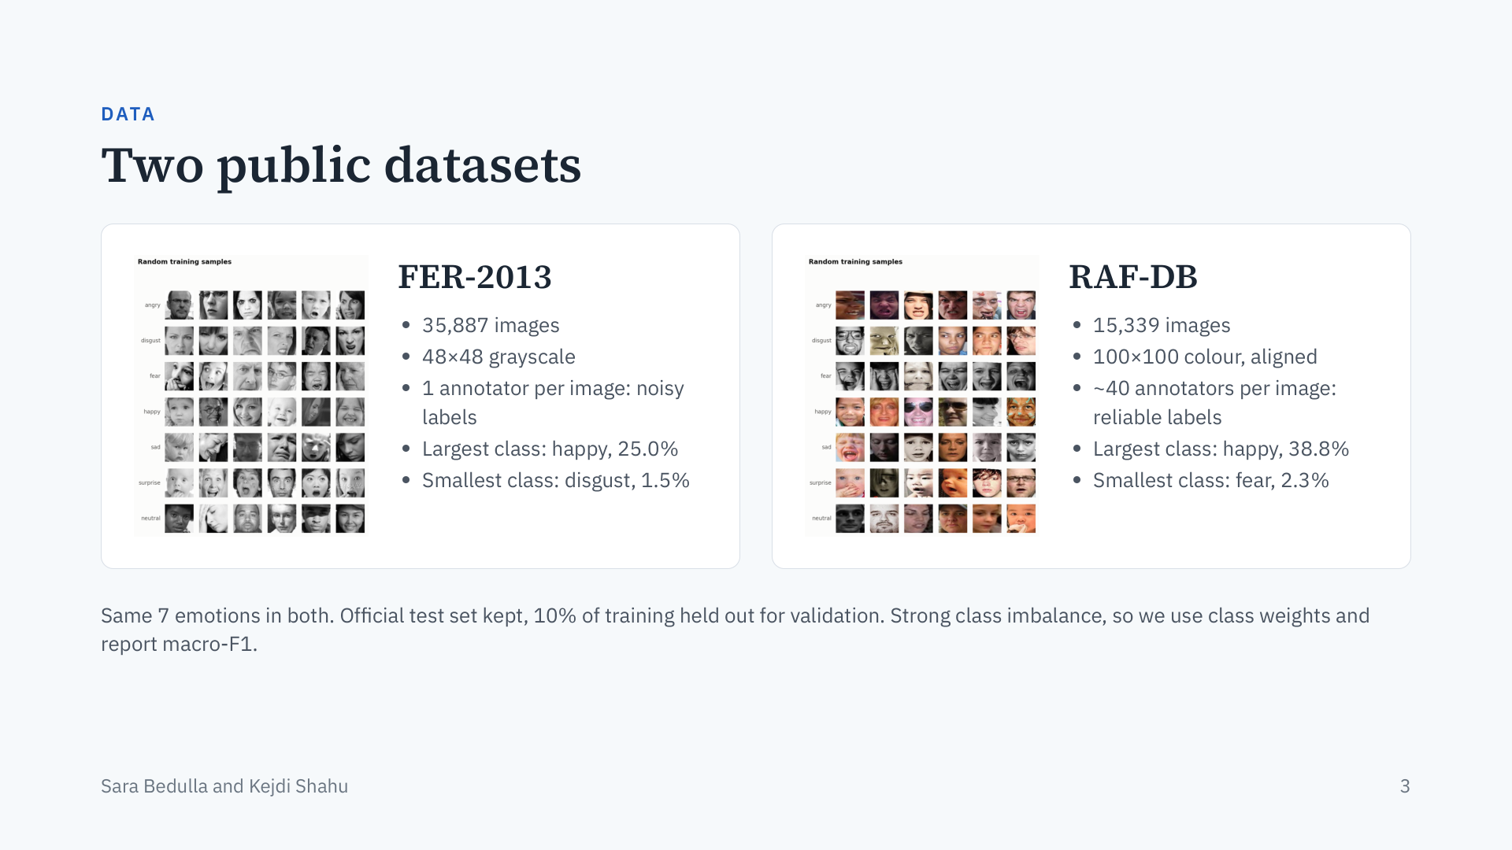
Notes:
Presenter: Sara. FER-2013 is large but low-resolution grayscale with noisy single-annotator labels; human accuracy on it is only about 65%. RAF-DB is smaller but colour, aligned and labelled by about 40 people per image. Both have the same 7 emotions, so results are comparable. Splits are fixed once and shared by every model. Both datasets are very imbalanced (happy is about 17 times larger than the smallest class), which is why training uses class weights and we report macro-F1 next to accuracy.

Slide 4
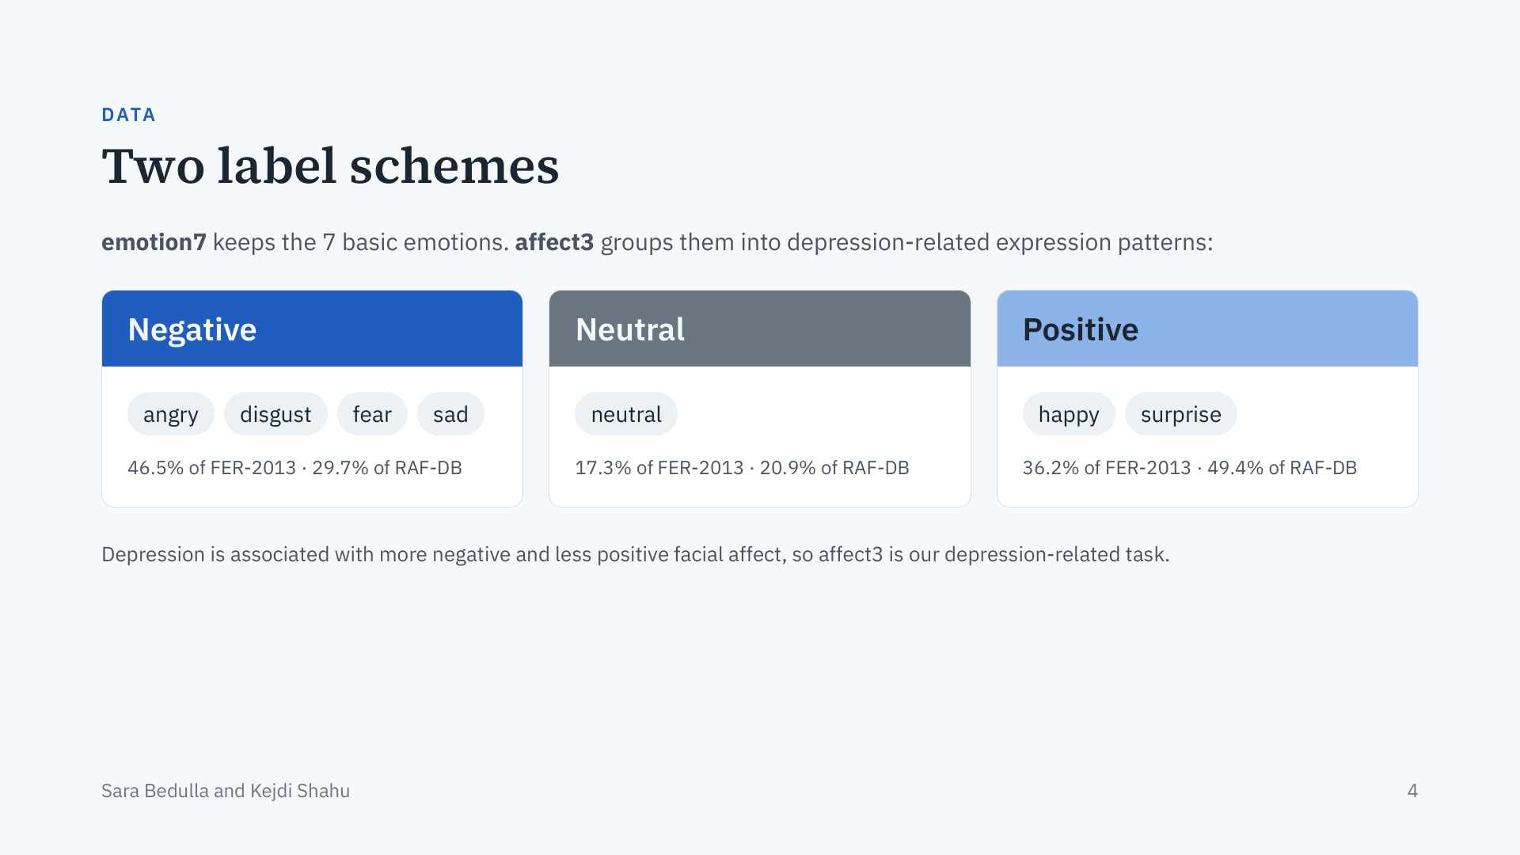
Notes:
Presenter: Sara. Every model is trained twice: once on the 7 emotions, and once on 3 affect classes. Negative groups angry, disgust, fear and sad; neutral stays neutral; positive groups happy and surprise. This grouping follows the finding that depression shows up as more negative and less positive affect. The shares show that the class balance differs between the two datasets.

Slide 5
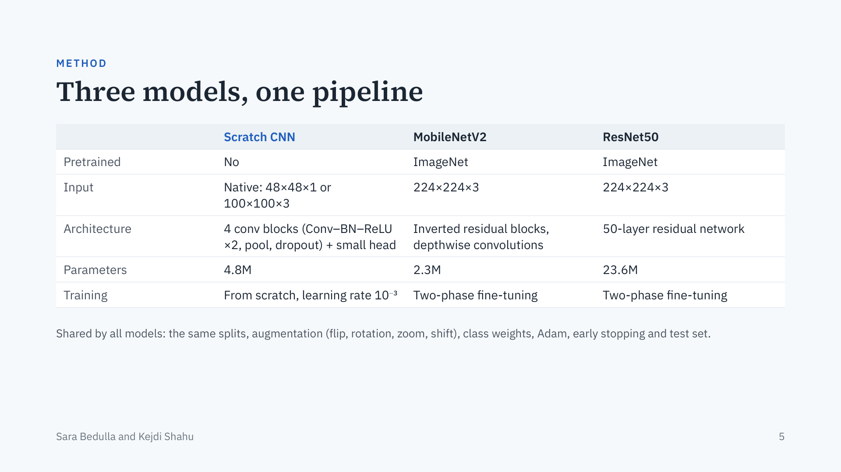
Notes:
Presenter: Sara (scratch CNN), then hand over to Kejdi (pretrained models). The scratch CNN is VGG-style: four blocks of two 3×3 convolutions with batch normalisation and ReLU, max-pooling and dropout, then global average pooling and a small dense head; it works on each dataset at its native size. MobileNetV2 is the lightweight pretrained model, ResNet50 the large one with ten times more parameters. Both get a new classification head and see faces resized to 224×224. Everything else in the pipeline is identical, so the comparison is fair.

Slide 6
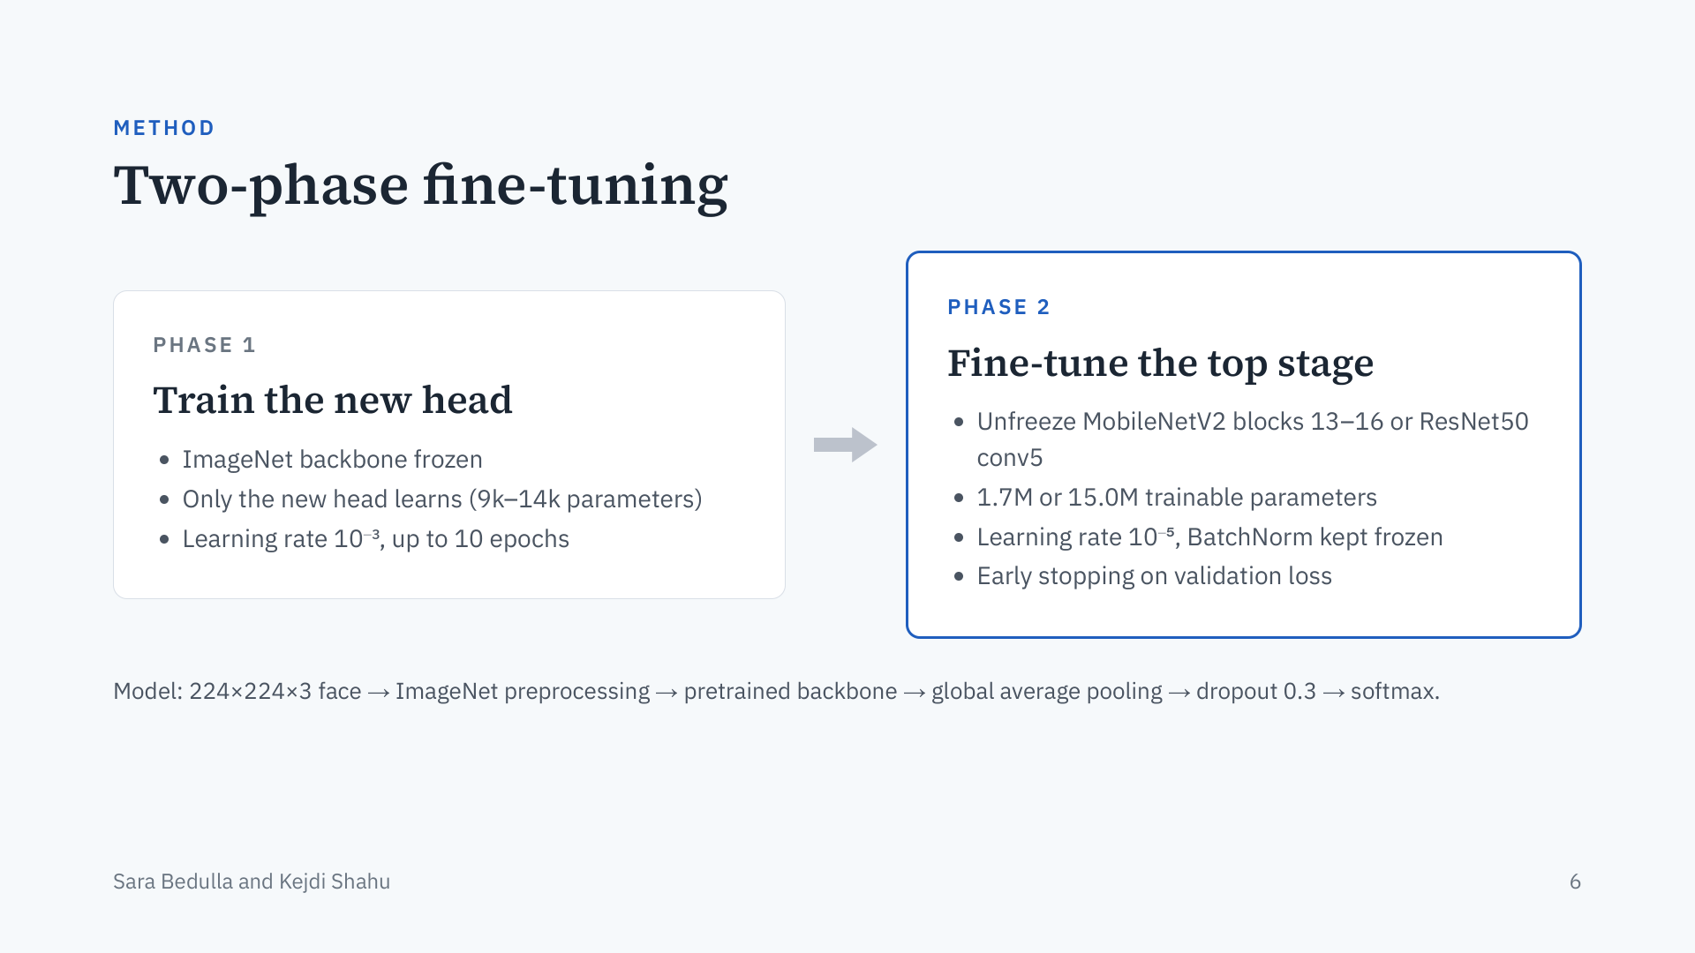
Notes:
Presenter: Kejdi. The pretrained models train in two phases. First the backbone is frozen and only the new head learns, so its random initial gradients cannot damage the ImageNet features. Then we unfreeze the top stage of the backbone and train it with a learning rate 100 times smaller, so the high-level features adapt to faces. Batch normalisation stays frozen to keep the ImageNet statistics. We keep the model with the lowest validation loss over both phases.

Slide 7
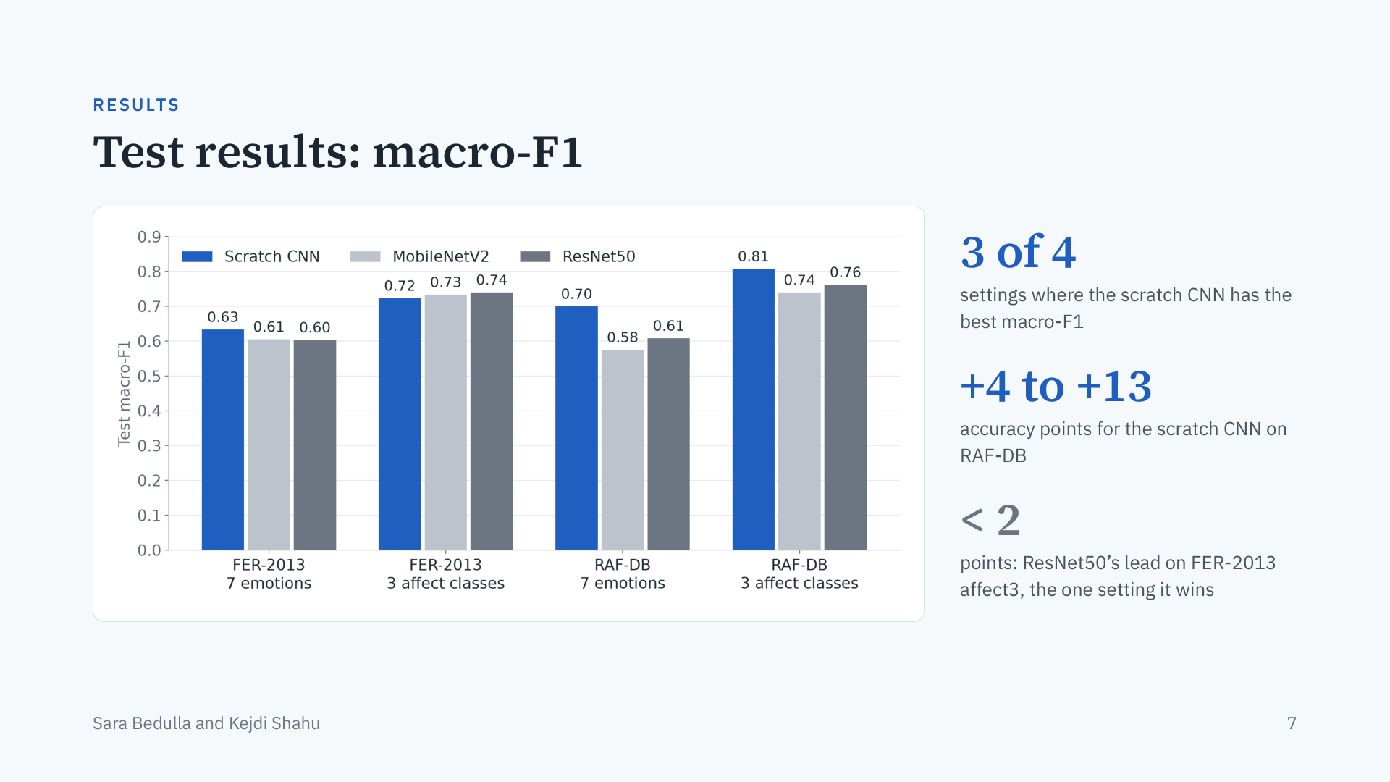
Notes:
Presenter: Kejdi. Blue is the scratch CNN, the grays are the pretrained models. Contrary to what we expected, the scratch CNN has the best macro-F1 in three of the four settings. On FER-2013 the models are close: one to three points apart, which may be within run-to-run variation since each model was trained once. On RAF-DB the scratch CNN is clearly ahead, by 4 to 13 accuracy points. ResNet50 wins only FER-2013 affect3, by less than two points.

Slide 8
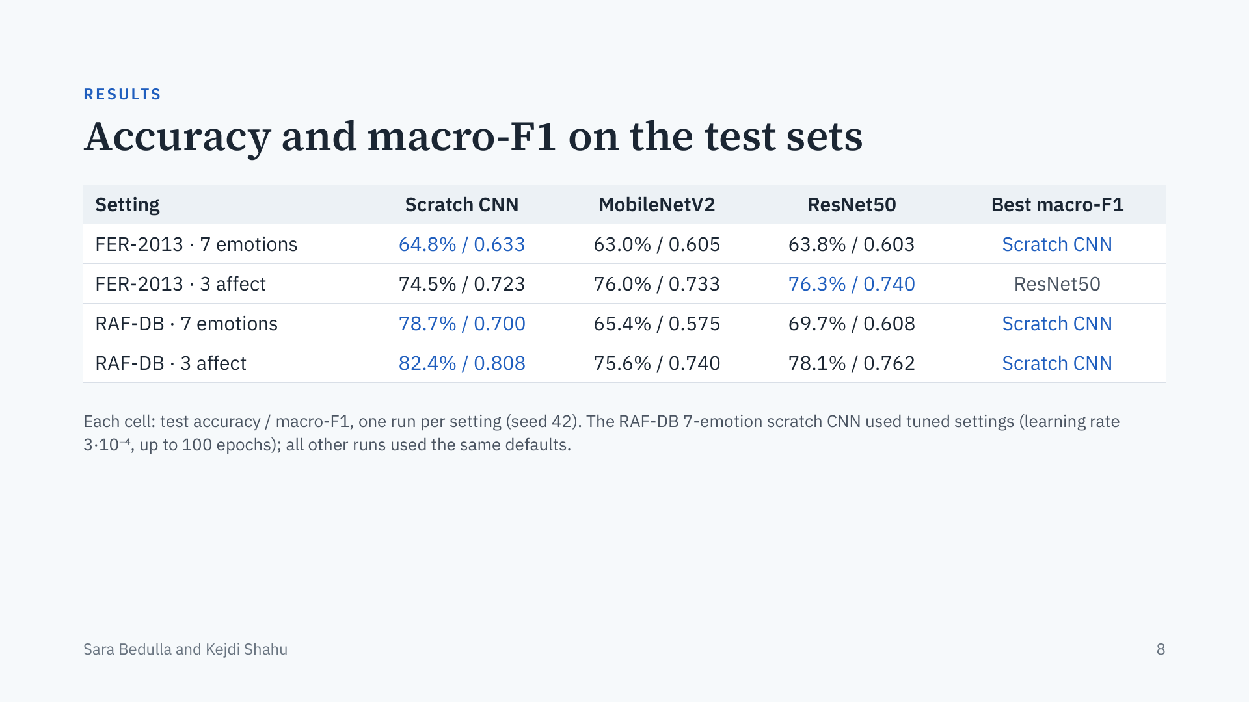
Notes:
Presenter: Kejdi. The exact numbers behind the chart. The best results are 64.8% on FER-2013 with 7 emotions, which is close to human accuracy on this dataset (about 65%), and 82.4% on RAF-DB for the 3 depression-related classes. Every model does better on RAF-DB, which has cleaner labels, and on the 3 affect classes, which merge emotions that are often confused. Be transparent: one scratch CNN run on RAF-DB had tuned settings, which favours it in that setting.

Slide 9
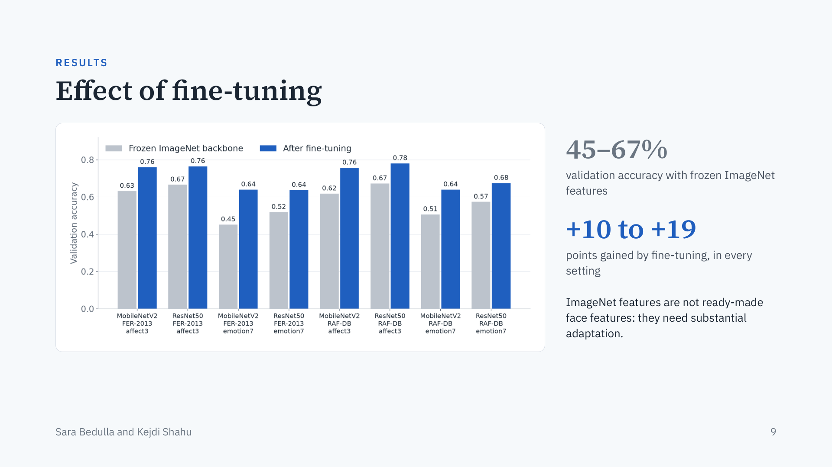
Notes:
Presenter: Kejdi. Gray is the best validation accuracy with the backbone frozen, blue is after fine-tuning. With frozen ImageNet features the models reach only 45 to 67 percent, well below the scratch CNN. Fine-tuning the top stage adds 10 to 19 points every time. So pretraining alone does not give useful face features; the network has to adapt a lot, and our conservative fine-tuning of only the top stage limits how far it can adapt.

Slide 10
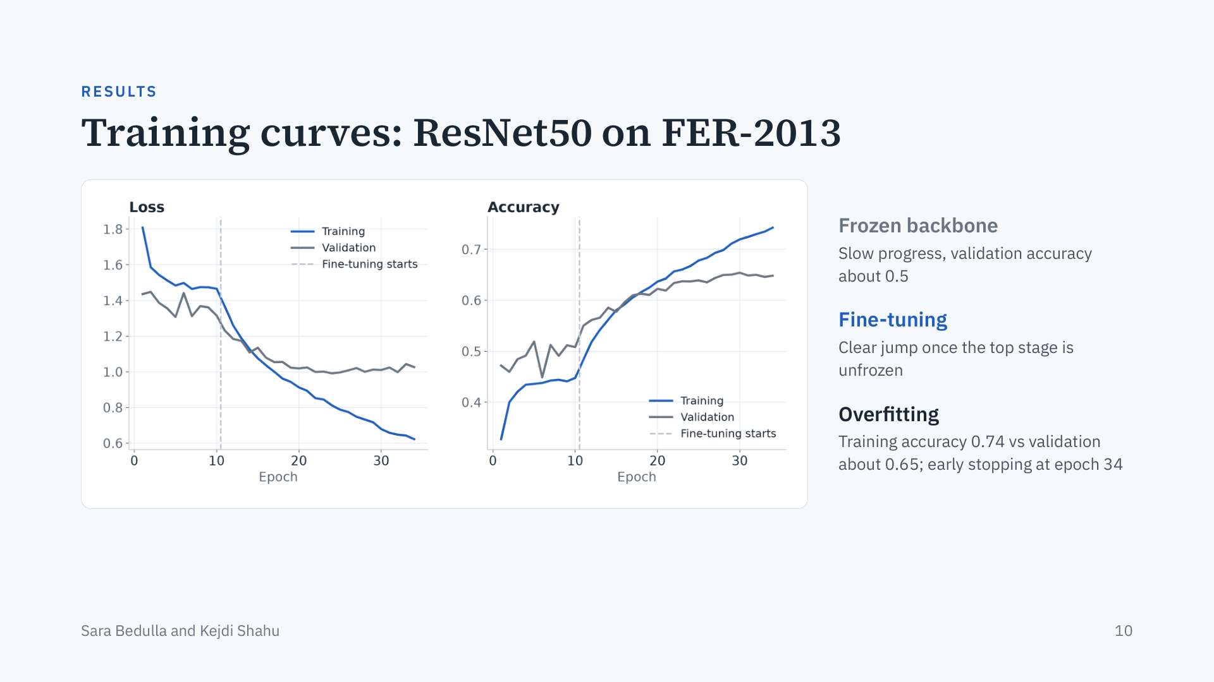
Notes:
Presenter: Kejdi. A typical pretrained run. Left of the dashed line the backbone is frozen and the model barely improves. When fine-tuning starts, loss drops and accuracy jumps. Then ResNet50 starts to overfit: training accuracy keeps rising while validation flattens, and early stopping ends the run. MobileNetV2 overfits less but learns slowly; on FER-2013 with 7 emotions it was still improving at the 60-epoch limit. The scratch CNN curves stay closer together. All other curves are in the report.

Slide 11
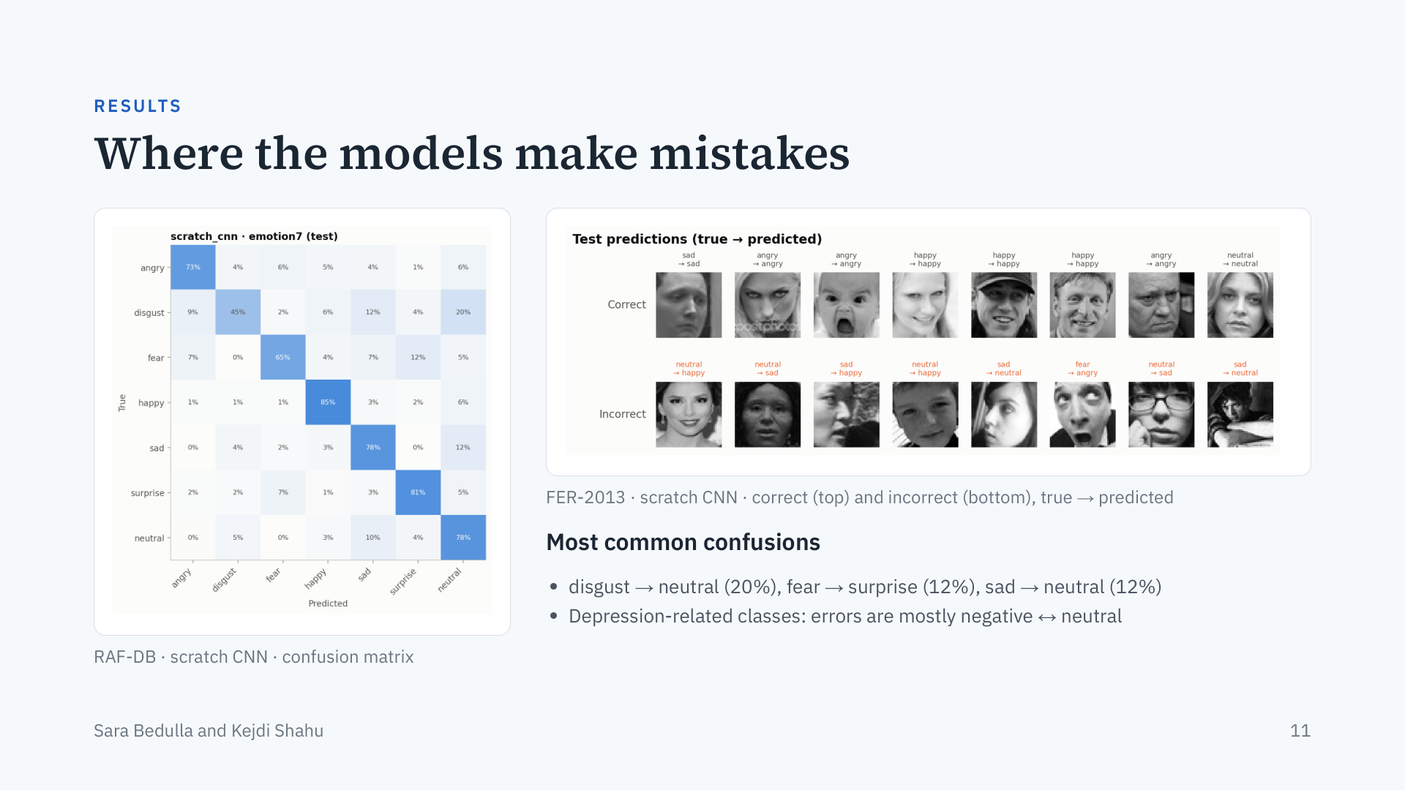
Notes:
Presenter: Kejdi. Each row of the confusion matrix shows how the test faces of one emotion were classified. Happy and surprise are easy for every model. The rare classes are hard: on RAF-DB, disgust is often called neutral; on FER-2013, fear is the hardest emotion and sad is often called neutral. For the 3 depression-related classes most errors are between negative and neutral, which matters because subtle negative or flat expressions look close to neutral. The example errors show ambiguous, dark, occluded or side-on faces, and some FER-2013 labels look questionable.

Slide 12
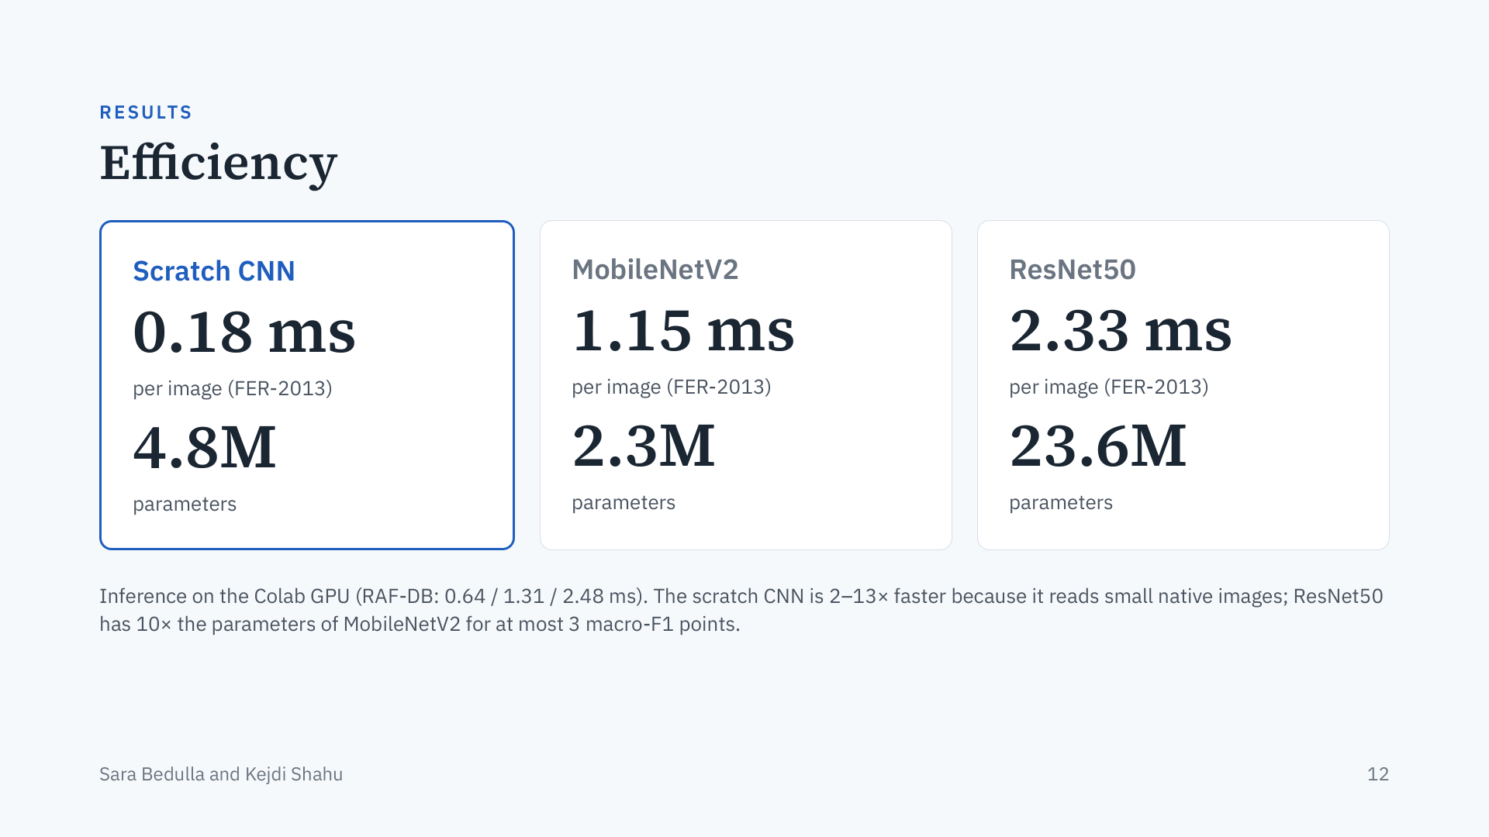
Notes:
Presenter: Kejdi. Accuracy is only half of the question. MobileNetV2 has the fewest parameters, but the scratch CNN is still the fastest model, because it works on 48×48 or 100×100 images while the pretrained models must process 224×224 inputs. ResNet50 is about twice as slow as MobileNetV2 and has ten times the parameters, for at most three macro-F1 points. Times were measured on shared Colab GPUs, so treat them as approximate.

Slide 13
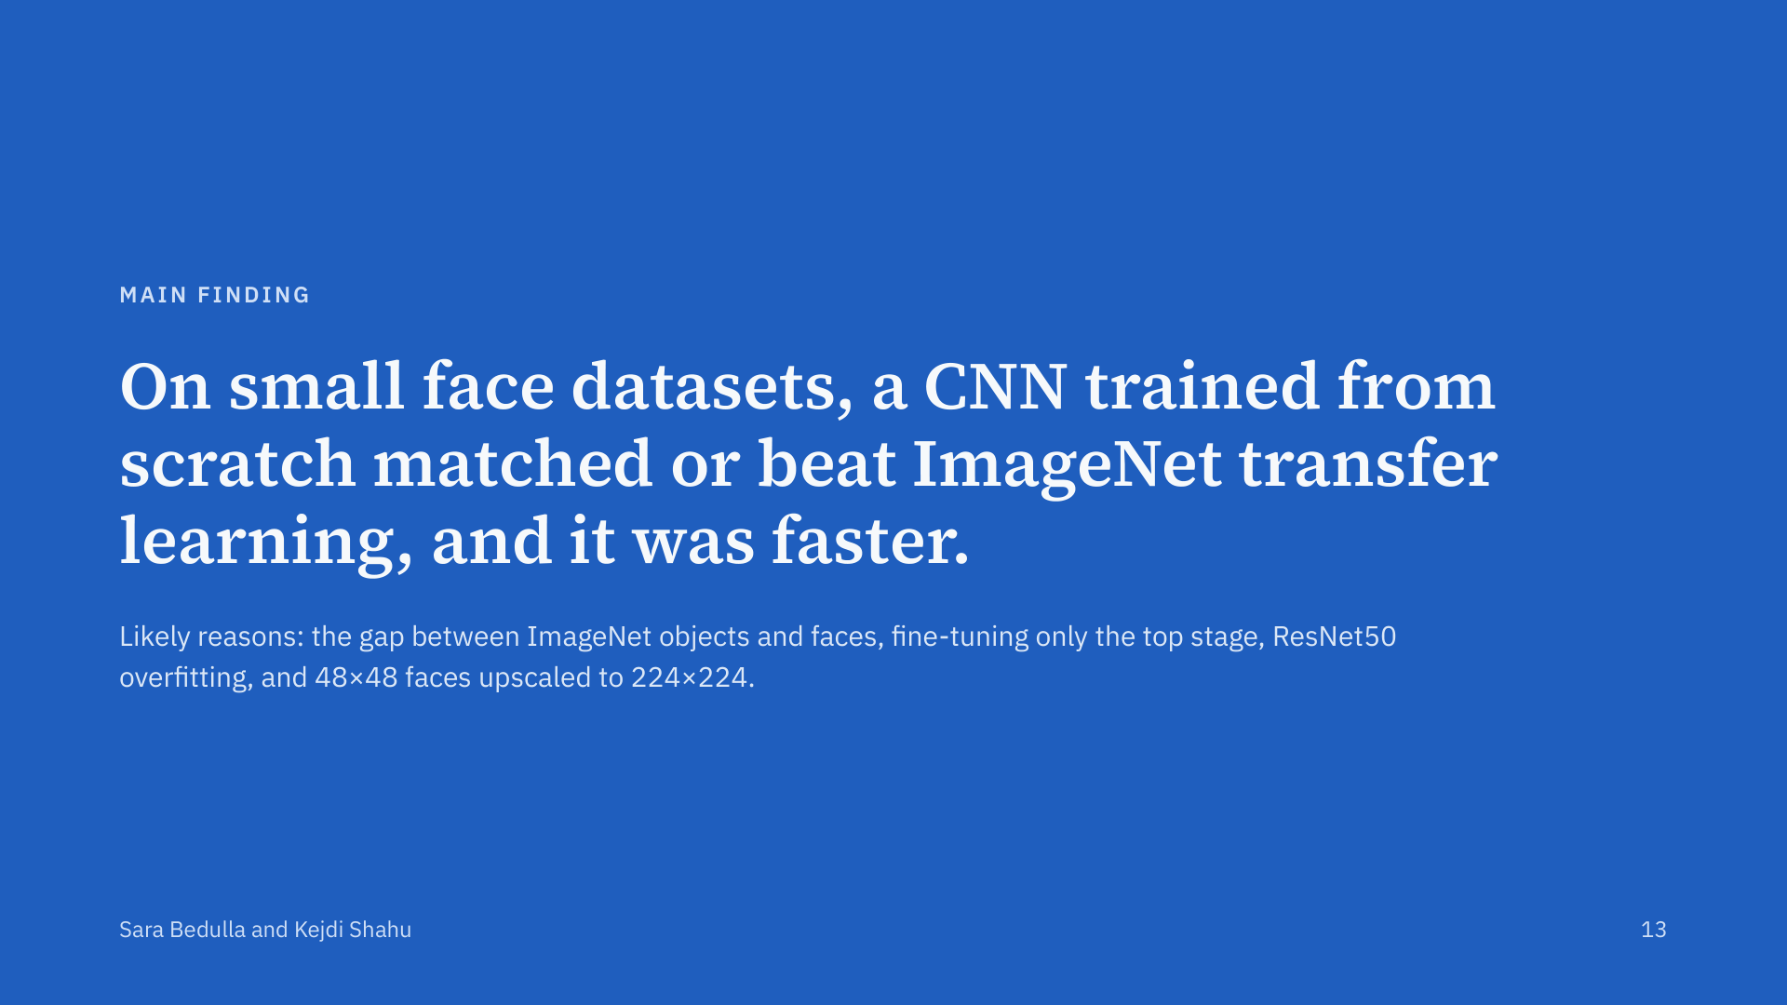
Notes:
Presenter: Kejdi. This answers our research question. Transfer learning did not give an advantage here. ImageNet contains objects, not close-up faces, so the frozen features were weak. We fine-tuned only the top stage with a small learning rate, which protects the pretrained features but limits adaptation. ResNet50, with 23.6 million parameters, overfitted our 11 to 26 thousand training images. And FER-2013 faces are only 48×48 pixels, so upscaling them to 224×224 adds no information.

Slide 14
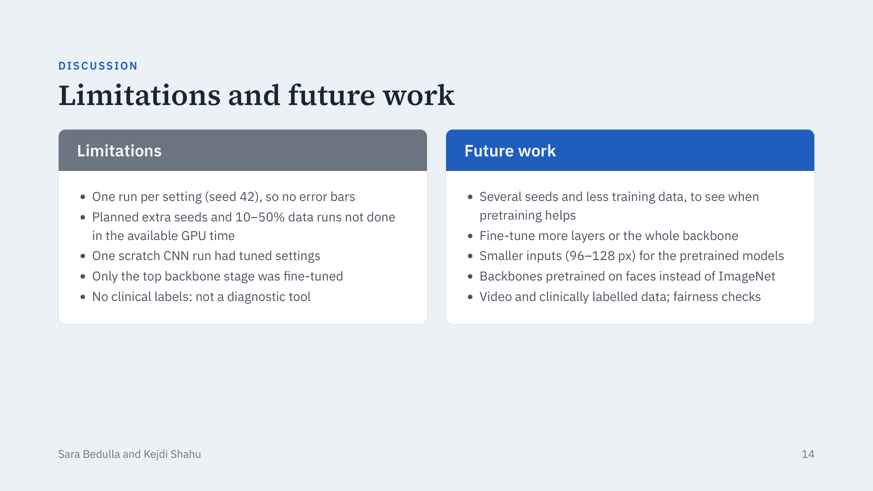
Notes:
Presenter: Kejdi (or both). Be upfront about the limits: each configuration was trained once, so small differences, especially on FER-2013, may be noise. We planned three seeds and a training-data-size experiment but did not have the GPU time. One scratch CNN run used tuned settings while the pretrained models used defaults. Future work: give the pretrained models a fairer budget (more layers unfrozen, longer training, smaller inputs), try face-pretrained backbones, and test on video and clinical data.

Slide 15
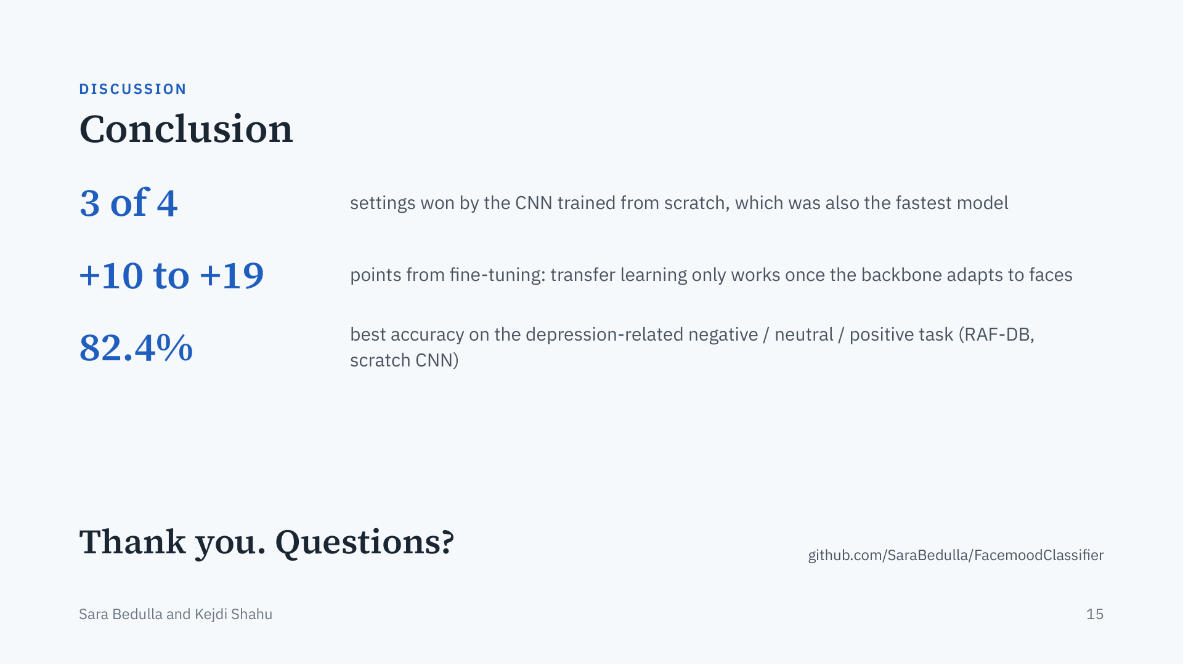
Notes:
Presenter: both. Summarise in three points. One: the CNN trained from scratch won three of the four settings and was the fastest. Two: fine-tuning added 10 to 19 points, so pretrained models only help once they adapt to faces. Three: the best depression-related result was 82.4% on RAF-DB. Finish by repeating that the system recognises expressions and does not diagnose depression, then take questions. The code and the Colab notebook are on GitHub.

