Slide 1


Slide 2
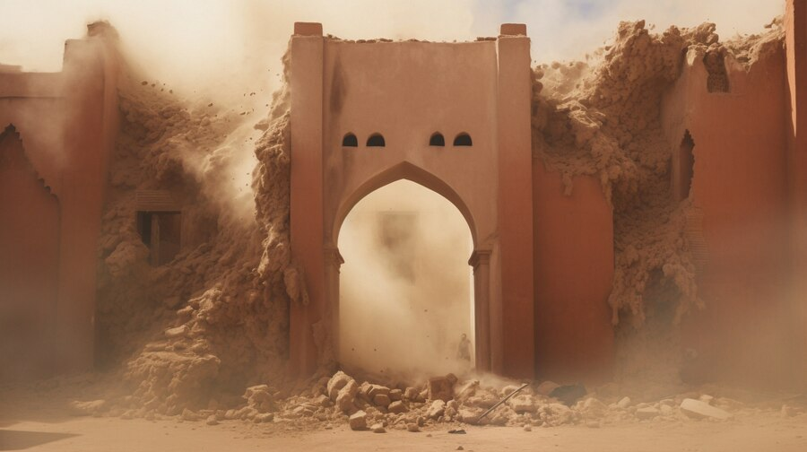
EARTHQUAKES
SARA BHATTI
Notes:
Hello and welcome to today's presentation on one of the most awe-inspiring and yet potentially destructive forces of nature – earthquakes.

Slide 3
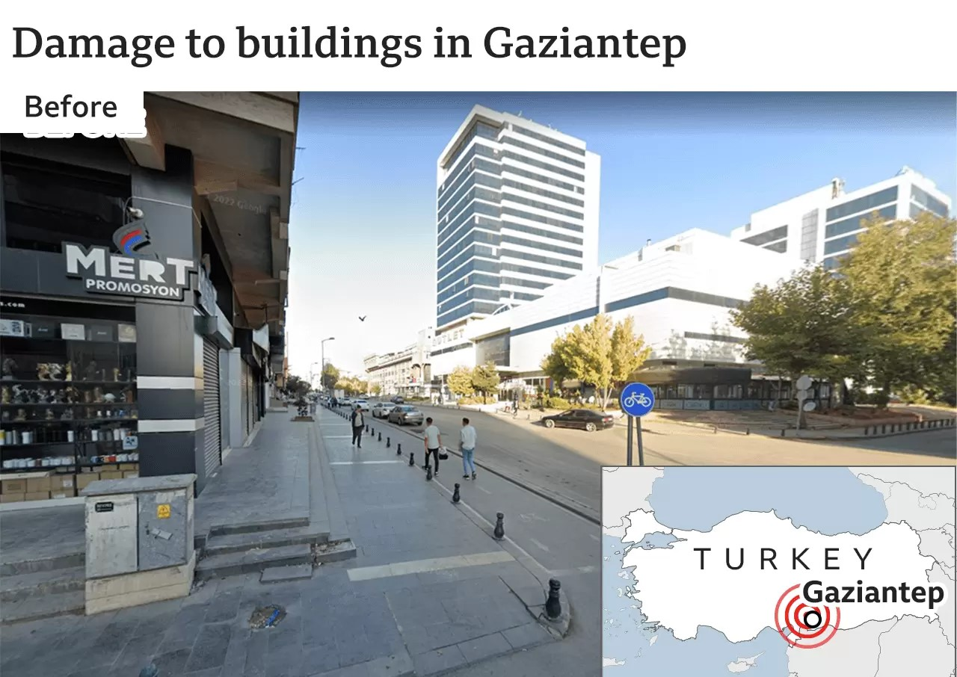
BEFORE
Source:
Google Getty Images
SARA BHATTI 2023
Notes:
Depicted here is a scene from before a significant seismic event that occurred in February of this year.
In the early hours of February 6th, two massive earthquakes rattled Turkey, registering as major seismic events with a magnitude of 7.8 on the scale.
The epicenter was situated near Gaziantep, a city home to approximately 2 million residents.

Slide 4
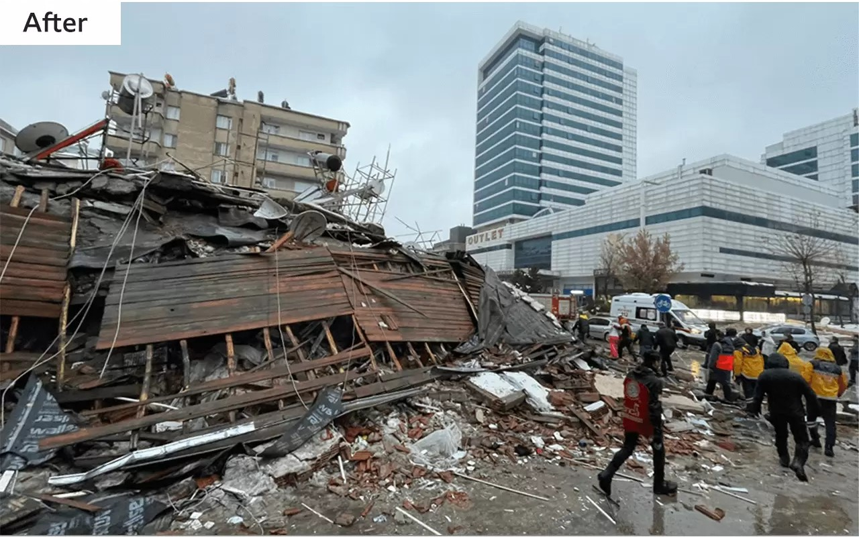
AFTER
Source:
Google Getty Images
Notes:
The destruction of the earthquake brough down tower blocks and building in northern Syria, the tremors were felt about 250 miles from the epicentre in Cyprus and Lebanon.

Slide 5

Source:
Prag News Digital
Notes:
We witness the profound human impact of earthquakes, where even a 2-month-old baby miraculously survived under the rubble after 128 hours. The devastating quake led to a tragic loss of 28,000 lives and the collapse of 6,000 buildings. Amidst the despair, stories of incredible survival and human resilience emerged as beacons of hope.
Communities around the world bear the consequences of seismic activity that continuously shapes our planet and societies. While these geological events can be frightening, they also provide valuable insights into the intricate dynamics of our Earth.
Earthquakes are both a captivating and vital field of study, as they possess the ability to reshape landscapes, influence economies, and impact the lives of millions.
In this presentation, we will delve into various facets of earthquakes, exploring their significance, effects, and the scientific knowledge they offer.

Slide 6
Location
Types
Frequency
Time
Top 10
Notes:
We will explore insights about earthquakes and what we can glean from them.
The data utilized in this study was sourced from the U.S. Geological Survey, which provides dependable and scientific information for describing and comprehending the Earth.
This data is a part of their program dedicated to monitoring earthquakes, assessing their impacts, studying hazards, and researching the causes and effects of seismic events.
We will be focusing on data from the last 30 days
We will be exploring the top 10 areas, global locations, the types of magnitudes and the frequency of these types over time.

Slide 7
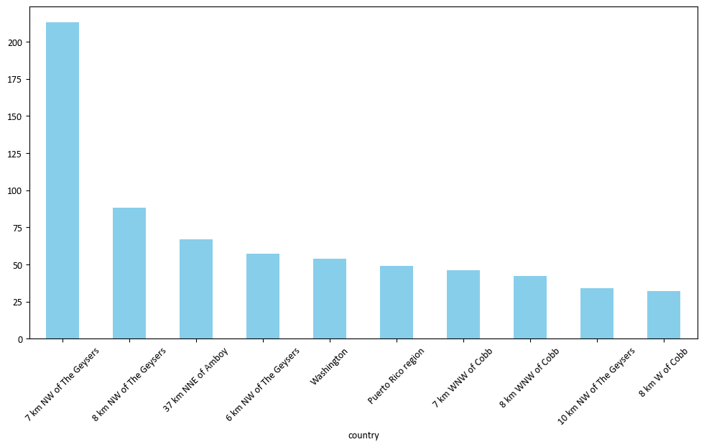
TOP 10
Notes:
The chart above illustrates the top 10 areas with the highest frequency of earthquakes. However, it's essential to note that a high frequency of earthquakes in these regions does not necessarily imply the most significant levels of damage.
From the chart, we observe that the location with the most earthquake occurrences during a 30 day period, was 7 km NW of The Geyres, which significantly differs from the next highest frequency, with more than half of the incidents separated between them.

Slide 8
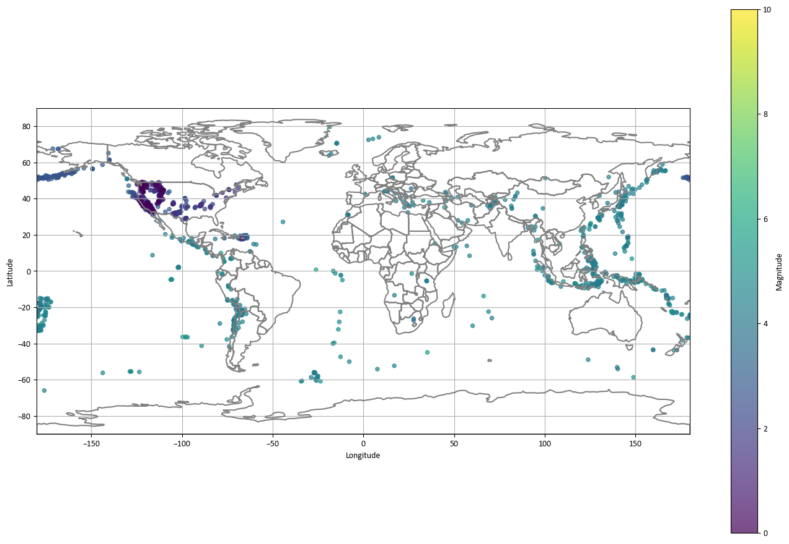
LOCATION
Notes:
In the color map presented, you can discern scatter points that correspond to recorded earthquakes, each denoting its magnitude.
Yellow points signify a greater magnitude, gradually transitioning to deep purple, indicative of a lower magnitude. Particularly noteworthy is the dense concentration of earthquakes in the western region of the Americas.

Slide 9
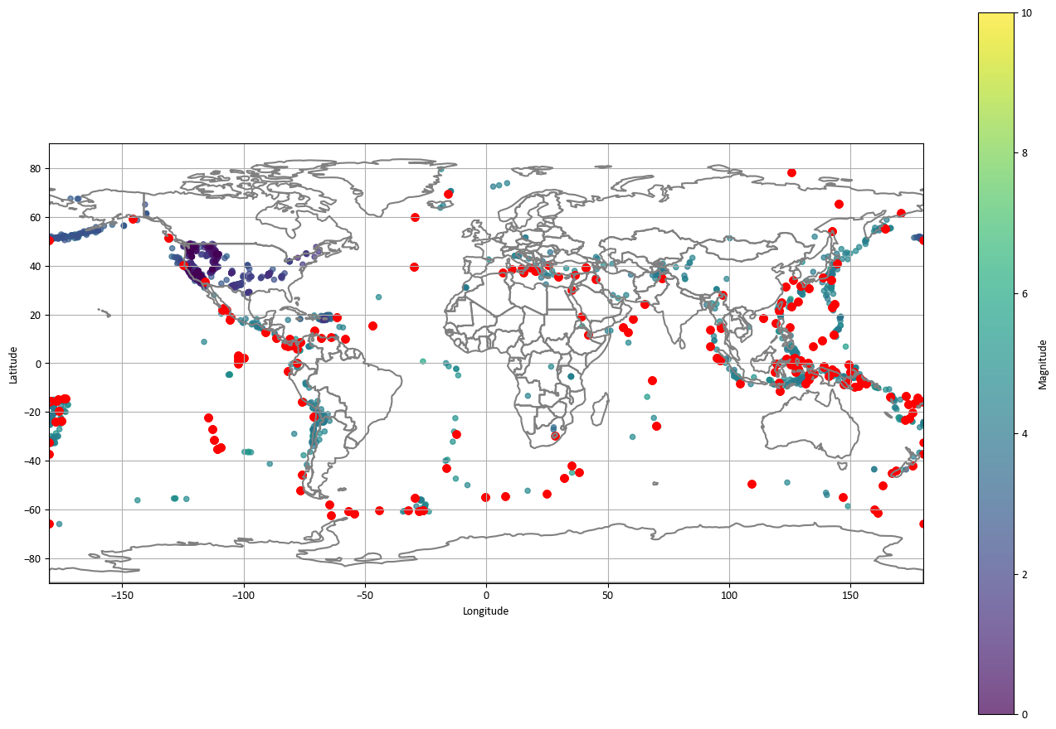
LOCATION
Notes:
If we overlay a map with the locations of tectonic plates, a fascinating correlation emerges. The distribution of earthquakes closely corresponds to the positions of these tectonic plates, highlighting the significant influence of plate boundaries on seismic activity.
Tectonic plate boundaries are where the Earth's lithospheric plates interact, leading to various geological phenomena, including earthquakes. This observation underscores the pivotal role of plate tectonics in shaping our understanding of seismic events and their occurrence.

Slide 10
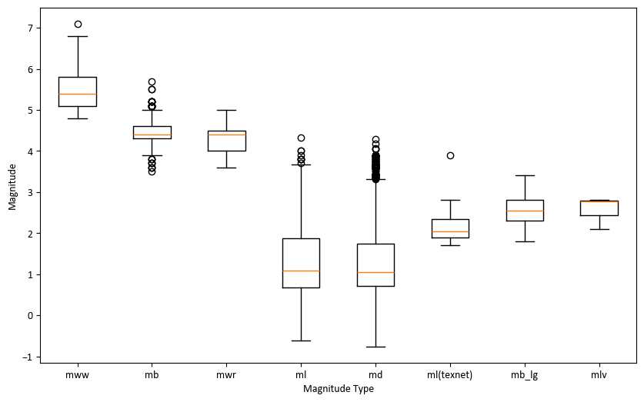
TYPE
Notes:
The United States Geological Survey (USGS) employs various magnitude types to measure and characterize earthquakes. These magnitude types offer diverse perspectives on the seismic energy released during an earthquake, serving various purposes in seismic analysis.
When comparing magnitude types with the magnitude of earthquakes using a box plot, valuable insights into the dataset's seismic characteristics emerge.
This visualization allows us to discern the distribution of earthquake magnitudes for each type, aiding in our comprehension of the range and central tendency of magnitudes associated with different types, such as 'mb' (body-wave magnitude) or 'Mw' (Moment Magnitude).
Remarkably, the MD magnitude type exhibits numerous outliers in comparison to the others. This observation suggests the possibility of unique geological conditions or measurement anomalies.
Furthermore, box plots enable statistical comparisons among different magnitude types. They reveal statistically significant differences in magnitude distributions among the various types.
In summary, comparing earthquakes across different magnitude types is feasible, but it necessitates careful consideration of the factors mentioned above. To ensure meaningful and accurate comparisons, it is advisable to standardize all magnitudes to a consistent scale (e.g., Mw) while remaining aware of the limitations and uncertainties associated with each magnitude type. Additionally, the choice of approach should align with the specific context and objectives of the comparison.

Slide 11
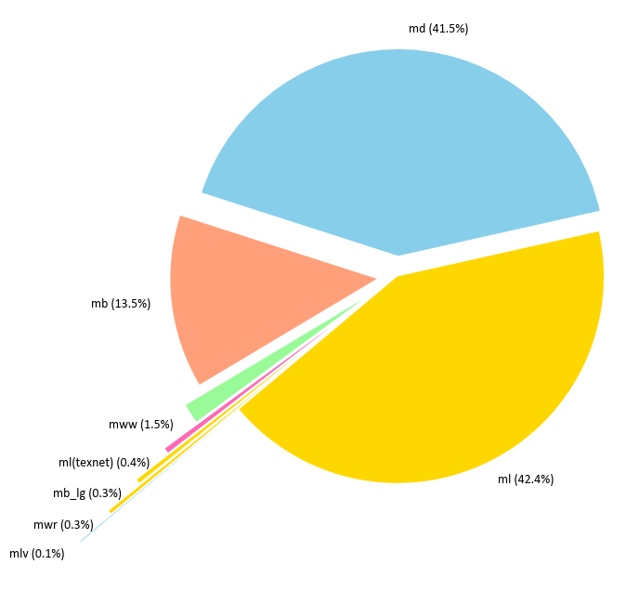
FREQUENCY
Notes:
The frequency of magnitude types can be seen in the pie chart.
The presence of multiple magnitude types, including some being more prevalent than others (such as Md and Ml), is due to historical and scientific developments in seismology, as well as regional variations in earthquake monitoring.
The variation of magnitude can occur due to a number of reasons, such as historical development, regional variations, magnitude types for different depth regions, advancement in seismology and international collaboration.
Different magnitude types serve specific purposes and are applied based on the seismic characteristics and needs of the region or event being studied.

Slide 12
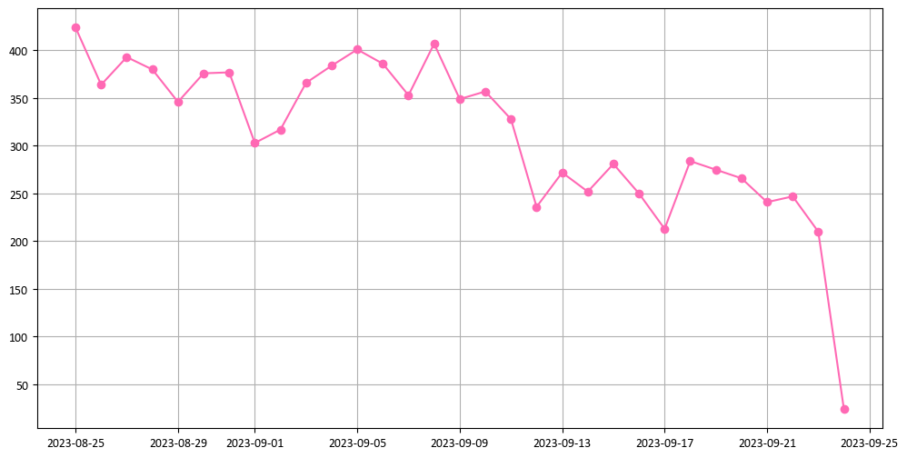
Time
Notes:
During this 30-day period, a significant number of earthquakes occurred, showing a general downward trend in seismic activity. The peak, which reached approximately 430 earthquakes, occurred at the beginning of the month. Subsequently, the earthquake frequency gradually decreased over the course of the month, reaching a low point of around 20 earthquakes toward the end of the observation period.
This trend in earthquake activity can be influenced by various factors, including tectonic plate interactions, stress accumulation and release, and geological conditions. The fluctuations in earthquake frequency offer valuable insights into the dynamic nature of seismic events in the region and may have implications for ongoing seismic monitoring and preparedness efforts.

Slide 13

Source:
Prag News Digital
Notes:
Back to our miracle baby
After 54 days the baby girl was reunited with her mother, Yasemin, who was initially thought to have died in the Earthquake that hit Turkey.

Slide 14
Environment
Infrastructure
Research
Resources
Safety & Risks
Notes:
Earthquakes have, and always will, pose risks to human life and property. Understanding the regions prone to earthquakes enables us to enhance preparedness for these potentially devastating disasters.
By comprehending areas susceptible to earthquakes, accurate risk assessments can ensure that individuals and businesses in high-risk zones are adequately protected.
Furthermore, earthquakes have environmental repercussions, including landslides and tsunamis, among other geological events.
A deeper understanding of these factors empowers governments and local authorities to develop and plan more robust infrastructure. This includes the implementation of early warning systems and evacuation procedures, crucial for withstanding potential seismic events.
Understanding the geographical distribution of earthquakes is crucial for scientific research into plate tectonics, seismology, and geology. This knowledge enriches our understanding of the Earth's interior, contributing to the development of earthquake prediction and warning systems, as exemplified by stories like Yasemin's and her beautiful baby girl’s.
Additionally, the box plots we observed enable statistical comparisons among different magnitude types. This information holds significance for seismic studies, hazard assessments, and research into the behaviour of distinct earthquake types.
Governments and local authorities can also allocate resources more effectively to regions experiencing heightened seismic activity, thereby optimizing disaster response efforts.

Slide 15
THANK YOU
?QUESTIONS?
Notes:
Thank you for listening, I open the floor to any questions.

