Slide 1
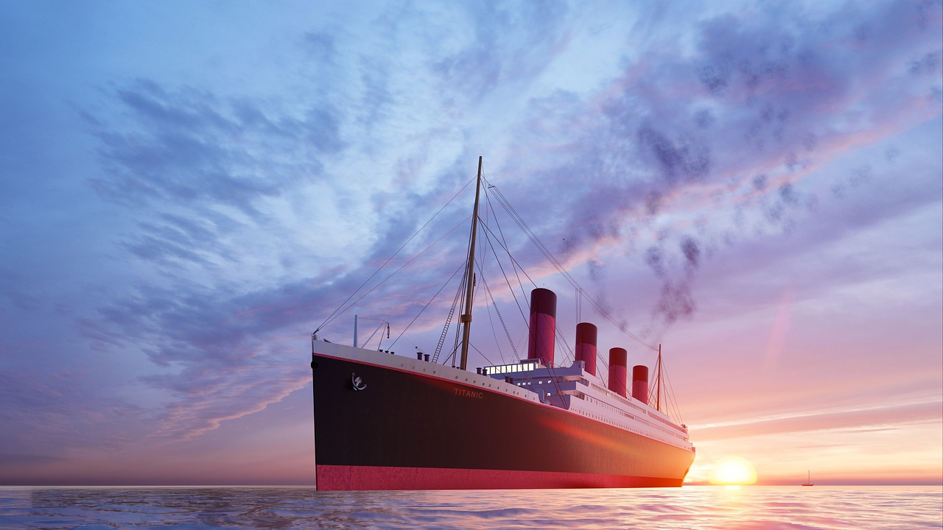
KEY FACTS
Maiden Voyage
10th April 1912
Southampton, Cherburg Queenstown
New York
2,224 people
April 15th
TITANIC

Slide 2
KEY FACTS
Maiden Voyage
10th April 1912
Southampton, Cherburg Queenstown
New York
2,224 people
April 15th
Notes:
The Titanic was completed and prepared for its maiden voyage on March 31, 1912, following three years of construction. It stood as a marvel of its era, boasting the impressive length equivalent to three football fields. On April 10, 1912, the Titanic embarked on its inaugural journey from Southampton, England, destined for New York. Along the way, it made stops in Cherbourg, France, and Queenstown, Ireland, to board additional passengers, resulting in a total of 2,224 individuals on board.
Tragically, on April 15th, the so-called "unsinkable" ship collided with an iceberg. Regrettably, there were an insufficient number of lifeboats available for the passengers and crew. Although luck played a role in survival, it becomes evident that certain groups of people had a higher likelihood of surviving this disaster than others.

Slide 3
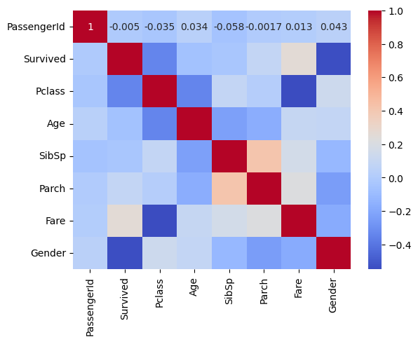
KEY FACTS
Maiden Voyage
10th April 1912
Southampton, Cherburg Queenstown
New York
2,224 people
April 15th
Categories
Survival
Gender
Family
Fare
Ticket Number
Age
Cabin Number
Class
Embarked
Notes:
Our objective is to forecast the likelihood of passengers surviving the Titanic disaster. To achieve this, we have access to a dataset that provides information on various factors, including survival, gender, family relationships, fare, ticket number, age, cabin number, class, and embarkation point. For our prediction, we will utilize gender, fare age, and class as key factors.

Slide 4
KEY FACTS
Maiden Voyage
10th April 1912
Southampton, Cherburg Queenstown
New York
2,224 people
April 15th
Categories
Gender
Fare
Age
Class
Notes:
What motivates the use of these factors? The heatmap analysis reveals interesting correlations. There is a negative correlation between class and fare, as well as class and age. This is logical, as first-class passengers are typically adults who pay the highest fares. Additionally, there is a positive correlation between survival and gender.

Slide 5
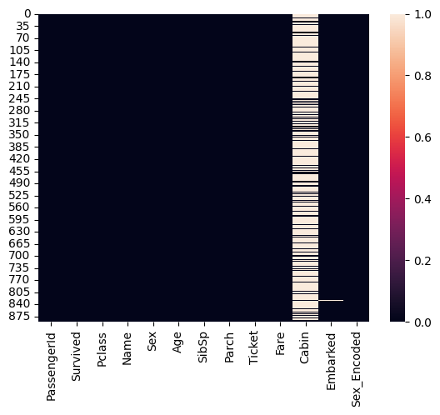
KEY FACTS
Maiden Voyage
10th April 1912
Southampton, Cherburg Queenstown
New York
2,224 people
April 15th
Categories
Gender
Fare
Age
Class
DATA
Clean
Numerical
Missing Values
Explore
Notes:
Our initial approach involved an examination of the data to determine the necessary steps for proceeding with our analysis. Our objectives included addressing missing values, numerical data and gaining insights from data exploration.

Slide 6
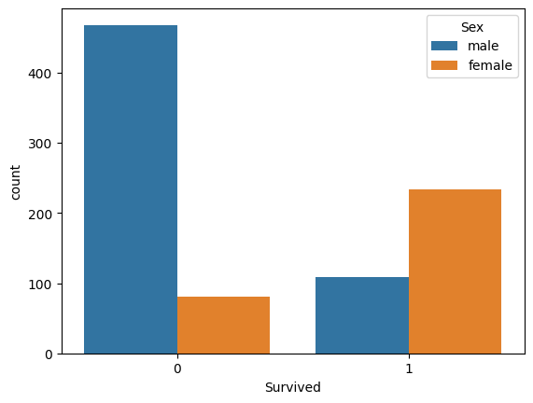
SURVIVAL
Gender
Socio-economic
Age
Class
DATA
21% Null Age
Filled with median 27
77% Null Cabin
Dropped
Embarked
Mode
Fare
Median
KEY FACTS
Maiden Voyage
10th April 1912
Southampton, Cherburg Queenstown
New York
2,224 people
April 15th
Notes:
In the heatmap, it becomes evident where our data contains null values. Notably, we observed that 21% of the 'Age' data was missing, while a substantial 77% of the 'Cabin' data was also null. While one approach could have been to impute the null values with the median, we opted to exclude the 'Cabin' data due to the remarkably high percentage of missing values. This significant absence of cabin numbers is likely attributed to the fact that many passengers didn't record specific cabin locations but instead lodged in various other parts of the ship. There was also missing values in the Embarked data which was replaced with the mode. There was one missing in Fare which was replaced with the median

Slide 7
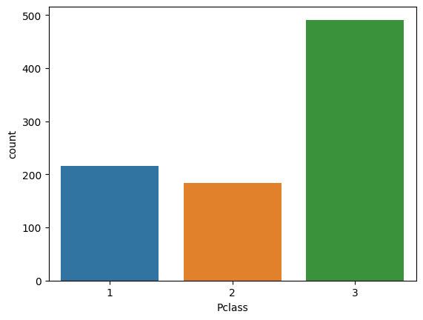
SURVIVAL
Gender
Socio-economic
Age
Class
KEY FACTS
Maiden Voyage
10th April 1912
Southampton, Cherburg Queenstown
New York
2,224 people
April 15th
DATA
Men less likely to survive than women
Notes:
Upon closer examination of the gender-based split, it becomes evident that a larger proportion of men did not survive, while more women managed to survive. This observation aligns with the prioritization of women and children during the evacuation process.

Slide 8
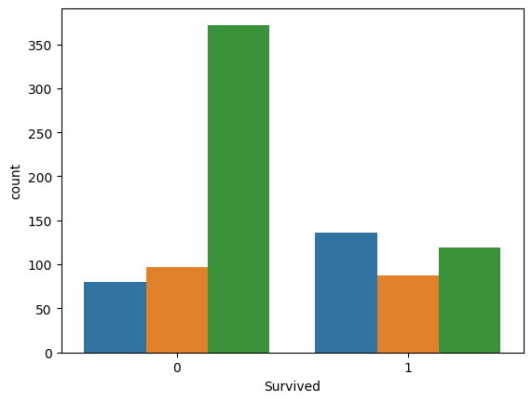
SURVIVAL
Gender
Socio-economic
Age
Class
KEY FACTS
Maiden Voyage
10th April 1912
Southampton, Cherburg Queenstown
New York
2,224 people
April 15th
DATA
More third class travellers
Notes:
In this bar chart, the distribution of passengers is depicted based on their respective classes. It is evident that there were more passengers in the third class than in the other two classes. This observation provides context for the subsequent chart.

Slide 9
SURVIVAL
Gender
Socio-economic
Age
Class
KEY FACTS
Maiden Voyage
10th April 1912
Southampton, Cherburg Queenstown
New York
2,224 people
April 15th
DATA
First Class more likely to survive
Notes:
First-class passengers exhibited a greater likelihood of survival, in contrast to the lower survival rates among third-class passengers. This insight underscores the societal dynamics in operation during the Titanic's tragedy. The prioritization of first-class passengers during the evacuation process raises emotional reflections on the tragic loss of lives associated with social status and financial means.

Slide 10
KEY FACTS
Maiden Voyage
10th April 1912
Southampton, Cherburg Queenstown
New York
2,224 people
April 15th
Categories
Gender
Fare
Age
Class
DATA
Clean
Numerical
Missing Values
Numeric Values
Explore
MODELS
Logistic Regression
KNN
Random Forest
Decision Tree
Notes:
In this machine learning exercise, we will employ the following models to formulate our predictions:
1. Logistic Regression
2. K-Nearest Neighbors (KNN)
3. Random Forest
4. Decision Tree

Slide 11
Logistic Regression Accuracy: 94%
K Nearest Numbers Accuracy: 63%
Random Forest Accuracy: 83%
Accuracy (gini): 78%
Accuracy (entropy): 75%
Accuracy (max depth): 98%
Decision Tree

Slide 12
THANK YOU
Notes:
While this exercise primarily deals with facts and figures, it's essential to bear in mind that we are discussing human lives. This tragedy serves as an educational example, but it's a historical moment that warrants sensitivity. Much like our world today, it prompts us to reflect on our lives and be grateful for them. Simultaneously, it underscores our responsibility to seek knowledge, self-improvement, and the betterment of the lives of those around us.

