Slide 1
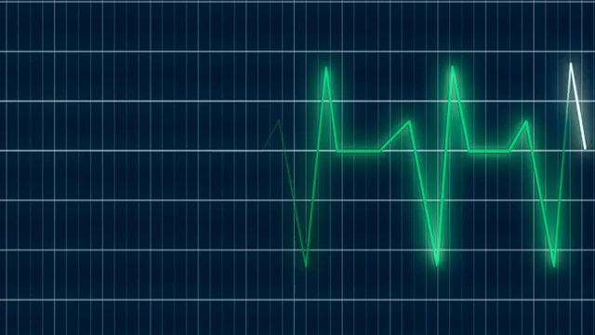
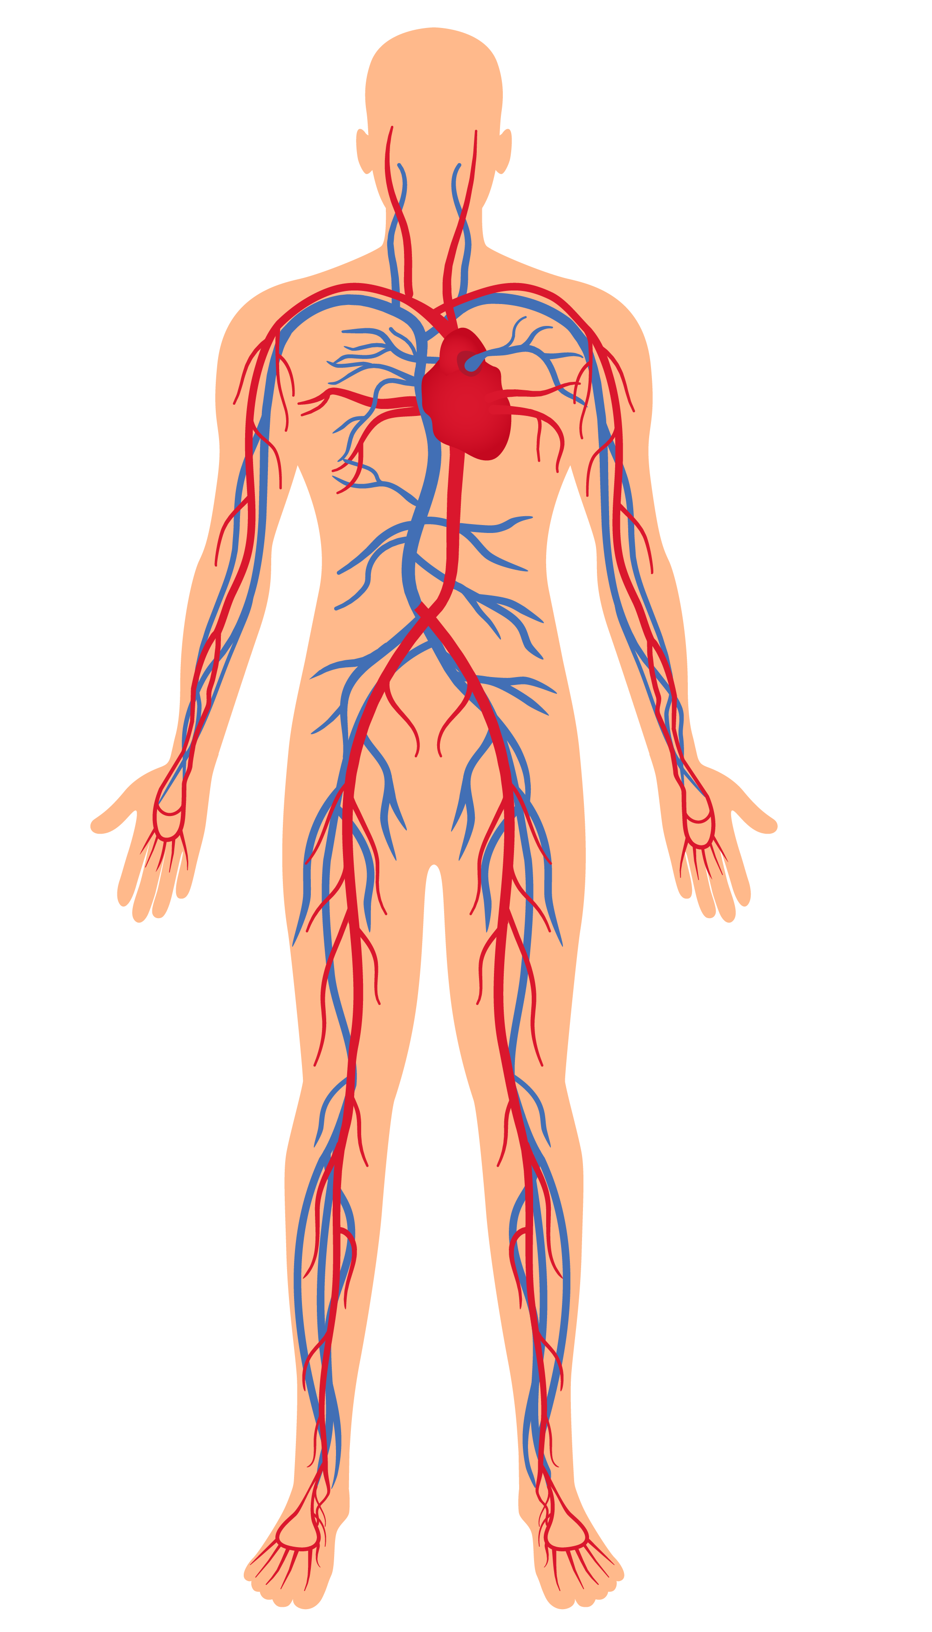
Heart
Failure
Notes:
Heart failure means that the heart is unable to pump blood around the body properly. It usually happens because the heart has become too weak or stiff.
Heart failure does not mean your heart has stopped working. It means it needs some support to help it work better.
It can occur at any age, but is most common in older people.
Heart failure is a long-term condition that tends to get gradually worse over time.
It cannot usually be cured, but the symptoms can often be controlled for many years.

Slide 2



Data Cleaning
Risk Factors
Exploration
Lifestyle

Slide 3
Risk Factors
CAD
Diabetes
High Blood Pressure
Obesity
Other Conditions – Heart Disease
Valvular Heart Disease
Notes:
What are the risk factors for heart failure?
Certain medical conditions can increase your risk for heart failure, including
Coronary artery disease (CAD) (the most common type of heart disease) and heart attacks
Diabetes
High blood pressure
Obesity
Other Conditions Related to Heart Disease
Valvular Heart Disease

Slide 4
Lifestyle
Smoking
Diet (Fat, Cholesterol, Sodium)
Exercise
Alcohol
Notes:
Unhealthy behaviors or lifelsty choices can also increase your risk for heart failure, especially for people who have one of the conditions listed above. Unhealthy behaviors include:
Smoking tobacco
Eating foods high in fat, cholesterol, and sodium
Not getting enough physical activity
Excessive alcohol intake

Slide 5
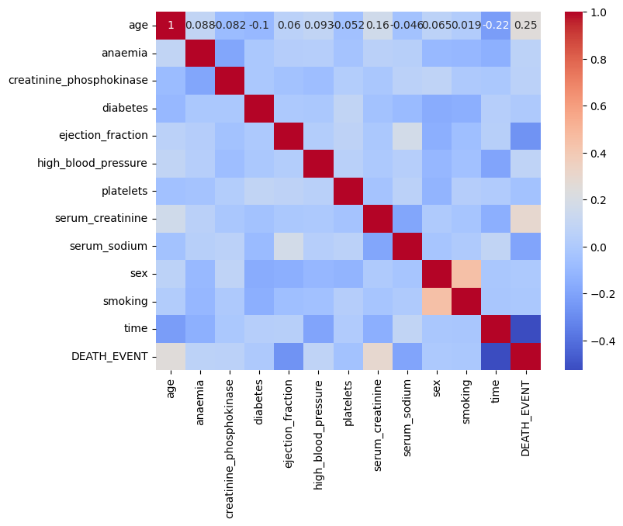
Risks/Lifestyle
Smoking
Diet (Fat, Cholesterol, Sodium)
Exercise
Alcohol
Notes:
Considering the risk factors and lifestyle choices we made a correlation heatmap to determine what kind of trelationship is the stroingest to use in our model. We will use the The blood pressure, smoking, sodium and the ejection fraction factors.

Slide 6
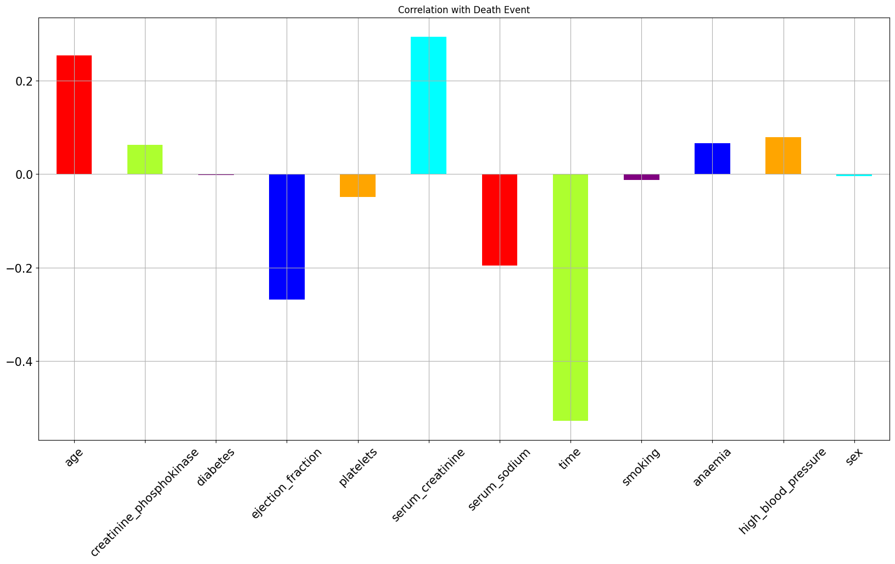
Risks/Lifestyle
Smoking
Diet (Fat, Cholesterol, Sodium)
Exercise
Alcohol
Notes:
Within this correlation plot, we can observe the relationships between various features and the target factor. Notably, 'time' exhibits a negative correlation, indicating it has limited relevance. Conversely, 'age' and 'creatinine' display positive correlations. Of particular interest is the negative correlation with 'sodium.’ which we previously identified as significant in heart failure.

Slide 7
Data
Missing Values
Duplicates
Numerical
SMOTE
Standard Scaler
Notes:
The dataset was well-prepared, with no missing values or duplicates. Furthermore, all data in the dataset was in numerical format. Implemented the standard scaler

Slide 8
Exploration
Size
Distribution
Genders
High Blood Pressure
Platelets
Notes:
While delving into the data, there were numerous factors I aimed to investigate. However, due to time constraints, I focused on a few specific aspects. These included assessing the dataset's size, observing the gender distribution, and exploring the relationships between blood pressure and platelet levels.

Slide 9
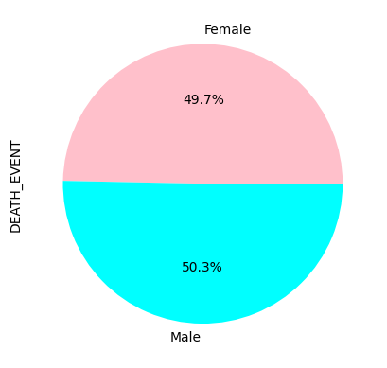
Exploration
Notes:
Taking a comprehensive view of the dataset, it's evident that the gender distribution is fairly balanced.

Slide 10
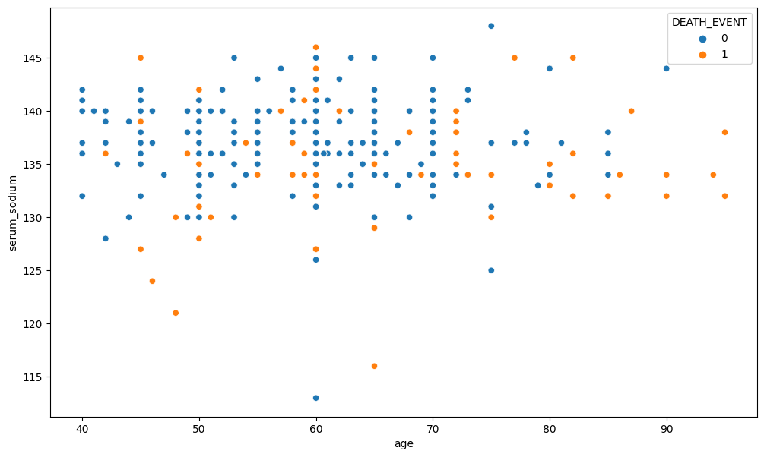
Exploration
Notes:
After conducting a more in-depth analysis, I created a scatterplot to investigate any potential connections with age and sodium levels. In this plot, I utilized the 'hue' parameter to distinguish between different death events, and it's apparent that the distribution is fairly balanced.

Slide 11
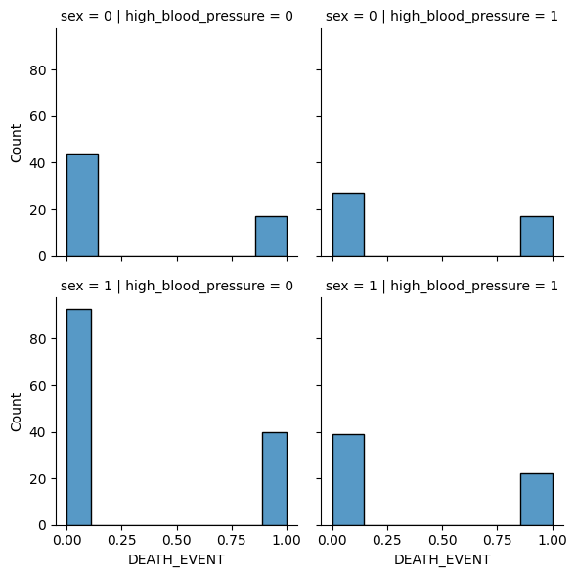
Exploration
Notes:
Furthermore, I sought to delve deeper into the relationships within the dataset, here you can see the genders across rows and blood pressure within the columns. It was observed that male patients who succumbed to heart failure had a notably elevated probability of having high blood pressure compared to those without high blood pressure. Nevertheless, there were still instances of heart failure in patients who did not exhibit high blood pressure.

Slide 12
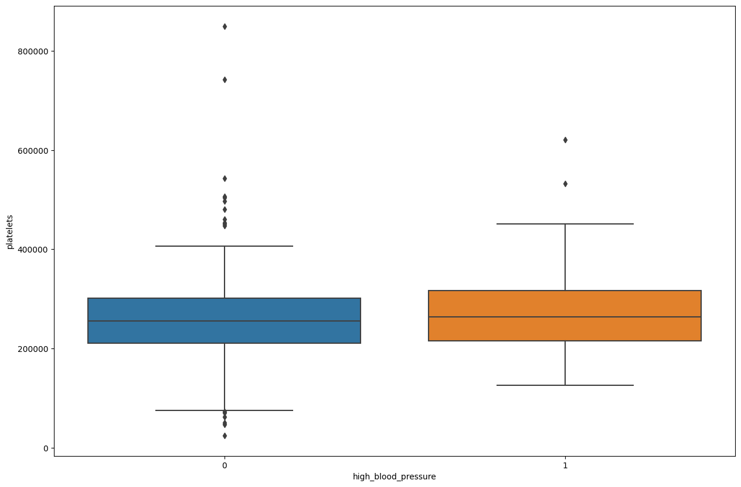
Exploration
Notes:
In this box plot I compare the high blood pressure and platelet levels.
high blood pressure, or hypertension, is a recognized risk factor for heart failure. Prolonged high blood pressure can strain the heart and blood vessels, increasing the likelihood of heart failure. Platelet levels, on the other hand, are more related to the body's response to heart failure rather than being a direct cause. Unusually high or low platelet counts can be associated with various cardiovascular conditions, but they are not the primary trigger for heart failure.

Slide 13
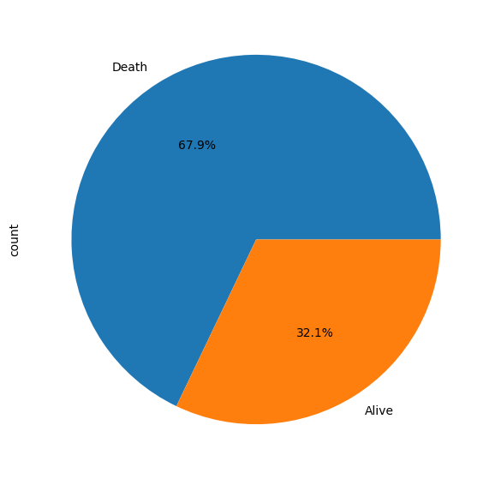
Exploration
Notes:
Upon visual examination of the dataset, a graphical representation illustrates the count of individuals who experienced death events and those who did not. It's evident that there is an imbalance in the dataset, thus there is there may be a need for bootstrapping or oversampling to address the imbalance. Which I didn’t get a chance to do

Slide 14
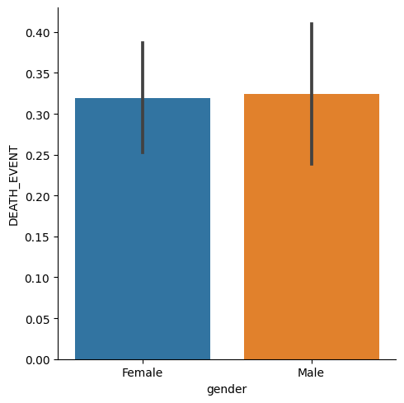
Exploration
Notes:
Distribution of deaths amongst the gender

Slide 15
Random Forest
Logistic Regression
ANN

Slide 16
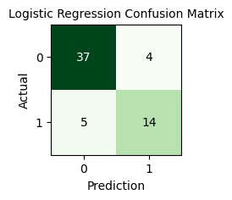
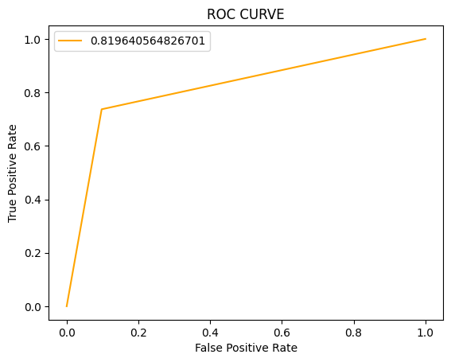
Logistic Regression
85%

Slide 17
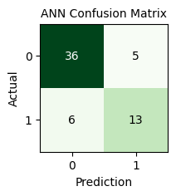
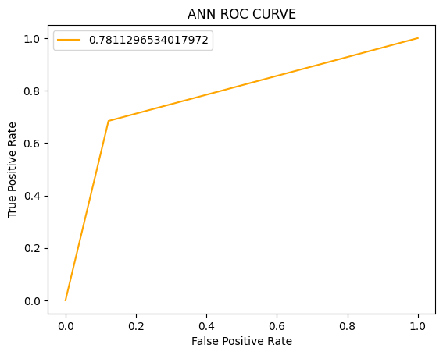
Artificial Neural Network
82%
Notes:
One hidden layer one output layer

Slide 18
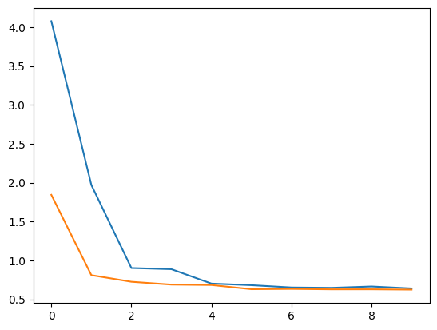
Artificial Neural Network
68%
Notes:
Plot of the loss and value loss

Slide 19
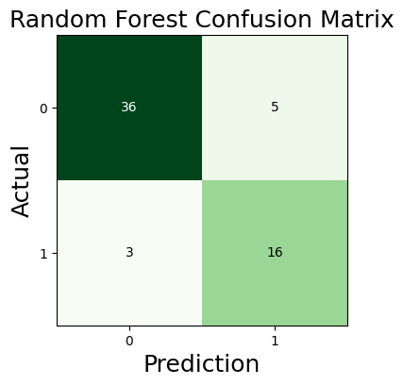
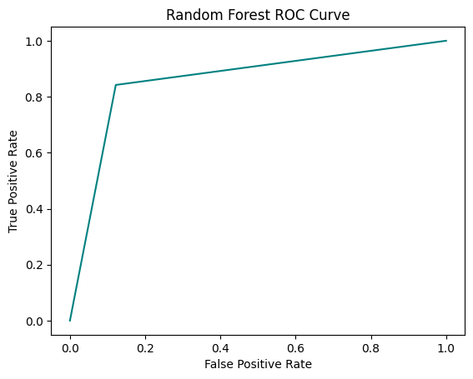
Random Forest
87%
Notes:
77%

Slide 20
Thank you
Notes:
More time to explore the features
More data

