Slide 1
The San Francisco Crime Dataset
Exploratory data analysis
Model
Future work

Slide 2
The San Francisco
Crime Dataset
Variable Group | Variable
Temporal | Date
 | Time
 | Weekday
Crime type | Label
 | Category
 | Description
Outcome | Resolution
Spatial | Longitude
 | Latitude
 | District
Reported crimes in the city of San Francisco
Years 2013-2018
2,129,216 observations

Slide 3
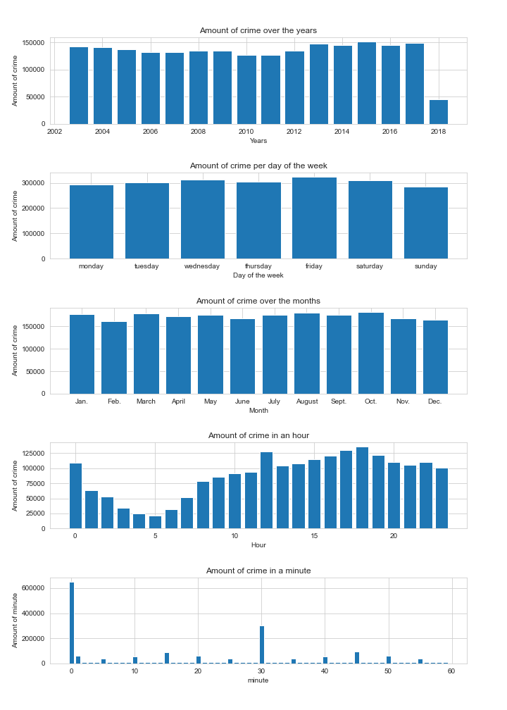
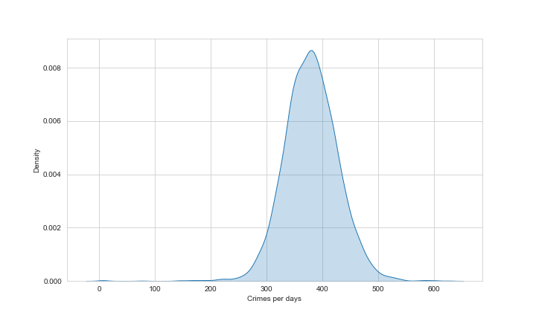
Temporal variables

Slide 4
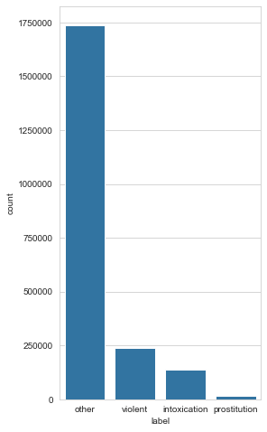
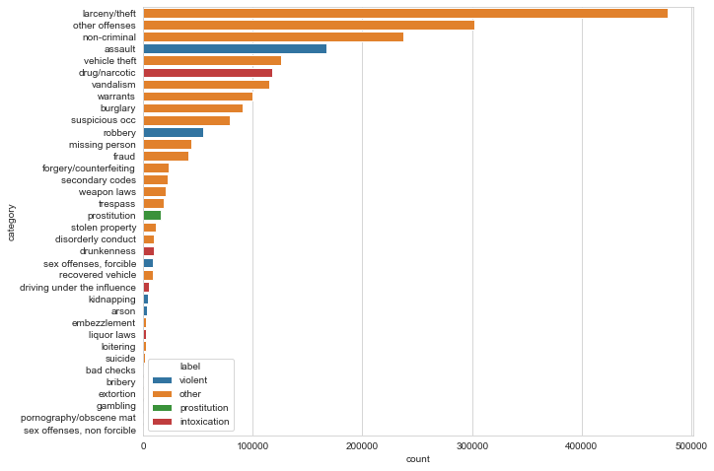
Crime type

Slide 5
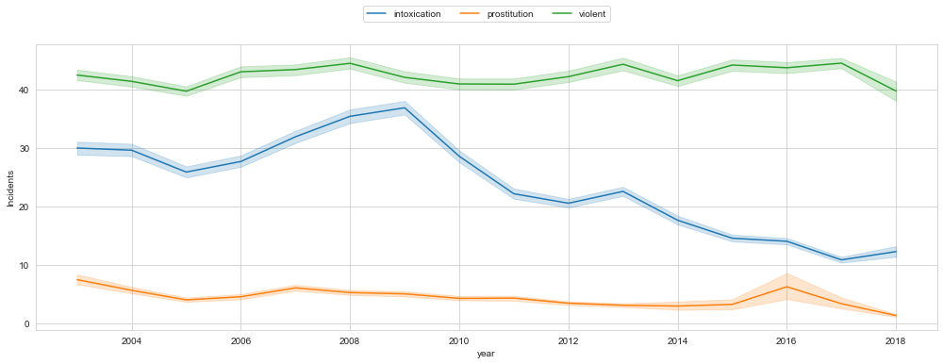
Crime type over year
Notes:
Vis også overall

Slide 6
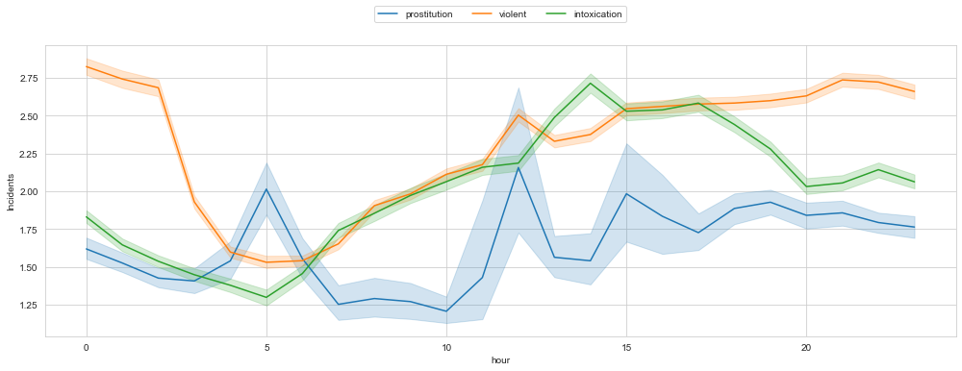
Crime type over hour
Notes:
Vis også overall

Slide 7
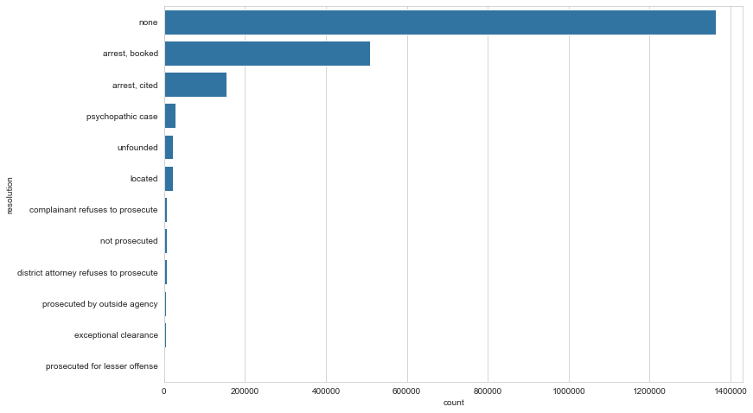
Resolution

Slide 8
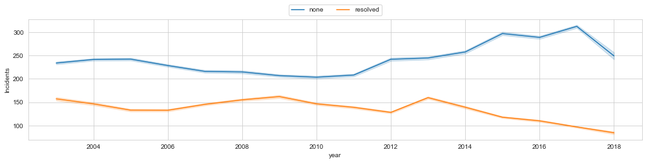
Resolution over year

Slide 9
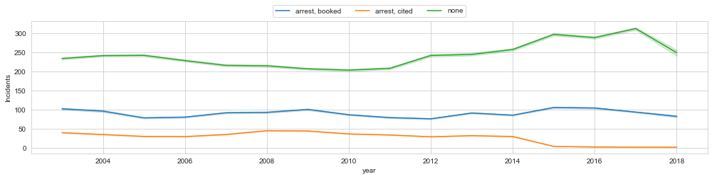
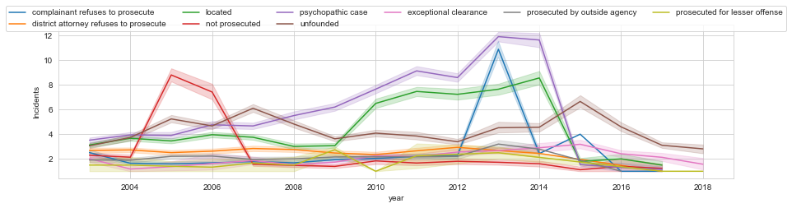
Resolution over year
Notes:
Vis også overall

Slide 10
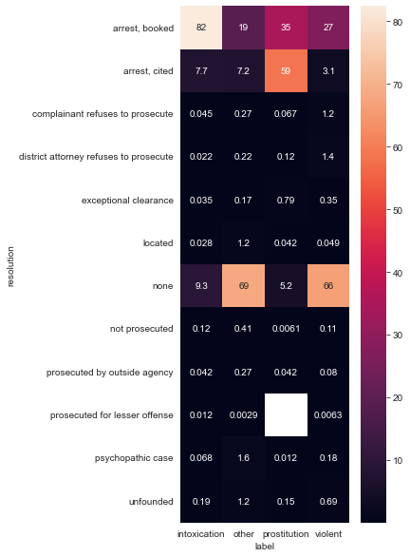
Resolution per crime
90% intoxicaitons leads to arrest
94% of prostitution crimes lead to arrest
Only 30% of violent crimes lead to arrest. 66% is unresolved.

Slide 11
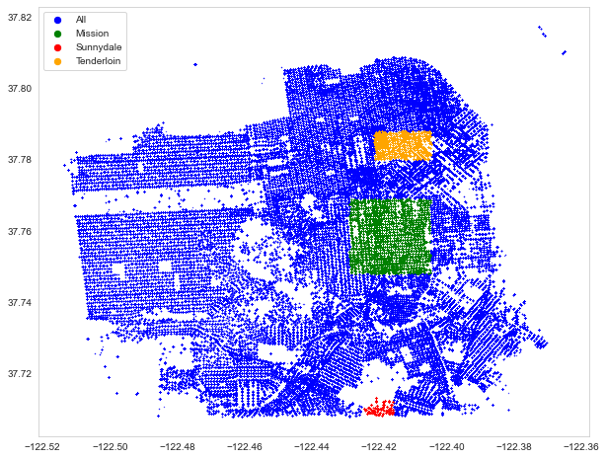
Spatial
District | Crimes
Tenderloin | 16.2%
Mission | 11.0%
Sunnydale | 0.6%
Other | 72%

Slide 12
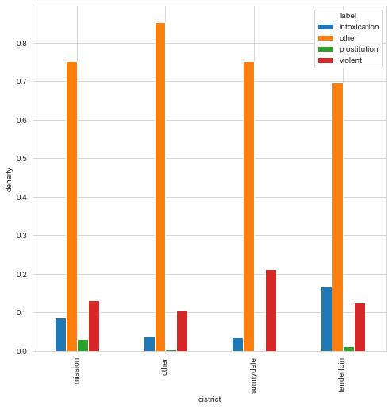
Distribution of crime
in each district
Tenderloin
Intoxications
Sunnydale
Violent
Mission
Prostitution
Notes:
SLET

Slide 13
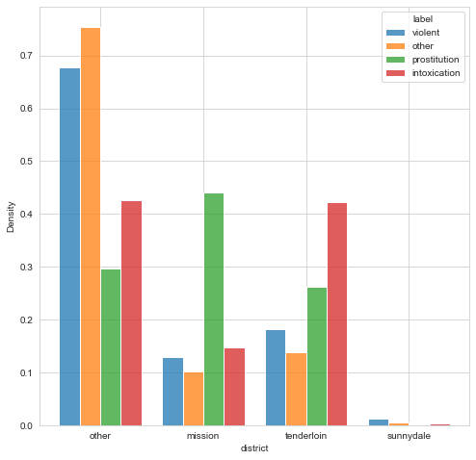
Crime type
distribution
Most prostitution in mission
Most intoxication in tenderloin

Slide 14
Insights
Decrease in reported intoxicaitions
Resolution in most recent years might be misleadning
Intoxicaitons and prostitution crimes lead to more arrest than violent crimes

Slide 15
Model
Can we predict if crime is resolved or not based on information at report time?

Slide 16
Data preprocessing
Remove data from year>2014
Transform cyclic variables
Set aside test set
CV pipeline:
Scale numeric variables
Train XGBoost

Slide 17
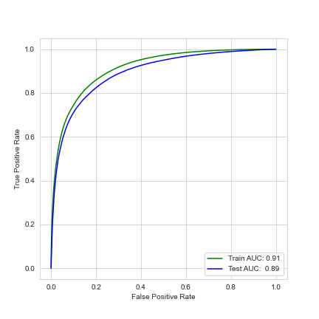
Model performance
 | Train | Test
Baseline acc | 0.39 | 0.39
AUC | 0.91 | 0.89
Accuray | 0.84 | 0.83
Sensitivity | 0.75 | 0.73
Specificity | 0.90 | 0.89
PPV | 0.83 | 0.81
NPV | 0.85 | 0.84

Slide 18
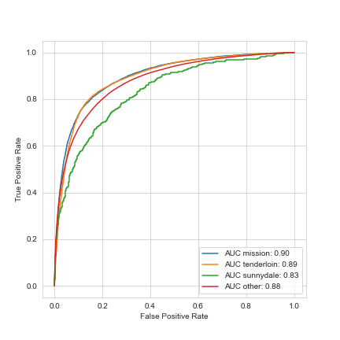
Model performance on different districts
 | mission | tenderloin | sunnydale | other
Baseline acc. | 0.489 | 0.612 | 0.372 | 0.324
Accuracy | 0.824 | 0.826 | 0.772 | 0.827
AUC | 0.898 | 0.893 | 0.833 | 0.879
Sensitivity | 0.786 | 0.843 | 0.615 | 0.670
Specificity | 0.861 | 0.800 | 0.865 | 0.902
ppv | 0.844 | 0.869 | 0.729 | 0.766
npv | 0.808 | 0.764 | 0.791 | 0.851

Slide 19
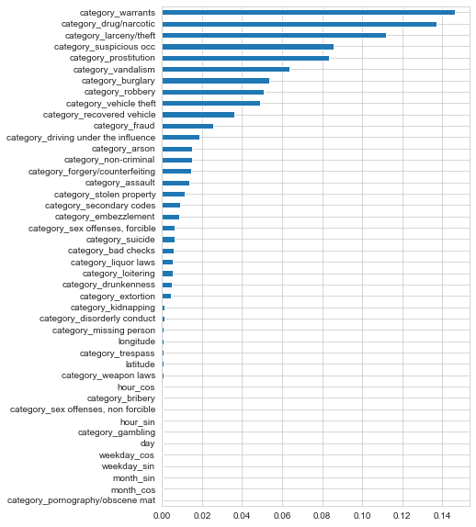
Feature importance
Future work:
Try only with crime category
Try with crime label instead
Compare performance per crime type to baseline per crime time

Slide 20
Future work
Compare to logistic regression
Confidence intervals
Include year>2014

Slide 21
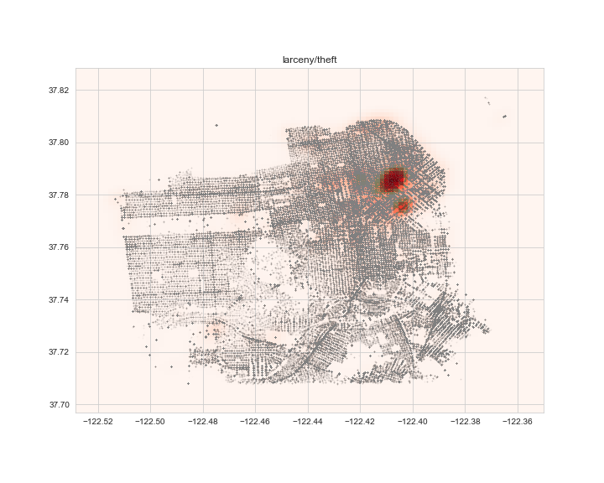
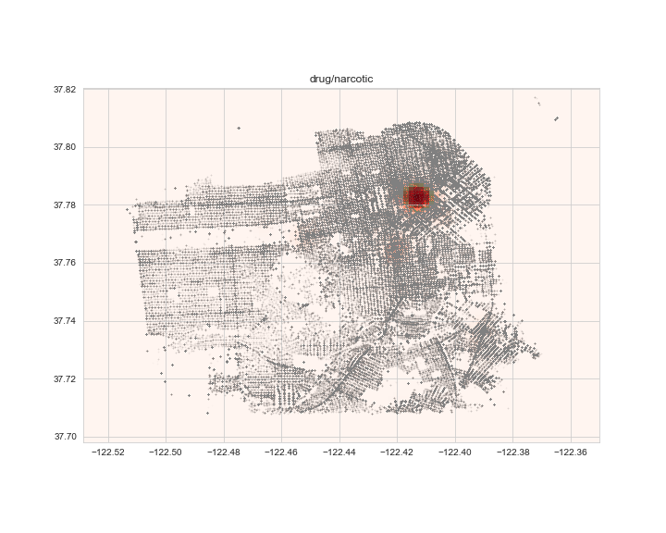
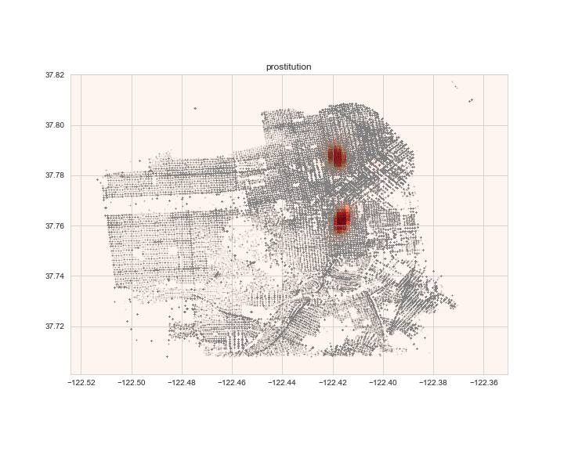
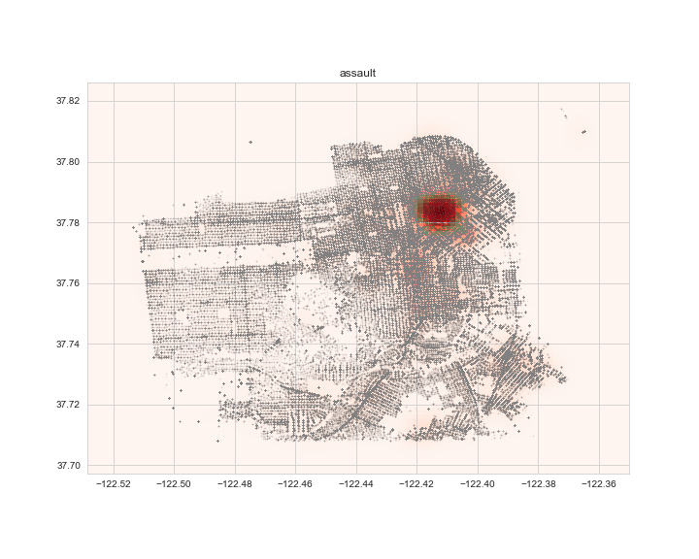
Future
Research
Spatial clustering

