Slide 1


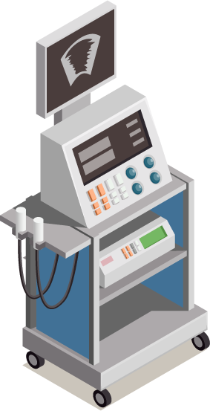
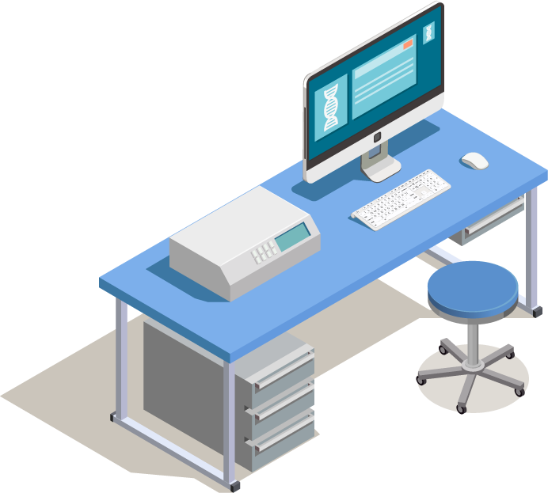
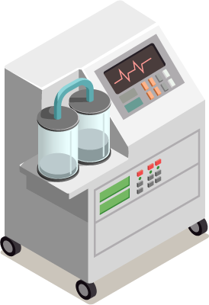
Biomedical Data Acquisition Course (BMD351)
Sara El-Sayed El-Metwally,
Associate Professor,
Biomedical Informatics Department.

Slide 2
Activities | Percentages
Assignments (Dr. Maryam) | 10%
Midterm (Dr. Maryam) | 20%
Quizzes (Dr. Maryam) | 10%
Project (Dr. Maryam) | 20%
Final (Dr. Maryam) | 40%
الأخلاق | -100
الغياب | 5

Slide 3
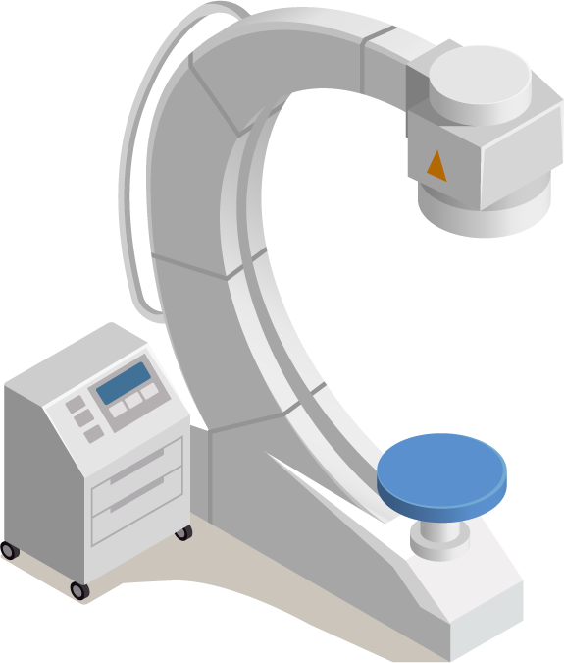
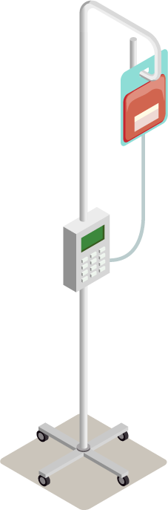
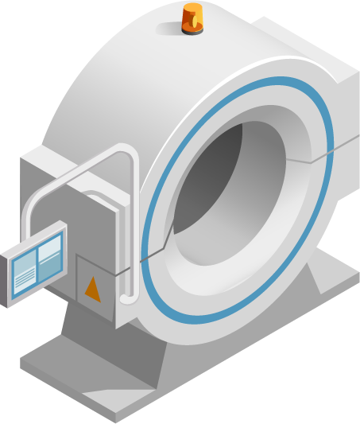
02
Biomedical Signals

Slide 4
EMG
Muscle Signals

Slide 5
Bio-Electric Signals
Electrical potential generated by the cell membrane potential called action potential and mainly generated by nerve and cell muscle.
Examples:
(1) Electroencephalography (EEG): brain signal recordings.
(2) Electromyography (EMG): muscle signal recordings.
(3) Electrocardiography (ECG): heart signal recordings.
(4) Electrooculography (EOG): eye signal recordings.
Notes:
https://www.youtube.com/watch?v=OqNDFF1RsMU&list=PLVsrfTSlZ_42OoOyhzWoDgZrL9iineZxQ&index=3
Current and volte

Slide 6
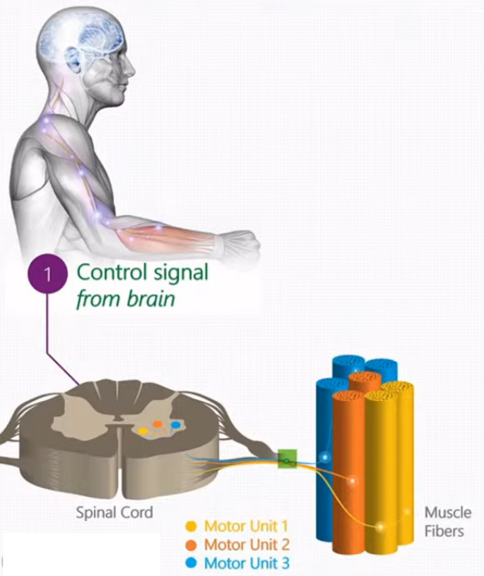
Introduction
Brain control muscles by sending electrical signals along motor neurons , which originates in the ventral horn of spinal cord
Each motor neuron innovates a group of muscle fibers together this called a motor unit
Motor unit single smaller controllable muscular unit we can measure
Muscles are composed of many motor units and each motor units contracts when it receives signals from brain and can be presented as motor unit firing instance.

Slide 7
Introduction
Different motor units can fire varying firing rates.
The contraction of a single motor unit creates an electrical signature called a motor unit action potential also known as MU.
Each MU provides varying amplitudes of force.
Sound of muscle
Any part of body that has a muscle such as face, tong, neck, Lower back, arms, legs

Slide 8
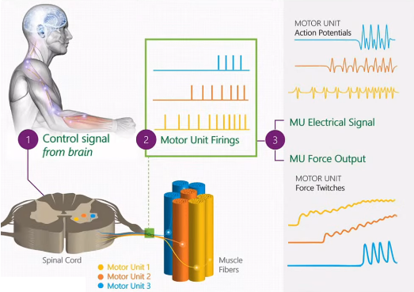
Introduction

Slide 9
EMG
Electromyography (EMG): is a technique for evaluating and recording the electrical activity produced by skeletal muscles.
EMG is performed using an instrument called an electromyography to produced a record called an electromyogram.
A resting muscle does not show recordable electrical potential but with increase force of contraction, amplitude of potential increases.
Electromyograph detects electrical potential generated by muscle cells when these cells are electrically or neurologically activated.

Slide 10
EMG
Device: via Cathode Ray Oscilloscope (CRO).
Electrodes:
Surface electrodes: SEMG: Metal disc ( skin) and superficial muscles, Nerve conduction test , surface electrode.
Needle electrodes: Intramusccular : invasive method Hypodermic needle (inside muscle), Needle EMG.
The major difference between invasive and non-invasive tests is that invasive tests are done by cutting or entering a body part using medical instruments, whereas non-invasive tests do not require breaking the skin or entering the body.

Slide 11
EMG
During increase the muscle contraction:
Increase frequency of nerve impulses to motor unit
Increase of contracting motor units.
Waves have different shapes because we are using different motor units.
Not all neurons are the same and not all muscle fibers are created equally.
The wave amplitude represents the number of muscle fibers within the unit.
The frequency range of EMG is from 5 Hz – 2KHz and amplitude range from 0.1-5 mV.
EMG can be used to diagnose muscle injury, nerve damage, and muscle dysfunction that happens due to neurological and muscular disorder.

Slide 12
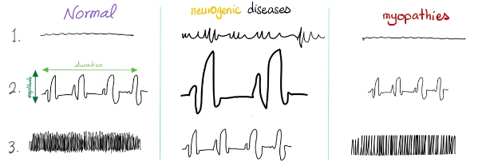
EMG
1: resting state.
2: Weak contraction.
3: full activity.

Slide 13
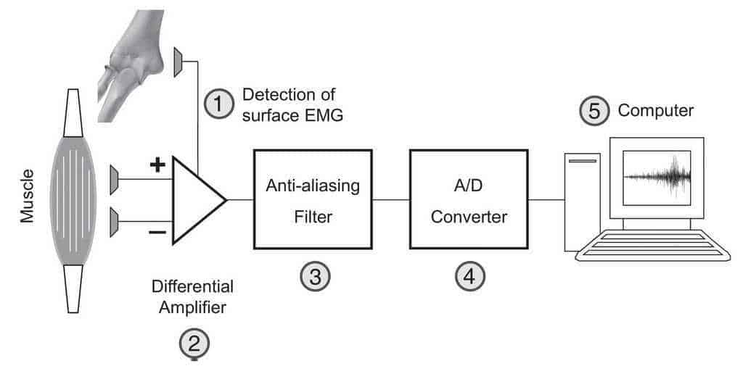
Measuring EMG

Slide 14
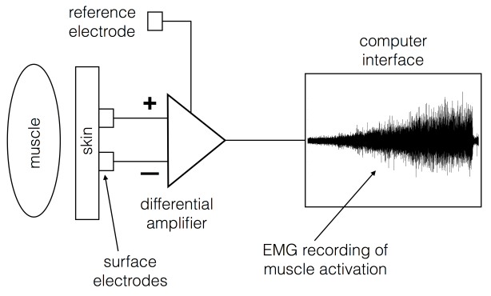
Measuring EMG

Slide 15
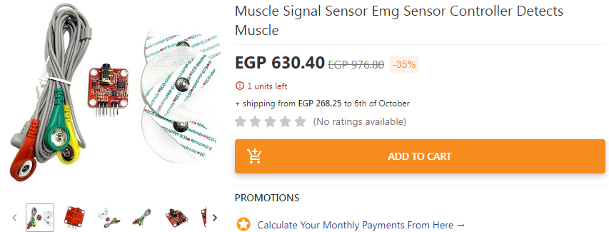
EMG sensors

Slide 16
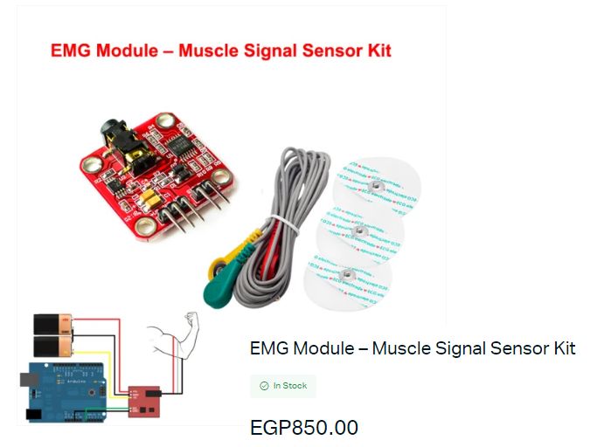
EMG sensors

Slide 17
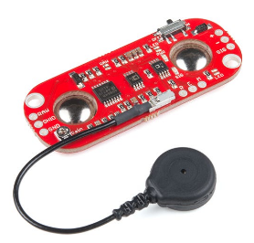
MyoWare Muscle Sensor
Notes:
https://medium.com/@leex5202/an-unofficial-introductory-tutorial-to-myoware-muscle-sensor-development-kit-e2169948e63

Slide 18

EMG Projects
Notes:
https://www.kaggle.com/competitions/amp-parkinsons-disease-progression-prediction/discussion/388322

Slide 19
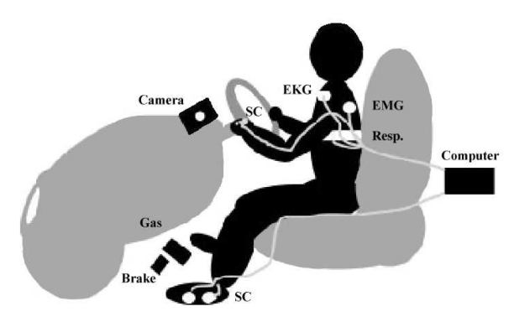
Stress Recognition in Automobile Drivers
This dataset contains a collection of multiparameter recordings from healthy volunteers, taken while they were driving on a prescribed route including city streets and highways in and around Boston, Massachusetts. The objective of the study for which these data were collected was to investigate the feasibility of automated recognition of stress on the basis of the recorded signals, which include ECG, EMG (right trapezius), GSR (galvanic skin resistance) measured on the hand and foot, and respiration
https://www.kaggle.com/datasets/bjoernjostein/stress-recognition-in-automobile-drivers

Slide 20
Thanks!
Notes:
How many cycles activity has in a second.
How waveform looks spike, sharp, duration of the wave microseconds
Amplitude = height of the wave in microvolt.

