Slide 1


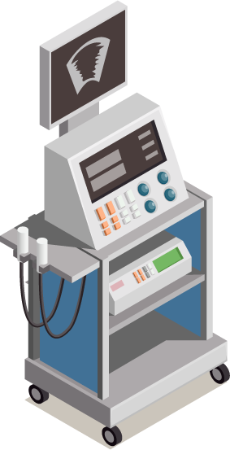

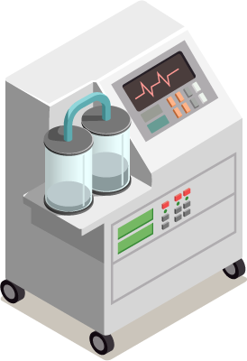
Biomedical Data Acquisition Course (BMD351)
Sara El-Sayed El-Metwally,
Associate Professor,
Biomedical Informatics Department.

Slide 2
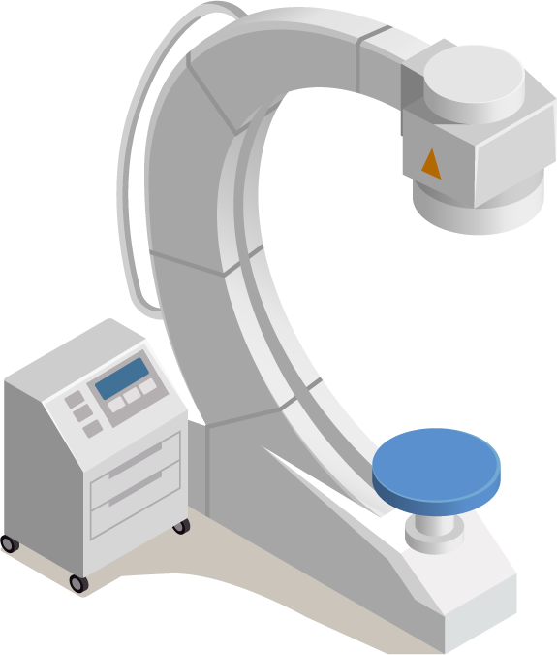
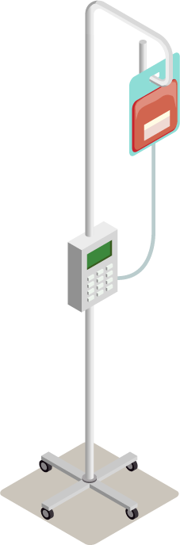
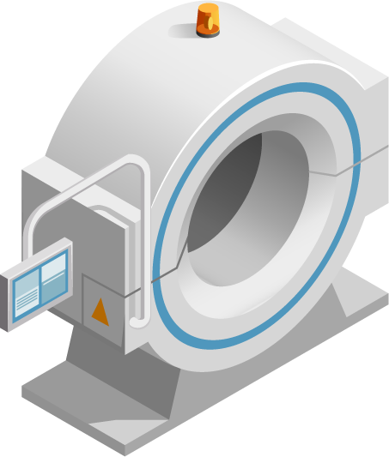
02
Biomedical Signals

Slide 3
EEG
Brain Signals cont.

Slide 4

EEG Activity
EEG activity can be broken down into 4 distinct frequency bands:
Beta activity > 13 Hz
Alpha activity 8 Hz-13 Hz
Theta activity 4 Hz-7 Hz
Delta activity < 4 Hz
Beta activity is a normal activity present when the eyes are open or closed. It tends to be seen in the channels recorded from the centre or front of the head. Some drugs will increase the amount of beta activity in the EEG.

Slide 5
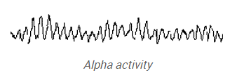
EEG Activity
Alpha activity is also a normal activity when present in waking adults. It is mainly seen in the channels recorded from the back of the head. It is fairly symmetrical and has an amplitude of 40 µV to 100 µV. It is only seen when the eyes are closed and should disappear or reduce in amplitude when the eyes are open.

Slide 6
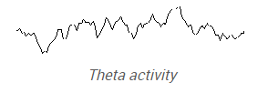
EEG Activity
Theta activity can be classed as both a normal and abnormal activity depending on the age and state of the patient. In adults it is normal if the patient is drowsy. However it can also indicate brain dysfunction if it is seen in a patient who is alert and awake. In younger patients, theta activity may be the main activity seen in channels recorded from the back and central areas of the head.

Slide 7

EEG Activity
Delta activity is only normal in an adult patient if they are in a moderate to deep sleep. If it is seen at any other time it would indicate brain dysfunction. Abnormal activity may be seen in all or some channels depending on the underlying brain problem.

Slide 8
EEG Activity
Delta activity is only normal in an adult patient if they are in a moderate to deep sleep. If it is seen at any other time it would indicate brain dysfunction. Abnormal activity may be seen in all or some channels depending on the underlying brain problem.

Slide 9
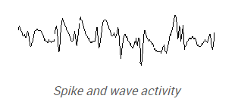
EEG Activity
There are a number of other waveforms which tend to be a little more specific to certain conditions. For example spike and wave activity indicates a seizure disorder and may be seen in the EEG even if the patient is not having an epileptic seizure. Other epileptic conditions may be diagnosed if spikes or sharp waves are seen.
Triphasic waves are sometimes seen if the patient has severe liver or kidney disease that is affecting brain function.

Slide 10
EEG Recording
The EEG recording can last from anything between 15 minutes to 1 hour or longer depending on the situation. Typically the patient will be lying down or sitting relaxed in a chair. Most of the recording is taken with the eyes closed, although the patient will be frequently asked to open them for short periods.
Most patients will be asked to carry out a period of deep breathing for approximately 3 minutes. This may produce some abnormal activity which would not be seen while the patient is relaxed. The physiological effect of deep breathing is to increase the amount of carbon dioxide (CO2) being removed from the bloodstream. This fall in CO2 produces a fall in blood pressure and at the same time blood vessels in the brain become constricted. This reduces blood flow and the delivery of oxygen and glucose to the brain. This in turn may produce some abnormal brain activity not seen in the resting record.
Photic stimulation is also carried out. A strobe lamp is placed 30 cm from the patient's eyes. Brief flashes of light (2 - 5 seconds in duration) at a number of different flash frequencies are delivered to the patient with both eyes open and eyes closed. A continuous flash with increasing and decreasing flash frequencies is sometimes used.
Some patients who are sensitive to flashing lights may show abnormal activity in the EEG.

Slide 11
EEG analysis
Throughout the test the recordist is constantly annotating the record with any patient movements, or tasks that they are carrying out.
The EEG reports consists of a number of different sections. The recordist may prepare a report describing the type of activity seen in the record together with changes produced by deep breathing and photic stimulation. They will also comment on the patient's state during the recording. The physician will then interpret these changes with regard to the medical problem being investigated.
With an increase in the number of long recordings being carried out, many departments make use of detection algorithms such as spike and seizure detection.
Other methods of analyzing EEG data include Power Spectrum Analysis. A Fast Fourier Transform (FFT) is performed on sections of EEG data to determine the power content of the four main frequency bands. The resulting waveforms can be displayed as a brain map which will show the scalp distribution of the power within each frequency band.
The amplitude of the different waveforms at a single point can also be displayed in a similar format.
This type of display provides a more objective analysis of the EEG activity compared to a subjective visual analysis by a physician.
Montage how electrodes are arranged in a relationship to each other.

Slide 12
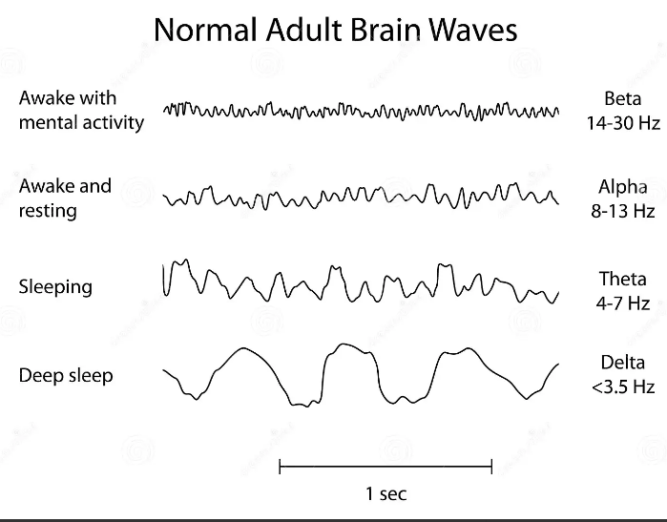
Notes:
https://www.dreamstime.com/royalty-free-stock-photo-normal-brain-waves-eeg-image29444815

Slide 13
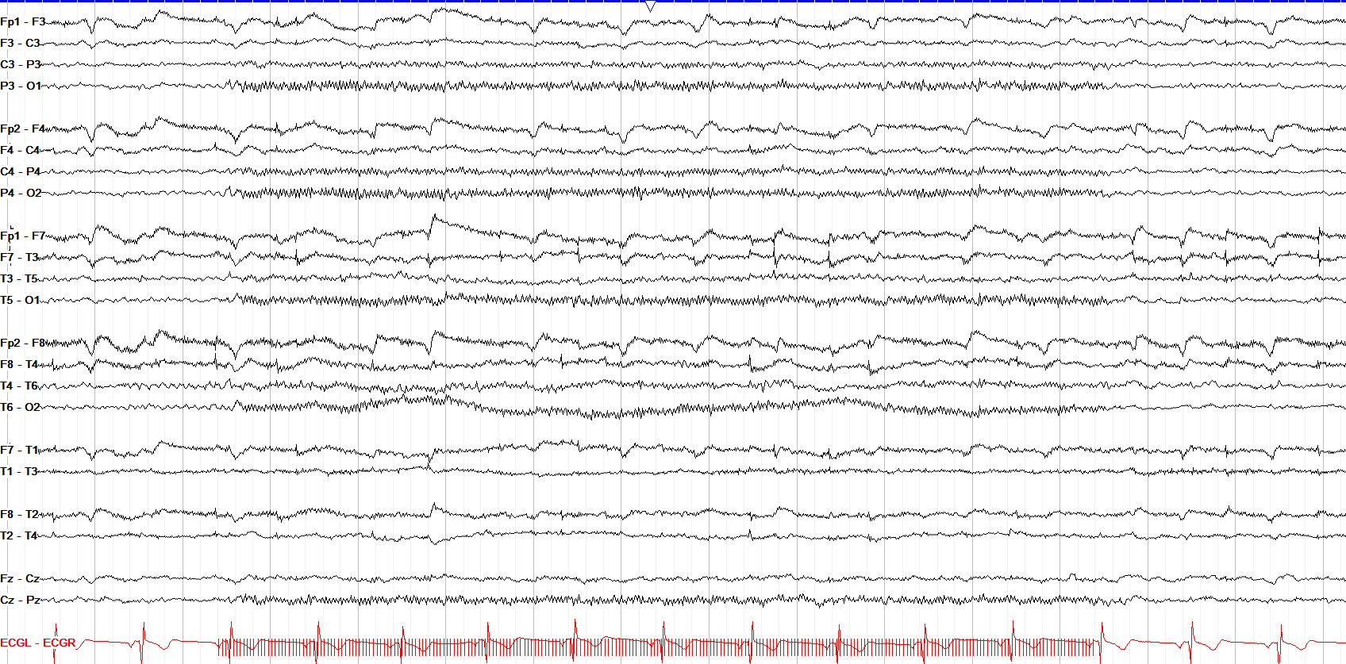
Notes:
https://www.youtube.com/watch?v=HD58ueZDB-k
https://www.youtube.com/playlist?list=PLtSlQVGgUYAFVMnJBAtzNsU_2mQcXqOwx

Slide 14
Features
Frequency Domain Features:
Frequency: How many cycles activity has in a second.
Location
Morphology: How waveform looks spike, sharp, duration of the wave microseconds
Amplitude: height of the wave in microvolt.
Time domain Statistical Features
Mean
Standard Deviation
Minimum value
Maximum Value

Slide 15
Applications of EEG
EEG is as an aid to diagnose:
Alzheimer’s disease (AD), a brain disorder,
Dementias
Brain cancer
Epilepsy
Parkinson’s and other movement disorders
Stroke

Slide 16

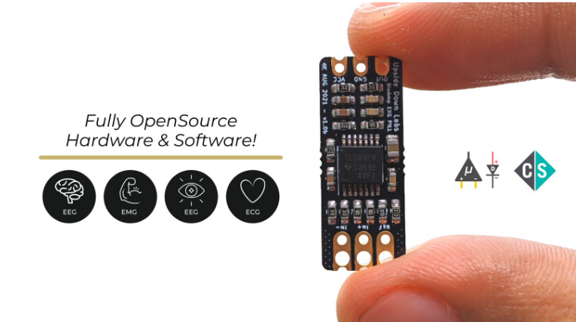
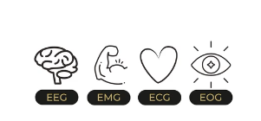
Biomedical Data Acquisition Sensor

Slide 17
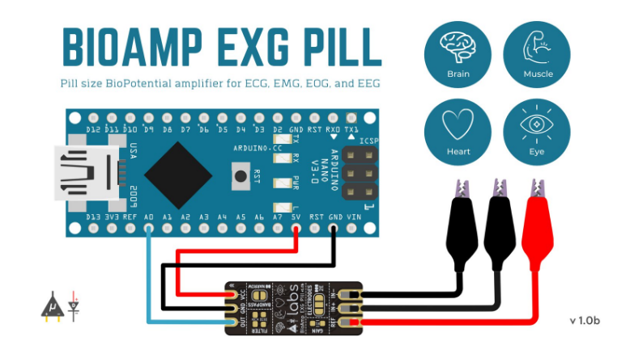
Biomedical Data Acquisition Sensor
BioAmp EXG Pill is a small, powerful analog-front-end (AFE) biopotential signal-acquisition board that can be paired with any microcontroller unit (MCU) or single-board computer (SBC) with an analog-to-digital converter (ADC) such as Arduino UNO & Nano, Espressif ESP32, Adafruit QtPy, STM32 Blue Pill, BeagleBone Black, and Raspberry Pi Pico, to name just a few. It also works with any dedicated ADC, like the Texas Instruments ADS1115 and ADS131M0x, among others.
Notes:
https://www.crowdsupply.com/upside-down-labs/bioamp-exg-pill
https://www.crowdsupply.com/upside-down-labs/bioamp-exg-pill
https://github.com/upsidedownlabs/BioAmp-EXG-Pill

Slide 18
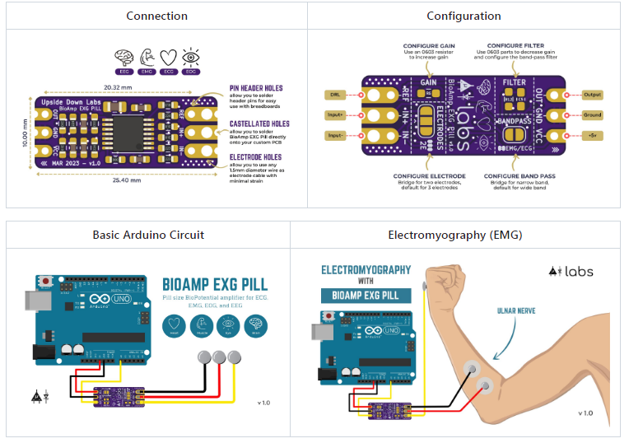

Slide 19
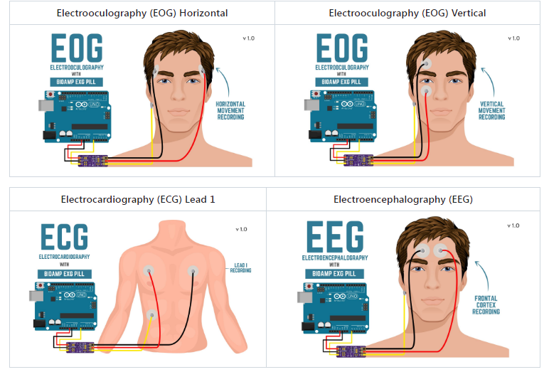
Notes:
https://github.com/upsidedownlabs/BioAmp-EXG-Pill
https://www.youtube.com/watch?v=qrb8LeRfkP4

Slide 20
Examples of EEG Projects
Project Goal | Link
EEG Data Analysis for Alcoholic and Control Group. | https://www.kaggle.com/code/ruslankl/eeg-data-analysis#1.-Project-Overview
Given EEG data from subjects who were watching movies, let's try to predict the emotional state of a subject during a given movie. | https://www.kaggle.com/code/gcdatkin/eeg-emotion-prediction/notebook
Eye State Classification EEG Dataset 1 indicates the eye-closed and 0 the eye-open state. | https://www.kaggle.com/datasets/robikscube/eye-state-classification-eeg-dataset
Grasp-and-Lift EEG Detection Identify hand motions from EEG recordings | https://www.kaggle.com/competitions/grasp-and-lift-eeg-detection

Slide 21
Examples of EEG Projects
Project Goal | Link
Confused Student EEG prediction | https://www.kaggle.com/code/shreyaspj/confused-student-eeg-prediction
EEG Psychiatric Disorders Dataset | https://www.kaggle.com/datasets/shashwatwork/eeg-psychiatric-disorders-dataset
EEG data from basic sensory task in Schizophrenia | https://www.kaggle.com/datasets/broach/button-tone-sz
Sleepy Driver EEG Brainwave Data | https://www.kaggle.com/datasets/naddamuhhamed/sleepy-driver-eeg-brainwave-data
Training of EEG-Schizophrenia Disorder using CNN | https://www.kaggle.com/code/owaiskhan9654/training-of-eeg-schizophrenia-disorder-using-cnn

Slide 22
Thanks!
Notes:
How many cycles activity has in a second.
How waveform looks spike, sharp, duration of the wave microseconds
Amplitude = height of the wave in microvolt.

