Slide 1


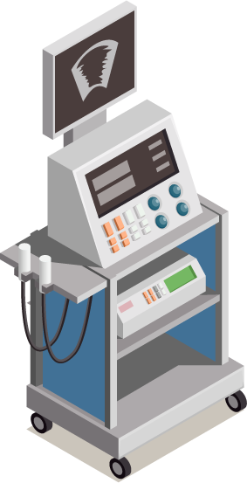
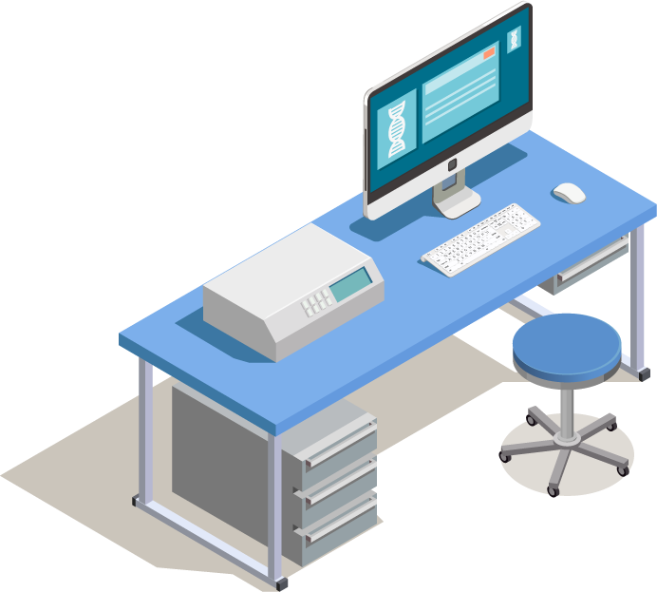
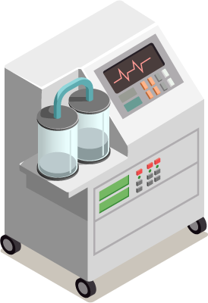
Biomedical Data Acquisition Course (BMD351)
Sara El-Sayed El-Metwally,
Associate Professor,
Biomedical Informatics Department.

Slide 2
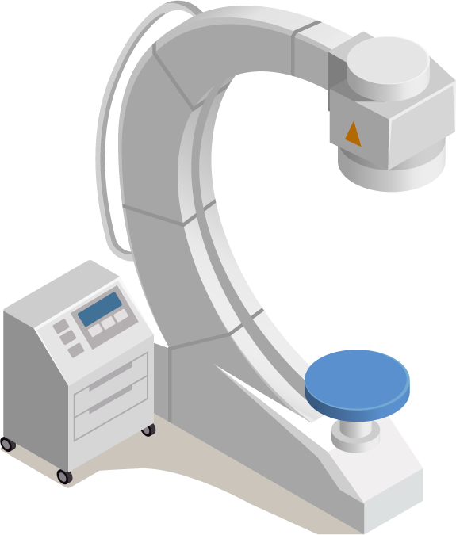
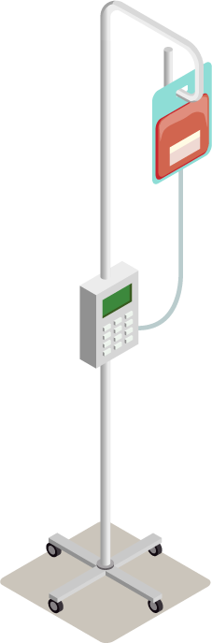
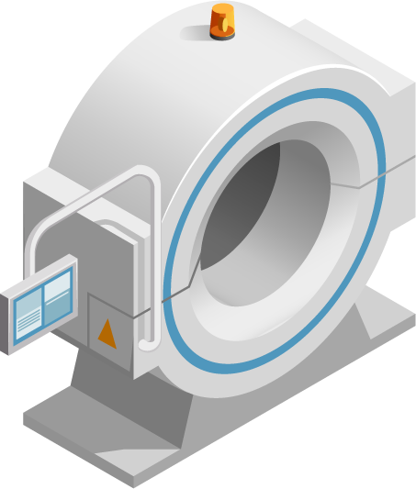
03
Biomedical Imaging
Notes:
https://www.ncbi.nlm.nih.gov/pmc/articles/PMC9192206/

Slide 3
Types of Biomedical Imaging
X-Ray
CT scan
MRI
Ultrasound
Microscopy
Nuclear Medicine
PET
SPECT

Slide 4
Types of Biomedical Imaging
X-Ray
CT scan
MRI
Ultrasound
Microscopy
Nuclear Medicine
Notes:
https://www.youtube.com/watch?v=PWFOu2EcYyM&list=PLChQQ5wHnWjJwamS1DijqnXQIlKyzAPsU

Slide 5
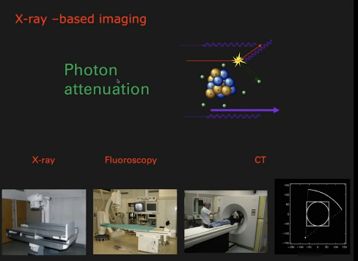

Slide 6
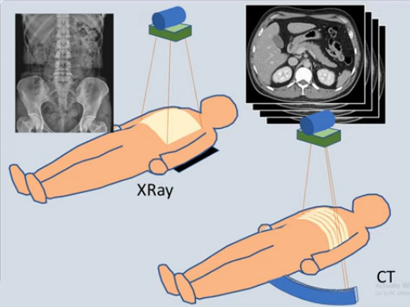
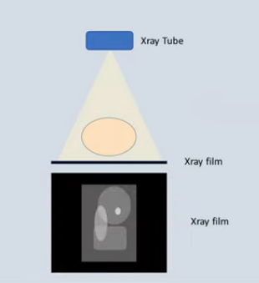
CT Scan

Slide 7
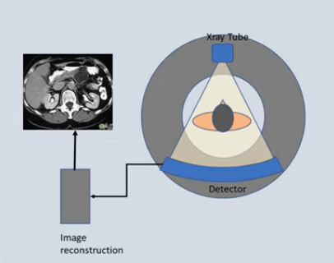
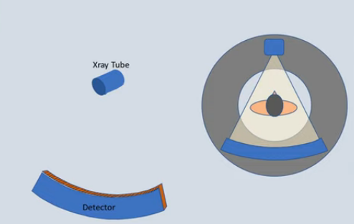
CT Scan

Slide 8
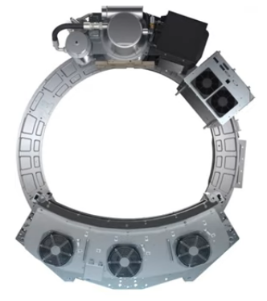
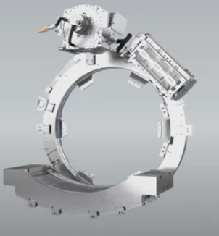
CT Scan
Notes:
https://www.youtube.com/watch?v=wMSryzRvC8Y
https://www.youtube.com/@amrelghorab2538/playlists

Slide 9
CT scan
The term “computed tomography”, or CT, refers to a computerized x-ray imaging procedure in which a narrow beam of x-rays is aimed at a patient and quickly rotated around the body, producing signals that are processed by the machine’s computer to generate cross-sectional images—or “slices”—of the body.
These slices are called tomographic images and contain more detailed information than conventional x-rays. Once a number of successive slices are collected by the machine’s computer, they can be digitally “stacked” together to form a three-dimensional image of the patient that allows for easier identification and location of basic structures as well as possible tumors or abnormalities.

Slide 10
How does CT work?
Unlike a conventional x-ray—which uses a fixed x-ray tube—a CT scanner uses a motorized x-ray source that rotates around the circular opening of a donut-shaped structure called a gantry. During a CT scan, the patient lies on a bed that slowly moves through the gantry while the x-ray tube rotates around the patient, shooting narrow beams of x-rays through the body. Instead of film,
CT scanners use special digital x-ray detectors, which are located directly opposite the x-ray source. As the x-rays leave the patient, they are picked up by the detectors and transmitted to a computer.
Each time the x-ray source completes one full rotation, the CT computer uses sophisticated mathematical techniques to construct a 2D image slice of the patient. The thickness of the tissue represented in each image slice can vary depending on the CT machine used.

Slide 11
How does CT work?
When a full slice is completed, the image is stored and the motorized bed is moved forward incrementally into the gantry. The x-ray scanning process is then repeated to produce another image slice. This process continues until the desired number of slices is collected.
Image slices can either be displayed individually or stacked together by the computer to generate a 3D image of the patient that shows the skeleton, organs, and tissues as well as any abnormalities the physician is trying to identify. This method has many advantages including the ability to rotate the 3D image in space or to view slices in succession, making it easier to find the exact place where a problem may be located.

Slide 12
What is a CT contrast agent?
As with all x-rays, dense structures within the body—such as bone—are easily imaged, whereas soft tissues vary in their ability to stop x-rays and, thus, may be faint or difficult to visualize. For this reason, contrast agents have been developed that are highly visible in an x-ray or CT scan and are safe to use in patients.
Contrast agents contain substances that are better at stopping x-rays and, thus, are more visible on an x-ray image. In some cases you may receive contrast dye before a procedure in a drink, injection or a Barium enema to make easier for doctor to see certain area in the body.
If you receive a drink with contrast dye , your esophagus or stomach will be highlighted .
If you receive an injection, your blood vessels , gallbladder, liver, urinary tract will be highlighted.
If you received a barium enema, your large intestine will be highlighted .

Slide 13
When would I get a CT scan?
CT scans can be used to identify disease or injury within various regions of the body. For example, CT has become a useful screening tool for detecting possible tumors or lesions within the abdomen. A CT scan of the heart may be ordered when various types of heart disease or abnormalities are suspected
CT can also be used to image the head in order to locate injuries, tumors, clots leading to stroke, hemorrhage, and other conditions.
All x-rays produce ionizing radiation, which has the potential to cause biological effects in the human body. For patients, these biological effects can range from an increased lifetime risk of cancer to possible allergic reactions or kidney failure due to contrast agents.

Slide 14
CT scanner
A CT scanner consists of the following main elements:
a data acquisition system that carries out the X-ray projections,
a computer to reconstruct the images from the projections and to assist in the analysis of the reconstructed images,
a variable power supply,
a monitor to display the routine operation of the computer system and to act as an interactive interface in the diagnosis of the reconstructed images,
a documentation camera to produce an image on film similar to traditional X-ray images,
other data archiving systems, such as tape or disk, collectively referred to as storage devices,
.
Notes:
https://link.springer.com/chapter/10.1007/978-0-85729-027-4_3

Slide 15
Data Acquisition Systems
The main components of the CT scanner design are:
The gantry with a central opening, into which the patient is moved during the examination. This is the most recognisable element of the CT scanner;
The X-ray tube, the source of the X-rays that pass through the body situated in the gantry and carry the information about the structure of the body to the detectors. The information is in the form of a series of projections;
The detector array converts the projection values, in the form of radiation intensities, into electrical quantities. Usually, the whole detector array rotates synchronously with the X-ray tube around the test object;
The table allows the patient to be manoeuvred easily into position. The table can be controlled manually before the actual scan begins, but it moves automatically during the scan. The table can be moved into or out of the gantry along the axis of the patient’s body, as well as up and down. This allows the patient to be appropriately positioned depending on which part of the body is being examined.
Notes:
https://link.springer.com/chapter/10.1007/978-0-85729-027-4_4

Slide 16
Fluoroscopy
Fluoroscopy is a medical procedure that makes a real-time video of the movements inside a part of the body by passing x-rays through the body over a period of time.
Fluoroscopy can be used for diagnosing (finding out the cause of) a health problem such as heart or intestinal disease. It also can be used to guide treatments such as implants or injections, or in orthopedic surgery.

Slide 17
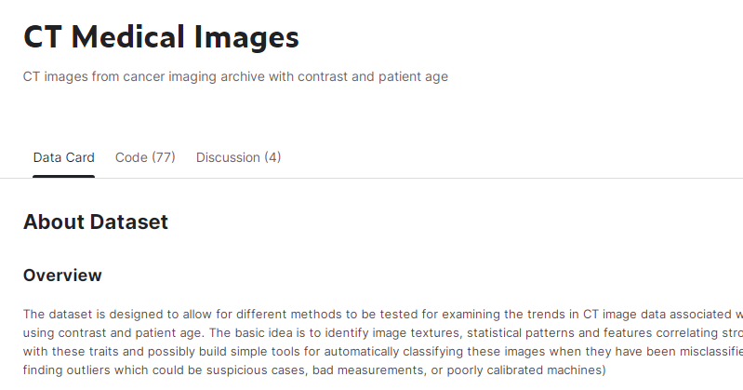
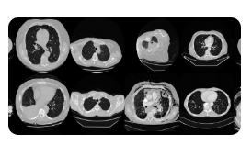
CT images from cancer patients
https://www.kaggle.com/datasets/kmader/siim-medical-images

Slide 18
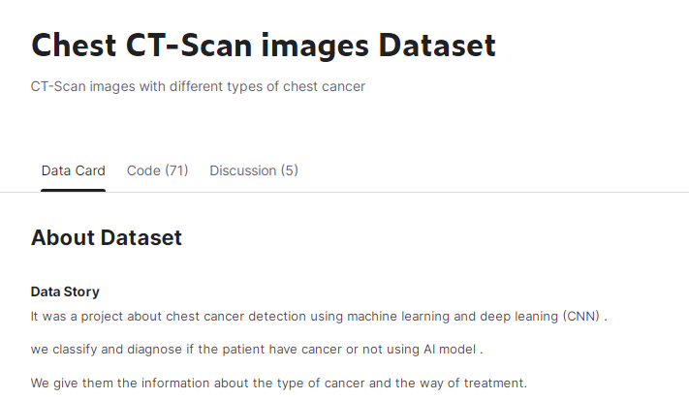
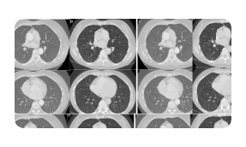
Chest CT-Scan
https://www.kaggle.com/datasets/mohamedhanyyy/chest-ctscan-images

Slide 19
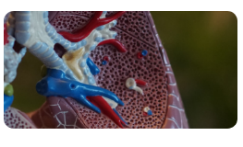

Pulmonary Embolism
https://www.kaggle.com/datasets/andrewmvd/pulmonary-embolism-in-ct-images
Notes:
الإنسداد الرئوي

Slide 20
Thank you!

