Slide 1
Mini Compiler Project
"Transforming Code into Innovation.”

Slide 2
Table of contents
:1Introduction
:2Grammar
:3Lexical Analysis Phase
:4Syntax Analysis Phase
First Set& Follow Set
Symbol table
Hash table
5:User Friendly Interface

Slide 3
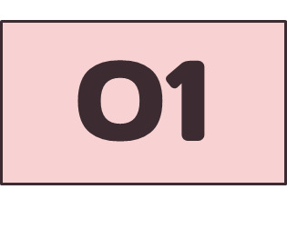
Introduction
Project Overview: Our project aims To
understand the phases of a compiler.
To implement a basic yet functional compiler.

Slide 4
Introduction
What is a Compiler 🤔?
A tool that translates high-level programming languages into low-level machine code.
Essential for executing programs on computers.

Slide 5
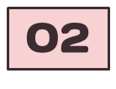
Grammar
.
Components:
Terminals: Basic symbols like keywords (if, while).
Non-terminals: Language structures (statement, expression).
Start Symbol: The entry point of the grammar (program).
Production Rules: Define how non-terminals expand into terminals or other non-terminals

Slide 6
Lexical Analysis
03
The Lexical Analysis phase converts the source code into a series of meaningful tokens, which are the smallest building blocks (like keywords, identifiers, and operators).

Slide 7
How The Lexer Works:
The source code is scanned character by character.
Matches are identified using predefined patterns (regular expressions in this case).
Each match is classified into a specific token type (e.g., data-type, identifier).
Output: The result is a structured list of tokens that represents the input code, ready for the next stage (Syntax Analysis).

Slide 8
Syntax Analysis Phase
Syntax analysis ensures that the program's structure conforms to the rules of the grammar defined for the programming language. It detects any syntactic errors in the code.
04
The Syntax analysis ensures that the program's structure conforms to the rules of the grammar defined for the programming language. It detects any syntactic errors in the code..

Slide 9
01
FIRST & FOLLOW Sets:
FIRST determines which symbols can appear at the beginning of a production.
FOLLOW identifies which symbols can appear immediately after a non-terminal.
These sets help in building efficient parsers and resolving ambiguities in grammar.

Slide 10
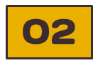
Symbol Table
The Symbol Table is constructed during this phase to store information about variables, such as their names, types, memory addresses, and references.
The provided Symbol Table class:
Scans the code line by line.
Extracts variable declarations, their data types, and tracks all references to these variables across the code

Slide 11
Output:
FIRST & FOLLOW Sets for guiding further analysis.
A populated Symbol Table to assist in semantic analysis.
Syntactic errors, if any, are identified and reported.

Slide 12
03
Hash table
• Insertion and lookup can be made very fast – O(1).
• The advantage is quick to search is possible and
the disadvantage is that hashing is complicated to implement.

Slide 13
05
User Friendly Interface
Tabs for organized output:
Input Code
Tokens
Symbol Table
FIRST Sets
FOLLOW Sets
Integrated buttons to process and clear input efficiently.

Slide 14
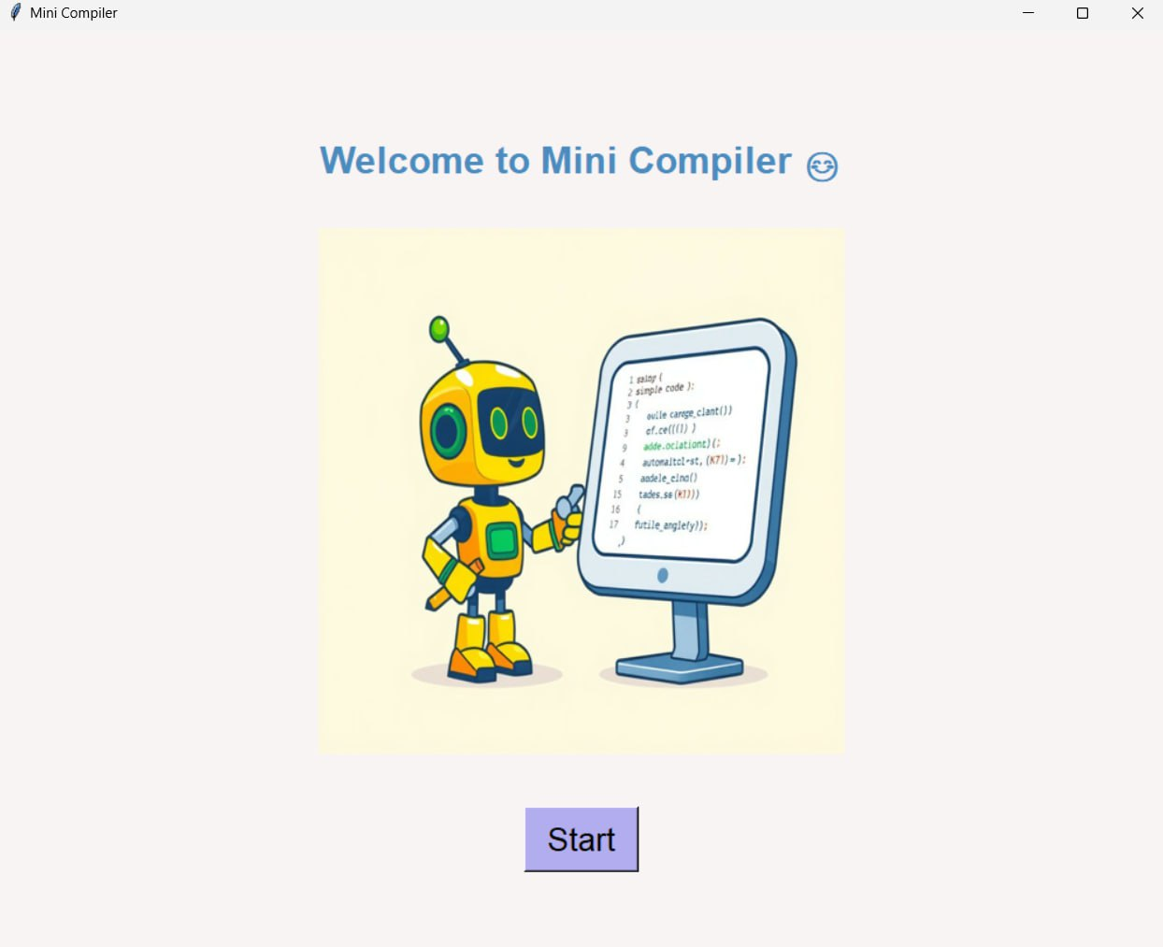

Slide 15
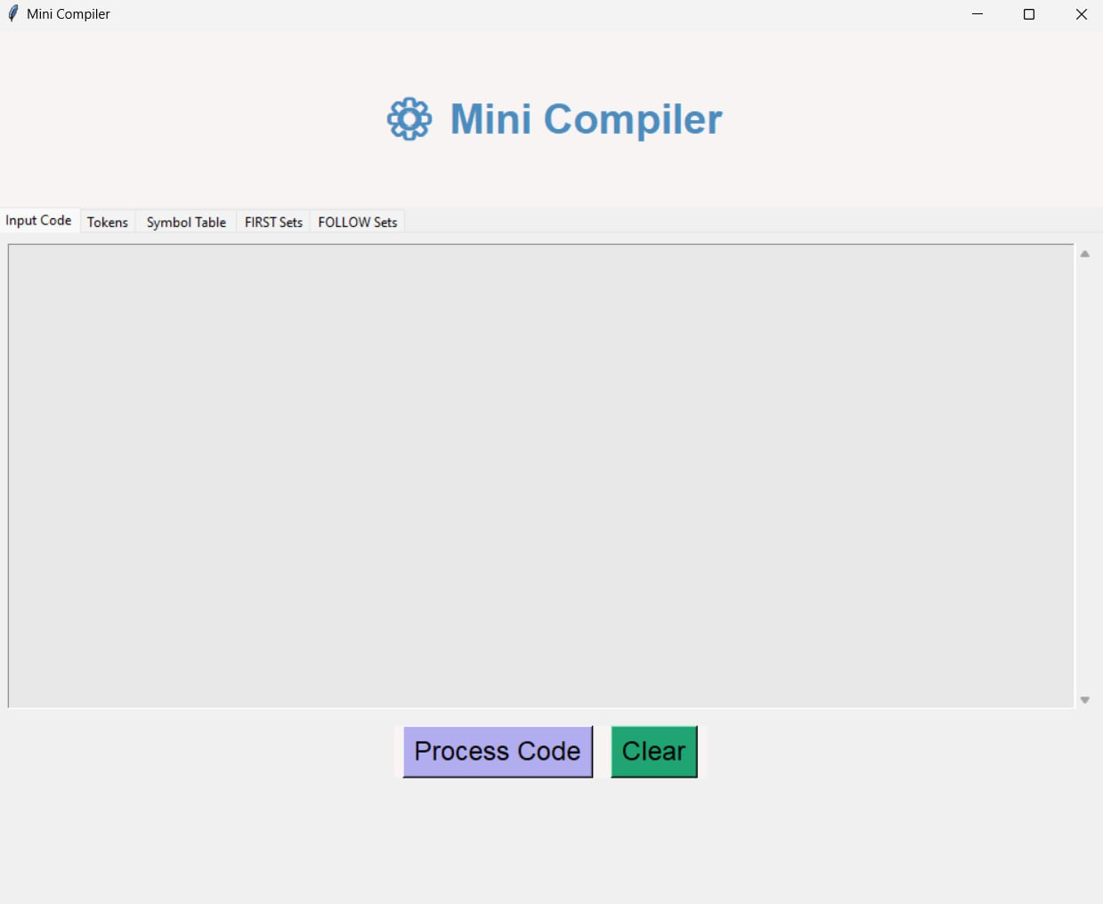

Slide 16
Team Members:
Amira Ashraf Alagha.
Sara Shaaban Elshaer.
Sara Mahmoud Elazb.

Slide 17
Thanks!

