Slide 1

Topology Discover
Created by Sara Ferrari, Hafsa Hamzaoui

Slide 2
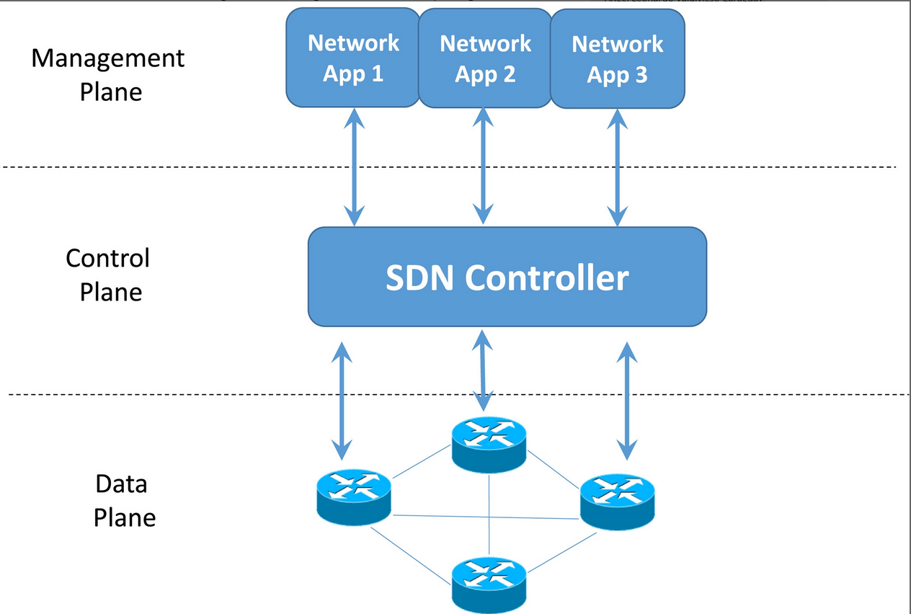
SDN Networks
SDN stands for Software Defined Network
Separation of Control Plane from Data Plane
Simplifies network management and makes it more efficient and scalable

Slide 3
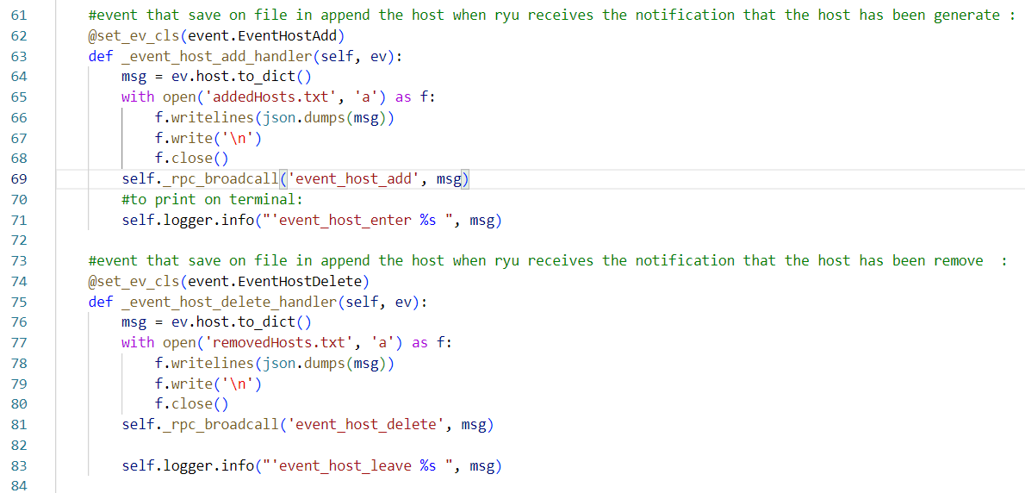
1.Step
We created our python application to retrieve the data of the topology and write them in to a file ;

Slide 4


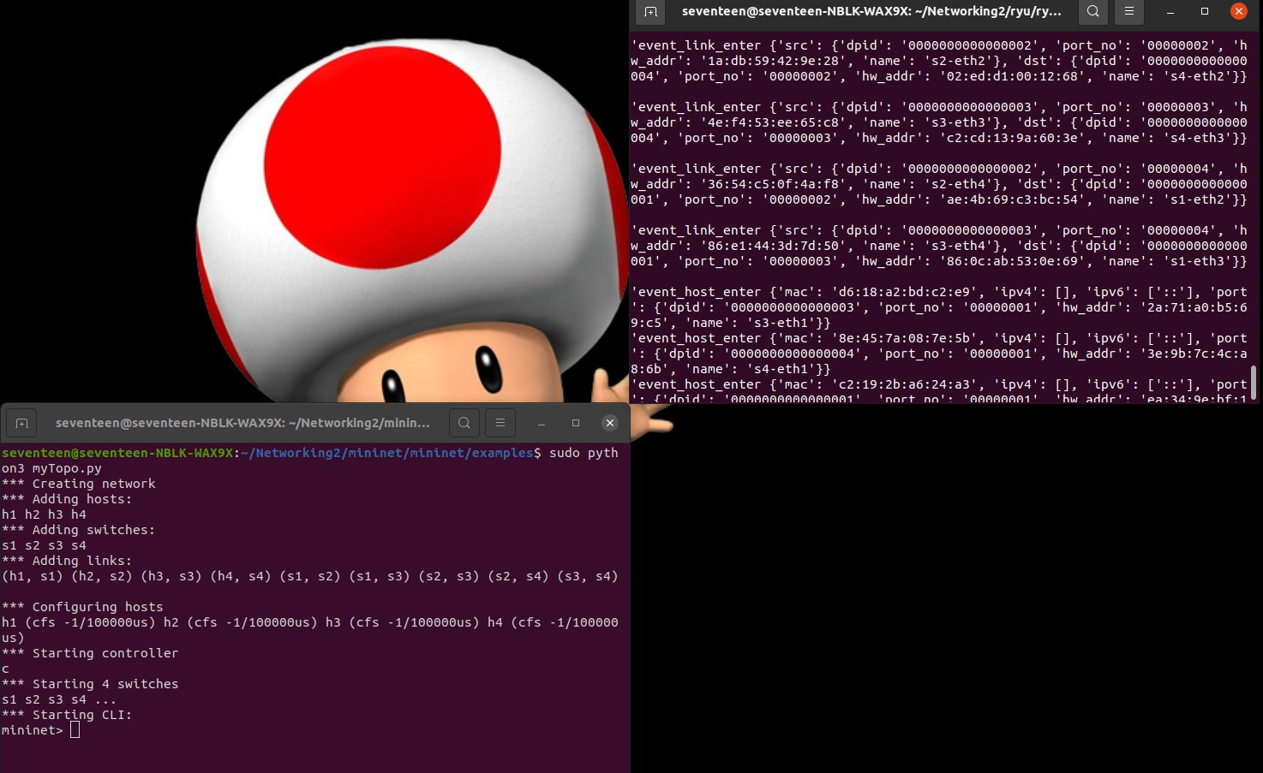


2. Step
Generate the topology using Mininet

Slide 5

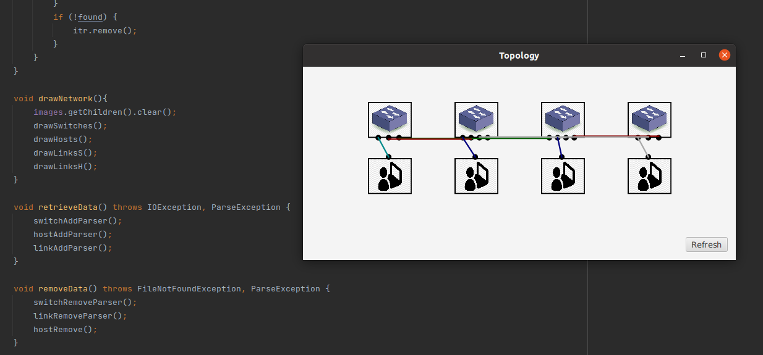
3. Step
We wrote code in Java to visualize the topology

Slide 6

Conclusion
Encountered some difficulties to retrieve the topology data
Enjoyable and interesting project
Satisfied of the final result

