Slide 1

1
Heat Equation
Parallelized Solutions
D
Sara Francavilla

Slide 2
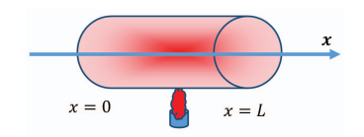
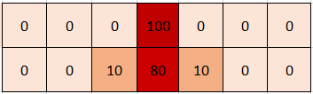
Heat Equation
Parallelized Solutions
Analysis of the problem
Heat applied at the rod's center spreads over time along its length.
Sara Francavilla
Stability depends on the thermal factor

Slide 3
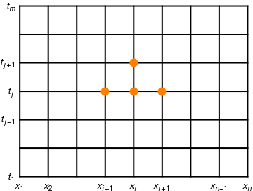
Heat Equation
Parallelized Solutions
Analysis of the problem
Each cell's temperature updates using its own and neighbors' previous values.
Sara Francavilla
Stability depends on the thermal factor

Slide 4
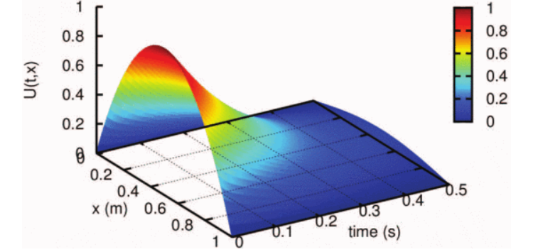
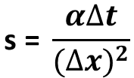
Heat Equation
Parallelized Solutions
Analysis of the problem
Stability depends on the thermal factor
$$\text{s}\text{ = }\frac{α∆t}{(∆{x)}^{2}}$$
Sara Francavilla
Stability depends on the thermal factor

Slide 5

Heat Equation
Parallelized Solutions
General solution
Matrix saved as a monodimensional array
Memory contiguity
Less address computation overhead
Compatibility with SIMD and compiler optimization
Sara Francavilla
Stability depends on the thermal factor

Slide 6
Heat Equation
Parallelized Solutions
General solution
Use of finite difference formula
The future temperature of each cell is a weighted combination of its neighbors and itself from the previous time step
$$u_{i}^{j+1}=s∙u_{i−1}^{j}+\left(1 −2s\right)∙u_{i}^{j}+s∙u_{i+1}^{j}$$
Sara Francavilla
Stability depends on the thermal factor

Slide 7

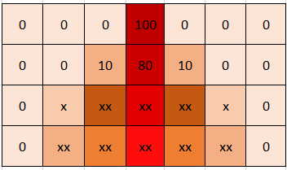
Heat Equation
Parallelized Solutions
The sequential solution
Full matrix → Basic implementation
Sara Francavilla
Stability depends on the thermal factor

Slide 8
Heat Equation
Parallelized Solutions
The sequential solution
Full matrix → Basic implementation
Sara Francavilla
Stability depends on the thermal factor

Slide 9
Heat Equation
Parallelized Solutions
The sequential solution
Half matrix → Doubling speed of computation
Sara Francavilla
Stability depends on the thermal factor

Slide 10
Heat Equation
Parallelized Solutions
The sequential solution
Half matrix → Doubling speed of computation
Sara Francavilla
Stability depends on the thermal factor

Slide 11
Heat Equation
Parallelized Solutions
The sequential solution
Swap Half matrix → Optimizing memory access
Sara Francavilla
Stability depends on the thermal factor

Slide 12
Heat Equation
Parallelized Solutions
The sequential solution
Swap Half matrix → Optimizing memory access
Sara Francavilla
Stability depends on the thermal factor

Slide 13
Heat Equation
Parallelized Solutions
The sequential solution
Swap Half matrix → Optimizing memory access
Sara Francavilla
Stability depends on the thermal factor

Slide 14

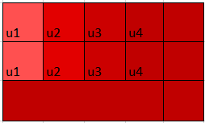
Heat Equation
Parallelized Solutions
The OpenMP solution
Half Matrix Unroll → Vectorization + Unrolling
Expliciting part of the loop to reduce computation overhead
Using SIMD on contiguous data
for (int i = 0; i < 4; i++) {
a[i] = a[i] * 2;
}
a[0] = a[0] * 2;
a[1] = a[1] * 2;
a[2] = a[2] * 2;
a[3] = a[3] * 2;
Single instruction
Sara Francavilla

Slide 15
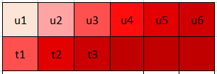
Heat Equation
Parallelized Solutions
The OpenMP solution
Half Matrix Block-Size → Reducing scheduling overhead
Sara Francavilla
Notes:
Nel progetto si chiama half matrix collapse ma solo perché mi ero dimenticata di cambiare il nome

Slide 16
Heat Equation
Parallelized Solutions
The OpenMP solution
Half Matrix Aligned → Vectorization
Using SIMD on contiguous data
Single instruction
Sara Francavilla

Slide 17
Heat Equation
Parallelized Solutions
The OpenMP solution
Half Matrix Swap Aligned → Vectorization on swap
Using SIMD on contiguous data
Swapping threads’ computed vector with matrix next line
Single instruction
Sara Francavilla

Slide 18

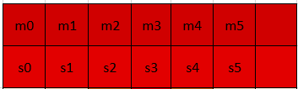

Heat Equation
Parallelized Solutions
The MPI solution
Half Matrix Broadcast → Collective Communication
Broadcast - Gatherv
Using Local Buffer
Sharing Global Matrix
Sara Francavilla

Slide 19
Heat Equation
Parallelized Solutions
The MPI solution
Half Matrix Scatter → Data locality
Sara Francavilla

Slide 20
Heat Equation
Parallelized Solutions
The MPI solution
Half Matrix Synchronous Send Receive → Point-to-point
Sara Francavilla

Slide 21
Heat Equation
Parallelized Solutions
The MPI solution
Half Matrix Asynchronous Send Receive → Asynchronous exchange
Sara Francavilla

Slide 22

Heat Equation
Parallelized Solutions
Program Schema
General Structure
Starting with maximum number of threads and processes
Chosing best number of threads/processes
Checking percentage communication time for bottlenecks
Sara Francavilla

Slide 23

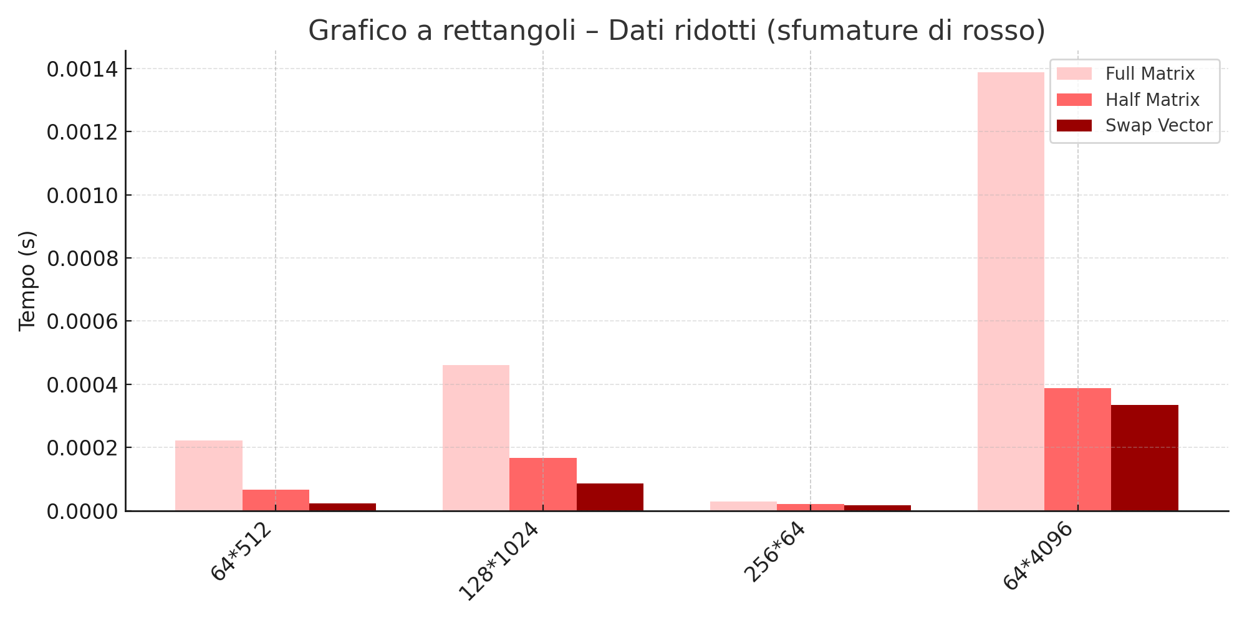
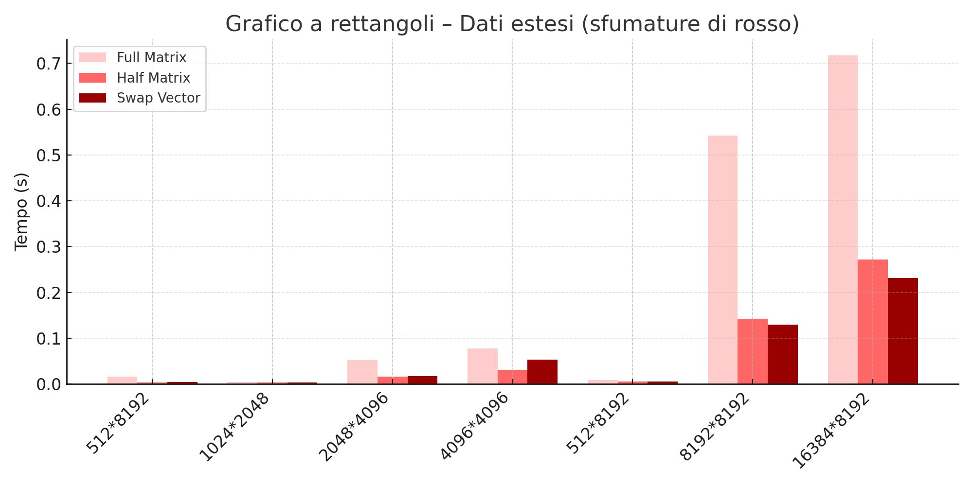
Heat Equation
Parallelized Solutions
Time Execution Analysis
Sequential Case
Sara Francavilla

Slide 24
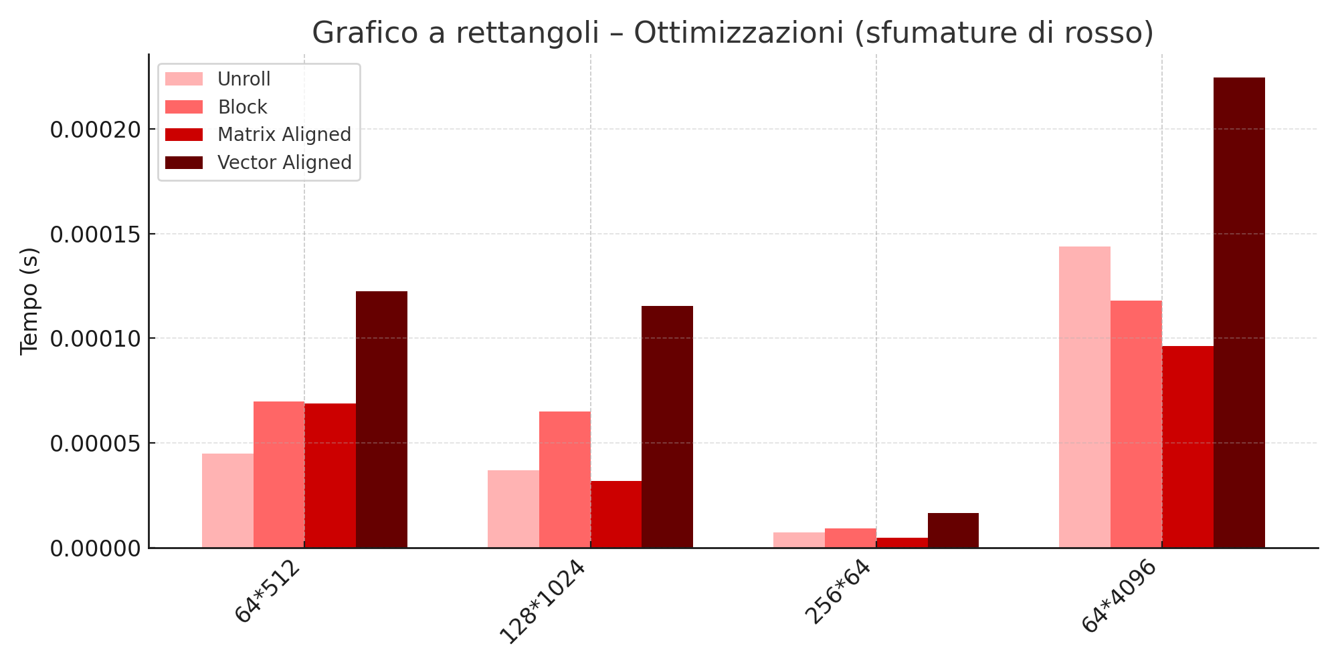
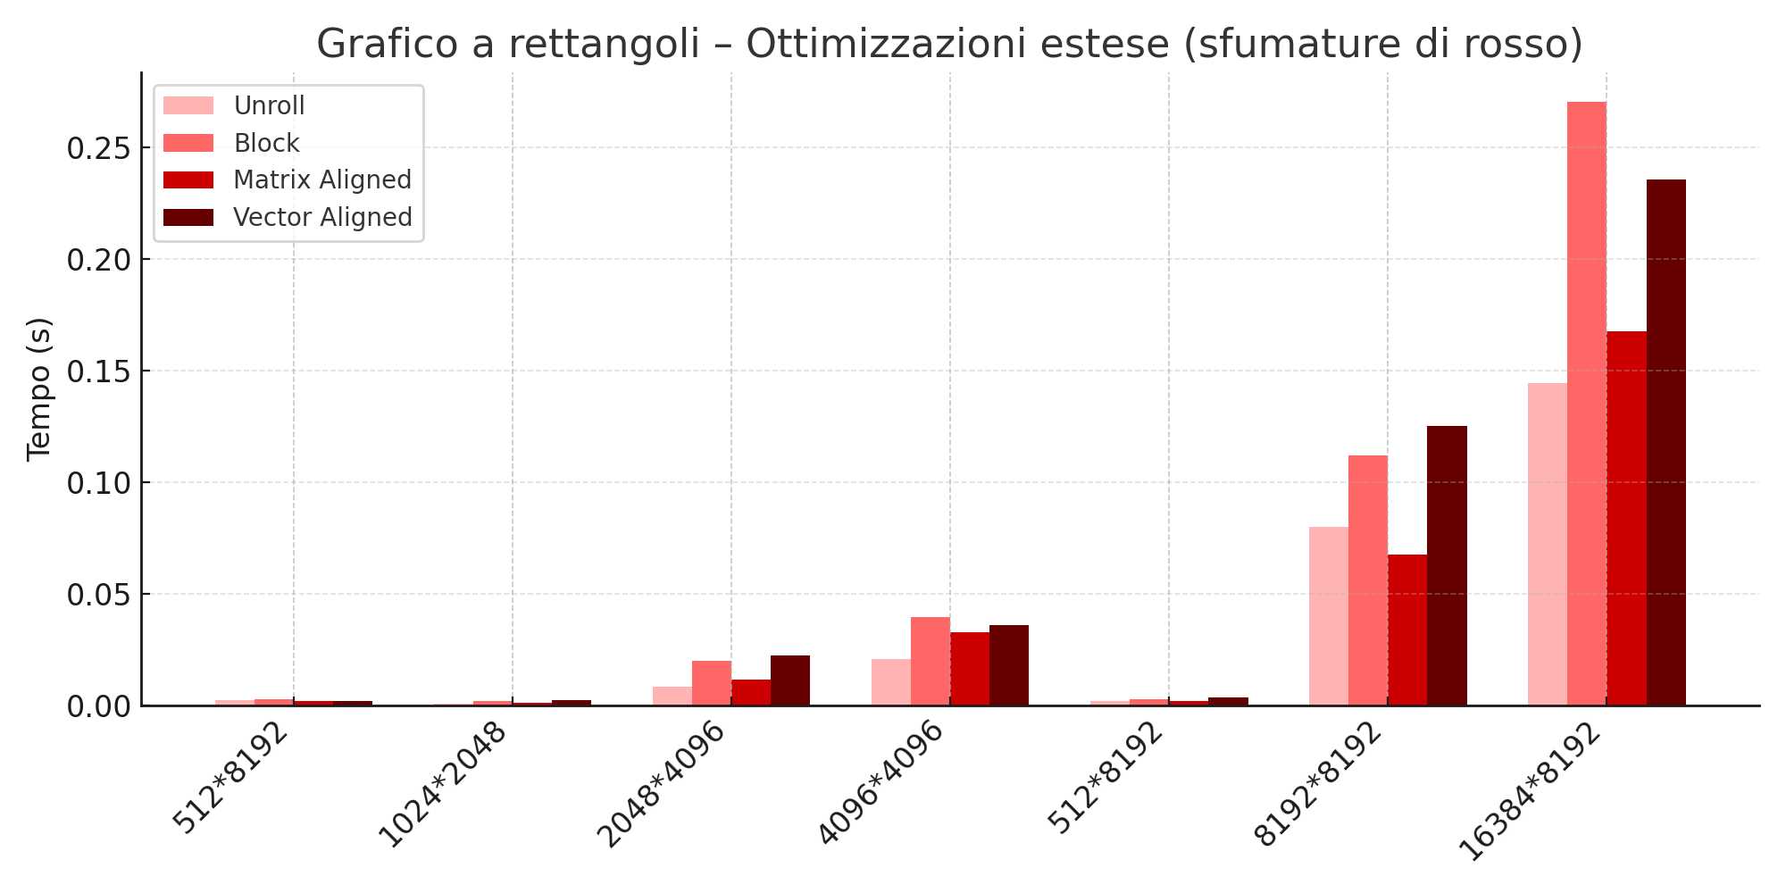
Heat Equation
Parallelized Solutions
Time Execution Analysis
OpenMP Case
Sara Francavilla

Slide 25
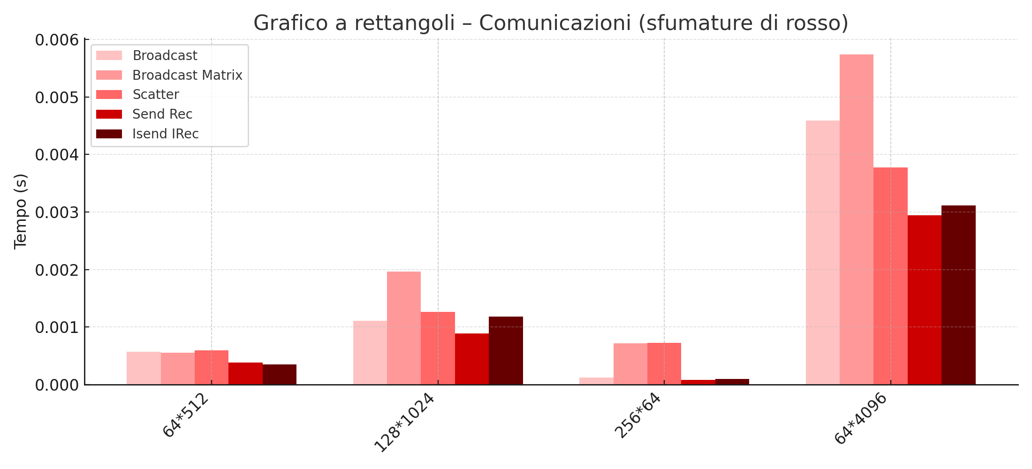
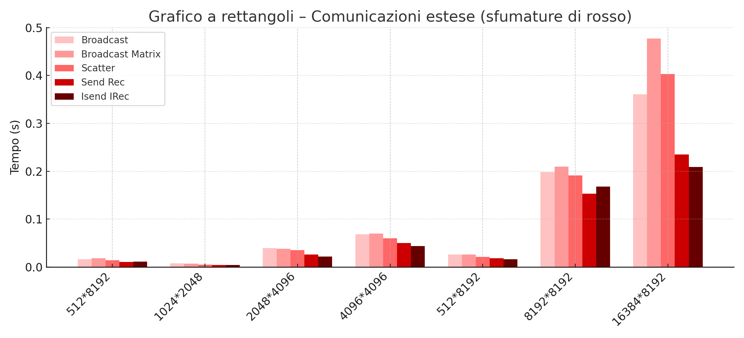
Heat Equation
Parallelized Solutions
Time Execution Analysis
MPI Case
Sara Francavilla

Slide 26
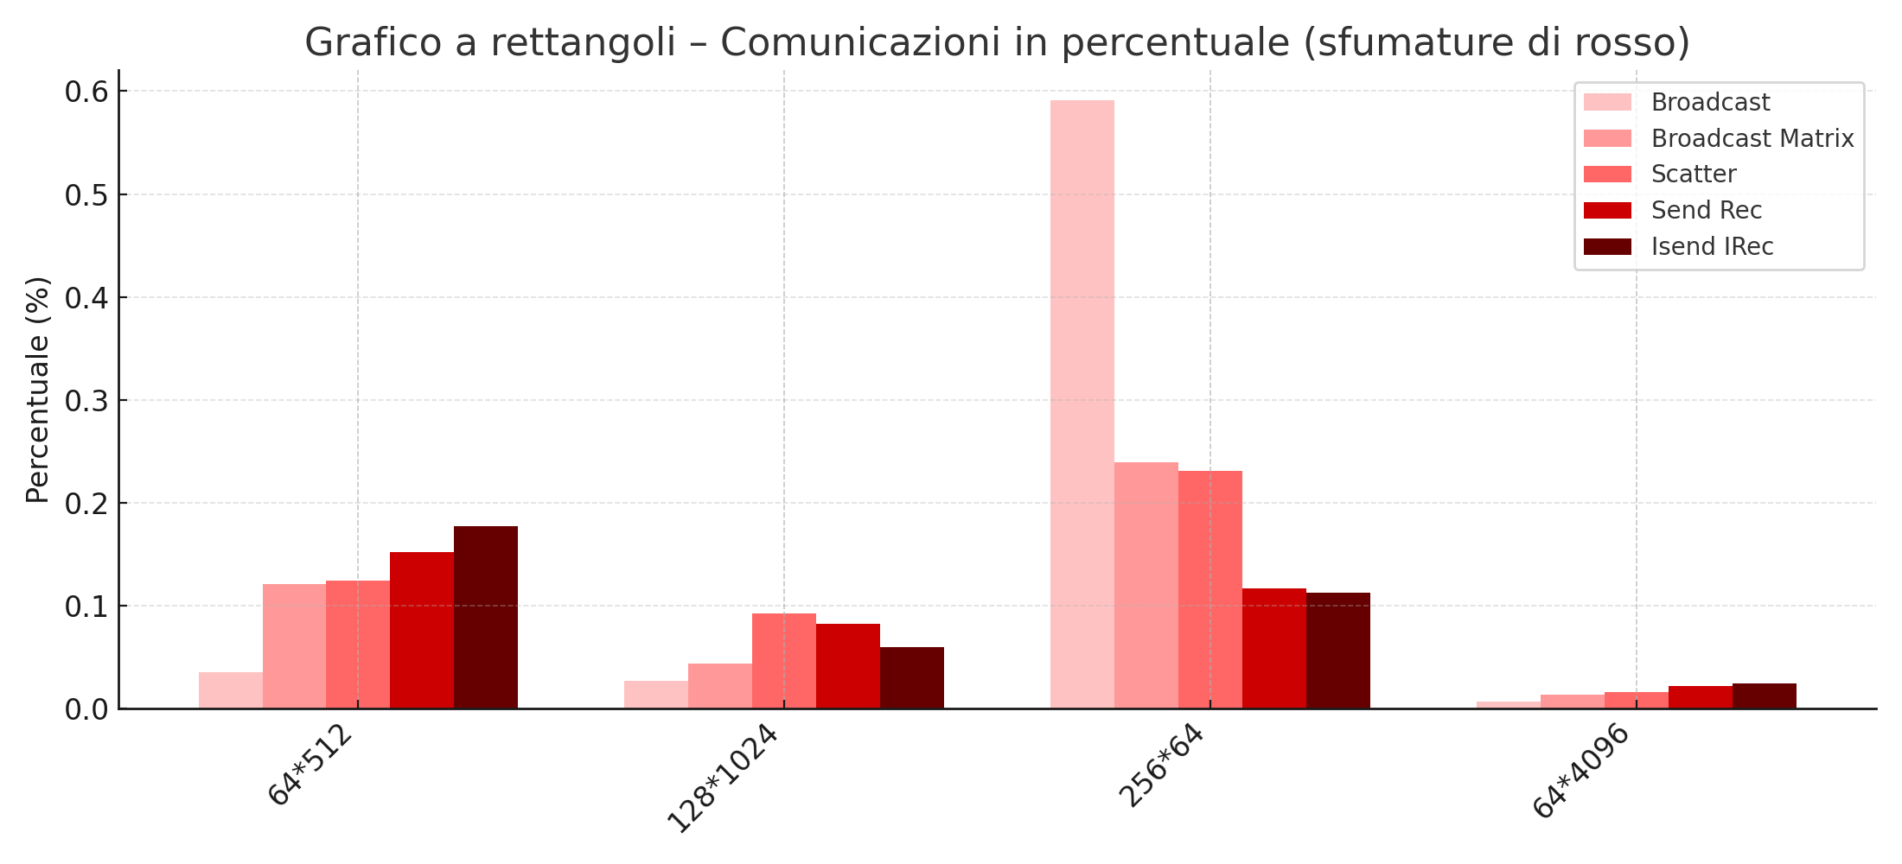
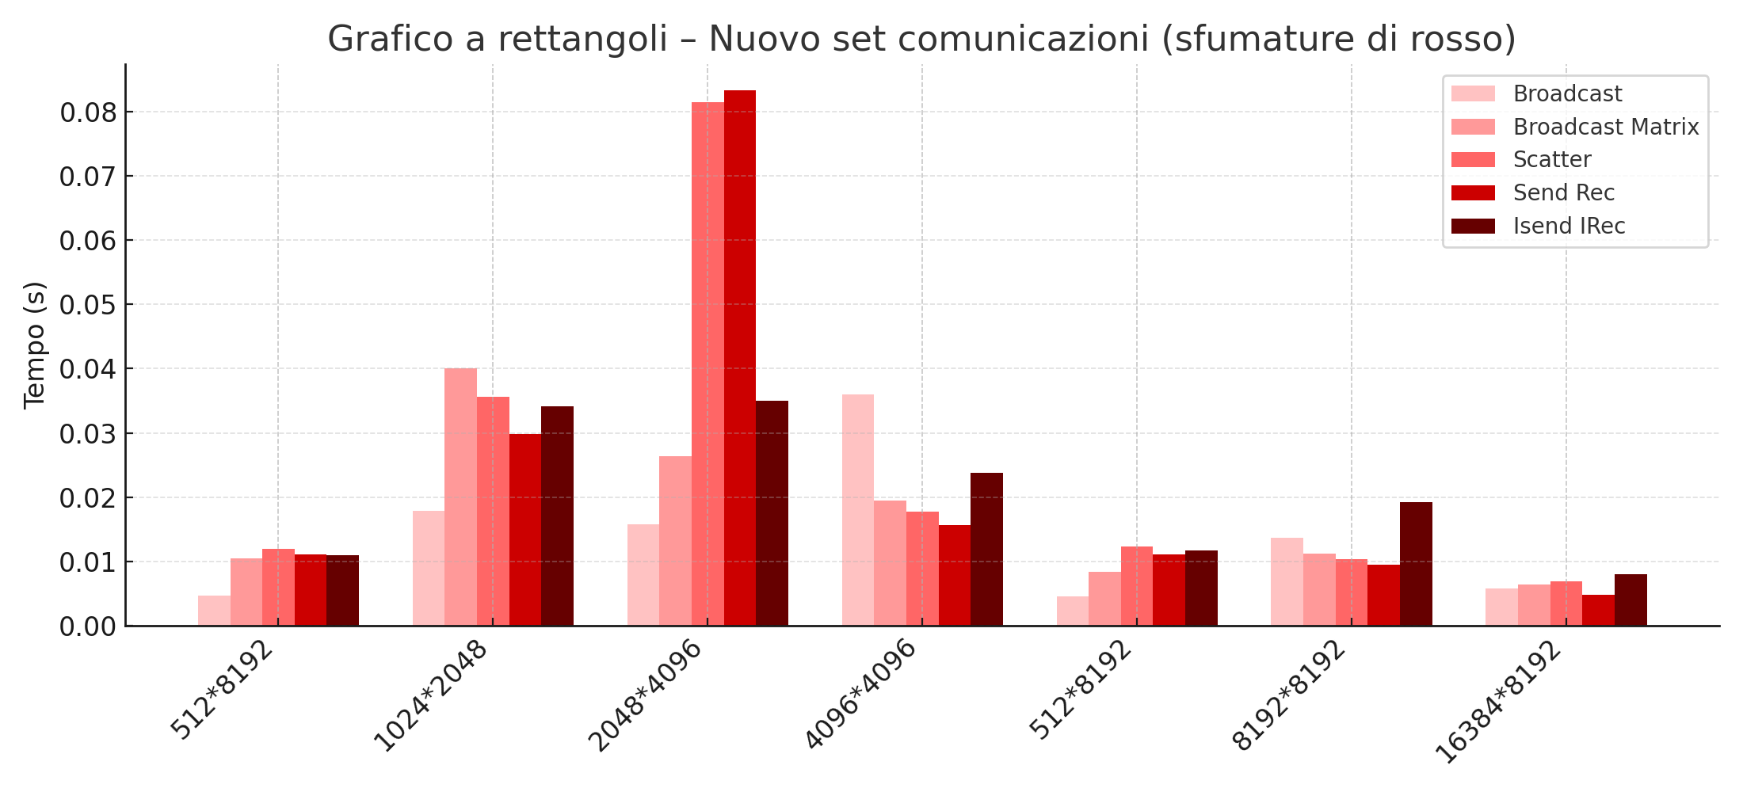
Heat Equation
Parallelized Solutions
Time Execution Analysis
MPI Communication time (%)
Sara Francavilla

Slide 27
Heat Equation
Parallelized Solutions
Time Execution Analysis
Final Results:
When working on smaller matrices Half Matrix wins, on the bigger ones Swap Matrix wins
Matrix Aligned is the best solution among all
ISend Irec outperforms Send/Recv only at large matrix sizes
MPI shows higher communication overhead for small matrices, often making it slower than the sequential version.
Sara Francavilla

Slide 28

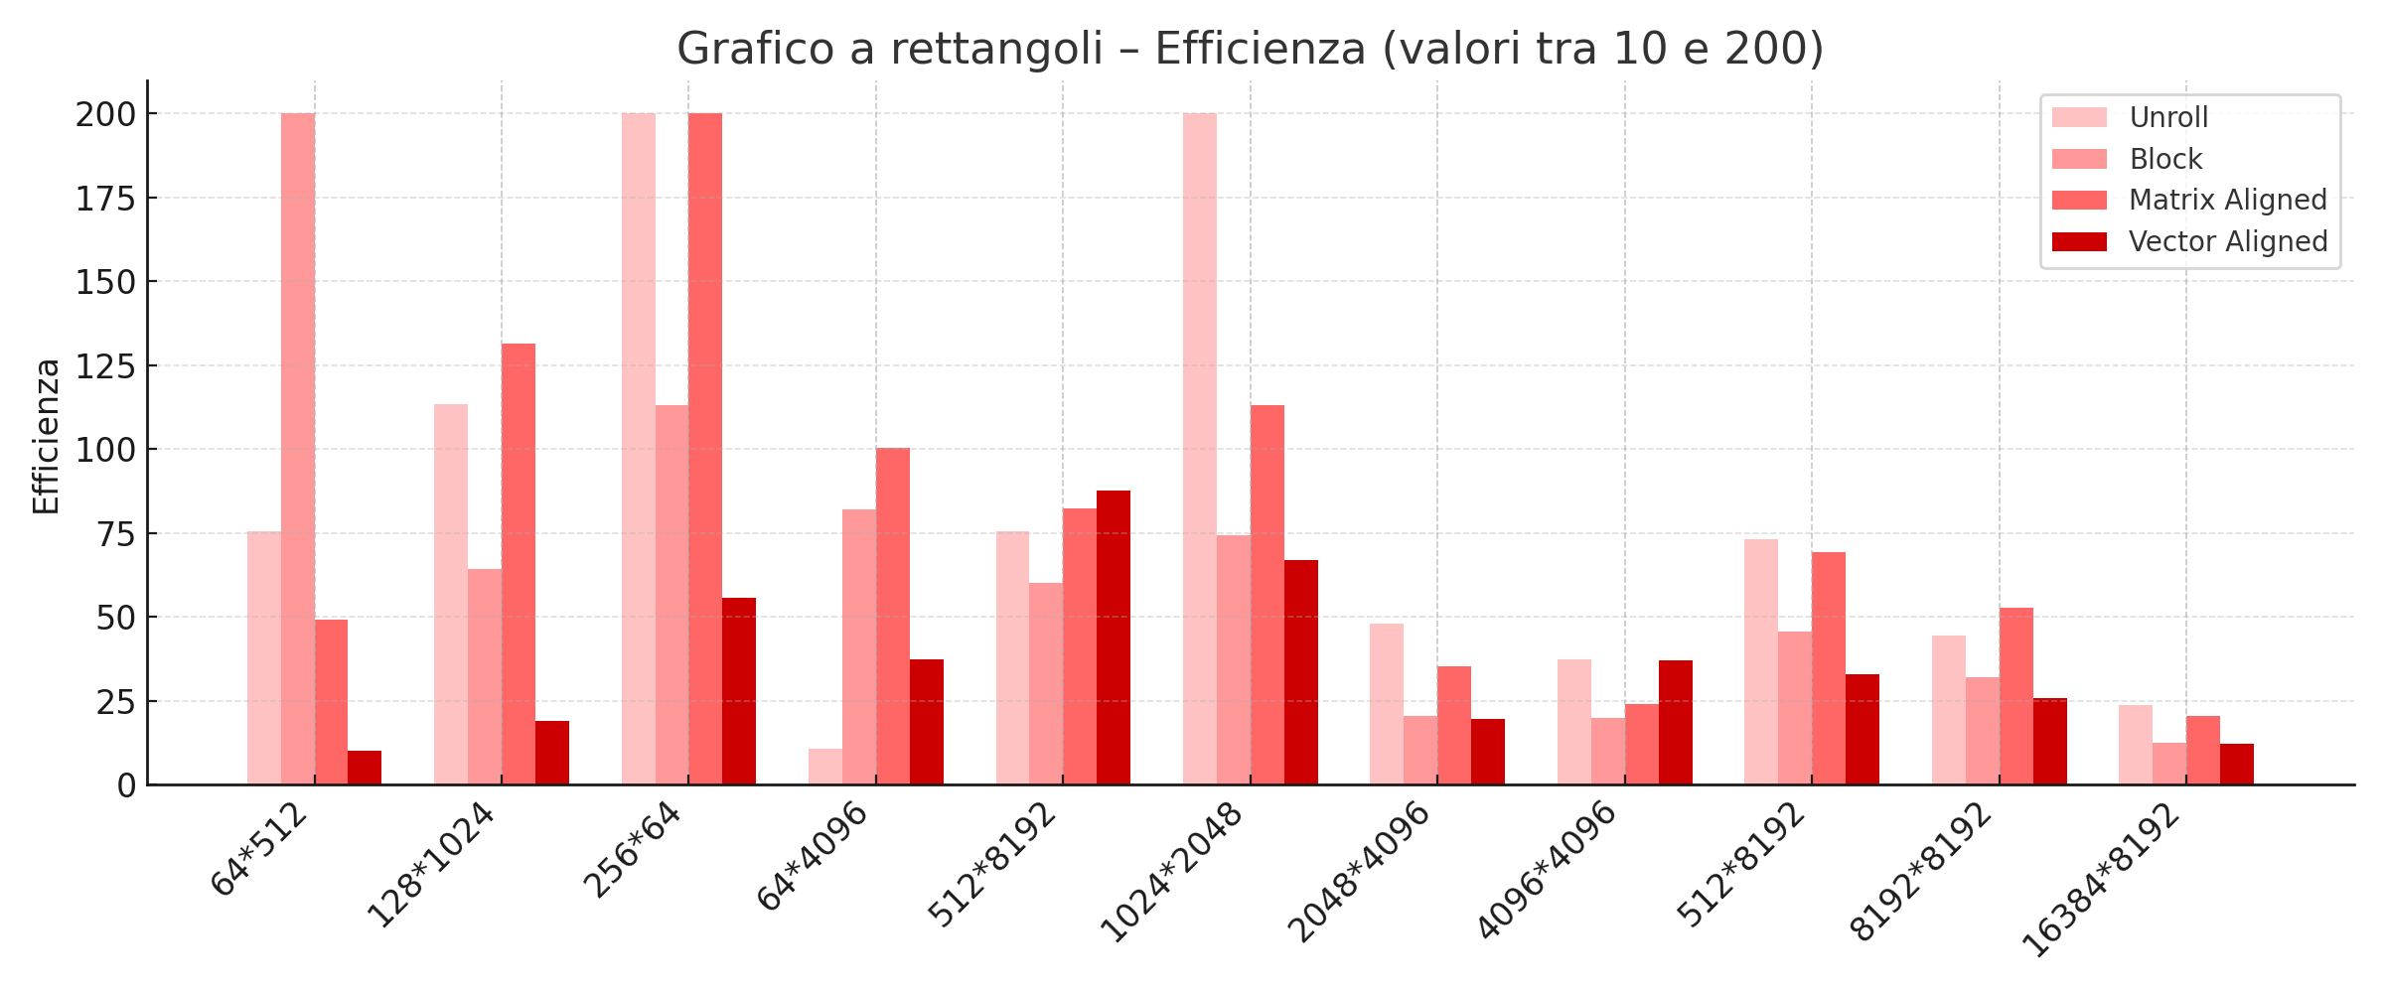
Heat Equation
Parallelized Solutions
Efficiency Analysis
OpenMP Case
Sara Francavilla

Slide 29
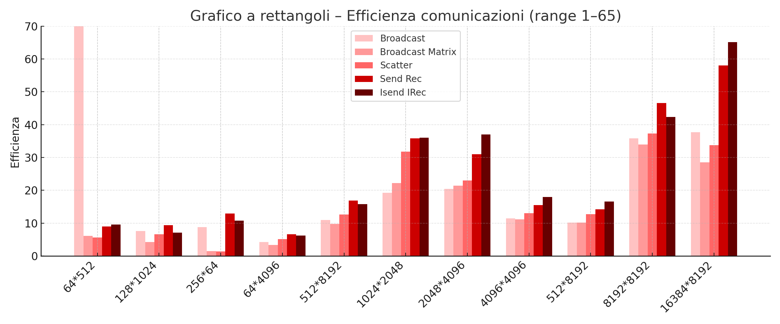
Heat Equation
Parallelized Solutions
Efficiency Analysis
MPI Case
Sara Francavilla

Slide 30
Heat Equation
Parallelized Solutions
Efficiency Analysis
Final Results
OpenMP efficiency decreases when MPI efficiency increases
OpenMP efficiency is maximal with smaller matrices
ISend IRec is the MPI implementation with maximum efficiency
Sara Francavilla

Slide 31

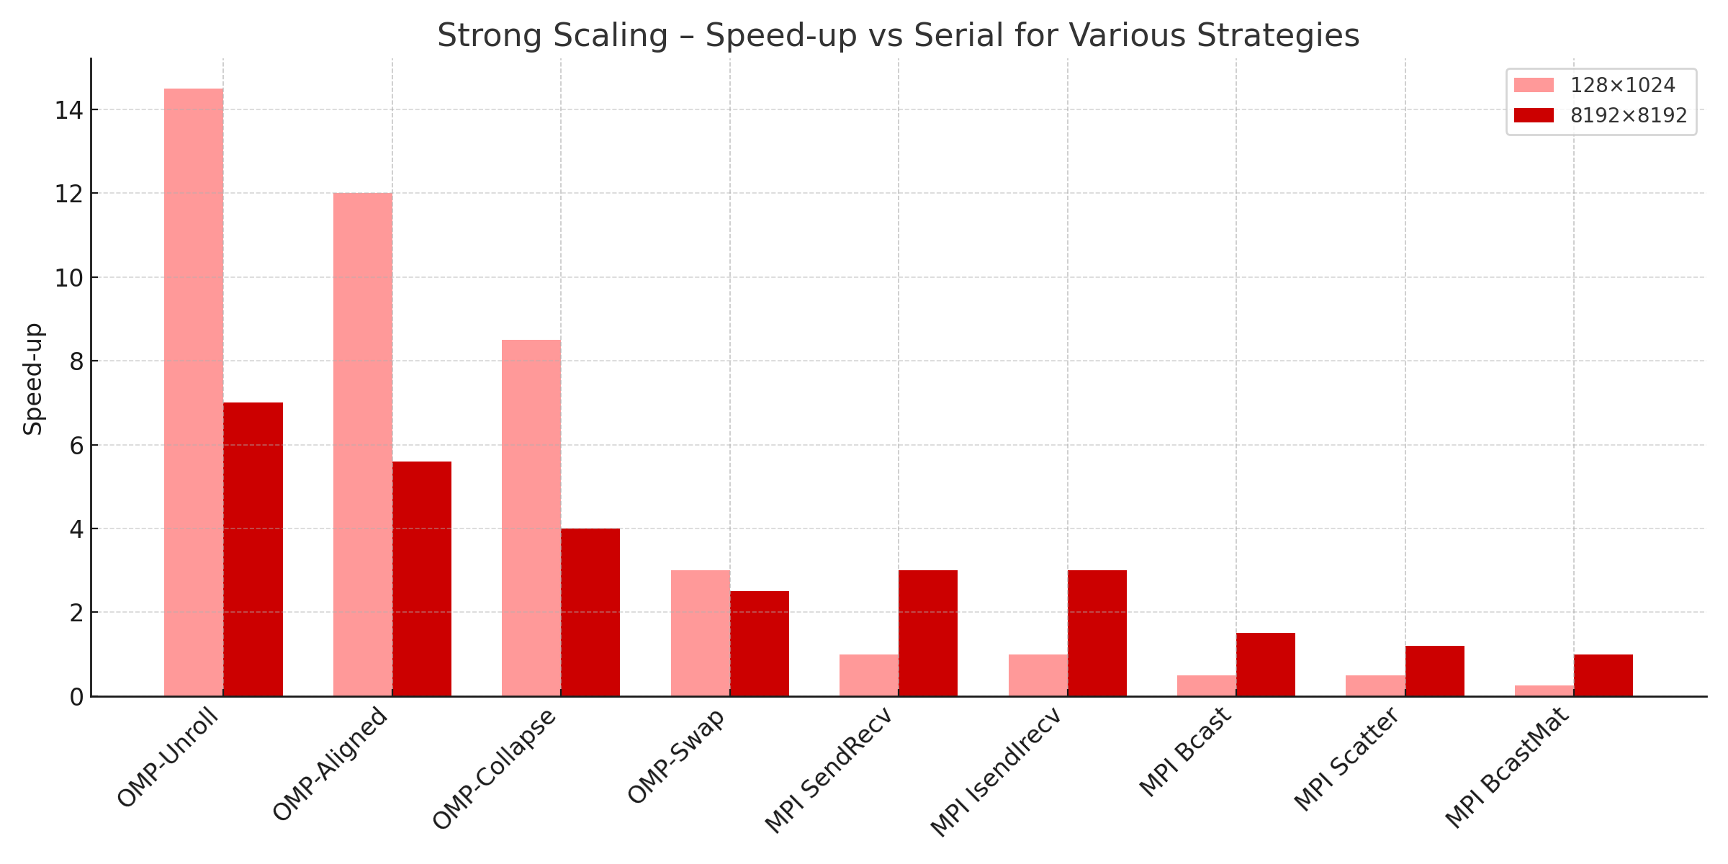
Heat Equation
Parallelized Solutions
Strong Scaling
OpenMP vs MPI
Sara Francavilla

Slide 32

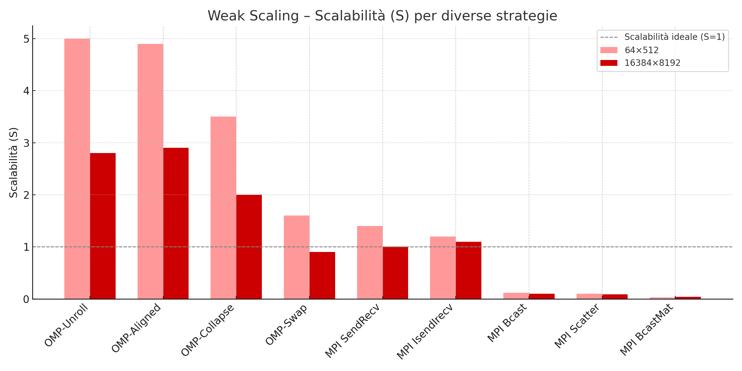
Heat Equation
Parallelized Solutions
Weak Scaling
OpenMP vs MPI
Sara Francavilla

Slide 33

Heat Equation
Parallelized Solutions
Conclusion
Final results:
MPI Send/Isend were the only variants matching serial time; collective MPI was up to 10× slower due to communication bottleneck
Half-Matrix + Unroll/Aligned was the fastest OpenMP implementation
OpenMP scaled well with 15× speed-up; MPI was limited by communication
Sara Francavilla

