Slide 1
Implementation of an Othello Player
Sara Gholami,
Sara Ghaemi

Slide 2
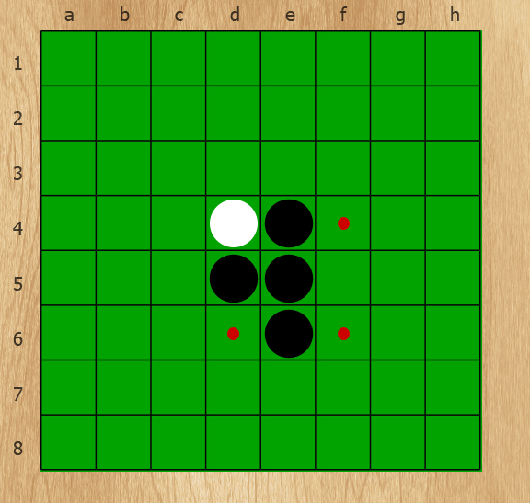
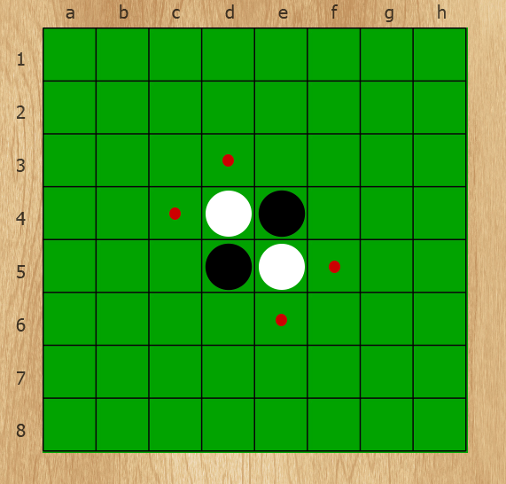
What is Othello
Also called Reversi
Two player game
Black goes first
Terminating condition
Special case

Slide 3
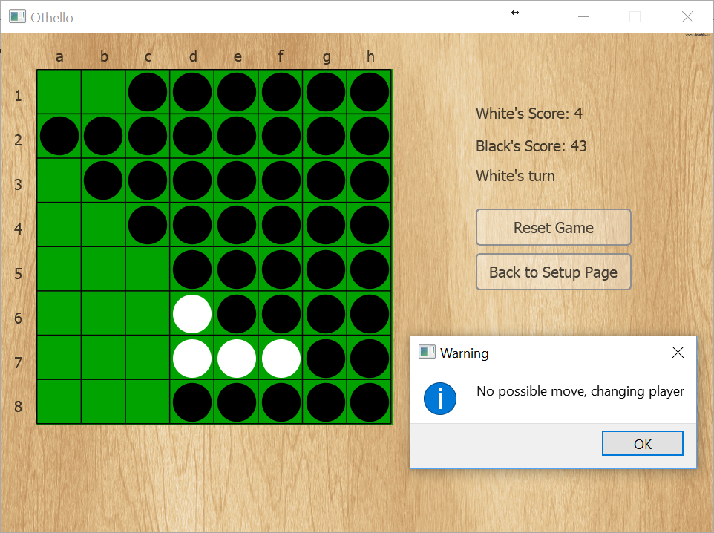
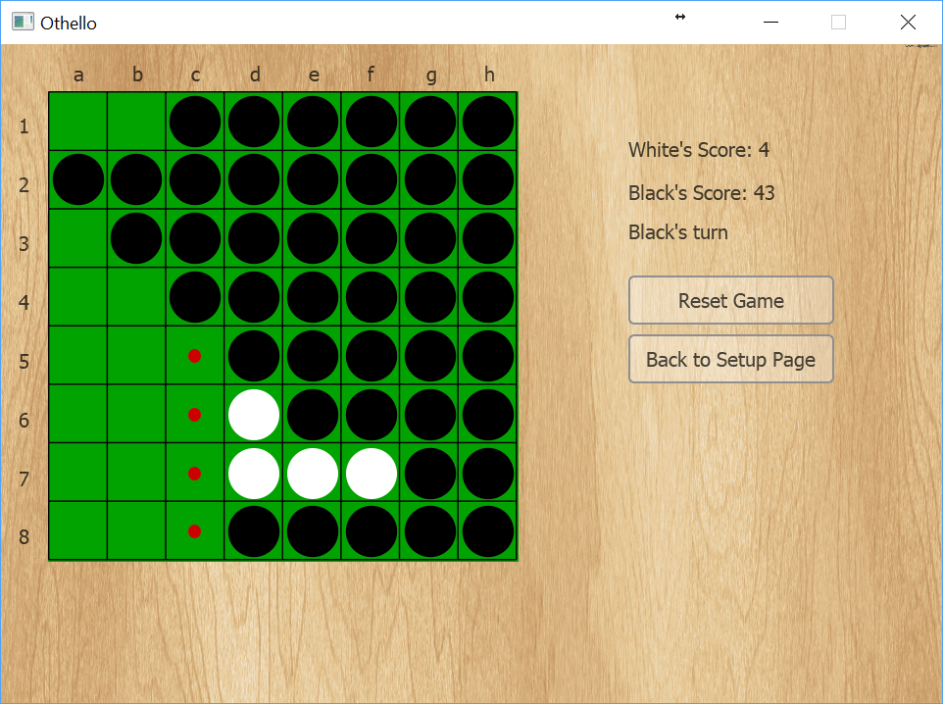
Special Case

Slide 4
Termination Condition
No one has any move
The board is full

Slide 5
Our Computer Player - Heuristics
Coin Parity
Static Weighting
Corners
Mobility
Potential Mobility
Stability

Slide 6
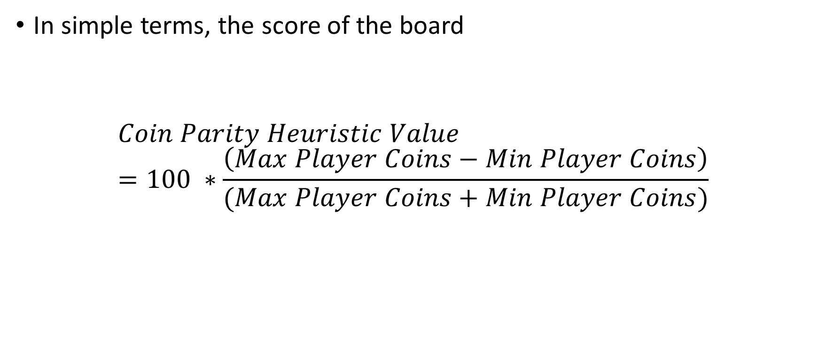
Heuristics - Coin Parity
In simple terms, the score of the board
$$Coin Parity Heuristic Value=100 ∗\frac{\left(Max Player Coins−Min Player Coins\right)}{(Max Player Coins+Min Player Coins)}$$

Slide 7
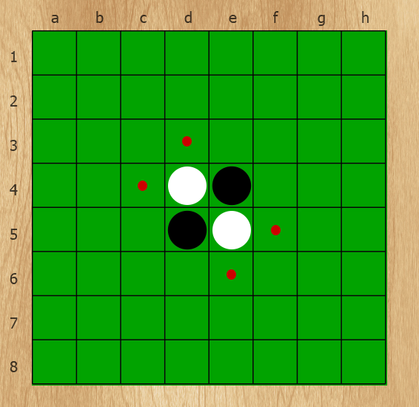
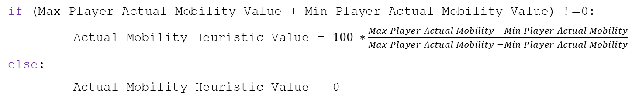
Heuristics - Mobility
if (Max Player Actual Mobility Value + Min Player Actual Mobility Value) $!=$0:
Actual Mobility Heuristic Value = $100 ∗\frac{Max Player Actual Mobility −Min Player Actual Mobility}{Max Player Actual Mobility −Min Player Actual Mobility}$
else:
Actual Mobility Heuristic Value = 0

Slide 8
Heuristics – Potential Mobility
In simple terms, the score of the board
$$Coin Parity Heuristic Value=100 ∗\frac{\left(Max Player Coins−Min Player Coins\right)}{(Max Player Coins+Min Player Coins)}$$

Slide 9
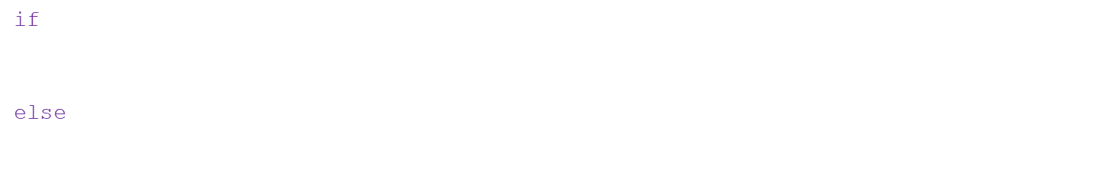
Heuristics - Corners
if (Max Player Actual Mobility Value + Min Player Actual Mobility Value) $!=$0:
Actual Mobility Heuristic Value = $100 ∗\frac{Max Player Actual Mobility −Min Player Actual Mobility}{Max Player Actual Mobility −Min Player Actual Mobility}$
else:
Actual Mobility Heuristic Value = 0

Slide 10

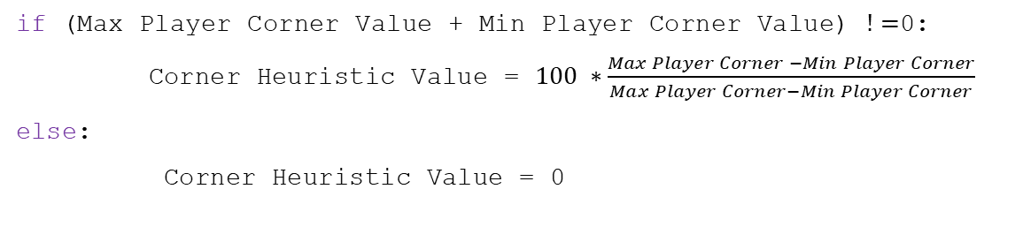
Heuristics - Corners
if (Max Player Corner Value + Min Player Corner Value) $!=$0:
Corner Heuristic Value = $100 ∗\frac{Max Player Corner −Min Player Corner}{Max Player Corner−Min Player Corner}$
else:
Corner Heuristic Value = 0

Slide 11
Heuristics - Stability
In simple terms, the score of the board
$$Coin Parity Heuristic Value=100 ∗\frac{\left(Max Player Coins−Min Player Coins\right)}{(Max Player Coins+Min Player Coins)}$$

