Slide 1
Implementation of an Othello Player
Sara Gholami,
Sara Ghaemi

Slide 2
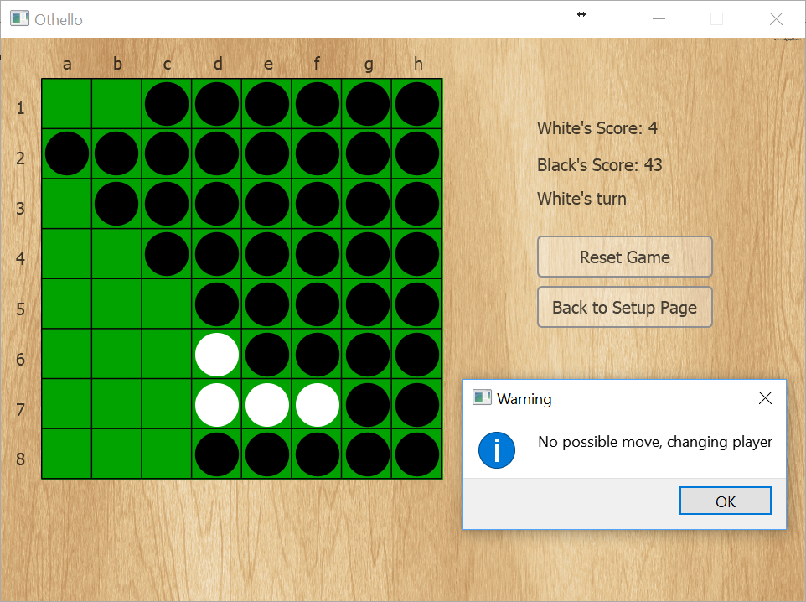
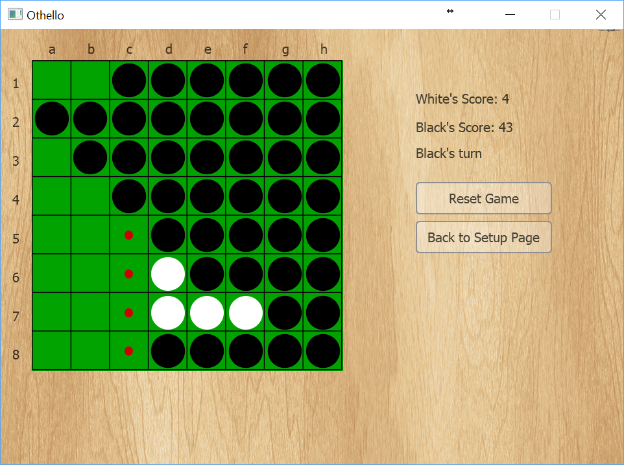
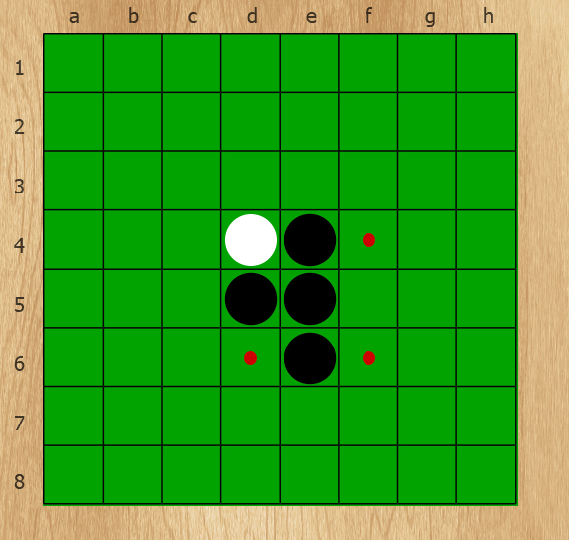
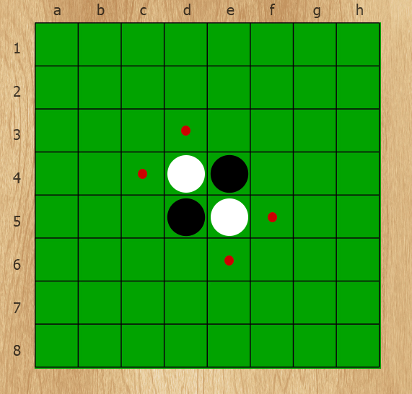
What is Othello
Also called Reversi
Two player game
Black goes first
Terminating condition
Special case

Slide 3
Our Computer Player

Slide 4
Moves

